Slide 1
Welcome

Slide 2
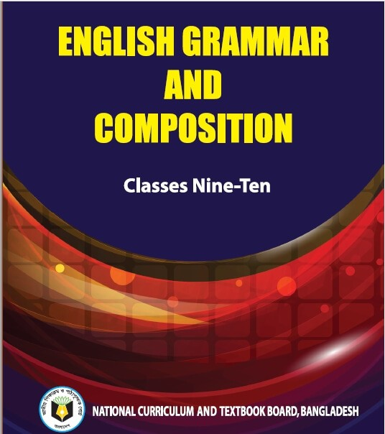
Identity
Mst. Arifa Khatun
Assistant Teacher (English)
Chand Sultana Secondary Girls’
School, Kushtia Sadar, Kushtia
Email: arifakch87@gmail.com
Mobile: 01936601076
The Sentence( Part-2)
Structure

Slide 3
Look at the example first, then discuss it with your partner.
I go to school.
They came here.
Man is mortal.
I do not go to school.
They did not come here.
Man is not immortal.

Slide 4
Our Today’s Lesson is -----
Structure of the Sentences

Slide 5
Learning outcomes: By the end of this lesson, we will be able to----
Read and understand the example,
Write down the structural functions of Assertive sentence and
Ask and answer the questions.

Slide 6
Assertive Sentence
I go to school.
S + V + Ext.
Note: S= Subject V=Verb
Ext= Extension

Slide 7
Assertive Sentence
They are playing ludu.
He is not a good man.
Are these two sentences same?
There are two forms of Assertive Sentence. Such-
Affirmative Sentence
Negative Sentence

Slide 8
Affirmative Sentence
I do it.
He is a boy.
She writes well.
They are good boy.
a. Affirmative Sentence: An Affirmative sentence is an Assertive sentence which Affirms something is called Affirmative Sentence.
Affirms: Something positive

Slide 9
Negative Sentence
I have no pen.
He is not good.
They do not eat rice.
I do not go there.
b. Negative Sentence: A Negative sentence is an Assertive sentence that denies something is called Negative Sentence.
Denies: Something negative

Slide 10
Affirmative Sentence( Principal Verb)
We like mango.
Structure: S+ P. V.+ Ext.
We eat mango.
They go to market.
Principal Verb: A verb that expresses its’ meaning without helping Auxiliary Verb is called Principal Verb.

Slide 11
Affirmative Sentence ( Auxiliary Verb)
You are eating banana.
He is going to town.
He will play football.
Auxiliary Verb: A verb that helps Principal Verb is called Auxiliary Verb.
Structure: S+ Aux.V.+ Princ. V.+ Ext.

Slide 12
Affirmative Sentence( To Be verb)
I am a student.
He is a boy
You are a teacher.
She was a nurse.
You were a doctor.
To Be Verb: Am, Is ,Are, Was, Were.
Structure: S + To Be V. + Ext.

Slide 13
Negative Sentence( To Be Verb)
I am not a student.
He is not a boy
You are not a teacher.
She was not a nurse.
You were not a doctor.
Structure: S + To Be V.+ Not+ Ext.

Slide 14
Negative Sentence( To Have Verb)
I have no pen.
You had no book.
He has no money.
To Have Verb: Have, Has, Had
Structure: S + To Have V.+ no/not+(a) + Ext.
Note: I do not (don’t) have any pen.
Structure: S+ do/does/did+ not +have + Ext.

Slide 15
Negative Sentence( Principal Verb)
I do not write a letter.
He does not eat mango.
You did not go there.
Structure: S+ do not/does not/did not +P.V. + Ext.

Slide 16
Thanks!

