Slide 1
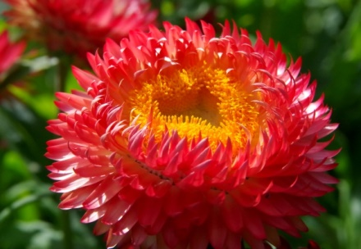
DEAR LEARNERS
WELCOME TO YOU

Slide 2
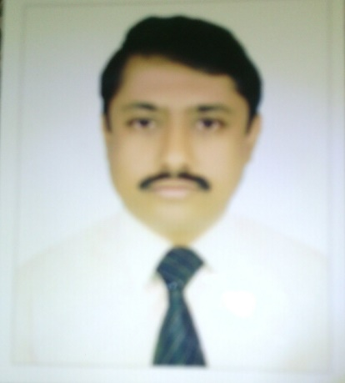
BIPLAB KUMAR CHOWDHURY
Assistant teacher
RAMMOHON TOMIZIA HIGH SCHOOL
Barura, Comilla.
Email: biplab1018476@gmail.com

Slide 3
Class: Six
Subject: English 1st paper
Lesson: 17
Name of lesson: An old people’s home
Time: 45 minutes.
Date:

Slide 4
LEARNING OUTCOMES
After completing the lesson students will be able to
read and understand texts.
ask and answer questions.
write answer of the questions.
Say true or false.
match the words.

Slide 5
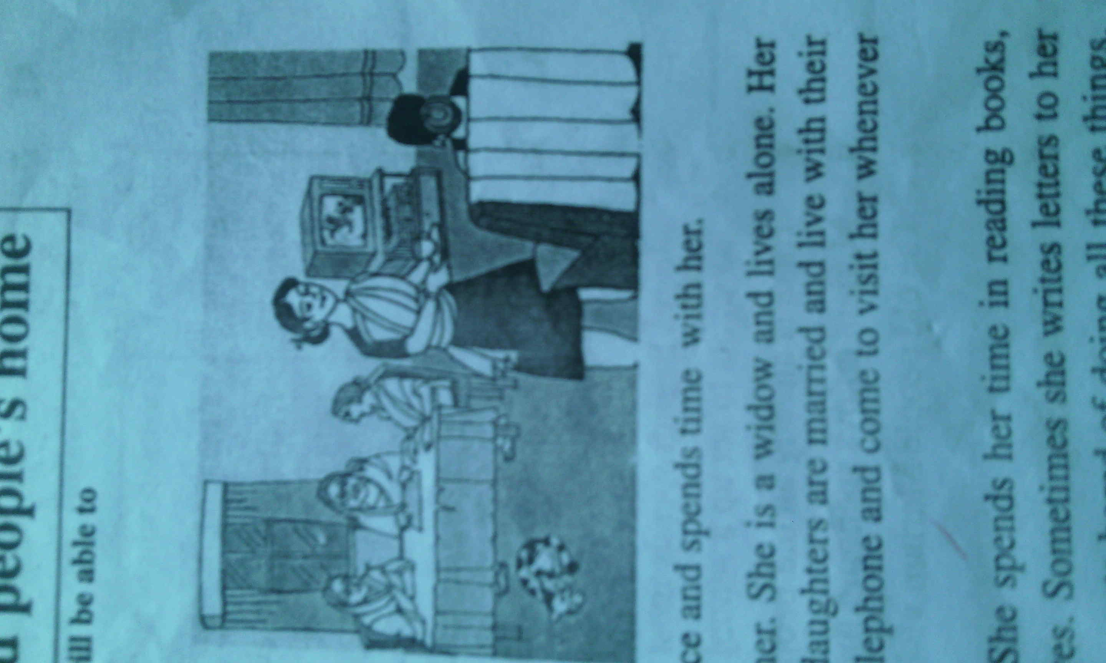
Look at the picture.
Q.Can you guess who they are?
Ans: They are old people.
Q.Where are they?
Ans: They are in an old people’s home.

Slide 6
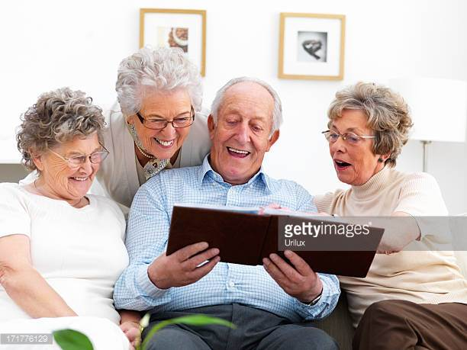
Let’s discuss on
An old people’s home

Slide 7
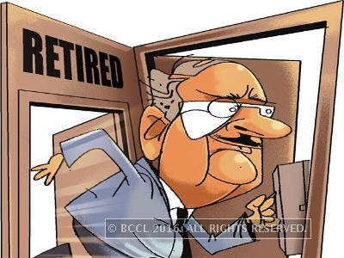
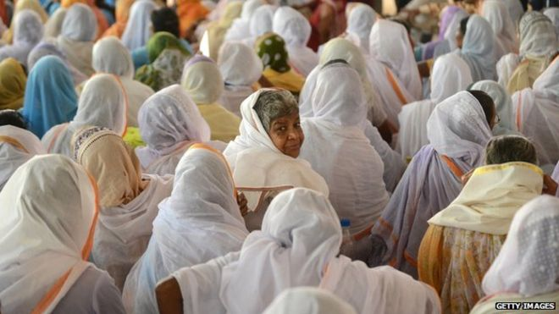
VOCABULARY
Retired
One who takes leave from the job
Mr. Santi Bhushon is a retired person.
Widow
Relict
All of them are widow.

Slide 8

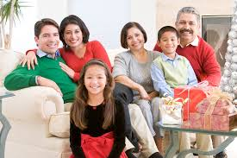
Watch
Look
An old people spends his time in watching TV.
Blood Relation
Relatives
They are relatives.

Slide 9
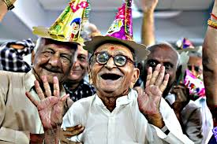
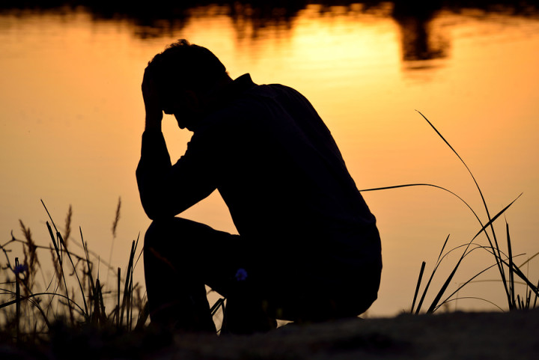
Elderly
Old
Some elderly people live all alone.
Alone
Solitary
Man can not live alone.

Slide 10

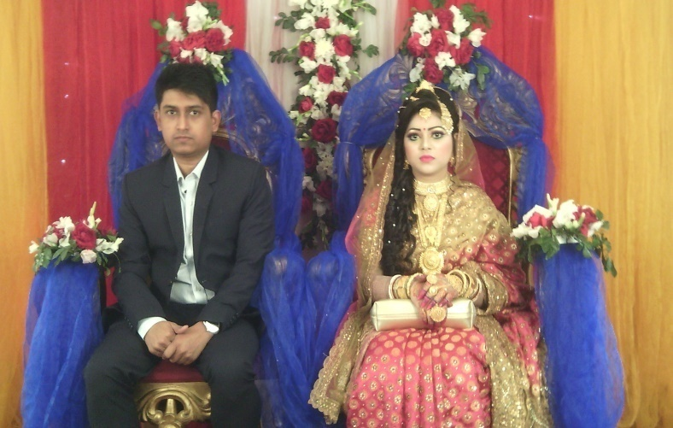
Homeless
Helpless
They feel helpless and miserable.
Married
Wedded
They are married.

Slide 11
GROUP WORK
8 minutes.
Read the text from the section A and write the answer of the following questions.
Q. 1. Who is Mariam’s aunt?
Q.2. What is her father?
Q.3. Where does Mariam go on Fridays?
Q.4 .When did Suraiya Begum’s husband die?
Q.5. How does she spend her time?
Q. 6. What is her planning?

Slide 12
Match your answers.
1. Ans: Suraiya Begum is Mariam’s aunt.
2. Ans: Her father is a businessman.
3. Ans: On Fridays she often goes to her aunt’s place.
4. Ans: Suraiya Begum’s husband died three years ago.
5. Ans: She spends her time in reading books, watching TV, visiting friends and relatives.
6. Ans: Her planning is to establish an old people’s home?

Slide 13
A1. Now read the text carefully again and match the words on the left with the words on the right that have similar meanings.
bored miserable colleague widow support | woman whose husband has died and who hasn’t married again a person one works with in a profession feeling tired because you don’t find interest in something help very unhappy

Slide 14
A2. Read the following sentences and say if they are true or false. If false, then give the right answers.
a. Suraiya Begum spends most her time taking care of her family.
Ans: False. Right answer: Suraiya Begum spends most her time in reading books, watching TV, visiting friends and relatives
b. She wants to set up a school for adults who cannot read or write.
Ans: False. Right answer: She wants to set up an old people’s home for the old who have nobody to take care of them.
C. There is already an old people’s home in the town.
Ans: False. Right answer: There is no old people’s home in the town.
d. Mariam enjoys spending time with her aunt.
Ans: True.
e. The old people Mariam visits do not like children’s presence.
Ans: False. Right answer: The old people Mariam visits do not like children’s presence

Slide 15
INDIVIDUAL WORK(Orally)
7 minutes.
Read the letter from B and answer the following question of B1.
a. Who is the writer of the letter?
Ans: Suraiya Begum is the writer of the letter.
b. Who is she writing to? What is the relationship between the two?
Ans: She is writing to Sharmila. Sharmila is her friend and ex-colleague.
c. Does the writer have any particular reason for writing this letter?
Ans: The writer has a particular reason for writing this letter. She wants to set up an old people’s home.

Slide 16
d. Do you think what Suraiya Begum wants to do is her profession , or is it a community work? Why do you think so?
Ans: I think what Suraiya Begum wants to do is a community work . I think so by doing so she will not get financially gain , she will help the other people to remove their loneliness and sickness.

Slide 17
EVALUATION
Q. 1. Who is Mariam’s aunt?
Q.2. What is her father?
Q.3. Where does Mariam go on Fridays?
Q.4 .When did Suraiya Begum’s husband die?
Q.5. How does she spend her time?

Slide 18
HOME WORK
Think ok some good work that you can do for someone around you. What are they? Now write two or three sentences about what you can do for them.
Cues: teach, help in doing something, clean etc.

Slide 19

THANK YOU ALL

