Slide 1
Welcome and good morning

Slide 2
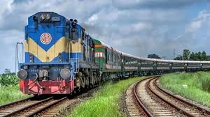
1. Have you ever travel by train?
2. Do you like train journey?

Slide 3
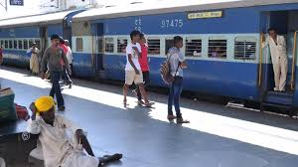
Today’s lesson is--
“Travelling by Train (2) ”
Unit-6 lesson-5

Slide 4
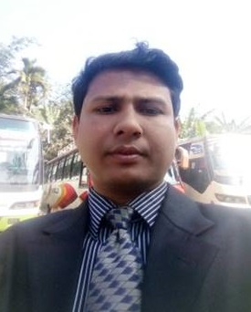
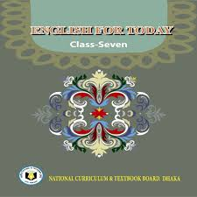
introduction
Dibash chandra singha
Asst. teacher
Kotchandpur govt.model pilot secondary school
Class 7
English 1st paper

Slide 5
Learning outcomes -
At end of the lesson, students will be able to –
Discuss about passage.
Introduce with some new words;
Ask and answer questions;
Write the summary of the text.

Slide 6
New Words: 1.Departure-প্রস্থান 2.emty-খালি 3.print out-ছায়াকপি 4.parents-পিতামাতা 5.compartment-বগি বা কামড়া বা বসবার বড় জায়গা বিশেষ 6.bound-অভিমূখী 7.left- ছেড়ে যাওয়া বা ত্যাগ করা 8.window-জানালা 9.beside-পাশে 10.downloaded-ইন্টারনেট থেকে নামানো 11.poem-কবিতা 12.similarities-একই রকম 13.between-মধ্যে 14.real-প্রকৃত 15.scenery-দৃশ্য

Slide 7
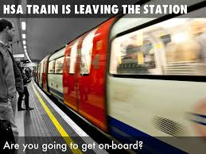
Kew words
departure
exit
The act of departing

Slide 8
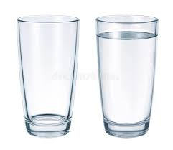
Kew words
empty
vacant
void
Empty glass
Glass full of water

Slide 9
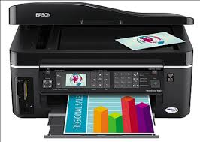
Kew words
Print out
publish
reproduce from type

Slide 10
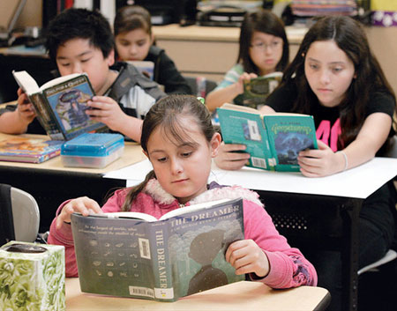
Zishan, Julie and their parents Mr and Mrs Arif Khan got into a 1st class compartment at Kamalapur Railway Station. It was Dewanganj-bound Tista Express. The train left at 8 o’clock. Zishan saw that the departure time on the big time table at the station was 7:30. However the train was running quite fast. The children sat by the window beside their parents. The compartment was half empty. Yesterday Julie downloaded a beautiful poem on a train journey by Robert Louis Stevenson. She took a printout of the poem. She was looking out and saw the passing things. Then she took out the poem and began to read.
Read the text

Slide 11
Questions:
1 Were all the seats in the compartment taken?
2 Where did Zishan sit?
3 Where was the train going?
4 Did the train leave Kamalapur Station late or on time?
5 Where did Julie get the poem from?
6 What was Julie doing from her seat?

Slide 12
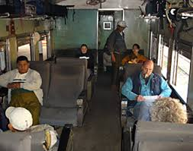
1.No,half of the compartment was emty.

Slide 13
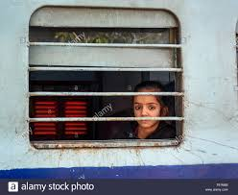
2.Jisan sat by the window.

Slide 14
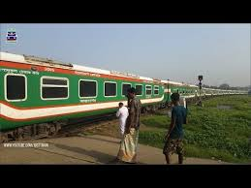
3. The train was going to Dewangonj.

Slide 15
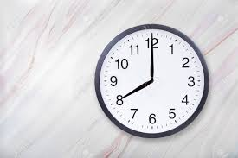
4.The train left Kamlapur Railway Station late.
The departure time on the table was 7.30
but the train left at 8 o’clock.

Slide 16
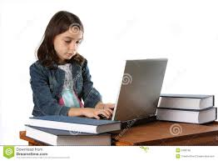
5.Julie got the poem from internet. She downloaded it.

Slide 17
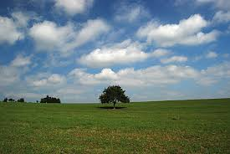
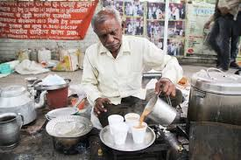
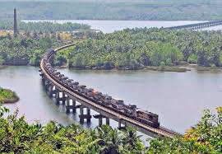
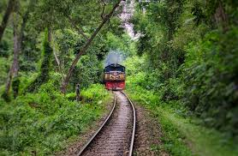
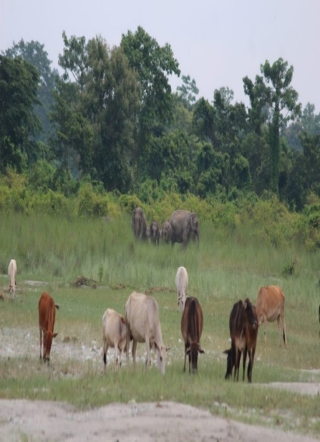
6.Julie was looking out and seeing the passing things from her seat .She was also reading the downloaded poem.

Slide 18
Home work
Summarise the text in your own words.

Slide 19
Thanks to all

