Slide 1
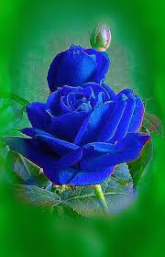
WELCOME

Slide 2
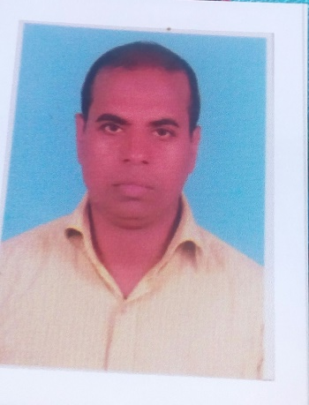
IDENTITY
Mohammad Shafiqul Islam
Lecturer in English
Sreechail Mohammad pur Islamia Alim Madrasha
Daudkandi,Cumilla
Sub-English Grammar and Composition
Class-Alim

Slide 3
WARMING UP
Read the following words-
Fair Unfair
Happy Unhappy
Husband Wife
What type of grammatical item is indicated by the above words?

Slide 4
So, today’s topic name-
Use of ‘Antonym’(part two)

Slide 5
LEARNING OUTCOME
In this lesson the students will be able-
To say the rules of ‘Antonym’
To use the uses of ‘Antonym’

Slide 6
FORMATION OF ANTONYMS
Usually antonyms are formed adding prefixes and direct opposite words. See the followings-
1.Noun by prefix Noun by different word
Ability inability Heaven hell
2.Verb by prefix verb by different word
Agree Disagree Accept reject
3.Adjective by prefix Adjective by different word
Active inactive Modern Ancient
4.Adverbs& Prepositions
Down up off on
Early late yes no
Usually antonyms are used by adding prefixes.The common prefixes are dis,ill,im,ig,ir,in,de,mis,
ab,un etc.

Slide 7
SOME EXAMLPES
Used prefixes | words | antonyms
il | Literate,legal,legible | Illiterate,illegal,illegible
in | Definite,effective,ability | Indefinite,ineffective,inability
im | Perfect,moral,pure | Imperfect,immoral,impure
un | Popular,able,wise | Unpopular,unable,unwise
dis | Allow,comfort,favour | Disallow,disallow,disfavour
anti | Climax,social,sympathy | Anti-climax,anti-social,anti-sympathy
mis | Conduct,fortune,use | Misconduct,misfortune,misuse
ir | Regular,responsible,relevant | Irregular,irresponsible,irrelevant
de | Merit,control,code | Demerit,decontrol,decode

Slide 8
Formation of antonyms by adding suffix ‘less’
Care+less=careless
Use+less=useless
Colour+less=colourless
Fear+less=fearless
Faith+less=faithless
Mercy+less=merciless
Hope+less=hopeless

Slide 9
EVALUATION
Write the antonyms of the following words-
Admire,brave,chain,disciple,eminent,ferocious,gen-uine,hope,insert,juicy.

Slide 10
HOME WORK
Write the antonyms of the following words-
Kill,lengthen,manage,negligence,neutral,obtain,obscure,
Obstacle,oppress,precious,place,qualify,quicken,rival,rapid,
Slay,treat,virtue,valid,wet.

Slide 11
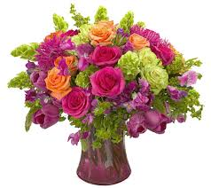
THANK YOU ALL

