Slide 1
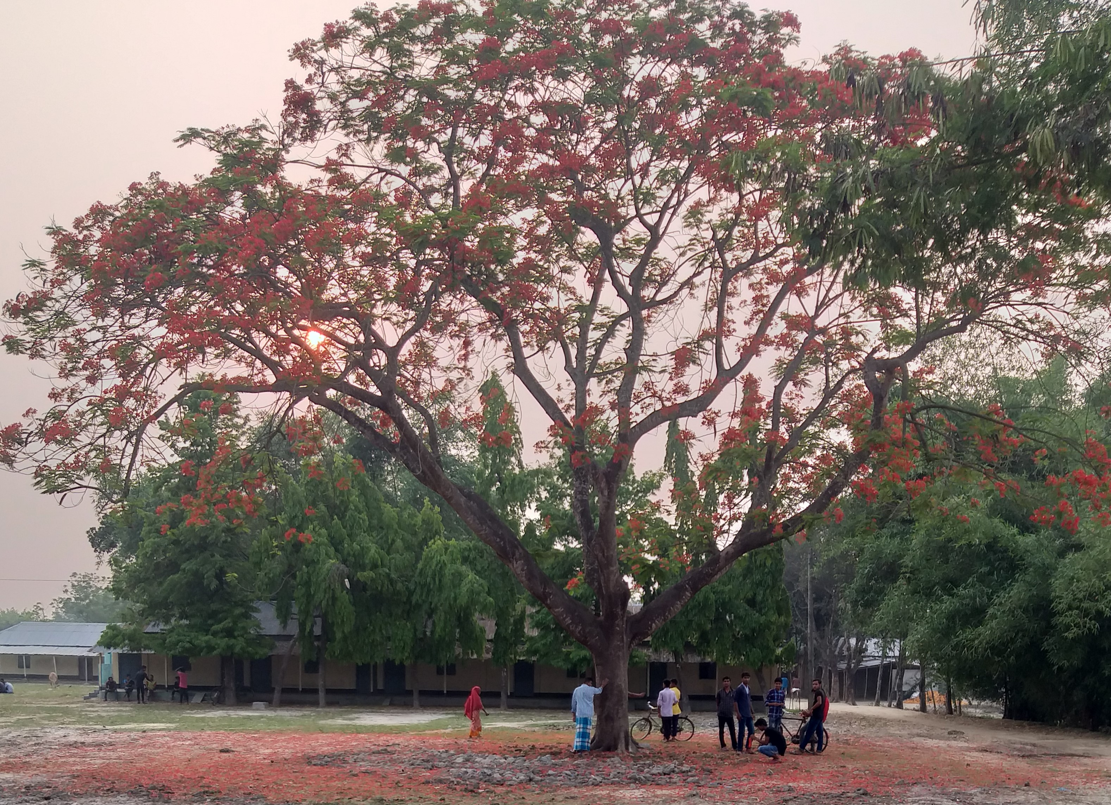
Welcome
Everybody

Slide 2
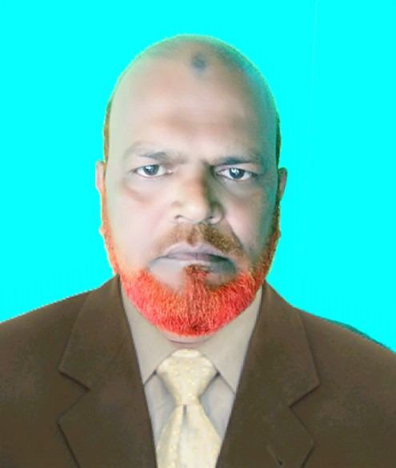
Md.Khalilur Rahman
Assistant teacher
Atgharia High School
Haripur, Thakurgaon

Slide 3
Class: Nine
Subject: English Second Paper
Title: Completing Sentence

Slide 4
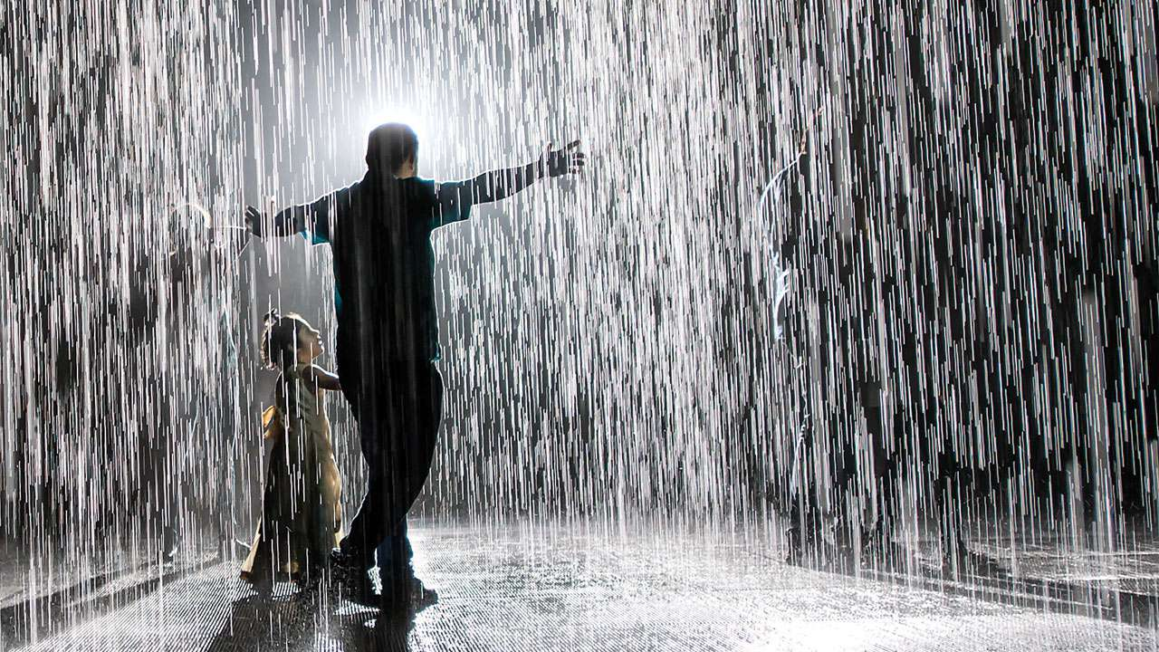
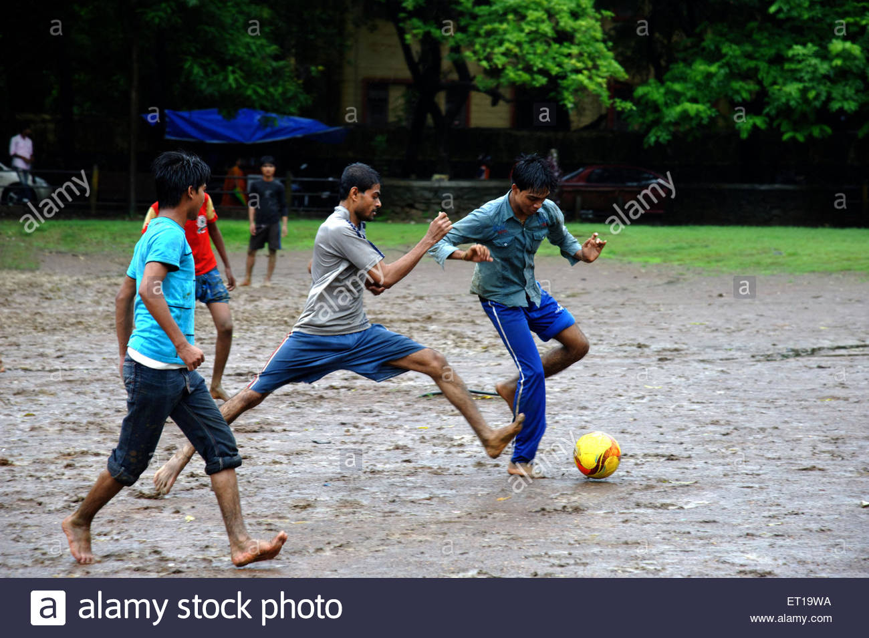
If it rains
If it rains ,I will get wet.
If it rained
If it rained, we would /could play football.

Slide 6
Learning outcomes :
At the end of the lesson the students will be able to-
1.tell and write the meaning of conditional sentence
3.complete the incomplete sentences
2.describe the rules of Zero, 1st,2nd and 3rd conditional sentences
rning outcome

Slide 7
1. What is conditional sentences?
Conditionals are structures in English that establish what will happen if a certain event takes place or if a certain action is performed.
2.How many types of conditional and what?
There are 4 types of conditional sentences.
Such as :a) Zero conditional;
b)First conditional;
c)Second conditional;
d)Third conditional.

Slide 8
Zero conditional: If +Present Simple,…. Present Simple.
I get tired
I get tired if I work too much.
If you freeze water,
If you freeze water,it turns into ice.

Slide 9
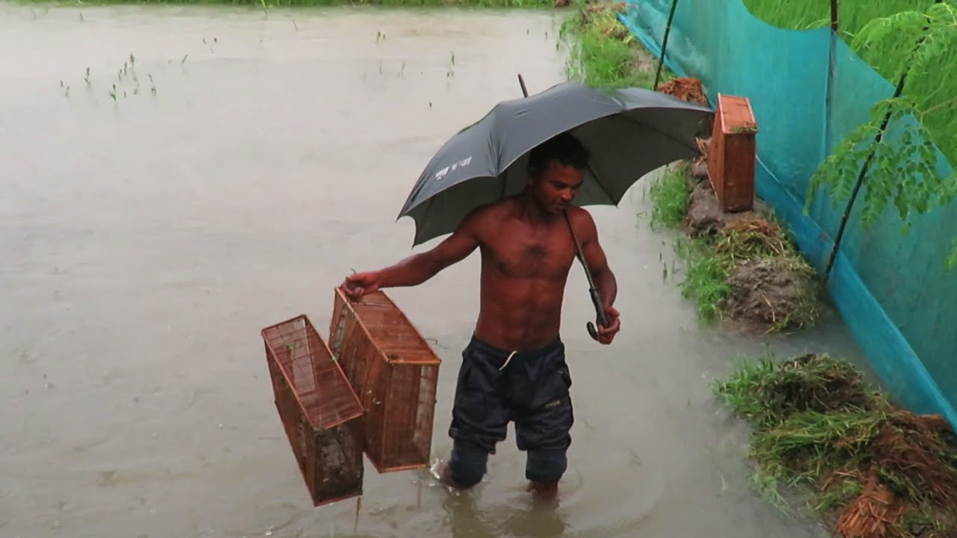
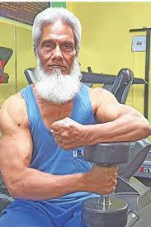
1st Conditional: If + Present Simple + Future Simple/
Future Simple + if+ Present Simple.
...if you follow the rules of health.
You will keep in good health if you
follow the rules of health.
If it rains,
If it rains, I will catch fishes.

Slide 10
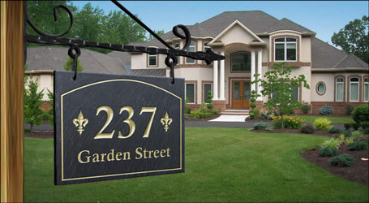
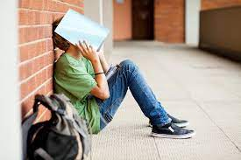
2nd Conditional: If + Past Simple + Past Conditional (Subject + would/could/might + main form of the verb) /
Past Conditional (Subject + would/could/might + main form of the verb) + If + Past Simple .
মা কটেজ
If he walked fast,
If he walked fast, he would not miss the class.
…….if I knew his address.
I would meet him if I knew his address.

Slide 11
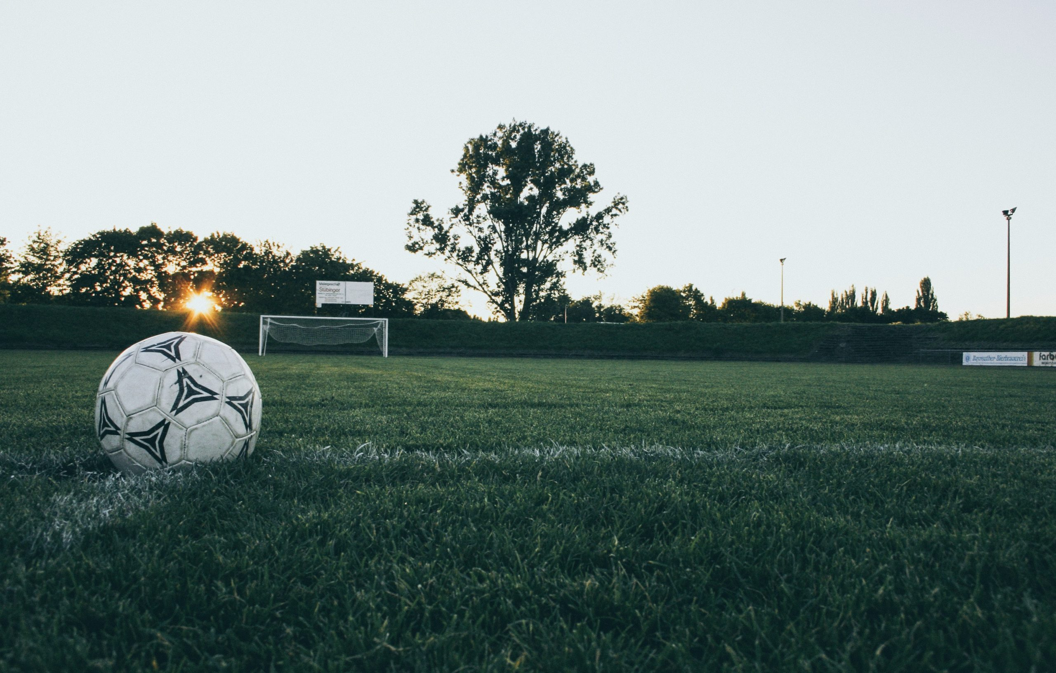
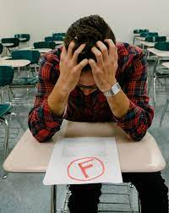
3rd conditional : If +Past perfect +Perfect Conditional(Subject +would have/ could have/ might have + past participle form of verb)/ Perfect Conditional(Subject +would have/ could have/ might have + past participle form of verb) If +Past perfect.
If he had read attentively,
If he had read attentively,
he would have passed in the examination.
If I had gone to field ,
If I had gone to field ,I could have played football.

Slide 12
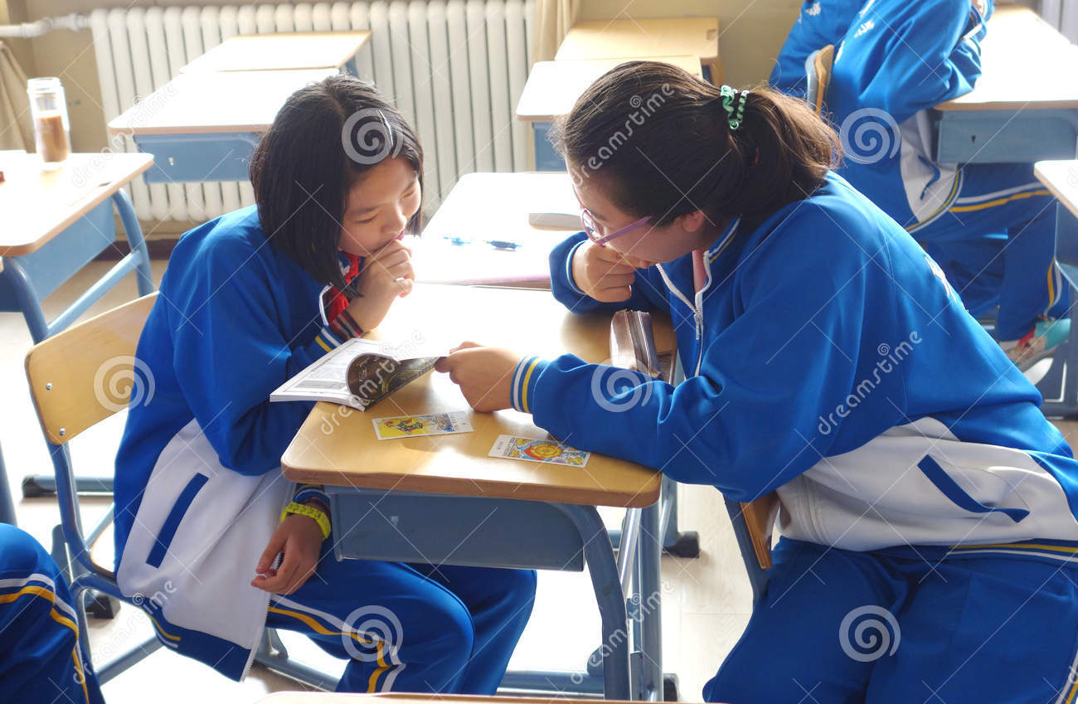
Pair Work
Complete the following sentences .
1.If I’m late for dinner,……….
2.If I had gone there,……..
3……… you would have passed the exam.
4…….. If I lived near our college.
5.I shall not go out………

Slide 13
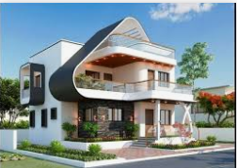
Home Work
Complete the following sentences .
1.If I’m late for school,……….
2.If I had done the work ,……..
3……… you would have prospered in life.
4…….. If I went to college.
5.I shall not go to college………

