Slide 1
How are you dear students?

Slide 2
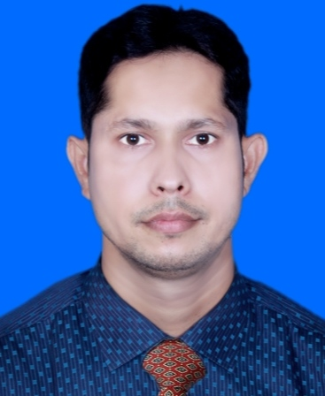
Md. Inam Ulla Khan
Assistant Teacher
Sharergoj Govt. Primary School
Sreemangal, Moulvibazar.
Class-1
Subject:english
Unit:23
Lesson:1-3
Activity:B

Slide 3
Learning outcome.
By the end of the lesson students will be able to-
Listening-111.Become familiar with english
sounds by listening to common english words.
Speaking-111.repeat after the teacher simple
words and phrase.
112.say simple words and phrase.

Slide 4
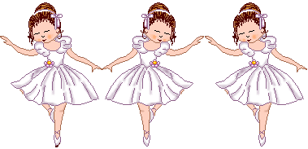
Dear students let’s singing a song .

Slide 5
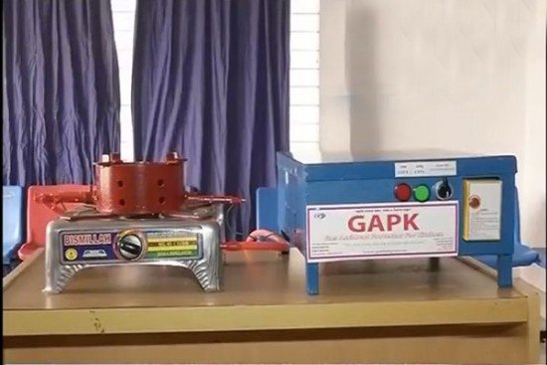
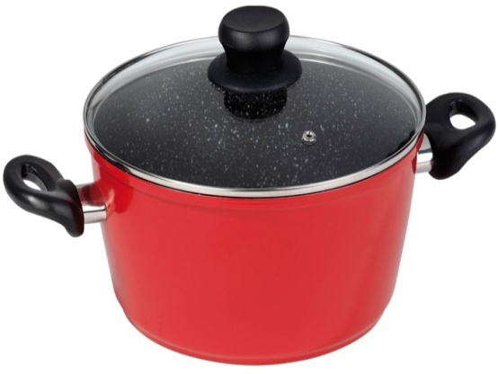
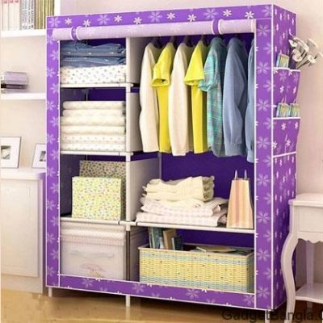
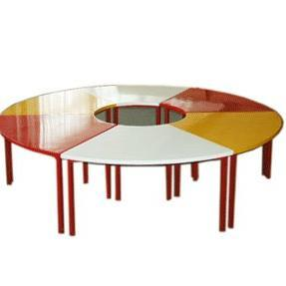
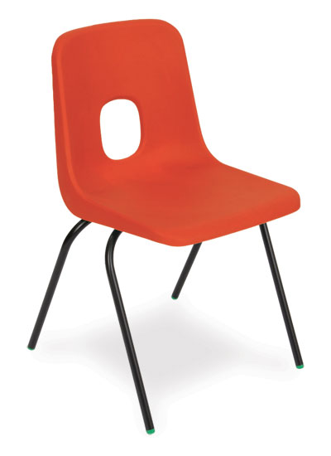
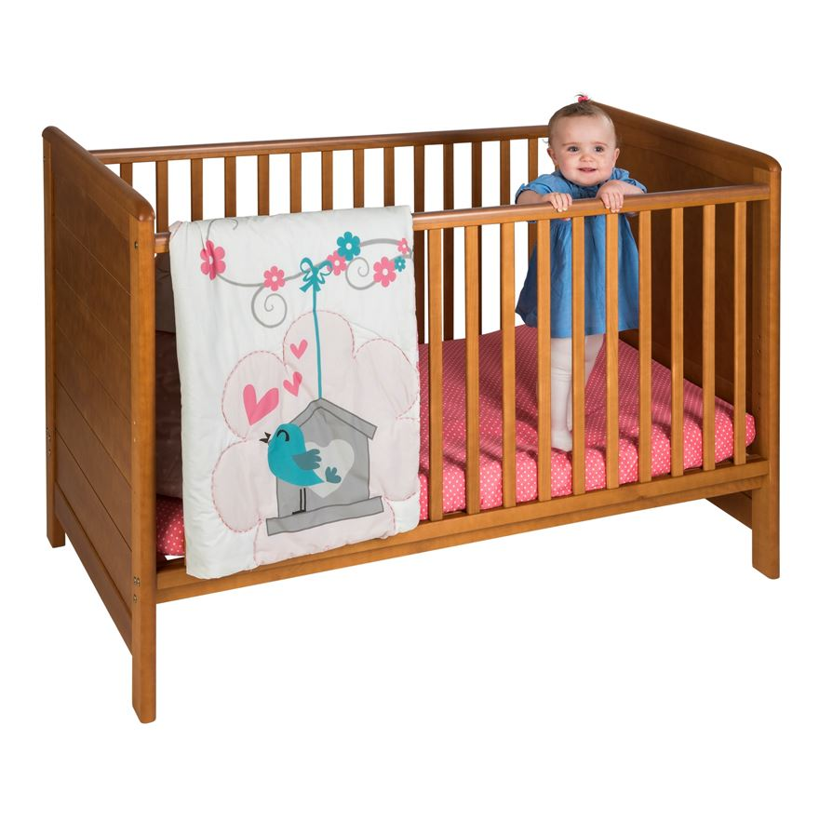
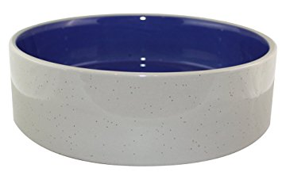
Lets we see more picture today.
Dear students let’s we see what we learn our previous class?

Slide 6
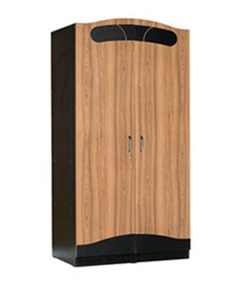
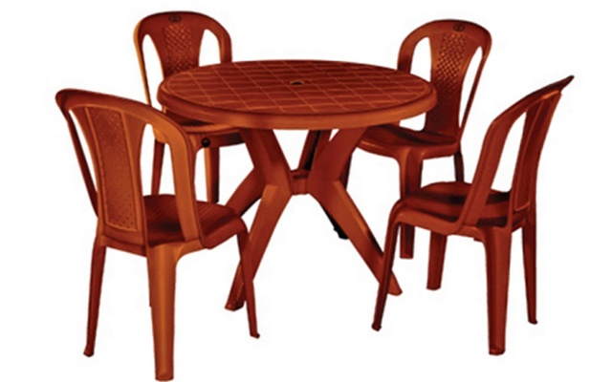
Where are you see this things ?
In the room.

Slide 7
Todays lesson is
In the room

Slide 8
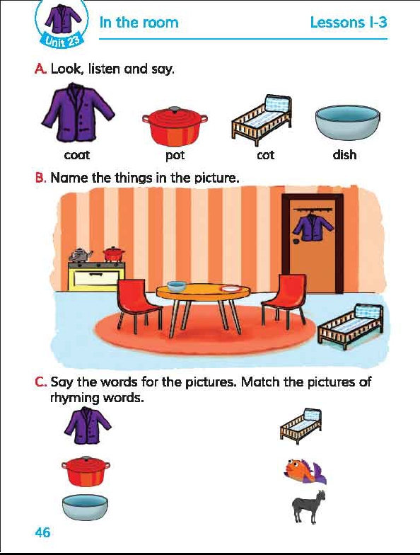
Dear students open at page46 of your english book .
Look at the picture
of Activity ‘ B’ .
Tell me about the
individual picture.

Slide 9
Listen to me carefully
what i say?

Slide 10
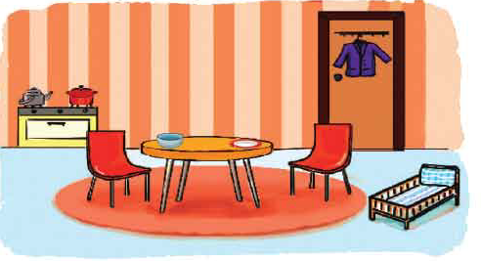
Is this classroom/ Is this a room ?
I’ll help them to answer the question

Slide 11
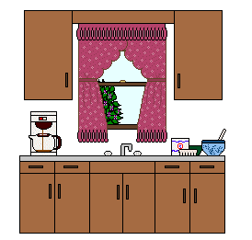
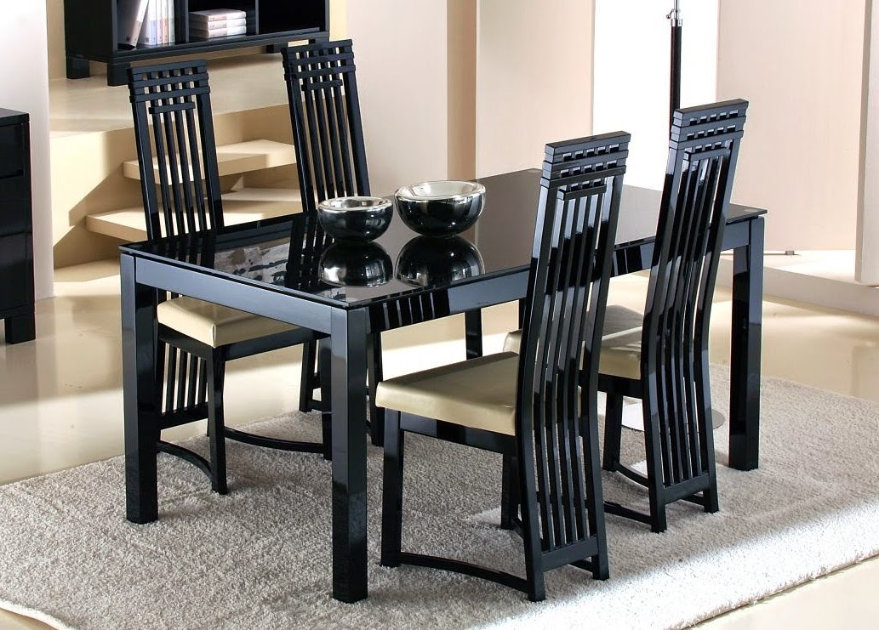
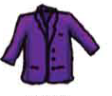
What are you see in this picture ?

Slide 12
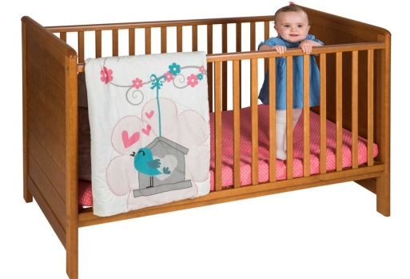
Let’s see the individual picture and know their name.
Coat
Pot
Cot
Dish
Chair
Almira

Slide 13
I’ll help the students to monitoring whole class

Slide 14
Think and say the correct word instead of the picture
Dish
Cot
Memory game
Chair
Pot
Almira
Coat

Slide 15
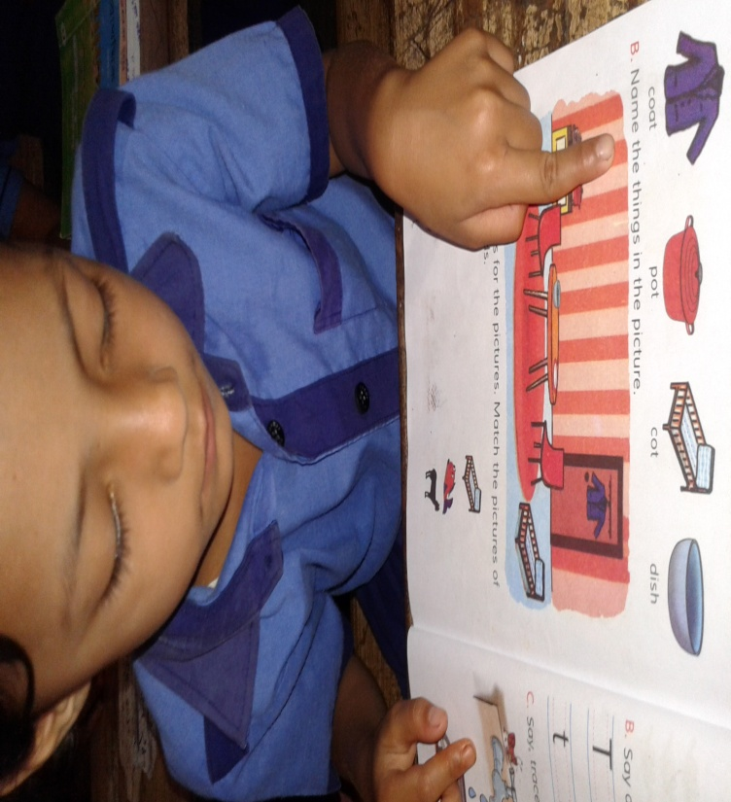
Individual work
Checking learning
Point to the picture and say the word

Slide 16
Dear students can you tell what we w’ll learn today in this lesson?
I’ll help them to say
Become familiar with english
sounds by listening to common english
words and say simple words and phrase.

