Slide 1
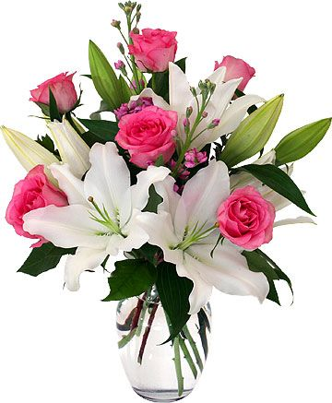
WELCOME

Slide 2
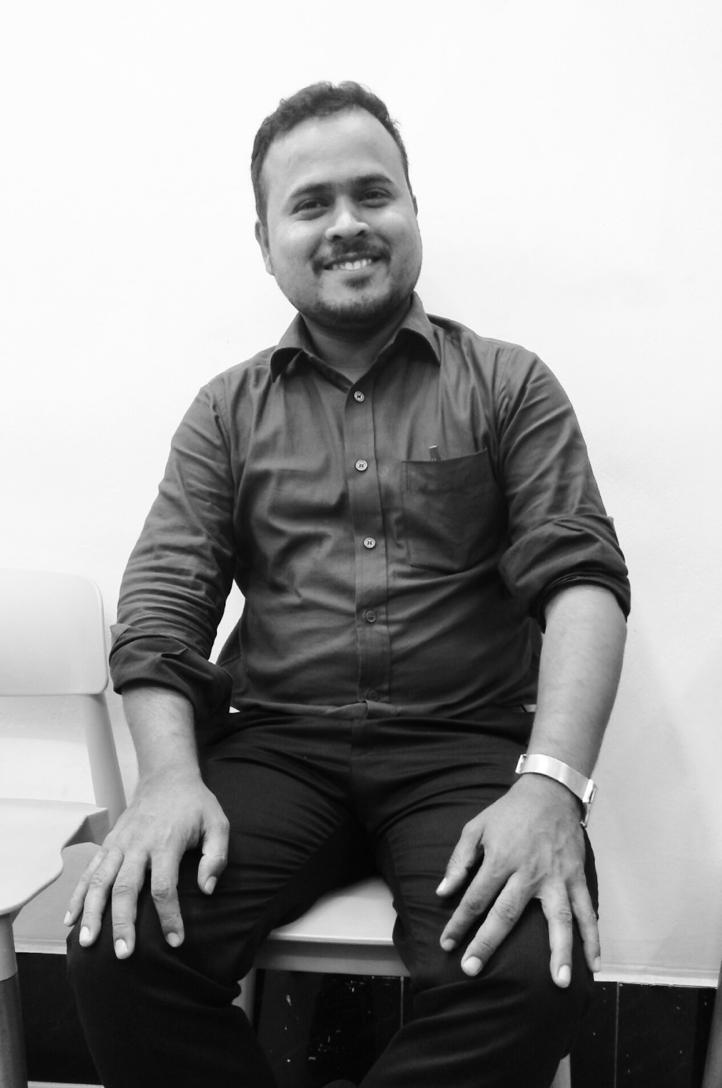
Teacher’s introduction
Md. Rafiqul Hasan
Assistant Teacher
Khonkarkhil Government Primary School
Sadar, Cox's Bazar.
email: rafiquecox1@gmail.com

Slide 3
Lesson’s introduction
Class- Four
WH questions
WHOSE

Slide 4
Let's see some words
What
class
Who
student
Why
to play
When
play
Whose
Farmer's

Slide 5
Remember the note:
Whose is a pronoun used in questions to ask who owns something or has something. In other words, whose is about possession.

Slide 6
Remember the note:
Whose এর বাংলা হলো কার?

Slide 7
Remember the note:
Whose book?
Whose pen?
Whose house?
Whose keys?
Whose laptop?
Whose dress?

Slide 8
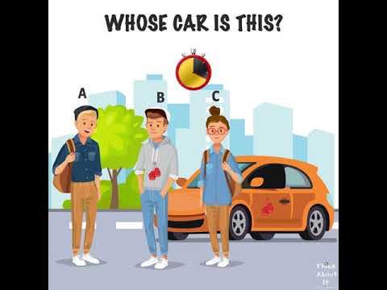
Look at the picture and think while then answer
This is Hasan's car.
WH question:
Whose car is this?
Picture-1

Slide 9
Look at the picture and think while then answer
This is my pen.
WH question:
Whose pen is this?
Picture-2

Slide 10
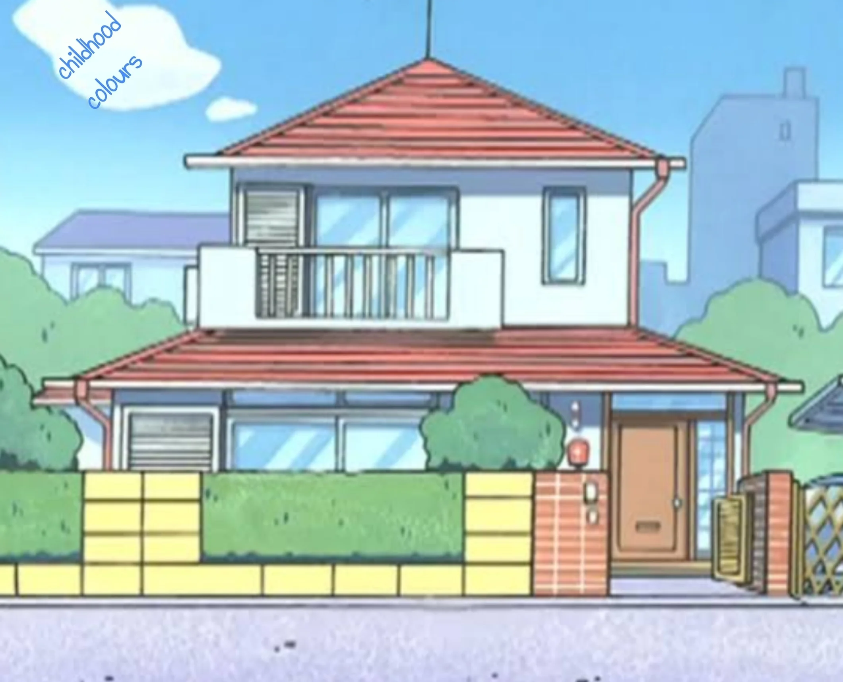
Look at the picture and think while then answer
This is Arif's house.
WH question:
Whose house is this?
Picture-3

Slide 11
1. Make WH questions of the following sentences.
a) It is Karim's birthday today.
Ans: Whose birthday is it today?

Slide 12
1. Make WH questions of the following sentences.
b) These are Munni's gloves.
Ans: Whose gloves are these?

Slide 13
1. Make WH questions of the following sentences.
c) It is Habib's book.
Ans: Whose book is it?

Slide 14
1. Make WH questions of the following sentences.
d) These are her pens.
Ans: Whose pens are these?

Slide 15
1. Make WH questions of the following sentences.
e) These are Roni's toys.
Ans: Whose toys are these?

Slide 16
1. Make WH questions of the following sentences.
f) These are Hasan's balls.
Ans: Whose balls are these?

Slide 17
1. Make WH questions of the following sentences.
g) It is Kalam's house.
Ans: Whose house is it?

Slide 18
1. Make WH questions of the following sentences.
h) His name was Tamim.
Ans: Whose name was Tamim?

Slide 19
1. Make WH questions of the following sentences.
i) Their eyes were wide.
Ans: Whose eyes were wide?

Slide 20
1. Make WH questions of the following sentences.
j) Their bags are old.
Ans: Whose bags are old?

Slide 21
1. Make WH questions of the following sentences.
k) This is Harun's car.
Ans: Whose car is this?

Slide 22
1. Make WH questions of the following sentences.
l) I am using my friend's keys.
Ans: Whose keys are you using?

Slide 23
1. Make WH questions of the following sentences.
m) This is Helen's camera.
Ans: Whose camera is this?

Slide 24
1. Make WH questions of the following sentences.
n) This is Ali's table.
Ans: Whose table is this?

Slide 25
Pair work
1. Make WH question of the following sentences.
a) This is Akram's mobile.
Ans:
b) He is Habib's friend.
Ans:
c) These are my friend's pens.
Ans:

Slide 26
Homework
1. Make WH questions of the following sentences.
a) These pens are her.
b) It is Kalam's daughter.
c) This is Helen's camera.
d) These are Habib's keys.
e) This is Moni's pen.

Slide 27
THANK YOU
THAT'S ALL FOR TODAY

