Slide 1
Welcome
welcome
welcome
MS English Online Class

Slide 2
Madhu
Sudan Das.
BA (H), English,
MA (Double),
ELL & ELT; M.Ed.
Bakalia Adarsha Girls’
High School.
Introduction
Candidates
and
Nine-Ten

Slide 3
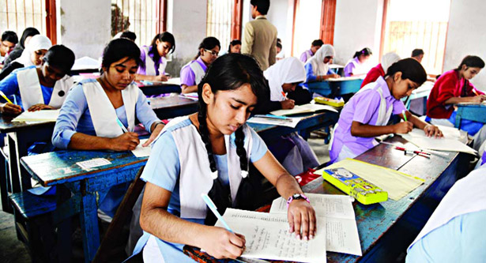
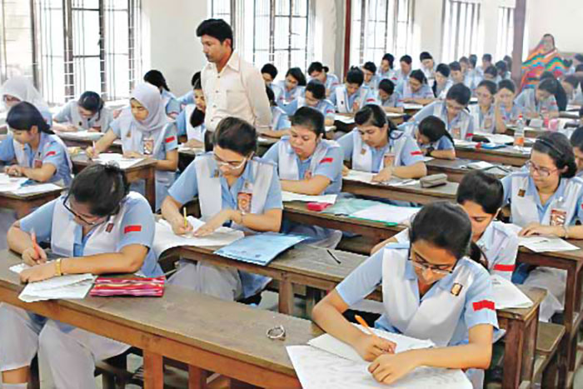
What are they doing?
What are they doing?
They are also appearing at SSC Exam.
They are appearing at SSC Exam.

Slide 4
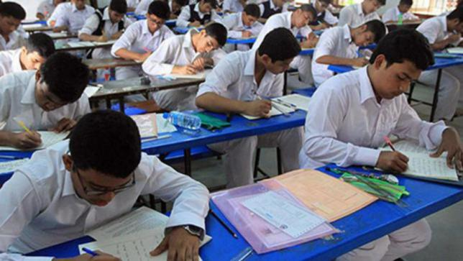
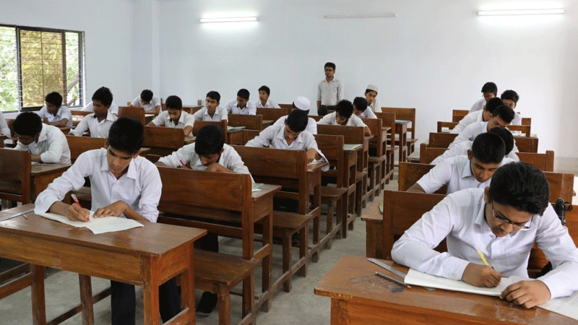
Today our topic is Questions items of SSC 2021

Slide 5
Learning outcomes:
After completing the lesson we will be able to:
Make Tag questions
Use right form of verbs
Make sentences using parts
Fill the blanks without words
Use Capitals and Punctuation Marks
Fill the blanks with suitable words
Speak about pictures and events
Fill the blanks with words from the box

Slide 6
1. Fill in the blanks with the words from the box. You may need to change the forms of some words. You may need to use one word more than once.
0.5×10=5
company | study | hard | up | an
the | on | a | on | in
Sundar Pichai is the CEO of technology (a)________Google. Success is achieved through (b) ___ work. He is a perfect fit as (c) ___ example of this mantra. He grew (d) __ in a middle class family (e) __ India. Pichai was born (f) __ June 10, 1982. He graduated in Technology from (g) __ Indian Institute of Technology (IIT) Kharagpur. He later completed (h) __ master’s degree in science from Stanford University. After (i) ________ science, he did an MBA from the Wharton School of the University of Pennsylvania. In 2014, Sundar Pichai was named as the CEO of Microsoft. However, his rival Satya Nadela, another Indian was later appointed to the post (j) ___ Microsoft.
company
hard
an
up
in
on
the
a
studying
by

Slide 7
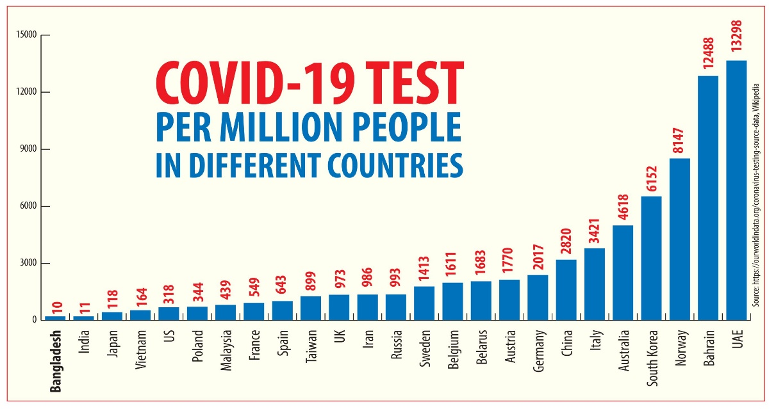
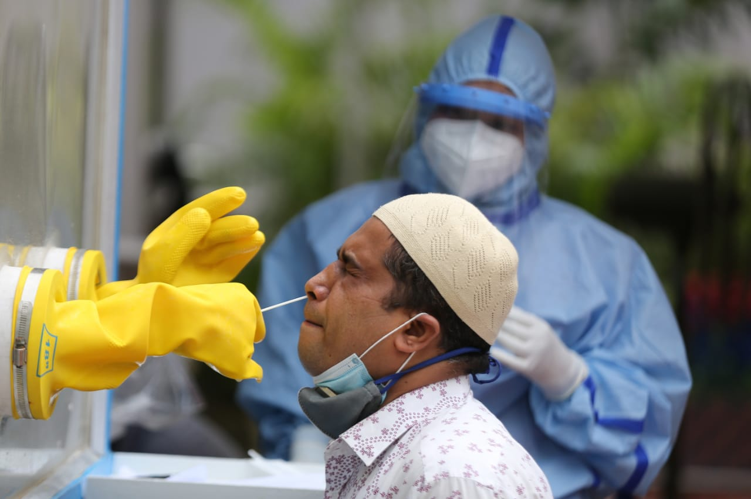
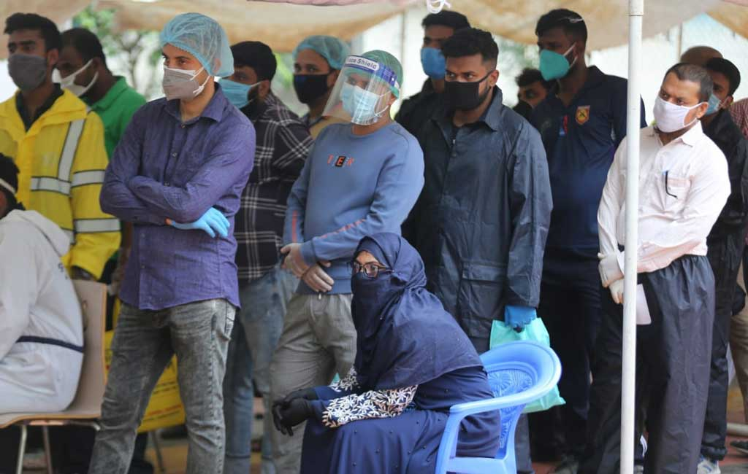
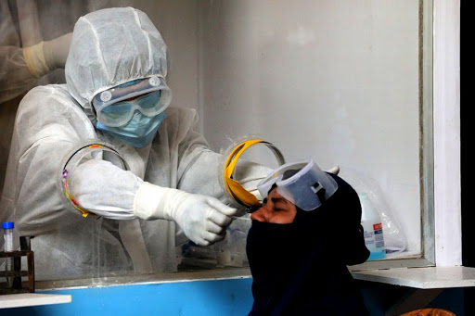
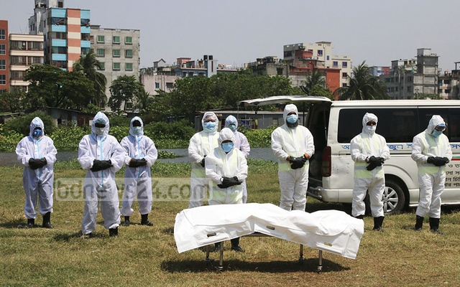
Sample is being collected from a woman for test.
They are standing for corona test
Sample is being collected from a man for test.
A patient died today
Corona Test of the world

Slide 8
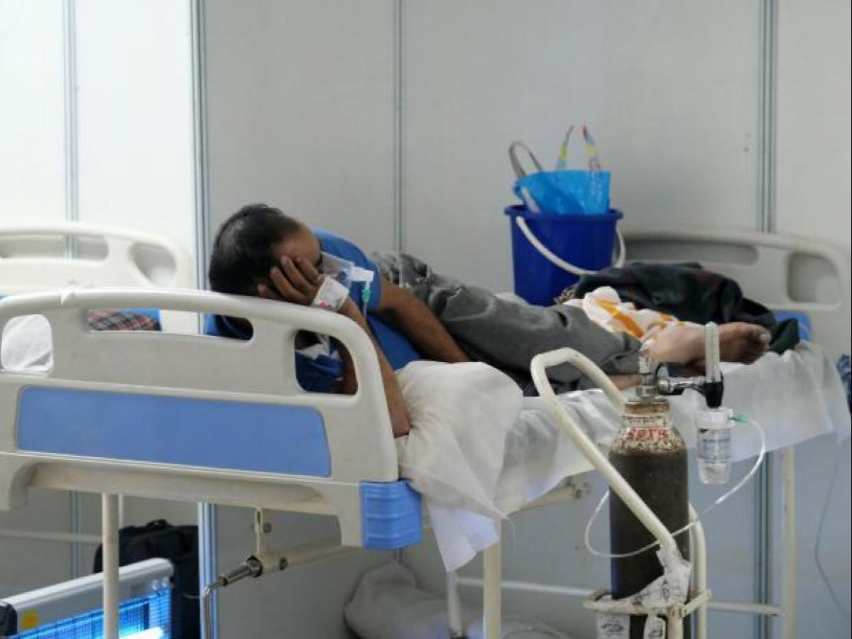
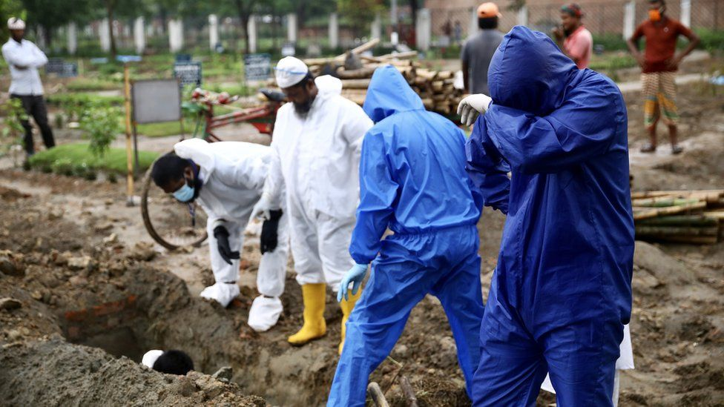
Pair work
2. Fill in the blanks with suitable words
1×5=5
In the last 24 hours in (a)― country, the number of deaths (b) ― detection of coronavirus has increased as (c) ― to the previous day. Thirty (d) ― have been died of coronavirus infection (e) ― 8 am on Wednesday and 8 am (f) ― Thursday. In the last 24 hours, 1,006 people (g) ― been diagnosed with coronary heart (h) ―. This information has been informed (i) ― the press release (j) ― the health department on Thursday afternoon..
Madhu Sudan Das. BA (Hon’s), English; MA (Double); ELL & ELT, M.Ed.
Corona has been detected in him
Answers:
a. the
b. and
c. compared
d. people
e. between
f. on
g. have
h. disease
i. in
j. of
A patient is being buried today.

Slide 9
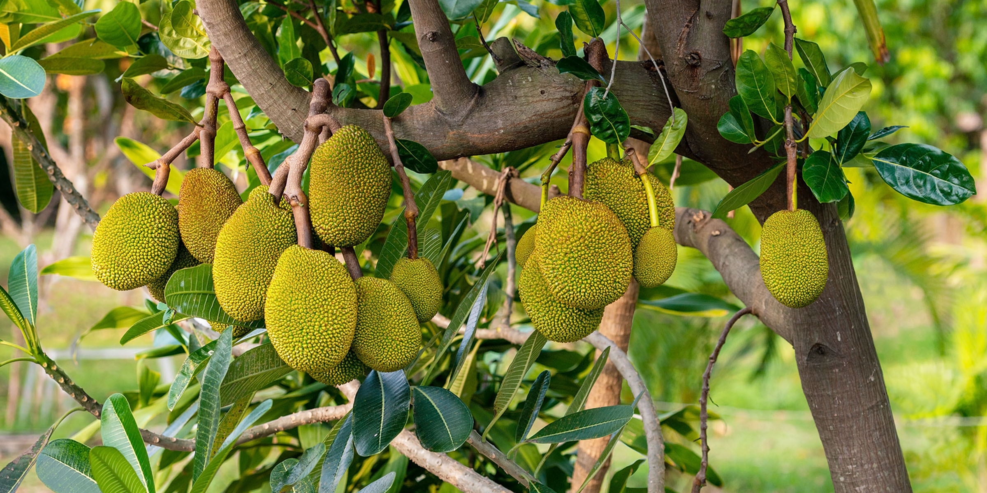
Madhu Sudan Das. BA (Hon’s), English; MA (Double); ELL & ELT, M.Ed.

Slide 10
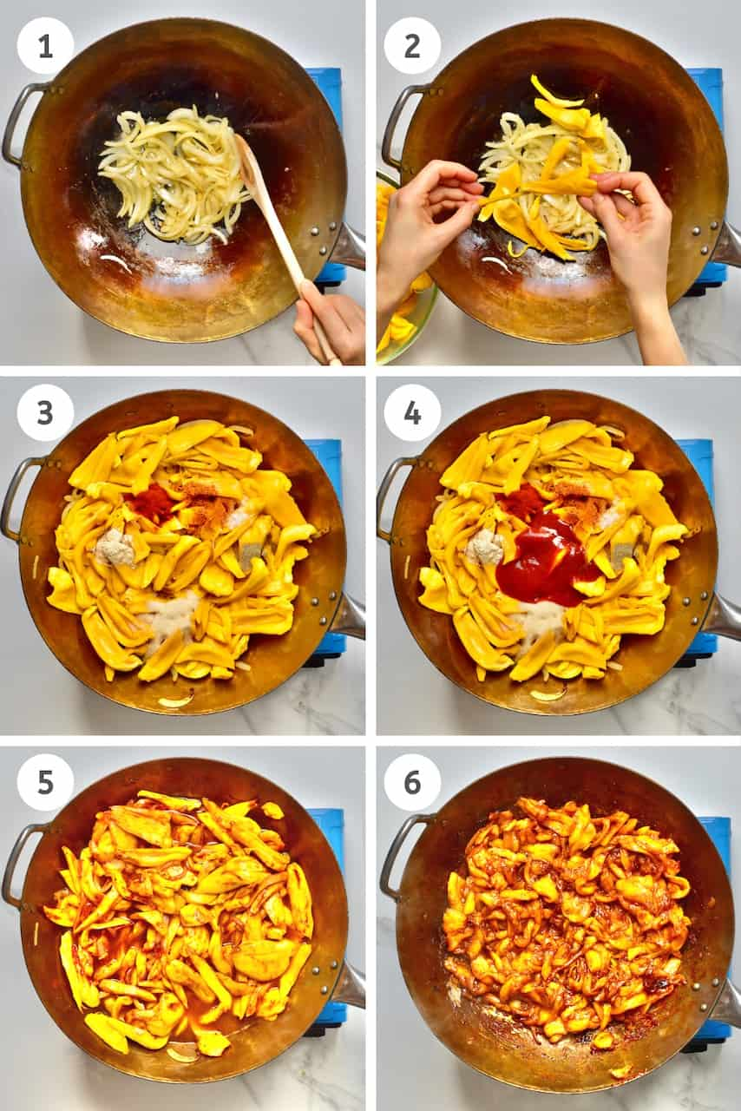
1×6=6
3.Make six sentences using parts of sentences from each column of the table.
Jackfruit
to store jackfruit
In many ways.
Both ripe
is
Boost immunity many times.
Many people love
And raw
A healthy food
Jackfruit is eaten
Is no less
Can be eaten.
Raw jackfruit
As a vegetable
Pickles in the fridge for days.
cures diseases and
In taste and quality.
Answer:
a. Jackfruit is a healthy food.
b. Both ripe and raw jackfruit can be eaten.
c. Many people love to store jackfruit pickles in the fridge for days.
d. Jackfruit is eaten as a vegetable in many ways.
e. Raw jackfruit is no less in taste and quality.
f. Raw jackfruit cures diseases and boost immunity many times.
Madhu Sudan Das. BA (Hon’s), English; MA (Double); ELL & ELT, M.Ed.

Slide 11
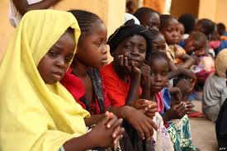
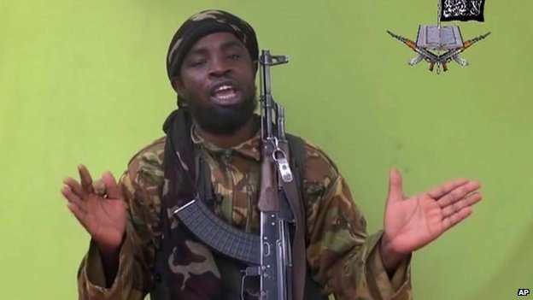
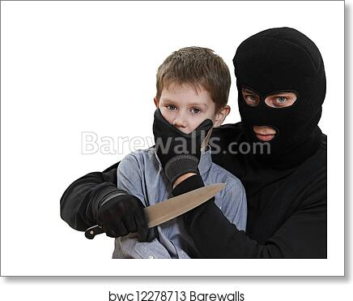
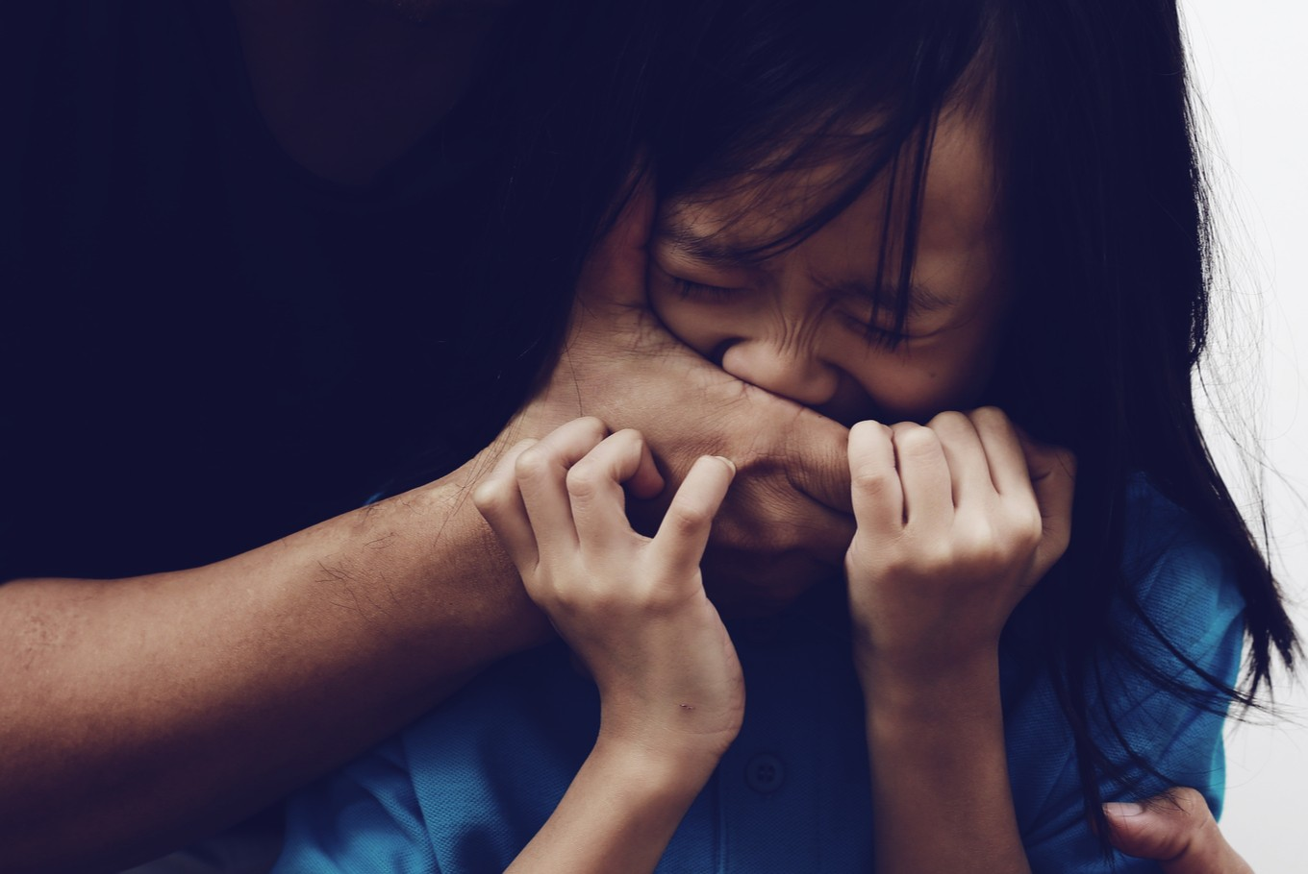
Look at the pictures
Madhu Sudan Das. BA (Hon’s), English; MA (Double); ELL & ELT, M.Ed.
A gunman.
Another baby is abducting or kidnaping.
Some children have been abducted.
A baby is abducting or kidnaping.

Slide 12
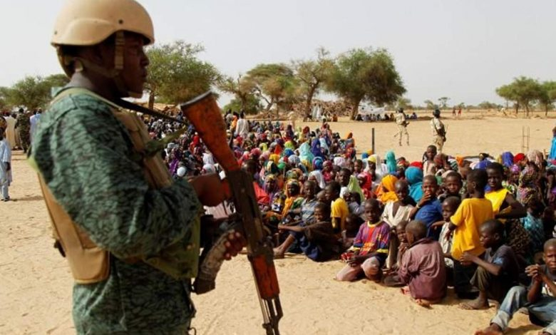
4. Use right form of verbs
1×10=10
take
be
say
confirm
abduct
loot
release
learn
Look at the picture
138 children have been (a) --- from a madrasa in Nigeria last Monday. Local authorities (b) --- gunmen abducted the children. The government has (c)--- the incident. However, they not (d) --- anything about the number of the children but state government had confirmed. Authorities (e) --- the abductors (f) --- 11 abducted children. These children (g) --- very young, they have not even (h) --- to walk properly. Local armed groups regularly (i) ---, steal cattle and (j) --- people hostage in central Nigeria.
Madhu Sudan Das. BA (Hon’s), English; MA (Double); ELL & ELT, M.Ed.
a. abducted
b. said
c. confirmed
d. did not say
e. say
f. released
g. are
j. take
h. learned
i. loot

Slide 13
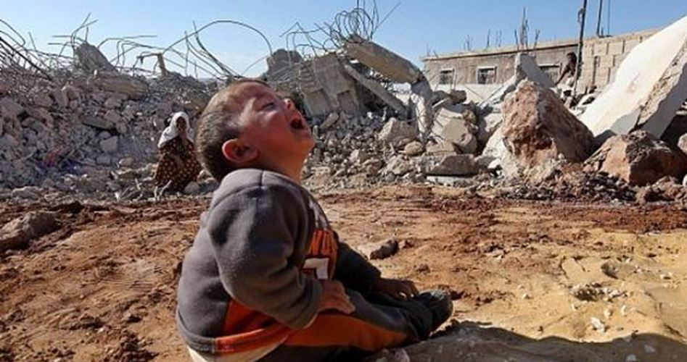
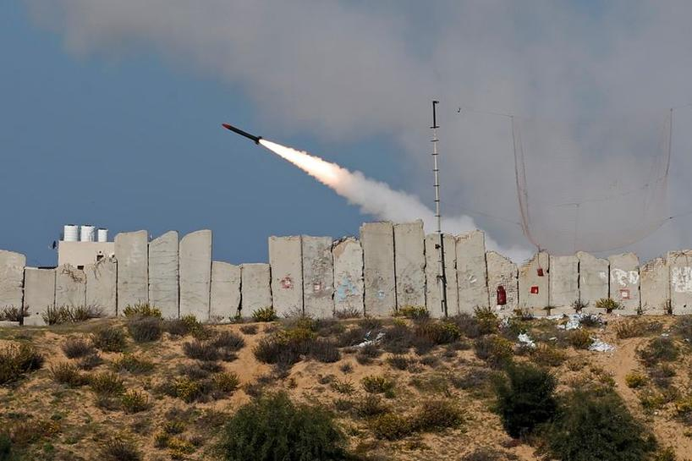
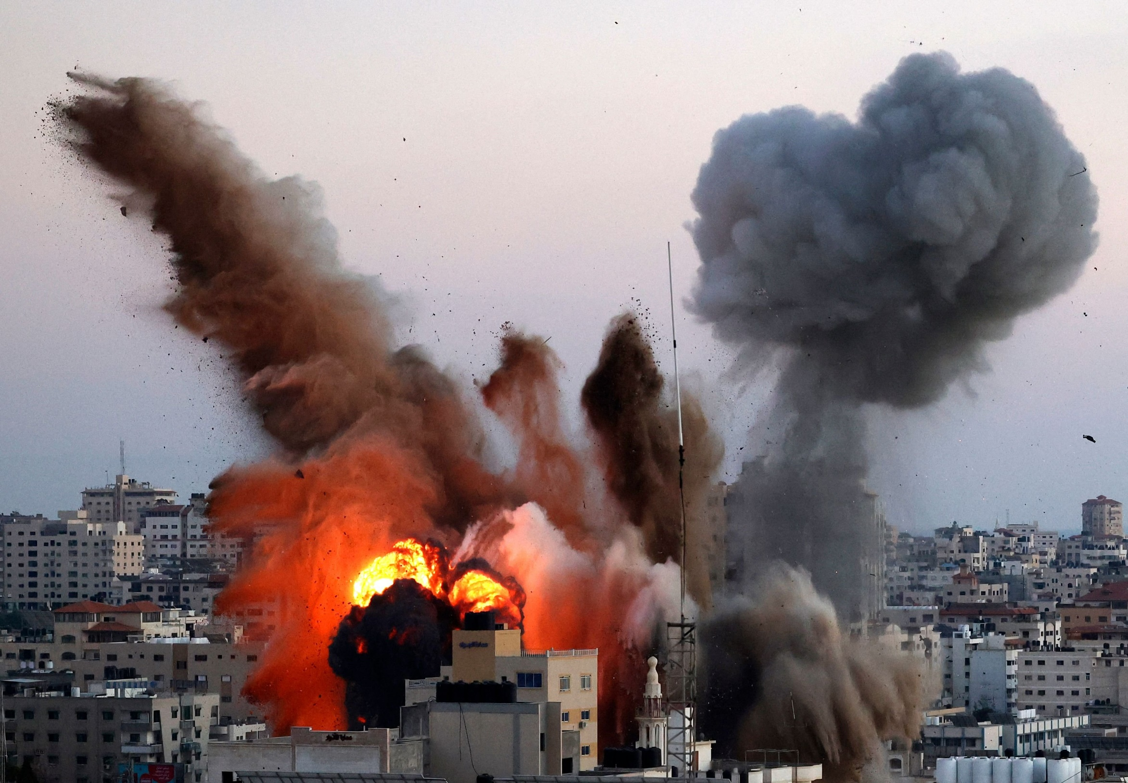
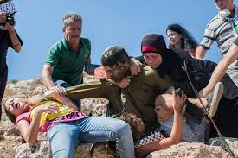
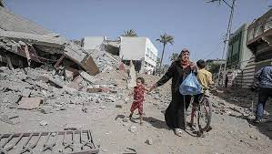
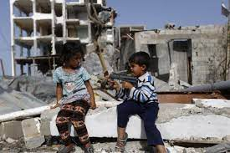
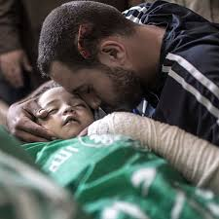
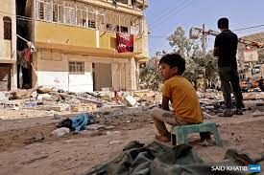
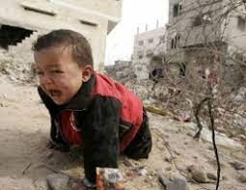
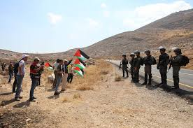
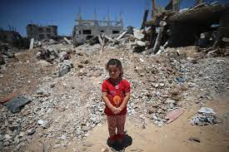
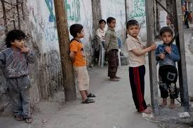
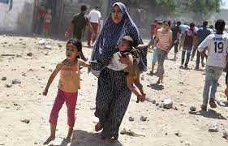
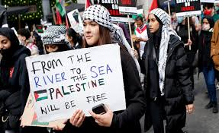
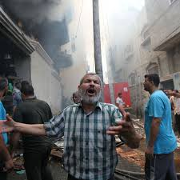
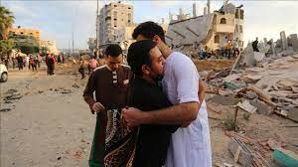
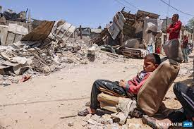
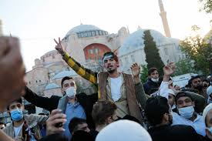
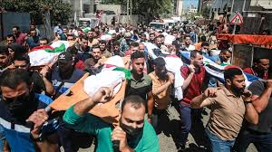
Madhu Sudan Das. BA (Hon’s), English; MA (Double); ELL & ELT, M.Ed.

Slide 14
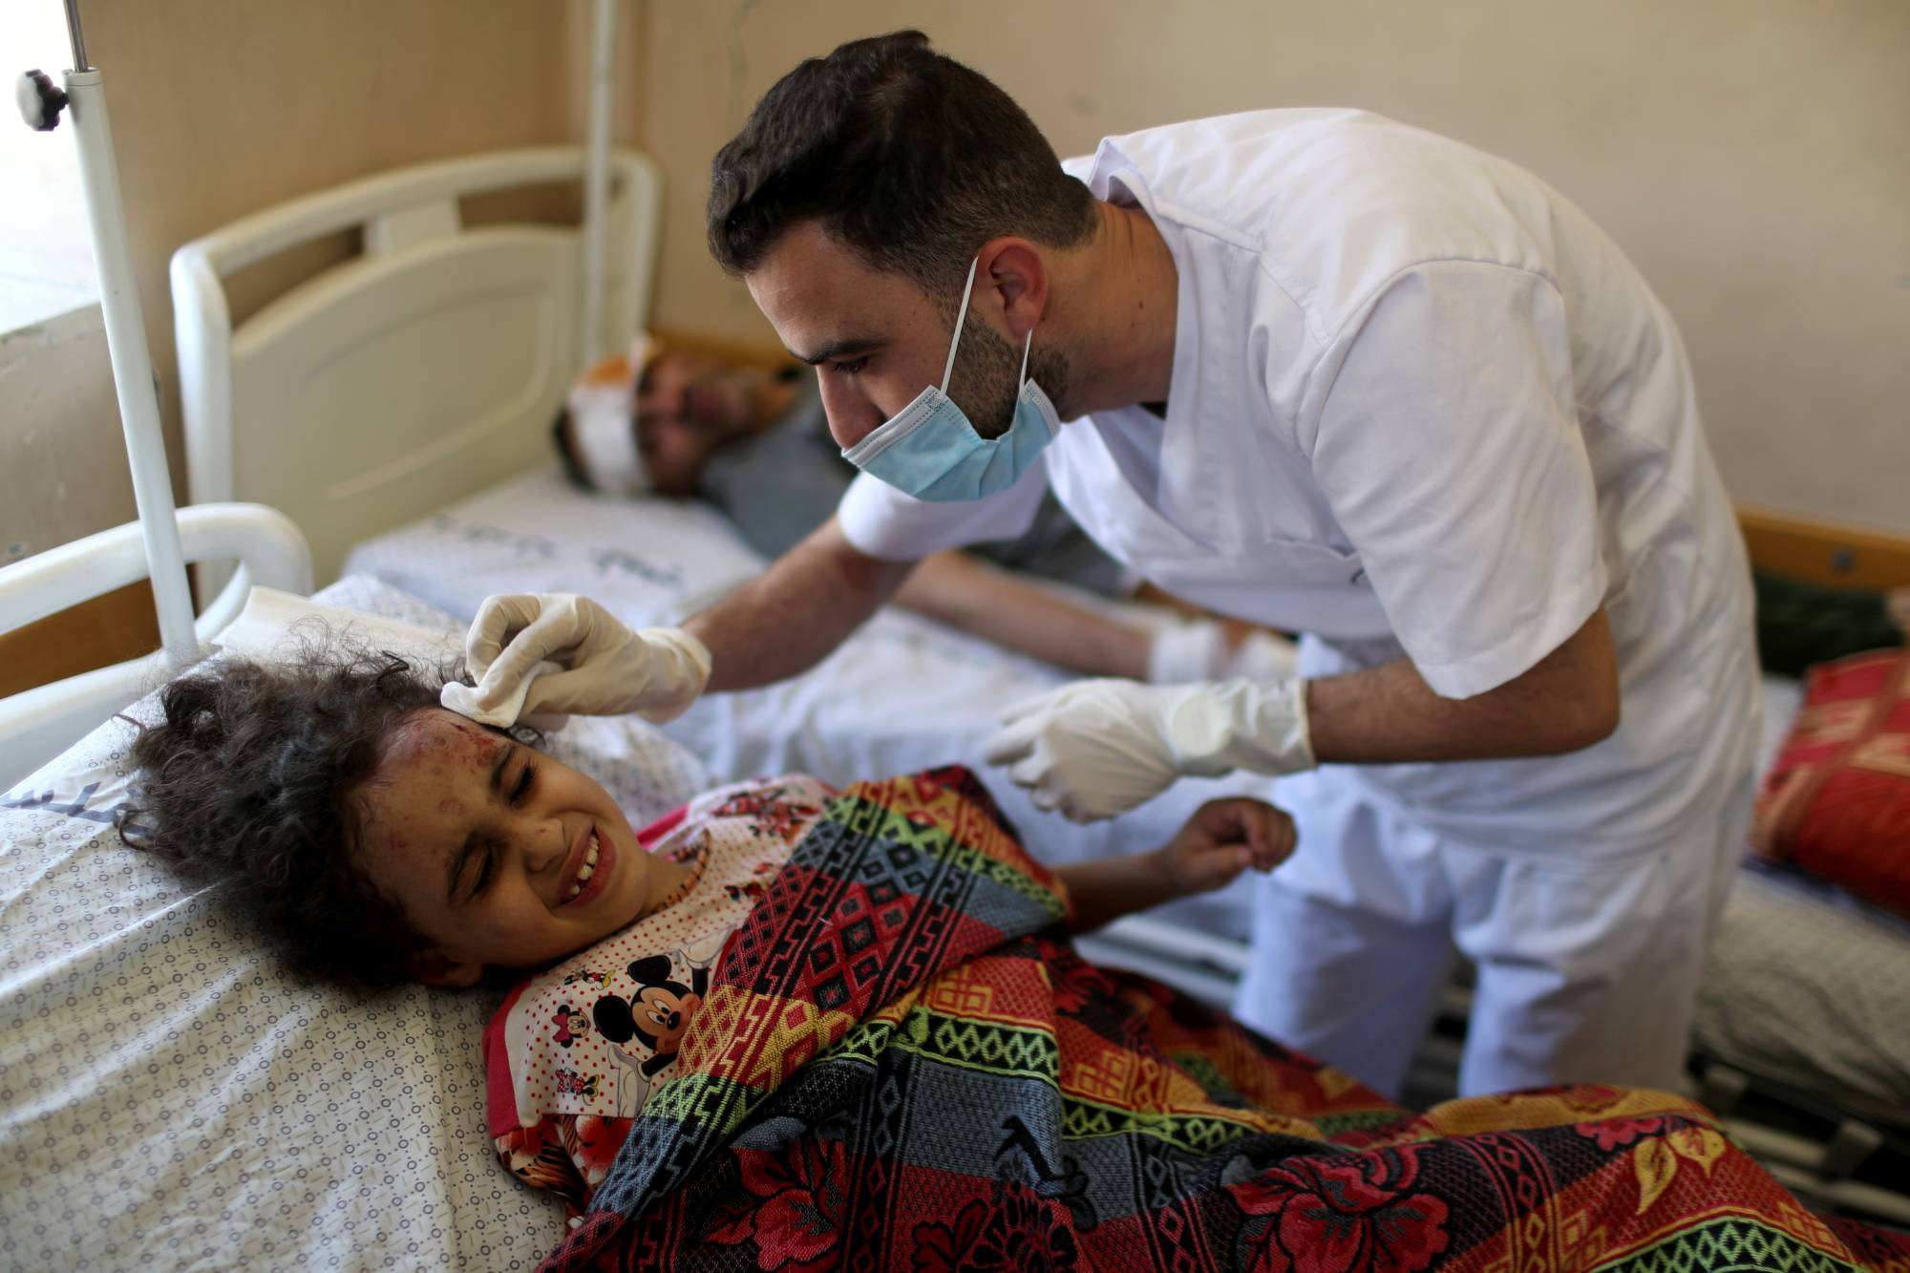
Group work
4. Use right form of verbs
1×10=10
be
follow
say
need
warn
occupy
step
include
provide
Look at the picture
The world Health Organization(WHO) has (a) --- that some 200,000 Palestinians (b) --- in need of medical assistance (c)--- last month’s clashes between Israel and Hamas. People in (d) --- Palestinian territories, (e) --- the West Bank, (f) --- medical attention. WHO has (g) --- up its efforts to (h) --- that. It further (i) --- that the situation (j) --- dire.
Madhu Sudan Das. BA (Hon’s), English; MA (Double); ELL & ELT, M.Ed.
a. warned
b. are
c. following
d. occupied
e. including
f. needed
g. stepped
h. provide
i. said
j. is

Slide 15
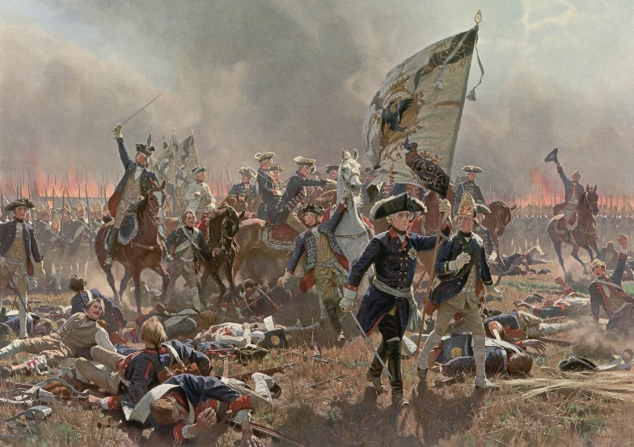
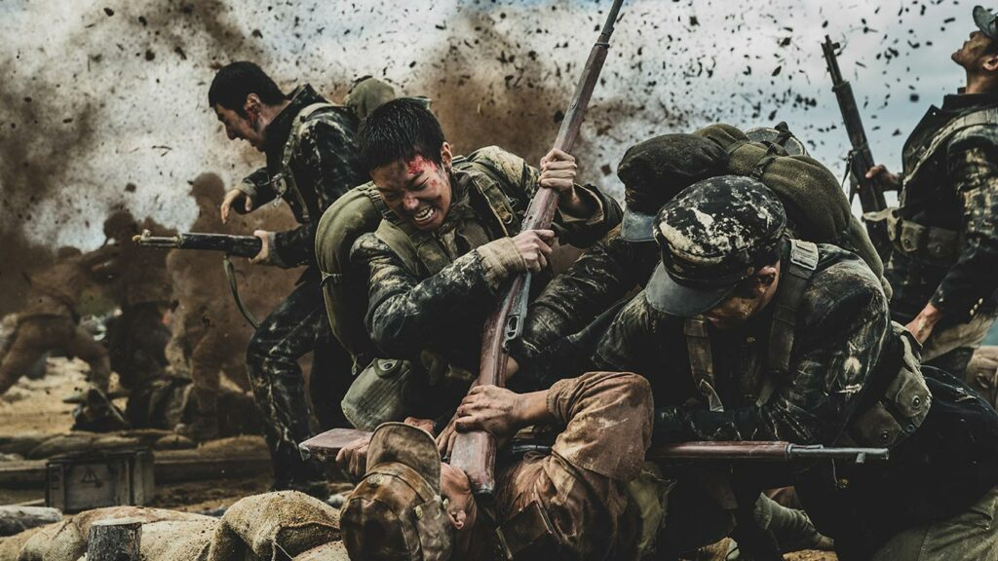
5. Change the sentences as directed
a. War is a curse for human civilization. (Negative)
Ans. War is not a blessing for human civilization.
b. It is not constructive. (Affirmative)
Ans. It is destructive.
c. It destroys civilization. (Passive)
Ans: Civilization is destroyed by it.
d. It is the worst evil in civilization. (Positive)
Ans: No other evil in civilization is as bad as it.
e. Nobody likes war. (Affirmative)
Ans: Everybody hates war.
f. We know that war brings destruction. (Passive)
Ans: It is known to us that destruction is brought by war.
Madhu Sudan Das. BA (Hon’s), English; MA (Double); ELL & ELT, M.Ed.

Slide 16
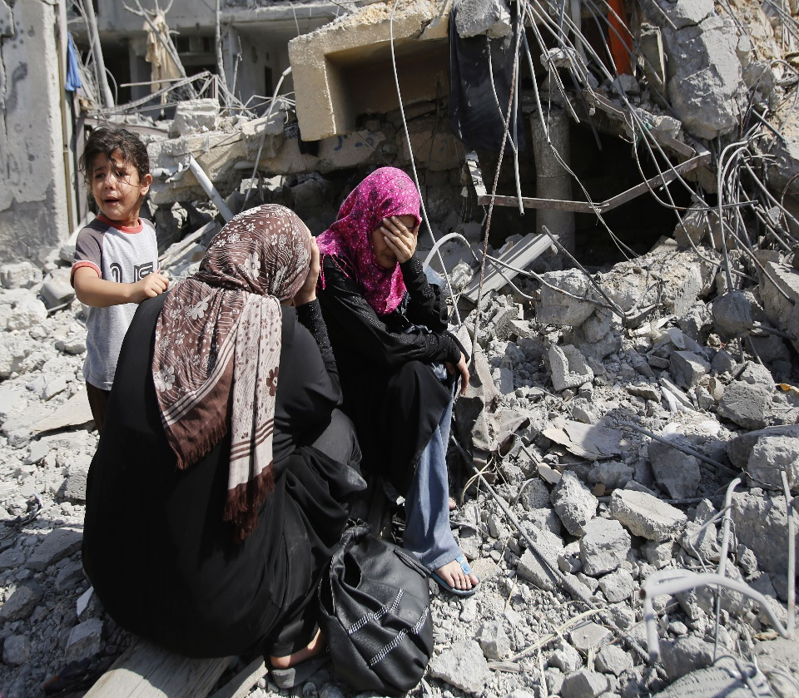
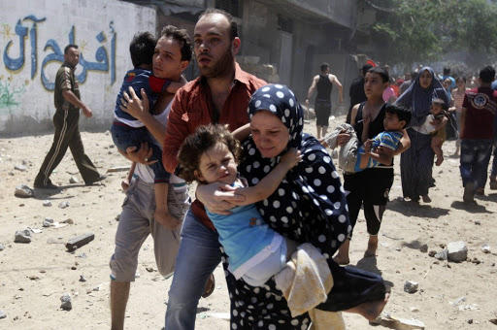
g. Man should not learn to live in chaos. (Affirmative)
Ans: Man should learn to live in peace.
h. How devastating war is! (Assertive)
Ans: War is very devastating.
i. Nothing is as corrosive as war. (Superlative)
Ans: War is the most corrosive thing.
j. The evil minded leaders must be avoided. (Active)
Ans: We must avoid the evil minded leaders.
Madhu Sudan Das. BA (Hon’s), English; MA (Double); ELL & ELT, M.Ed.

Slide 17
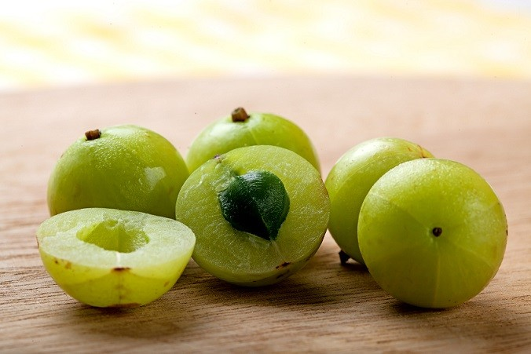
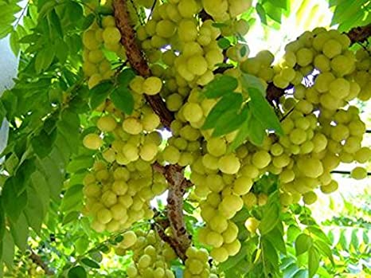
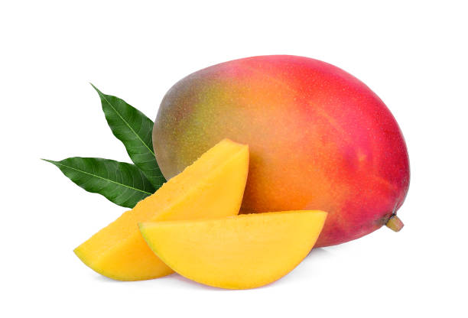
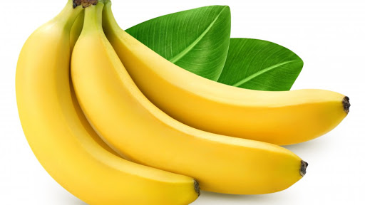
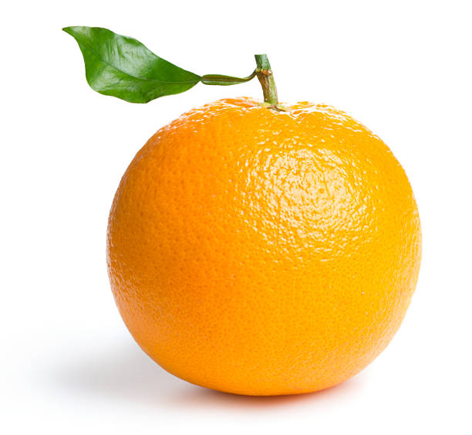
6. Use suffix or prefix or both:
Individual work
0.5×14=7
(a) — (man) is a unique fruit. In addition to (b) — (cure) various diseases, mango helps in (c) — (build) immunity. Amalaki extract is now also used in (d) — (Ayurved) medicine for its (e) — (medicine) properties. Amalaki contains three (f) — (time) and ten times more vitamin C than guava and paper lemon. Amalaki (g) — (contain) 15 to 20 times more vitamin C than oranges, 120 times more than apples, 24 time more than mangoes and 60 times more than bananas. It can be (h) — (eat) with hot water or on an empty stomach. It is rich in (i) — (oxidants). Its juice can also be drunk. (j) — (eat) on an empty stomach (k) — (improve) our health (l) — (internal), which (m) — (keep) our skin and hair (n) — (health).
Look at the picture
a. mango
d. Ayurvedic
e. medicinal
f. times
b. curing
c. building
g. contains
h. eaten
i. anti-oxidants
j. eating
k. improves
l. internally
m. keeps
n. healthy
Madhu Sudan Das. BA (Hon’s), English; MA (Double); ELL & ELT, M.Ed.

Slide 18
1×7=7
7. Make Question tag
1. I spent little as I have little, ________?
did I
2. Little monkeys have little tails, ________?
don’t they
3. The jury gave the same opinion, ________?
didn’t it
4. That he was honest was proved, ________?
wasn’t it
5. Only a few students made few mistakes, ________ ?
didn’t they
6. The needy need needful cash, ________?
don’t they
7. He put the book on the table, ________?
didn’t he
Madhu Sudan Das. BA (Hon’s), English; MA (Double); ELL & ELT, M.Ed.

Slide 19
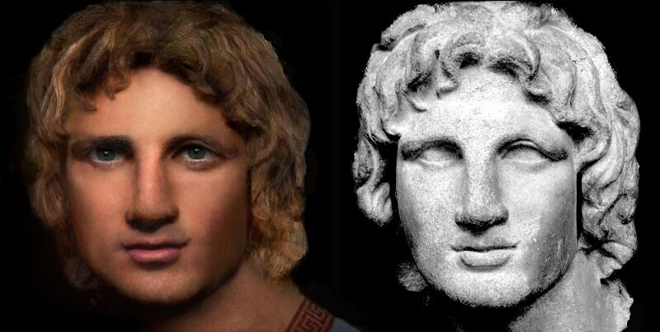
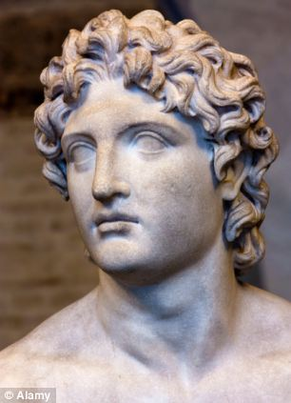
8. Use capitals and punctuation marks:
0.5×10=10
i am emperor alexander what can i do for you he said smiling down at the queer old man sitting in the tub you can remove yourself from the sun shine do not take from me what you cannot give replied the old man
“I am Emperor Alexander.
What can I do for you?”
he said, smiling down at
the queer old man sitting in the tub.
“You can remove yourself from the sun shine.
Do not take from me what you cannot give,”
Replied the old man.

