Slide 2
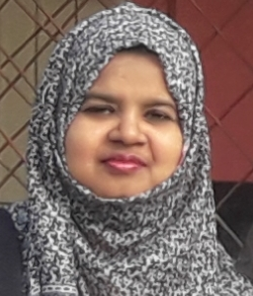
Teacher’s identity
Farjana Amin
Assistant teacher
Dhadash Govt. Pri. School
Puthia, Rajshahi.

Slide 3
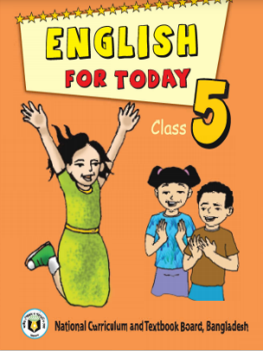
Lesson identity
Sub: English
Class: Five
Unit: 4 (Leisure time)
Lesson:1-2(A. Read and say.) ( Tamal… connected)

Slide 4
Let’s play a game:
D | A | N | C | E | F | R | T
T | R | A | V | E | L | E | V
T | R | A | V | W | L | C | D
D | R | O | P | A | N | I | G
D | B | J | W | T | Z | T | Z
A | K | A | U | C | E | E | R
B | R | P | T | H | C | H | G
D | X | S | E | S | I | N | G
The game is called Word square:
Pick up letter from the
square to make word:
You can arrange words horizontally, diagonally or vertically :

Slide 5
When do we do these activities?
Dance
Travel
Recite
Free time
Draw
Sing
Watch
We do these activities in our free time.
So, can you guess what’s our today’s lesson?

Slide 6
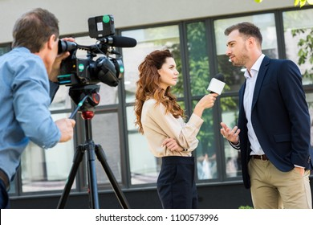
Today’s lesson:
Leisure time

Slide 7
Learning outcomes
Students will be able to-
Listening: 1.3.1 Recognize which words in a sentence are stressed.
Speaking: 8.1.1 Take part in conversations on appropriate topics.
Reading: 7.1.1 Recognize punctuation marks and read accordingly.
Writing: 10.1 make sentences using words and phrases given in the text.

Slide 8
Open at page 14

Slide 9
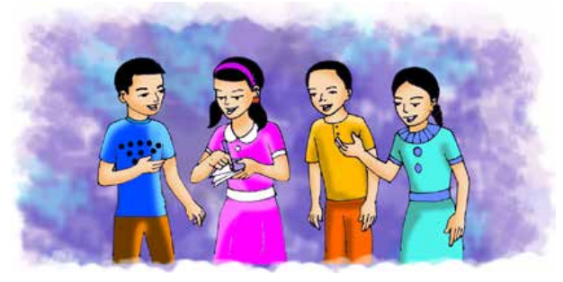
What are they doing?
What can you see in the picture?
They are talking.
There are two boys and two girls.

Slide 10
Let’s know the lesson with the pictures
Tamal
Sima
Hi, my friend! Nasreen and I are reporters for the English Club Magazine. Would you mind answering some questions?
Sure. No problem. It’s my pleasure.

Slide 11
Let’s know the lesson with the pictures
Tamal
Sima
Could you tell me your name and what class you are in?
I’m Sima. I’m in class 5

Slide 12
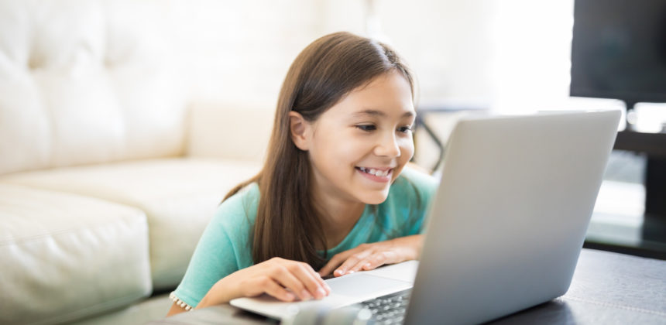
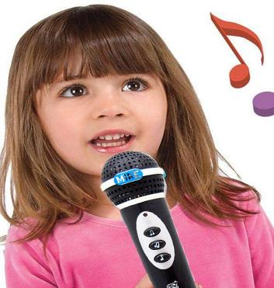
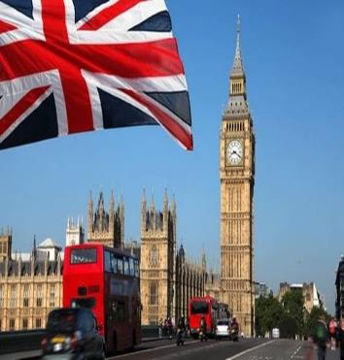
Let’s know the lesson with the pictures
Tamal
Sima
Nasreen
How do you spend your leisure time,Sima?
My cousin lives in the UK.
Sometimes, I talk to her and her friends on the internet.
Well, I like to walk in the park.
I also like to sing.
So talking on the internet keeps you connected.

Slide 13
Now listen the audio.

Slide 14
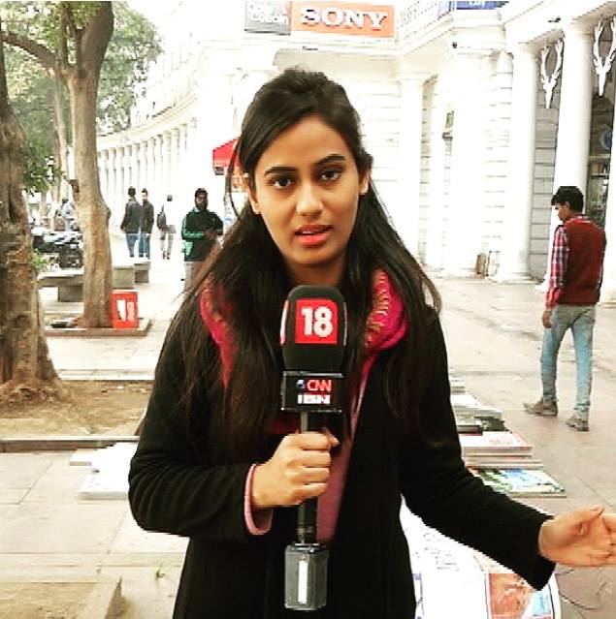
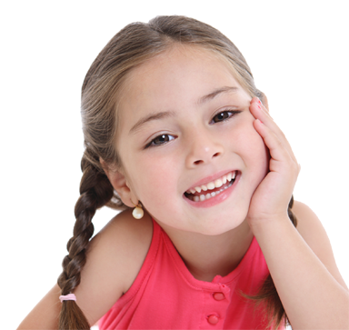
Teaching Vocabularies
Let’s find out new or difficult words
A person who makes news .
প্রতিবেদক
Reporter
Happiness or satisfaction.
Pleasure
আনন্দ
A type of thin book which contains articles and photographs.
Magazine
পত্রিকা

Slide 15
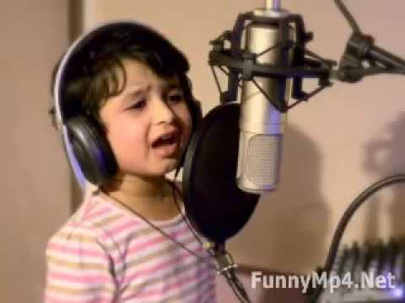
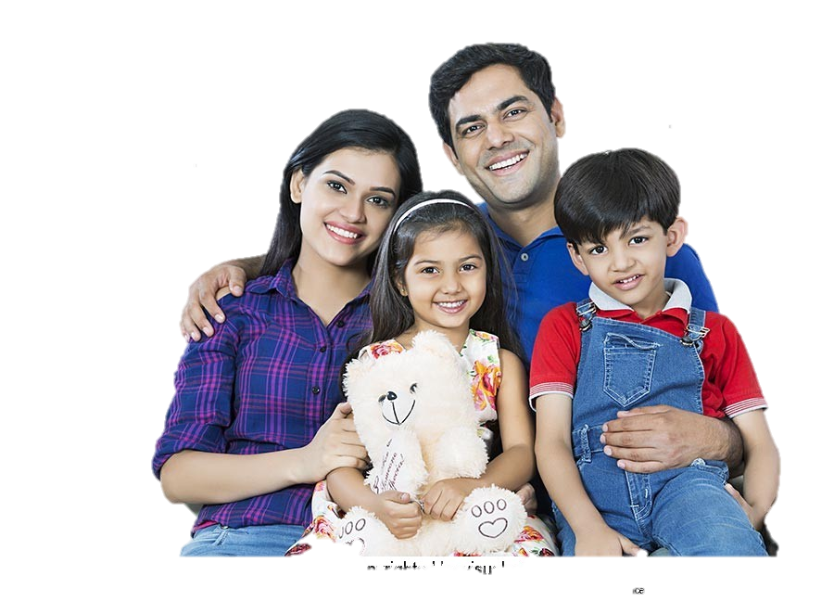
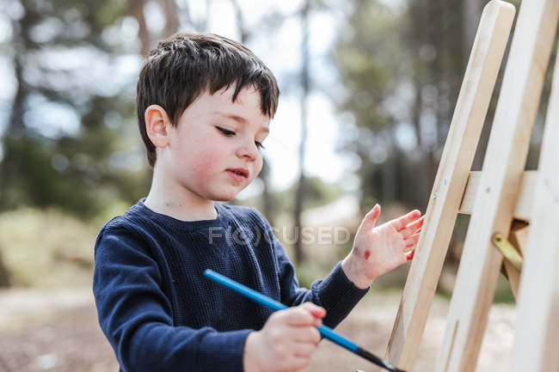
To pass time in a particular way.
Spend
ব্যয় করা
A child of aunt or uncle.
Cousin
চাচাতো/খালাতো ভাইবোন
Time when we are not working.
Leisure
অবসর

Slide 16
Make sentences
IW
Reporter
My brother is a Reporter.
Magazine
I like to read English Magazine.
Pleasure
I get pleasure to see the cartoon.
Leisure
In my leisure time I draw picture.
Sure
Sure I read the book.

Slide 17
Student’s Silent Reading

Slide 18
Student’s Chain Drilling.
Tamal: Hi my friend! Nasreen and I are reporters for the English Club Magazine. Would you mind answering some questions ?
Sima : Sure. No problem. It’s my pleasure.
Tamal: Could you tell me your name and which class are you in?
Sima: I’m Sima. I’m in class 5.
Tamal: How do you spend Your leisure time, Sima?
Sima: Well I like to walk in the park. I also like to sing. My couse lives in the UK. Sometimes, I talk to her and her friends on the internet.
Nasreen: So, talking on the internet keeps you connected.

Slide 19
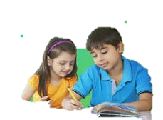
Group work
Group-A
Who are the reporters?
Group-B
What does Sima do in her leisure time ?
Group-C
Which magazine are they reporting for?
Someone from the group, please write the answer in the box

Slide 20
Pair work
Write True for correct statement and False for incorrect statement
Let’s click on the sentences to know the answer
a) Sima is in class 8.
False
b) Nasreen and Tamal are reporters.
True
c) Sima likes to walk in the park.
True
d)Sima’s parents lives in UK.
False
e) Sima talk to her teacher on the internet.
False

Slide 21
Match the words of column A with the similar meaning of Column B. Two extra meaning are given in column B.
Column A
Column B
a) Reporter
i) a without any doubt.
ii) go or come to see something .
b) Leisure
iii) something liked by somebody.
c) Cousin
a person who collects information for a
Newspaper.
d) Like
e) Sure
v) the time when we do not work.
vi) To enjoy something .
vii) Child of one’s uncle or aunt. .

Slide 22
Evaluation
Rearrange the words to make a meaningful sentence:
a) pleasure, my, it’s .
It’s my pleasure.
b) UK, cousin, lives, my, the, in.
My cousin lives in the UK.
c) in, I’m, 5, class.
I’m in class 5 .
d) talk, I, to, internet, the, on, her.
I talk to her on the internet.
e) park, like, I, to, the, in, walk.
I like to walk in the park.

Slide 23
One day one word
Conected
সংযুক্ত/যুক্ত রাখা
Joined together.

Slide 24
Home work
What you do in your free time? Write 5 sentences.

Slide 25
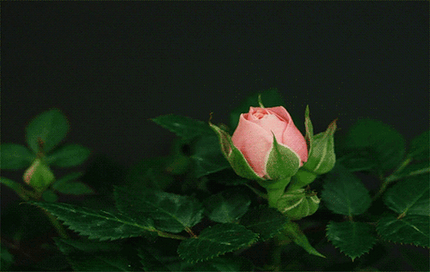
Good bye

