Slide 2
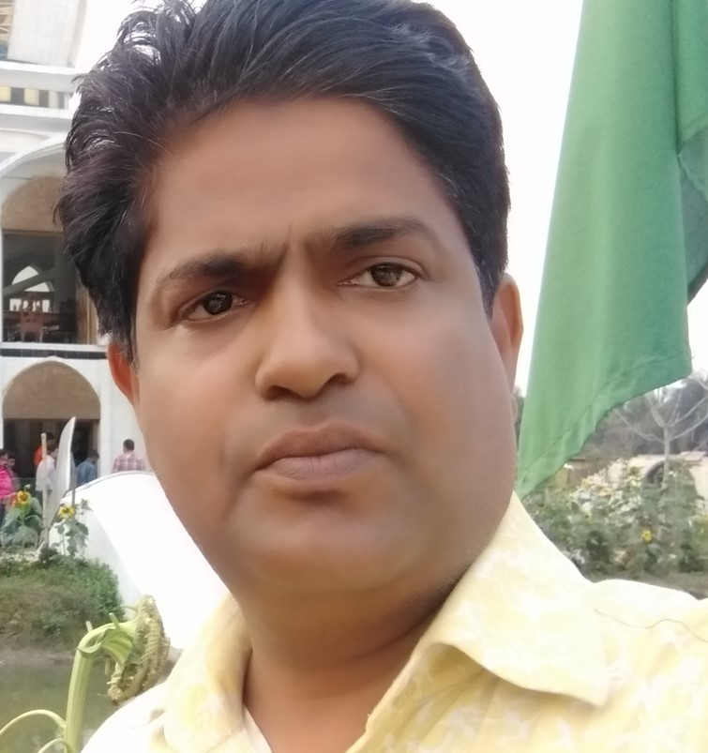
Teacher’s Identity
Md Jahid Hossen Khan
Head Teacher
Rajihar Govt. Primary School
Agailjhara , Barishal .
Mobile : 01714564933

Slide 3
Class: One
Subject: English

Slide 4
Learning outcomes
Students will be able to
1.1.1. become familiar with English sounds by listening to common English words .
Listening
1.1.1. repeat after the teacher simple words and phrases.
Speaking
1.1.2 say simple words and phrases.

Slide 5
Let’s watch the video

Slide 6
Today’s Lesson
Unit:13
Lesson: 1-3
Topic: Rhyme
Activity : A

Slide 7
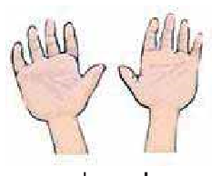
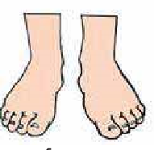
Repeat after me
Hands
Feet

Slide 8
eyes
head

Slide 9
Look and Say

