Slide 1
Assalamu Alaikum
Welcome to English Class

Slide 2
Nazma Akter
Assistant Teacher
Trishal Govt. Primary School
Trishal, Mymensingh

Slide 3
Today’s Topic
Class – 3
Unit – 3
Lesson – 4 to 6
Page – 7

Slide 5
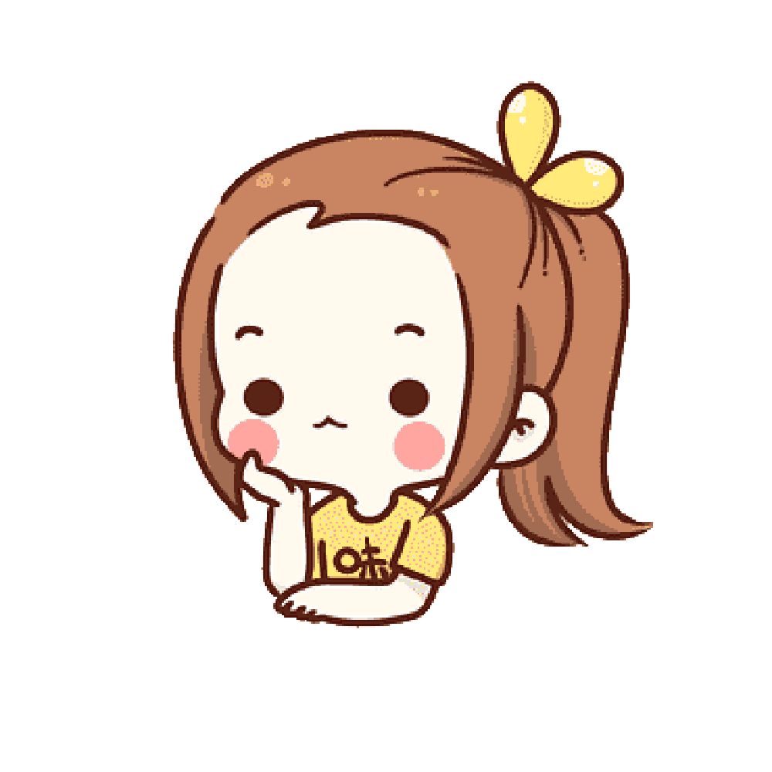
Would you like to
play with me?
Yes. I’d like that,
Thank you.
Sorry, but I can’t.

Slide 6
Answer to the questions
1. Where do you live in?
2. Would you like come
to My house?
3. Would you like to play
With me?

Slide 7
New Words
Live
Near
Would
Like
Sorry
But
With
Invite
Partner

Slide 8
Homework
Live
Near
Would
Like
Sorry
But
With
Invite
Partner
Words

Slide 9
Good day to all of you
Good Bye

