Slide 1
WELCOME

Slide 2
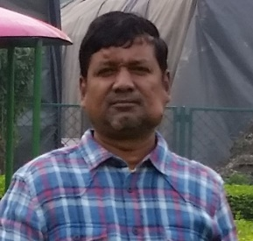
IDENTITY
Teacher
Lesson
Shah Mohammad Lutful Haider
- Assistant Teacher
LUTFUNNESA BALIKA BIDDANIKETON
PAGLA, GAFARGAON
English For Today
Class : Six
Unit : one
Lesson : 14

Slide 3
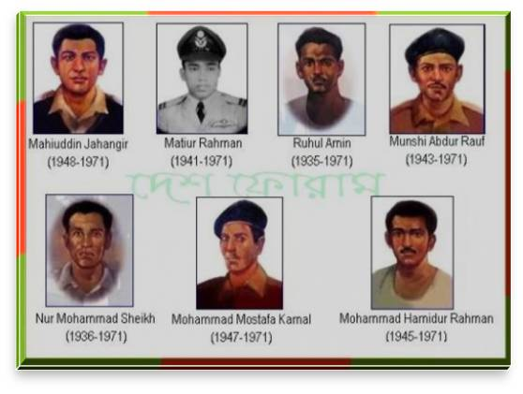
Look at the picture: Do you know them ?
They are freedom fighters (birsarestho) and our pride.

Slide 4
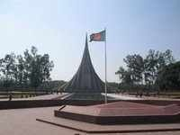
Lesson Declaration
OUR PRIDE

Slide 5
Learning Outcomes
After completing this lesson students will be able to ..
1
read and understand texts
2
ask and answer questions
3
write short paragraph
4
participate in short dialogues and conversations on familiar topics

Slide 6
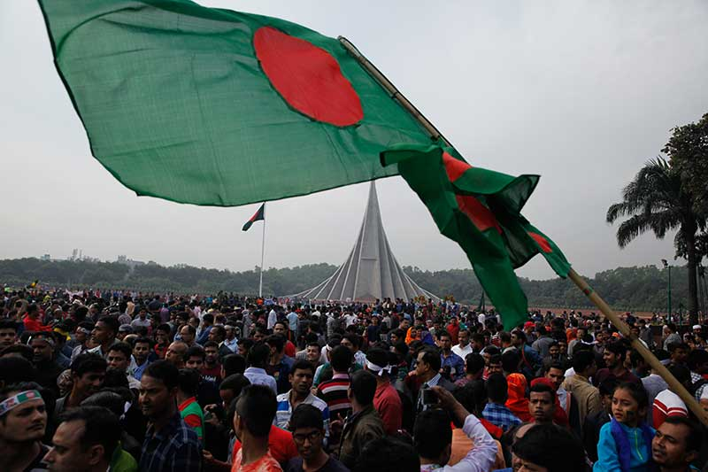
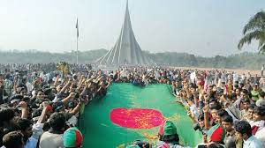
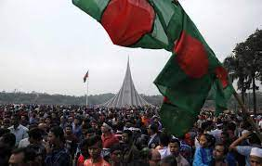
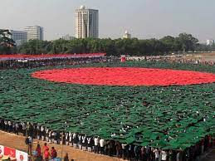
They are celebrating our Victory day.
What are they doing?

Slide 7
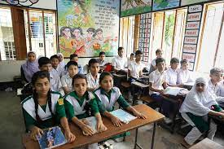
Go to the section – A and listen the passage attentively then go to section A1 and solve the task.
Notes:
After completing the reading teacher will give the task slide no 9.

Slide 8
Section – A1, Individual Work
(Match the words with their meanings)
Culumn – A | Culumn - B
unforgettable | Revolution
Independence | Falling on
Celebrate | Sacrificial victim
Swooped | Freedom
Revolt | Memorable
Martyrs | Make famous / party.
Notes:
Teacher will throw the slide for the ss. At first ss will try to solve then teacher can give the feedback by arrow. If it is possible teacher can go to the section A1 for more exercise using blackboard.

Slide 9
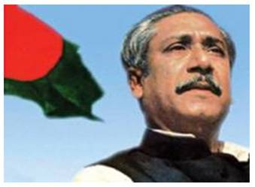
Look at the picture, do you know him ?
Bangabandhu Sheikh Mujubur Rahman who declared the independence of Bangladesh.
Notes:
At first teacher will show the picture and try to get answer form students then he can give feedback.

Slide 10
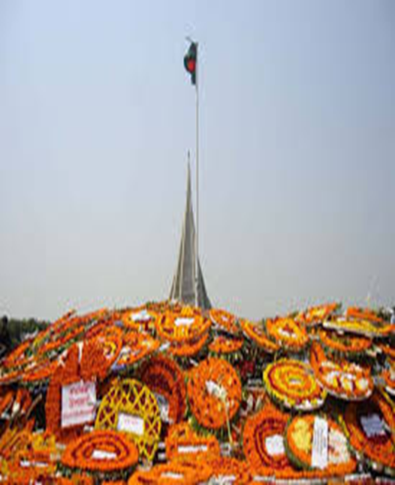
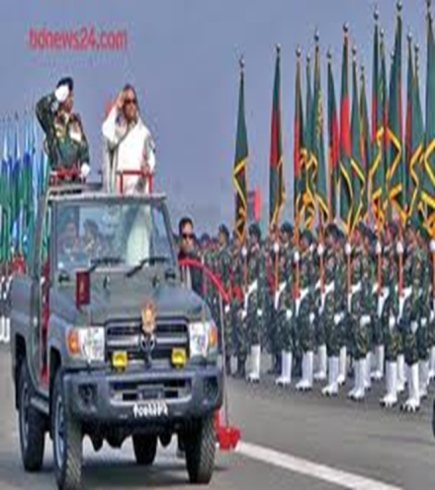
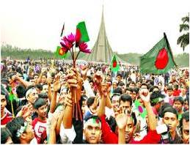
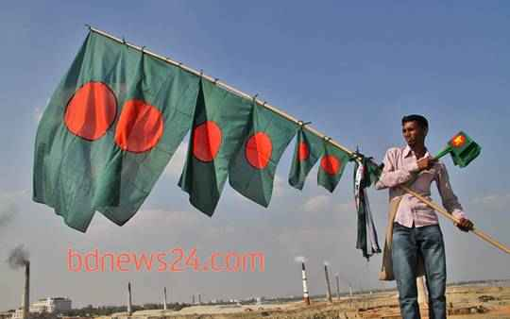
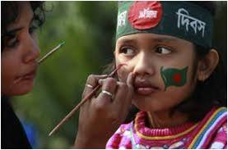
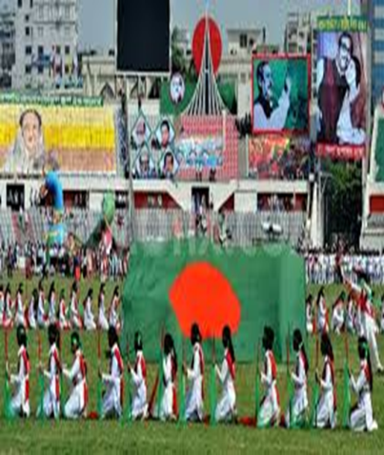
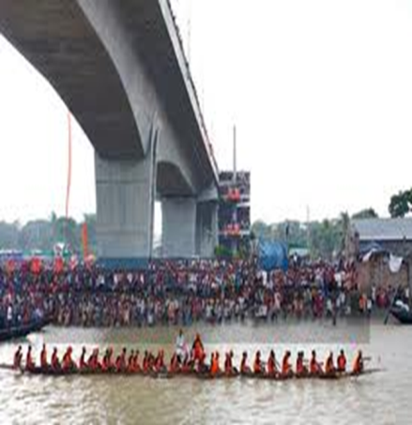
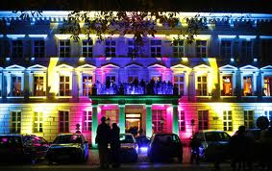
Presentation : Our pride
Now 26 March is our Independence day which we celebrate annually with pride and joy.
Notes:
Teacher can discuss about the above pictures, how we celebrate our independence and victory days.

Slide 11
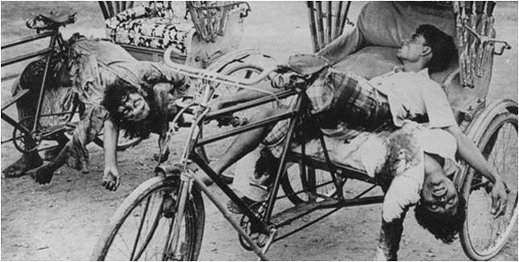
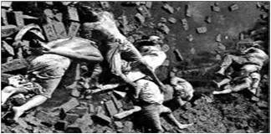
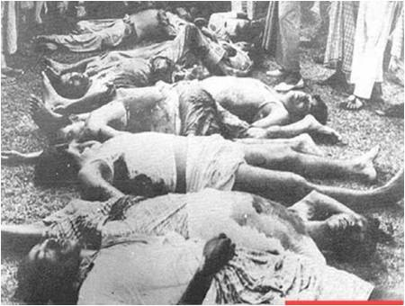
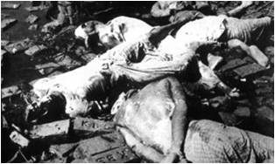
Presentation : Our sorrow and grief
March is also a month of sad memories for us. On the 25th March 1971, in the darkness of the night, the Pakistani army swooped down upon and killed many unarmed men, women and children in Dhaka.
Notes:
Teachers can discuss about the above pictures.

Slide 12
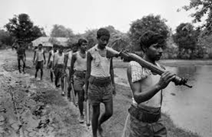
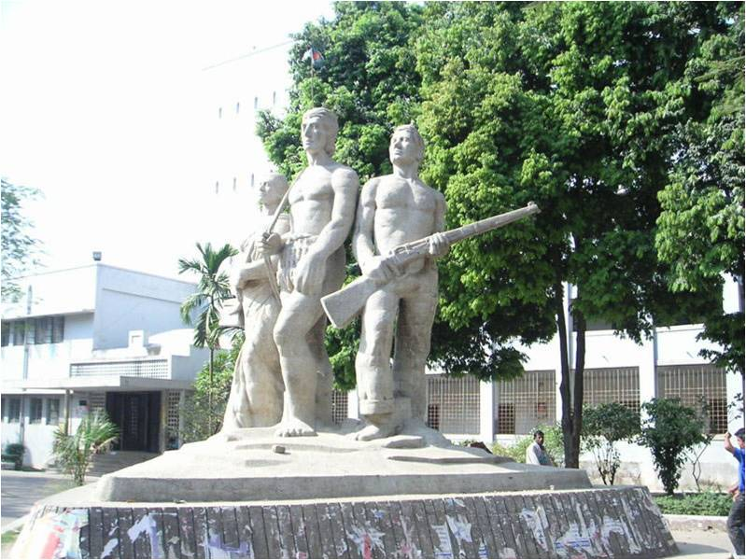
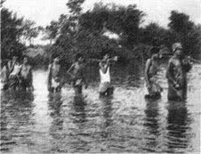
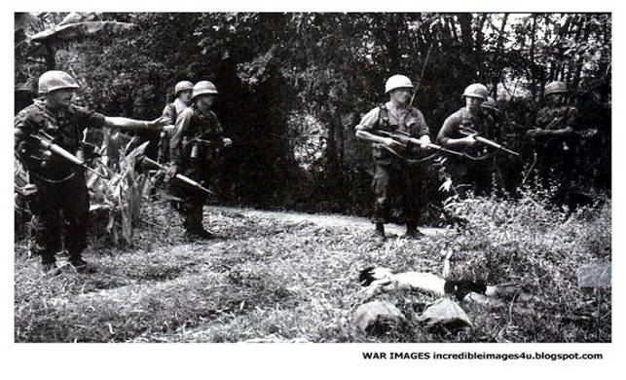
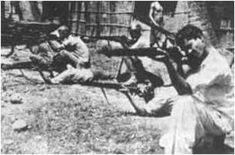
Presentation : Our pride.
However, the Bangladesh soon rose in heroic revolt and war of liberation began.
Notes:
Teachers can discuss about the above pictures.

Slide 13
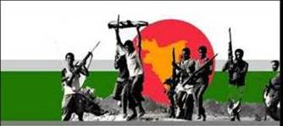
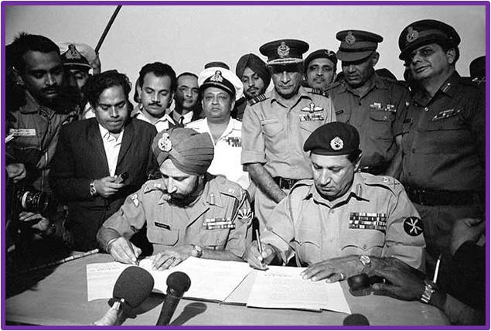
VOCABULARY
Try to make sentence with the following words:
Victory
December 16 is our Victory Day.
Surrender
On 16 December `71 the Pakistani army surrendered unconditionally.
Notes:
First, the word will be shown, SS will be asked to pronounce the word. If it needed teacher will help. Then the picture will be shown and asked to guess the meaning. After that the meaning will be shown. Then they will be asked to make sentence. Teacher will show the students for the feedback.

Slide 14
Vocabulary
War
We achieve our freedom after a war.
Martyrs
We should pay our deep respect to the martyrs.
Notes:
First, the word will be shown, SS will be asked to pronounce the word. If it needed teacher will help. Then the picture will be shown and asked to guess the meaning. After that the meaning will be shown. Then they will be asked to make sentence. Teacher will show the students for the feedback.

Slide 15
Pair works
Read the text again then
ask and answer with your partner :-
Why 25 march is often called “The dark night” ?
Notes:
Teacher can ask pair by pair in front of class for evaluation.

Slide 16
Individual/Pair work
Look at the above pictures and write a few sentences about our liberation war.
Notes:
Teacher can shortly discusses about the pictures. Teachers also can take orally.

Slide 17
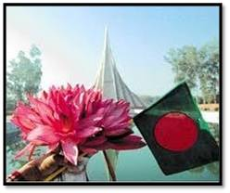
Home Work
Take a interview from a freedom fighter of your locality about our liberation war.
Notes:
Teacher can give some instructions about the home work.

