Slide 1
Fatehnagar Wadudia Fazil Online Madrasah

Slide 2
WELCOME
Good Morning
Ismat Jahan Ruma Assistant Teacher, English Fatehnagar Wadudia Fazil Madrasah
Raozan,Chattogram.

Slide 3
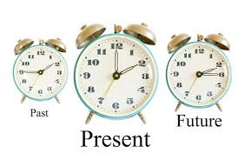
What do you see in the picture?

Slide 4
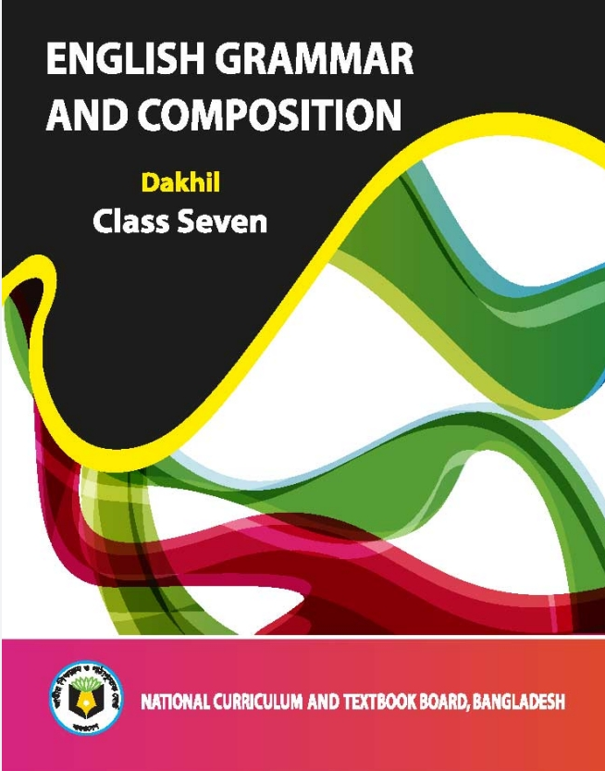
Unit - Three

Slide 5
Learning Outcomes :
After the lesson students will be able to :
understand the tense of verb.
Identify the past tense of
verb of sentences.
Use right form of verb by using structure of past tense.

Slide 6
Tense
Present
Future
Past

Slide 7
Forms of verb
Five Forms
Base Form
Past Form
Past Participle
S/ es Form
Ing Form
V1
go
do
V2
went
did
V3
gone
done
V e/es
goes
does
V ing
going
doing

Slide 8
Past Tense
We use past tense to describe an action that has already happened .
Ex :
I walked to work today.
She arrived late to school.
I ate my lunch in the cafe.
I saw my friend in the shop.
Here walked ,arrived ,ate ,saw
Are the past form of verb .All the activities
That had happen in the past.

Slide 9
Types of Past Tense
Indefinite
continuous
Perfect
Perfect Continuous

Slide 10
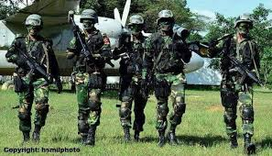
Past Indefinite Tense
We use past indefinite tense to express an action in the past or that was completed before the time of speaking.
Ex :
The soldiers fought the war bravely.
Here the soldiers have
already fought the war
Runa won the first prize.
Here Runa has already
won the prize

Slide 11
Past Indefinite Tense
Structure :
Subject + v2+ object.
Rahim wrote a letter.
Here the sentence indicate that the letter is already done by Rahim.

Slide 12
Past Indefinite Tense
Structure :
Subject + v2+ object.
He went for movie.

Slide 13
Past Indefinite Tense
Structure :
Subject + v2+ object.
Runa did her work honestly.
Here the sentence indicates that the work is already done by Runa

Slide 14
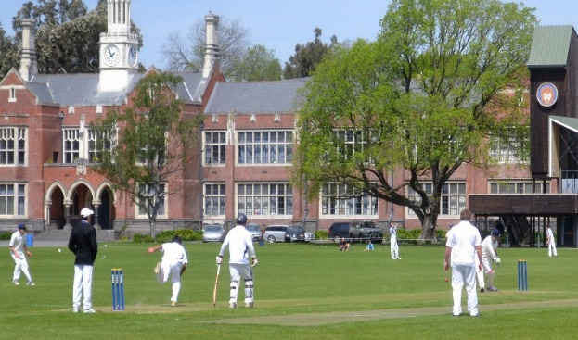
Past Continuous Tense
Past Continuous tense is used to describe a
past action that was on-going. It shows an action
being in continuing at some particular time in the past.
EX:
I was going to Madrasah.
He was looking for the last train.
.
Here the action of going,looking,playing were still in continuing.
They were playing cricket when
my mum called me..

Slide 15
Past Continuous Tense
Structure :
Subject +was / were + main verb( ing )+object.
I was writing a letter.
He was writing a letter.
Rahim was writing a letter.
They were writing a letter.
The boys were writing a letter.
I ,She , He,It. | We, They ,you.
Was | Were

Slide 16
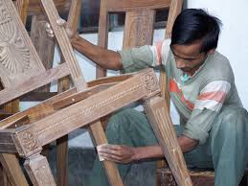
Past Continuous Tense
Structure :
Subject +was / were + verb( ing )+object.
The carpenter was mending the chair.
Singular

Slide 17
Past Continuous Tense
Structure :
Subject +was / were + verb( ing )+object.
The farmers were working in the field.
Plural
Here the farmers were working in the past and no longer working.

Slide 18
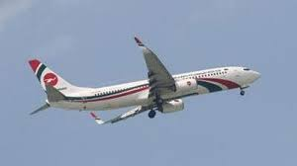
Past Perfect Tense
Past perfect tense is used to describe an action that was finished before another past action.
The rain had stopped when we went out to attend the meeting.
Here The rain has stopped before we went out. The action of stopping of rain completed before the action of going out.
The plane had left before we reached the airport.
Here both the actions happened in the past.

Slide 19
Past perfect Tense
Structure :
Subject + had + v3 + object.
The plane had left before we reached the airport.
Past perfect tense
Simple past tense

Slide 20
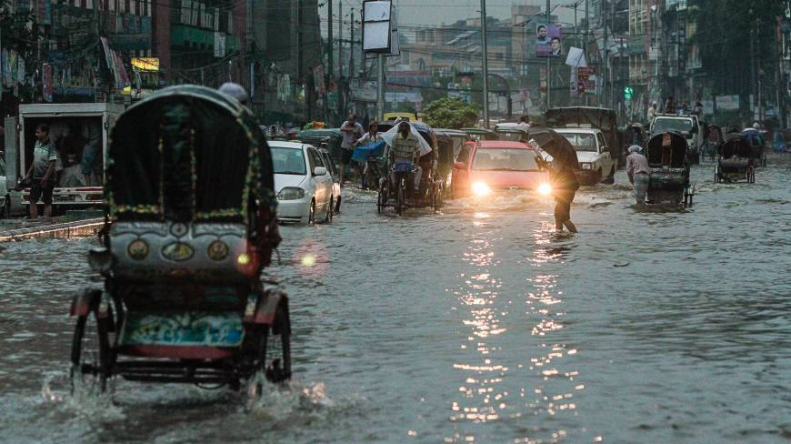
Past Perfect Continues Tense
This tense is used to describe an experience or an action that started in the past and continued till another action or time in the past.
Ex :
He had been preparing dinner when I arrived home.
It had been raining all day ,so I could not walk to work.

Slide 21
Past Perfect Continues Tense
Structure :
Subject + had been + verb( ing ) + object + Extension .
Rana had been writing a letter.

Slide 22
Evaluation:
Tell me the types of past tense? What are they?
What is the Structure of past continuous tense?
What is the auxiliary verb of past perfect tense?

Slide 23
Home task:
Use the correct form of verbs.
The sun(shine)when we went out.
I (eat)my dinner when you phoned.
I (go) there yesterday.
My uncle (visit) Europe when he (be) a job in England.
He had(write) a letter.
When you came, I (write).

Slide 24
Thanks To All

