Slide 1
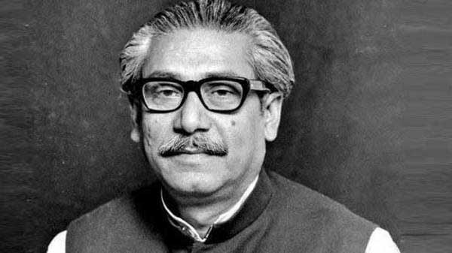
Welcome my dear students

Slide 2
INTRODUCTION
Md. Khalilur Rahman
Assistant Teacher (English)
Gaibandha Govt. Girls’ High School
Mobile No 01718935913
Email - rkhalilur03@gmail.com

Slide 3
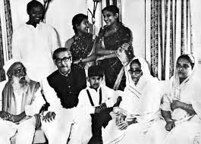
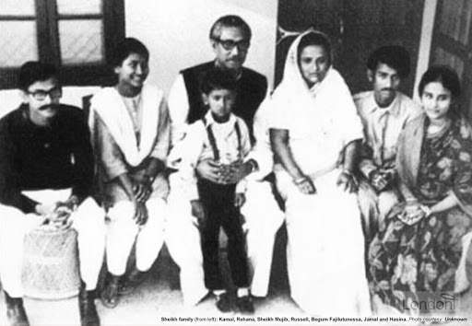
Who can you see in these pictures?

Slide 4
Today our topic is--
Bangabandhu’s Family in 1971

Slide 5
Learning outcomes:-
After studying this unit students will be able to ---
Describe the ways how the Pakistani Army tortured Bangabandhu’s family.
Describe the sufferings of Bangabandhu’s family during liberation war.

Slide 6
Let us listen to the audio

Slide 7
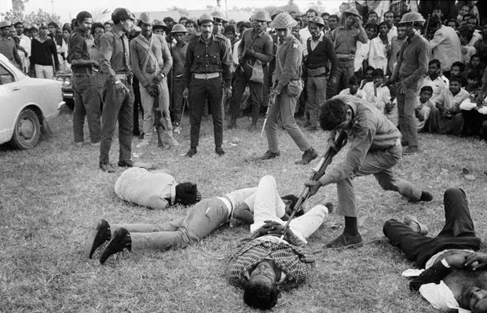
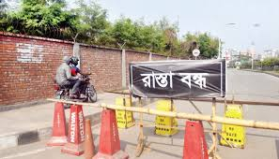
Word Meaning
Miserable
Tragic
We saw some tragic sceneries
Obstacle
Barricade
Sheikh Kamal was busy to barricade the Pakistan Army

Slide 8
Word Meaning
Concealment
Disguise
Sheikh Kamal came to his family in disguise
Belongings
Things
Begum Mujib packed the belongings

Slide 9
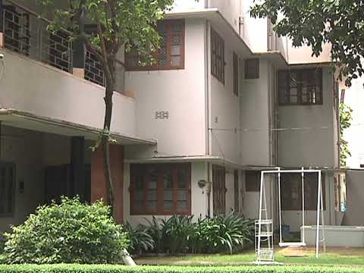
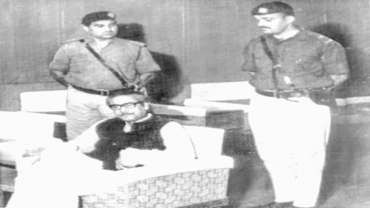
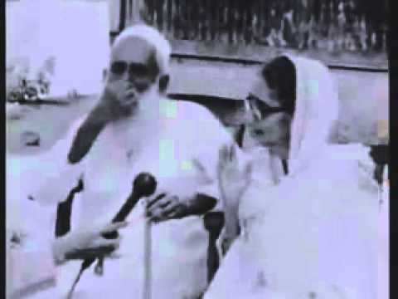
Let us see some pictures
Dhanmondi 32 No House
Captivity
Bangabandhu’s parents

Slide 10
Individual Work
List the five ways how Pakistani Army tortured Bangabandhu’s family.

Slide 11
Suggested Answers
Compel the family to leave house no 32 with their children and other members of their home.
2. To keep them under house arrest at Dhanmondi house no 18.
3. To set fire to Bangabandhu’s Tungipara house in front of his parents.
4. Begum Mujib was not allowed to be with her daughter Sheikh Hasina at hospital.
5. Sheikh Jamal was threatened to hang upside down.

Slide 12
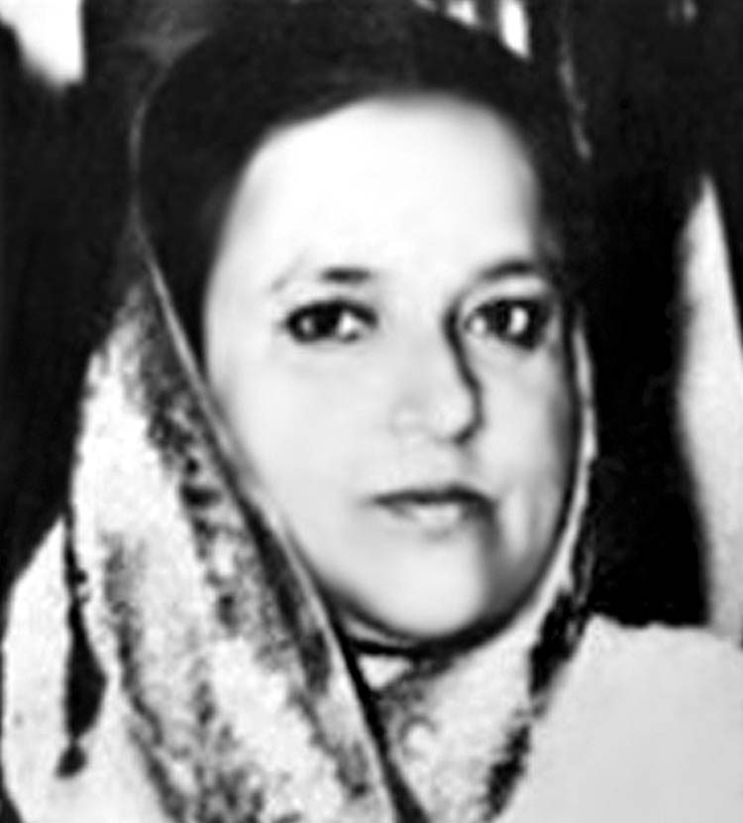
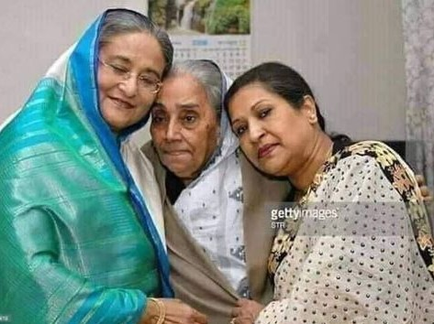
Bangabandhu’s family members
Sheikh Hasina, Sheikh Rehana and Khadija Hossain Lily (Bangabandhu’s youngest sister)
Begum Fazilatunnesa Mujib

Slide 13
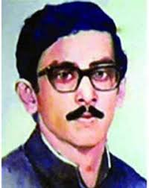
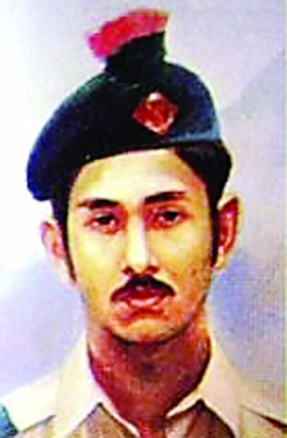
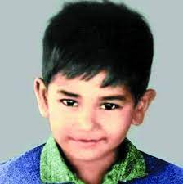
Bangabandhu’s family members
Sheikh Kamal
Sheikh Jamal
Sheikh Rasel

Slide 14
Pair Work
Make a dialogue about the sufferings of Bangabandhu’s family during liberation war (Do not look at book)

Slide 15
Suggested answers
Stdudent 1 : Hello, friend . What do you know about the sufferings of Bangabandhu’s family during liberation war?
Student 2: Well , after declaring the independence of Bangladesh , Bangabandhu was arrested by the Pakistani Army and was sent to the prison of Pakistan. They also compelled the family to leave house no 32. Then the family moved from one place to another for a safer shelter for two months. At that time some people helped them with money and food stuff, while some other refused to help.
Student 1: You are right. But soon the family was kept under house arrest at Dhanmondi house no 18. Not only that the Pakistani Army set fire to Bangabandhu’s Tungipara home in front of his parents.

Slide 16
Student 2 :What a cruel incident! The Pak army also did not permit
Begum Mujib to be with her daughter Sheikh Hasina in
the hospital. Besides they often used to threaten Sheikh
Jamal to hang him upside down.
Student 1: Really Bangabandhu’s family suffered a lot during
liberation war.
Student 2 : Of course. Because of their sacrifice we got independent
Bangladesh.
Student 1: Obviously. Thank you.
Student 2 : Welcome.

Slide 17
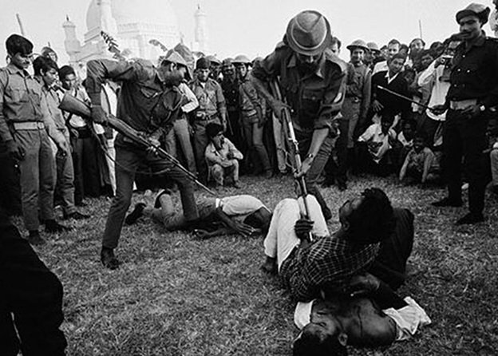
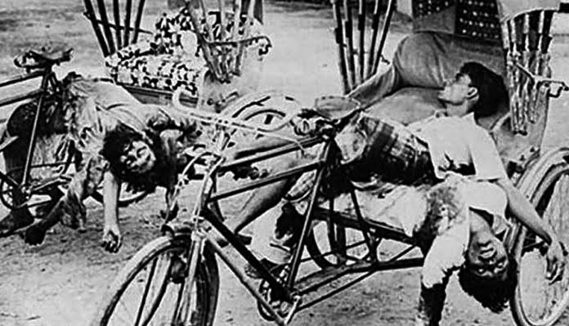
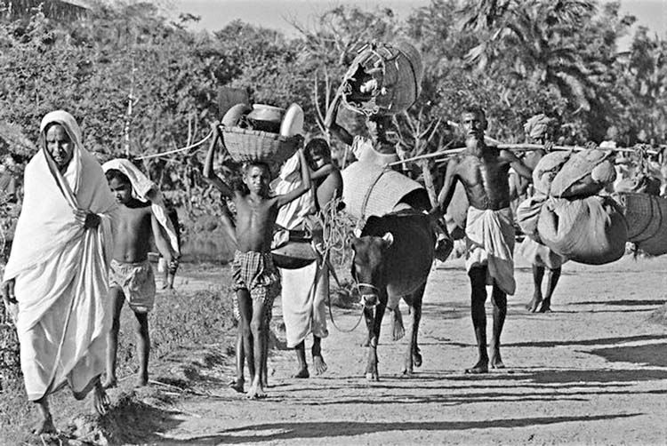
Let us see some pictures
Torture
Genocide
In search of shelter

Slide 18
Home Work
Write a short paragraph on “ The sufferings of people during Liberation War”

Slide 19
ALLAH HAFEZ

