Slide 1
WELCOME

Slide 2
Teacher’s Identity
Md. Reajul Islam
Assistant Teacher
Arajiniamot Govt. Primary School
Gangachara , Rangpur.
E-mail: reajatgps1992@gmail.com

Slide 3
Lesson Identity
Subject : English
Class : Five
Unit : 1
Lesson :1-3 (Hello!)
Part of the lesson : A&B (Sima: Hello! May…………… too, Sima.)
Time : 40 minutes.
Date : 24.05.2021

Slide 5
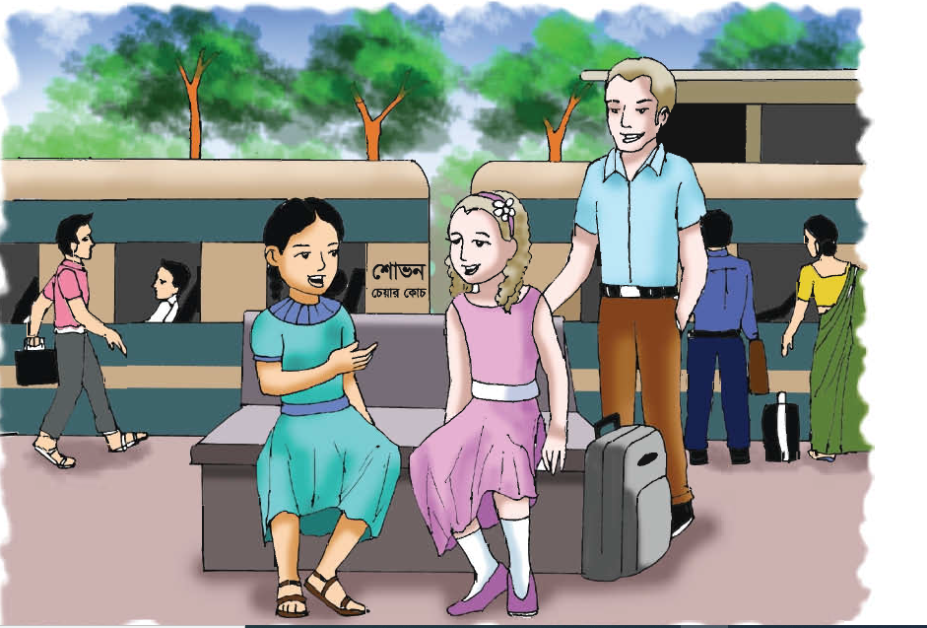
Let’s see the picture

Slide 6
Today’s Lesson
Hello!

Slide 7
New words
Introduce
পরিচয় করানো
Make known
Really
সত্যি!
Truly
Holiday
ছুটি
Vacation
Getting to know
Meeting
দেখা হওয়া
Departing
Leaving
ছেড়ে যাবে

Slide 8
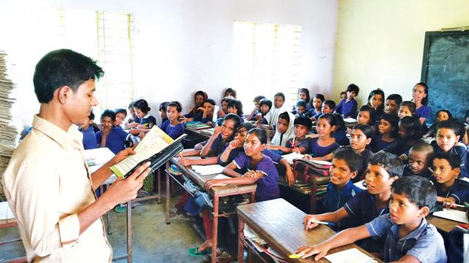
Teacher’s reading

Slide 9
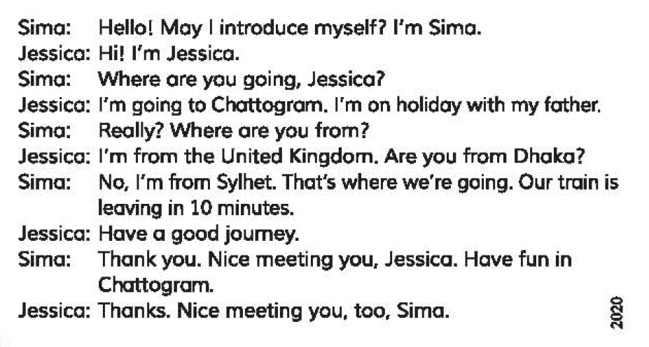

Slide 10
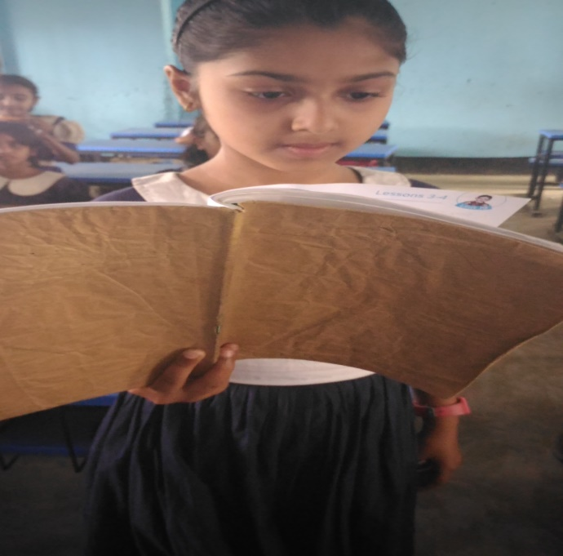
Student’s Reading
Let’s read by change role.

Slide 11
Pair work
Answer the following questions:
a. Where is Jessica from?
b. When is Sima’s train leaving?
c. Where are Sima and Jessica?
d. Where is Sima going?
e. Why has Jessica come to Bangladesh?

Slide 12
Group work
Group: Rose
Write True for correct statement and False for incorrect statement:
a. Jessica is from UK.
b. Sima lives in Dhaka.
c. Sima and Jessica are students.
Group: Lily
Fill in the blanks using the right words:
a. I want to ---------------- myself to you.
b. Where are you ---------- to?
c. You should have ---------- in Chattogram.
d. Jessica is on a -----------.
introduce
True
going
False
fun
True
holiday

Slide 13
Evaluation
Answer the questions
a. Where is Jessica going?
b. Why is Jessica going there?
c. Is Sima from Dhaka?

Slide 14
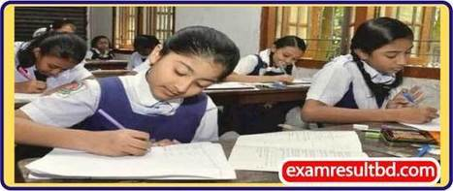
One day one word
Journey
অর্থ
ভ্রমণ
Have a safe journey.

Slide 15
Home work
Write five sentences about ‘Your Train Journey’.

Slide 16
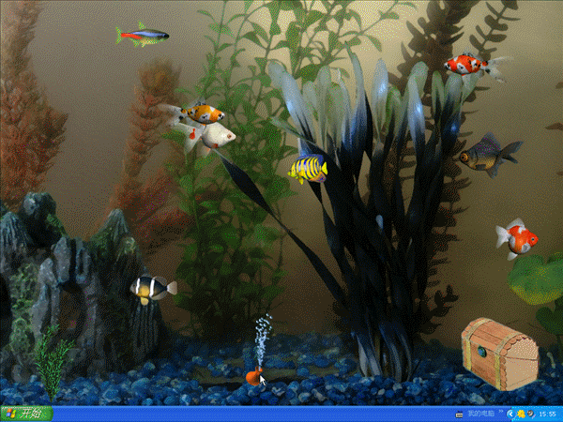
Thanks everybody

