Slide 1
Welcome

Slide 2
Identity
Md Amir Hossain (M.A,B.Ed) Head Teacher (English)
Hossapur Girls High school
Mobil No: 01714-315772
79hossainamir@gmail.com

Slide 3
Class : Nine-Ten
Subject : English 2nd Paper
Time : 40 Minutes
Date : 18/06/2021

Slide 4
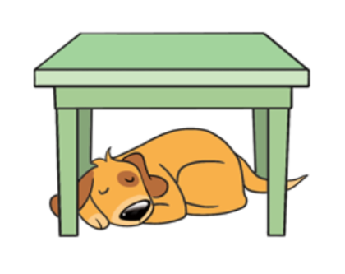
Under
On
Behind

Slide 5
Today our lesson is—
“Preposition (1)”
Class:10, Subject: English 2nd Paper

Slide 6
Learning Outcomes
After we have studied this lesson we will be able to-
What is Preposition.
How many kinds of Preposition are there.
Definition of all kinds of Preposition.
Identify the Preposition.

Slide 7
What is Preposition ?
The Preposition is a word which shows the relation between a word or a noun or a pronoun of a sentence .

Slide 8
Preposition
Simple
Participle
Compound
Double
Phrase
Disguised

Slide 9
Simple Preposition
The Preposition which consists of one word is called Simple Preposition.
Example: at, on, by, of, for, from, after, with, off, in, to etc.

Slide 10
Double Preposition
The Preposition which is consists of two simple preposition is called Double Preposition.
Example: into (in+to), within (with+in), without (with+out), Upon (up+on) etc.

Slide 11
Compound Preposition
Compound Preposition is that which usually a Simple Preposition to a noun or adjective or adverb.
In Compound preposition we will use ‘a’ in the place of ‘on’ and ‘b’ or ‘be’ in the place of ‘by’.
Example: across (on+cross), behind (by+hind), before (by+fore), between (by+twin), beside (by+side), beyond (by+yond) etc.

Slide 12
Phrase Preposition
A group of words when works like a Preposition is called Phrase Preposition.
There are a Simple Preposition before and after of a Phrase Preposition.
Example: In spite of, by dint of, in front of, in stead of, look for, by means of etc.

Slide 13
Participle Preposition
A Participial Preposition is a participle that functions as a preposition.
Example: according, assuming, during, considering, regarding, concerning etc.

Slide 14
Disguised Preposition
Disguised Prepositions are those that are not used in the sentences but are implied.
In Disguised Preposition , ‘a’ stands for the shortened form of the Preposition ‘on’ and ‘o’ stands for the shortened form of the Preposition ‘of’.
Example: It is five o’clock. ( It is six of clock )
He went a hunting. ( He went on hunting )

Slide 15
Individual Work
What is Preposition ?

Slide 16
Pair work
Write the definitions of (Simple, double, compound, phrase, participle, disguised) Prepositions with example.

Slide 17
Group work
Identify the words which prepositions are they :
Upon, on, into, beside, behind, in spite of, at, across, between, in front of, during, assuming , in stead of, according, in.

Slide 18
Write five new preposition of each group.

Slide 19
Good bye

