Slide 1
WELCOME

Slide 2
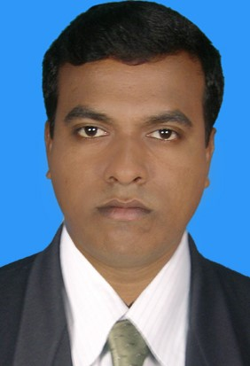
Teacher`s Identity
Krishno Pada Bormon
Assitant Teacher
Badamtala D.N. Govt.Primary School
Dacope,Khulna.

Slide 3
Lesson`s Identity
Class: Four
Subject: English
Unit-7
Lesson: 1-2

Slide 4
Learning Outcomes
Listening: 2.3.1 Respond to requests
Speaking: 6.2.1 Talk about people,objects,events etc.

Slide 5
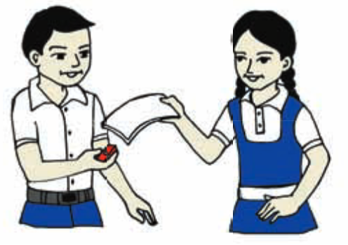
Look at the picture and say about it

Slide 6
Lesson Declaration
Making Requests

Slide 7
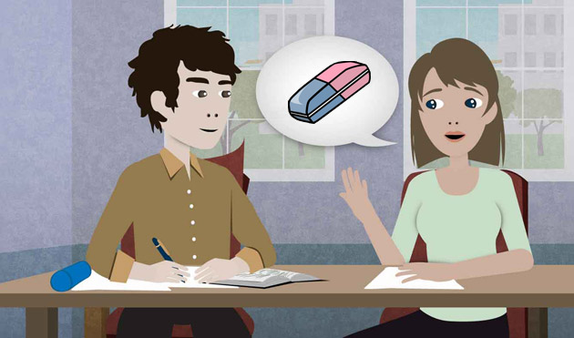
Girl: Excuse me.Can I borrow your eraser?
Boy: Sure.Here you are..

Slide 8
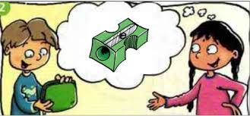
Girl: Thanks.Can I use your sharpener,too?
Boy: I`m sorry.I don`t have a sharpener.

Slide 9
Girl: That`s ok.Thanks anyway.

Slide 10
Boy: Could I have some paper,please?
Girl: Sure.Take it.

Slide 11
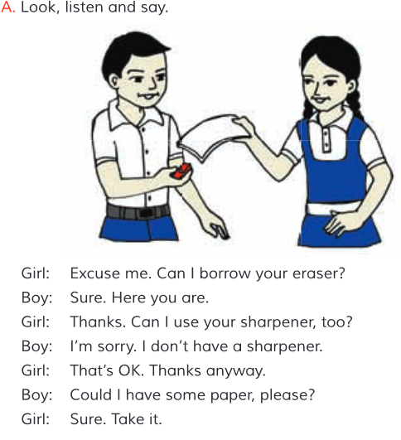
Open your book at page 14

Slide 12
Some new words and it`s meaning
Borrow
ধার করা
Sharpener
শার্পনার/পেনসিল কাটার যন্ত্র বিশেষ
Eraser
রাবার

Slide 13
Home Task
Practise this conversation with your friends and family members.

Slide 14
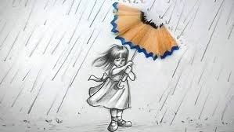
Goodbye
See you again

