Slide 1
Good
Morning

Slide 2
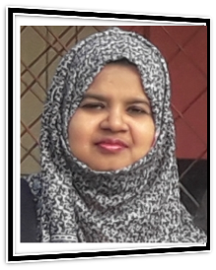
Introduction
Class: Two
Subject: English
Alphabet. Lesson:4-6
Unite : 3. Page : 7
Farjana Amin
Assistant teacher
Dhadash Govt. Pri. School
Puthia, Rajshahi.

Slide 3
Let’s watch a video

Slide 4
What are they called ?
What can you see ?

Slide 5
Today we will learn
Alphabet(Pp-Tt)

Slide 6
Learning outcomes
Students will be able-
1.1.1 to become familiar with English sounds by listen to
common English word.
1.1.2 to say simple words.
1.2.1 to recognize and read the alphabet both small and
capital (non-cursive) letters.
3.1.2 write words using non-cursive small letters.

Slide 7
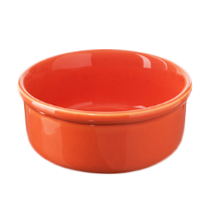
Look, listen and say
P
p
pot

Slide 8
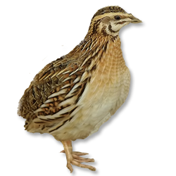
Look, listen and say
q
Q
quail

Slide 9
Look, listen and say
R
r
rose

Slide 10
Look, listen and say
S
s
Sun

Slide 11
Look, listen and say
T
t
tiger

Slide 12
Write the small letter for each letter.
p
q
P Q R S T
r
s
t

Slide 13
Loud reading by the teacher
P
S
pot
sun
Q
T
quail
tiger
R
rose

Slide 14
Match the pictures with the letters
P.W
P
rose
Q
sun
R
tiger
S
pot
T
quail

Slide 15
Rearrange the pictures according to the letters
G.W
P
Q
R
S
T

Slide 16
Read and say. Trace and write.
WCW
Rose
Quail
Rose
Pot
Quail
Pot
Sun
Tiger
Sun
Tiger

Slide 17
Look and say. Write.
Evaluation
Look at the picture and fill in the gaps
Pot
sun
quail
tiger
rose

Slide 18
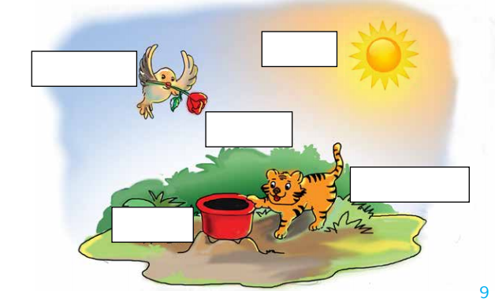
Look and say. Write.
Evaluation
sun
quail
rose
tiger
pot

Slide 19
Good bye

