Slide 1
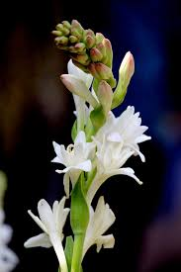
WELCOME

Slide 2
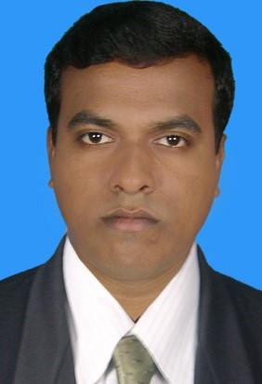
Teacher`s Identity
Krishno Pada Bormon
Assitant Teacher
Badamtala D.N. Govt.Primary School
Dacope,Khulna.

Slide 3
Lesson`s Identity
Class: Two
Subject: English
Unit-5
Lesson: 4-6

Slide 4
Learning Outcomes
Listening: 1.1.1 become familiar with English sounds by listening to common English.
Speaking: 1.1.1 repeat after the teacher simple words and phrases with proper sounds and stress.

Slide 5
Lesson Declaration
Alphabet

Slide 6
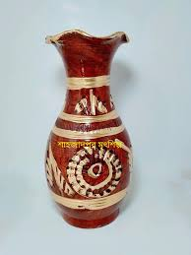
Look at the picture
Uu
Vv
Umbrella
vase

Slide 7
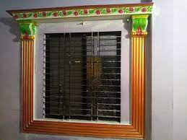
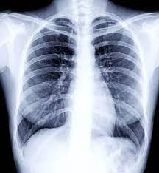
Ww
Xx
window
X-ray

Slide 8
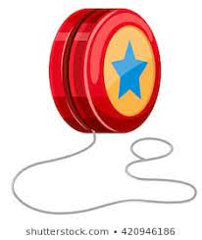
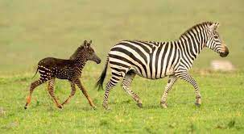
Yy
Zz
Yo-yo
Zebra

Slide 9
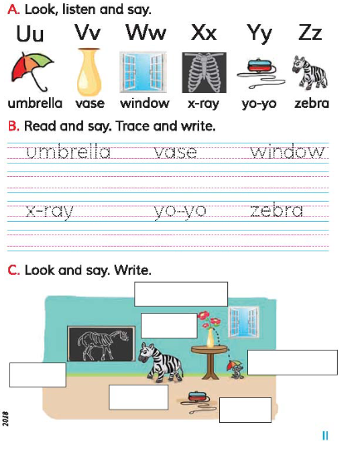
Open your book at page 11

Slide 10
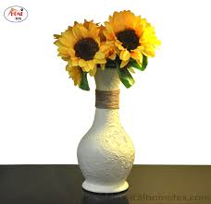
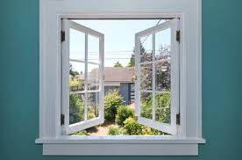
Look and say
umbrella
vase
window

Slide 11
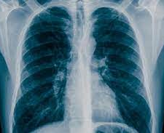
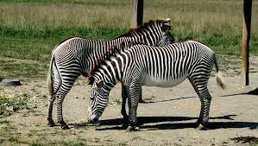
Look and say
X-ray
zebra
Yo-yo

Slide 12
Window
vase
umbrella
zebra
x-ray
yo-yo

Slide 13
Matching
zebra
umbrella
vase
window

Slide 14
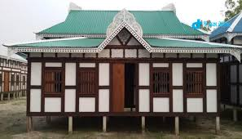
Home work
Read this word again and again

Slide 15
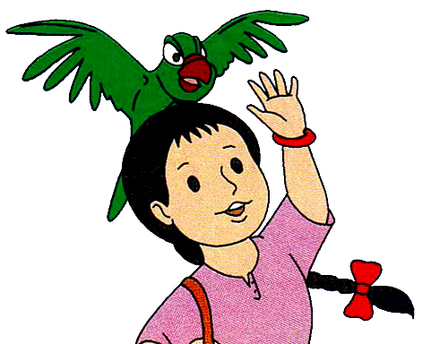
Bye bye

