Slide 3
Identity
Name: Swandip Banerjee
Desig: Assistant Teacher (English)
School: Pallimangal Secondary School, Khulna.
E-mail: swandipb1@gmail.com
Mobile No: 01718503573

Slide 4
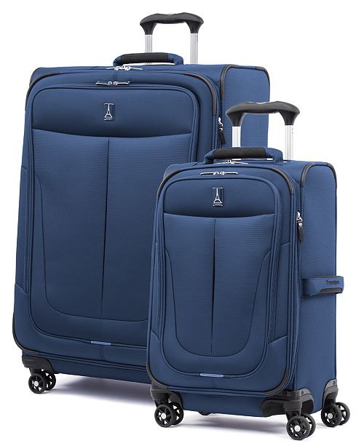
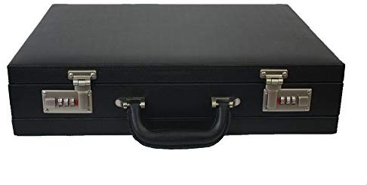
Look at the pictures and say which one is easier to move and why?

Slide 5
Our today’s lesson is...
The wheel
Unit: 09 Lesson:01

Slide 6
Learning outcomes.
By the end of the lesson students will be able to…
ask and answer questions.
read and understand text materials.
write answers to questions.
write short paragraphs.

Slide 7
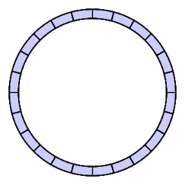
New word
having the shape of a circle.
Circular
move or cause to move in a circle round an axis or centre.
Rotate

Slide 8
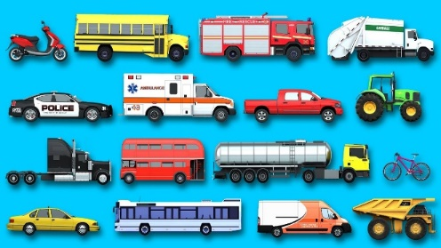
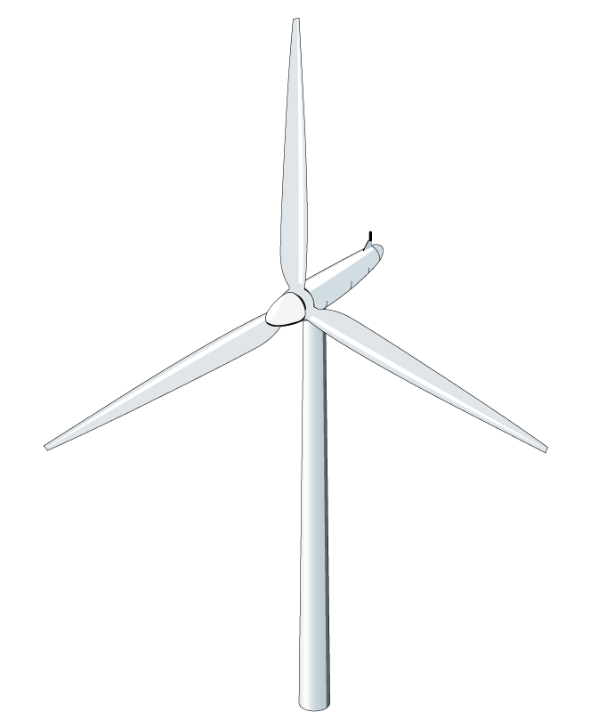
New word
Vehicle
a thing that is used for transporting people or goods from one place to another, such as a car or lorry
Turbine
Machine powered by rotating blades

Slide 9
Read the text and answer the following questions.
Questions.
What is a wheel? 2. What can a wheel do? 3. Where can you find wheels?

Slide 10
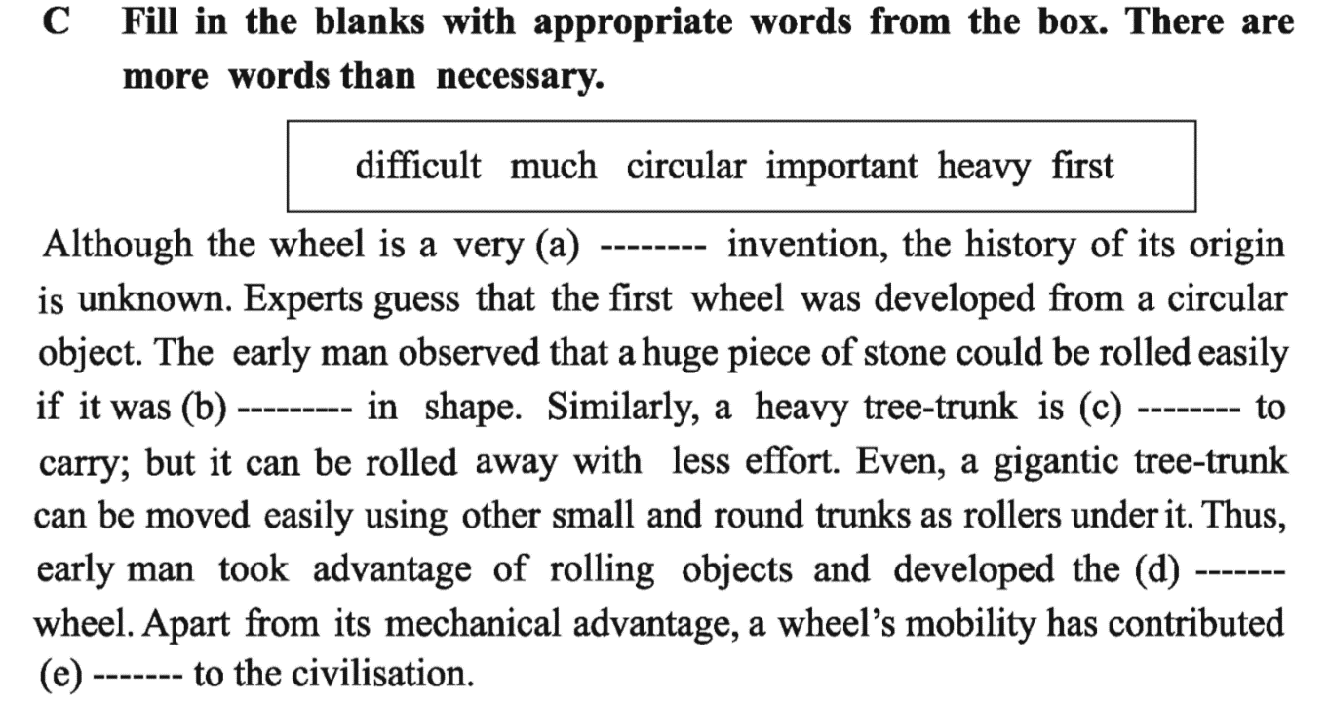
heavy, important, much, difficult, circular, first
important
difficult
heavy
circular
much

Slide 11
D. Make as many correct sentences as you can using the substitution table. In the third column there are more items than necessary.
The wheel A plain wheel It A propeller | is has rotates | a type of wheel. around its axis. one of the simplest machines. wheels on vehicles and machines. helped in rapid progress of civilization.
Answer.
The wheel rotates around its axis.
A plain wheel is one of the simplest machines.
It has helped in rapid progress of civilization.
A propeller is a type of wheel.

Slide 12
EVALUATION
What is a wheel and how it can rotate?
What can a wheel do?
Where can we find wheels?
How have human beings brought great civilisation?

Slide 13
HOME WORK

