Slide 1
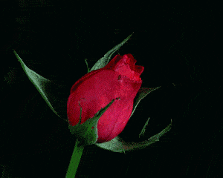

Slide 2
Introducing
China Akter
Assistant Teacher
Sholaprotima Dakhil Madrasha
Sakhipur, Tangail.

Slide 3
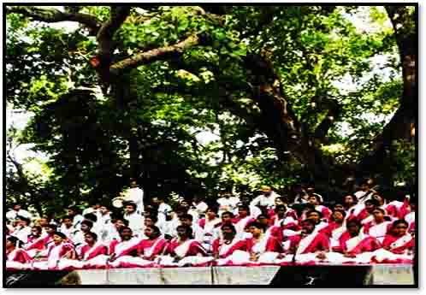
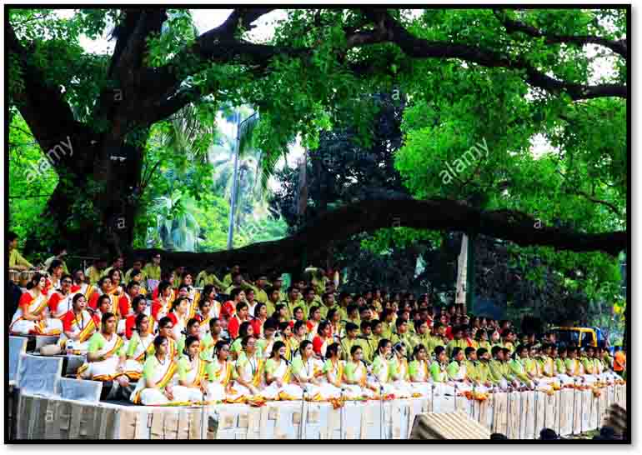
Look at picture
What’s the picture about?
Where do you think the picture was taken?
What are the people doing?

Slide 4
Heading :
Unit: Three, lesson: 6

Slide 5
Learning outcome
After we have studied this unit, we will be able to :
Talk about events and festivals
Answer to the following questions
Infer meanings from the context.

Slide 6
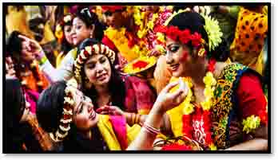
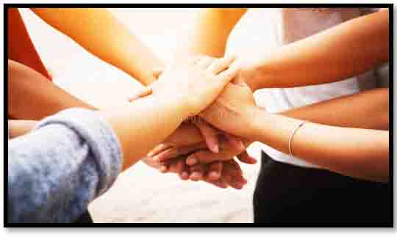
Important vocabularies
Traditionally
According to tradition
Identity
The fact of being who or what a person or thing is
Unity
The state of being in agreement or working together

Slide 7
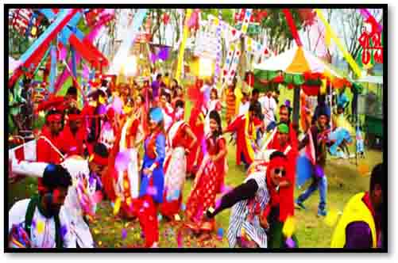
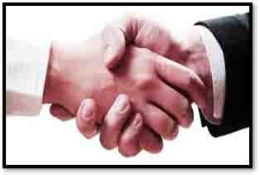
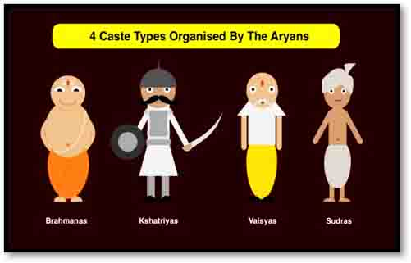
Carnival
A public festival
A strong feeling that something/ somebody exists or is true
belief
Any of the four main divisions of Hindu society
Caste

Slide 8
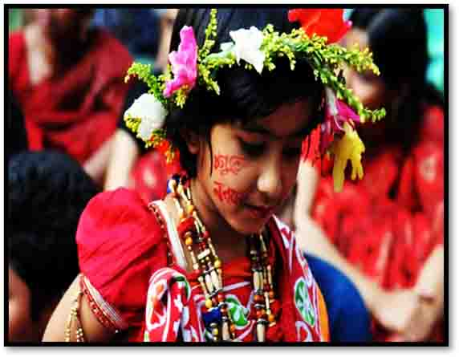
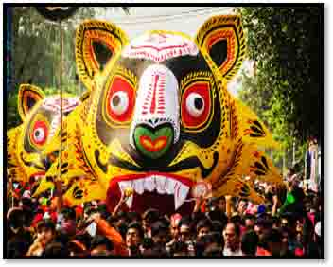
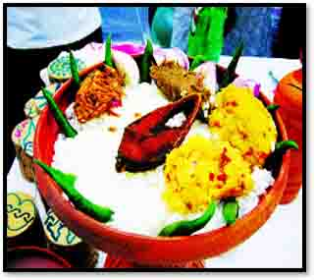

Slide 9
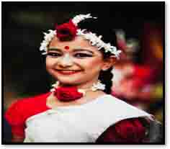
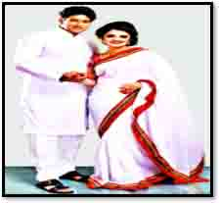
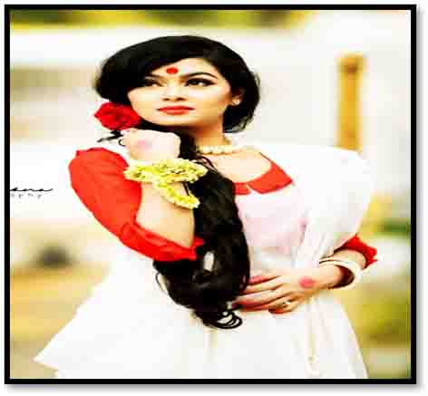

Slide 10
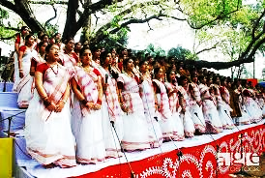
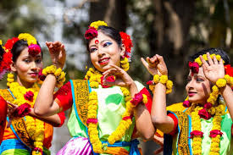
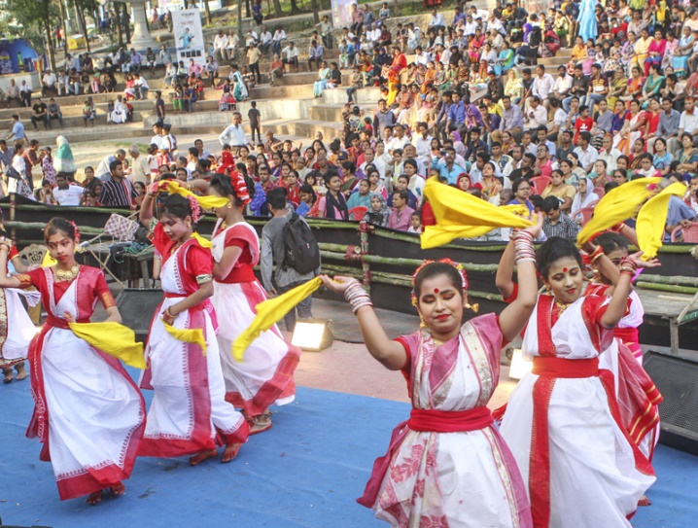

Slide 11
Answer the following questions
1. What is Pahela Baishakh?
Ans. Pahela Baishakh is the first day of Bangla new year.
2. What kind of food people eat in the Pahela Baishskh.
Ans. Usually, people eat ‘Panta Bhat’ and ‘Hilsha Fish’.
3. What do people wear in Pahela Baishakh?
Ans. People wear traditional dresses on Pahela Baishakh.

Slide 12
first
only
also
observed
festival
in
also
traditional
procession
upholding

Slide 13
Group Work
Discuss in groups What preparations you would need to hold a Baishakhi mela at your madrasha and make a list of the activities you want to have during the mela.

Slide 14
Evaluation
1. What is the first day of Bangla new year?
2. Which organization organize cultural function at Romna Batamul?
3. When do people wake up at Pahela Baishakh?

Slide 15
Home work
Write a paragraph about ‘Baishakhi Mela’ you ever seen.

