Slide 1
WELCOME TO ALL

Slide 2
NAZMUS SADAT, ASST: TEACHER
KARIA GPS
PANCHBIBI, JOYPURHAT
CLASS: One
SUB: ENGLISH
UNIT:4 Alphabet

Slide 3
LEARNING OUTCOMES
Students will be able to -
Listening
1.1.1 to become familiar with English sounds by listening to common English words.
Speaking
1.1.1 repeat after teacher and say words and phrases.
Reading
1.2.1 recognize and read the alphabet both small and capital. (non-cursive)
Writing
1.1.1 to practice letter shapes/ simple writing patterns.
1.2.1 write non cursive capital and small letters.

Slide 4
Lets watch a video
https://www.youtube.com/watch?v=SNgUoinyQUU

Slide 5
LOOK LISTEN AND SAY

Slide 6
ap
c

Slide 7
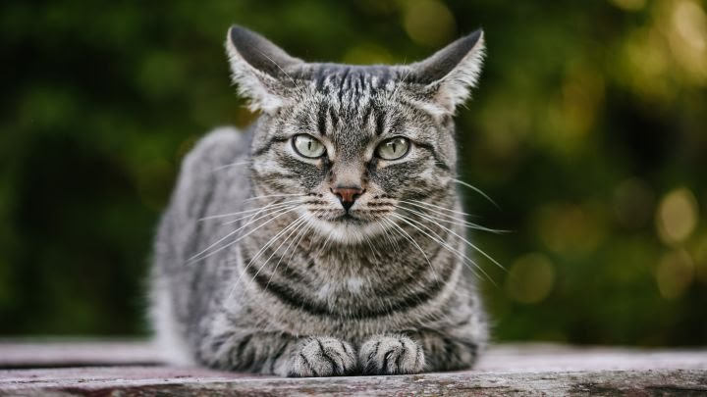
at
c

Slide 8
Lets watch a video about how to write letter ‘c’

Slide 9
--
c
ap

Slide 10
ca
---
p

Slide 11
--
c
at

Slide 12
ca
---
t

Slide 13
Practice
Trace the letter ‘c’ on your book

Slide 14
Practice
Write the letter ‘c’ on your exercise book.

Slide 16
THANKS TO ALL

