Slide 1
WELCOME TO ALL

Slide 2
NAZMUS SADAT, ASST: TEACHER
KARIA GPS
PANCHBIBI, JOYPURHAT
CLASS: One
SUB: ENGLISH
UNIT:6 Numbers

Slide 3
LEARNING OUTCOMES
Students will be able to -
Reading
2.1.1 recognize and read cardinal numbers up to 10
Writing
2.1.1 write cardinal numbers up to 10 in figures

Slide 4
Lets watch a video
https://www.youtube.com/watch?v=blBJfAb0Bbk&t=23s

Slide 5
How many caps?
2

Slide 6
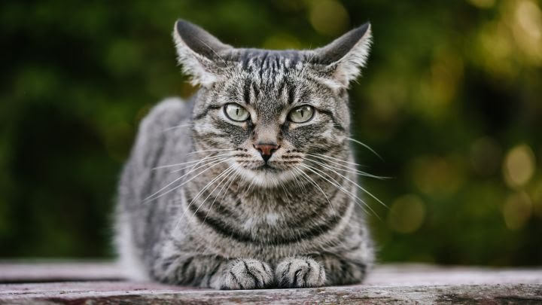
How many cat?
1

Slide 7
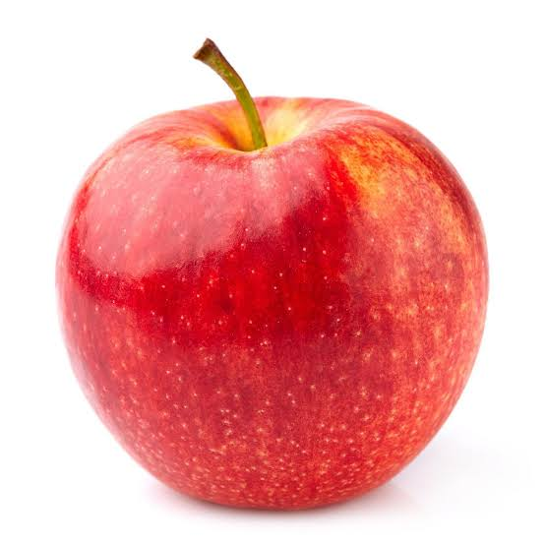
How many apples?
3

Slide 8
How many balls?
3

Slide 9
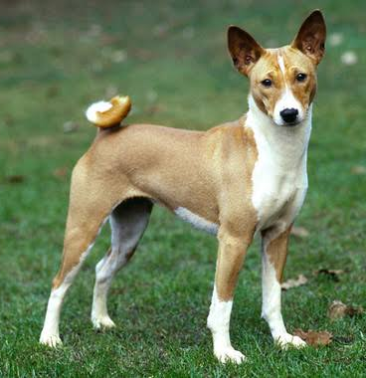
How many dog?
3

Slide 10
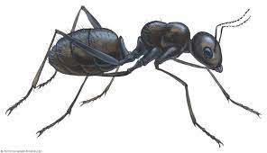
How many ants?
2

Slide 11
How many apple?

Slide 12
Lets watch a video
https://www.youtube.com/watch?v=wuxu6Qsaq5I

Slide 13
Write the numbers
1, 2, and 3

Slide 15
THANKS TO ALL

