Slide 1
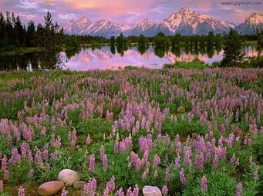
Welcome

Slide 2
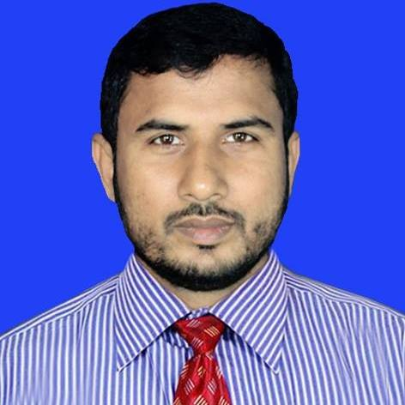
Identity
Class:7
Subject:English 1st paper
Writing part
Md. Asrafuzzaman Hanif
Asst Teacher
Baragangdia Secondary school
Daulatpur, Kushtia
Mobile No:01734219519

Slide 3
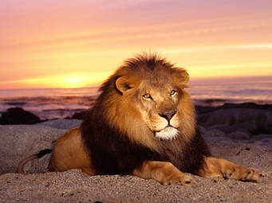
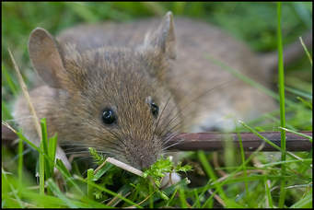
What can see the pictures?

Slide 4
Our today’s lesson is a story

Slide 5
Learning outcomes
After we have studied this lesson we will be able to……………
1.Listen information.
2.Ask and question.
3.Write a story.

Slide 6
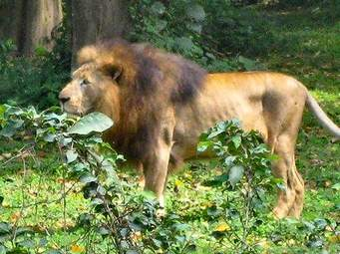
The lion and the mouse

Slide 7
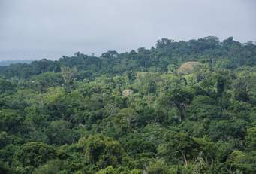
It was a deep forest.

Slide 8
There lived a big lion and a little mouse.

Slide 9
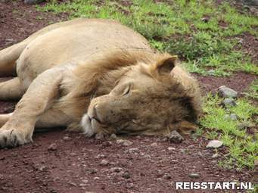
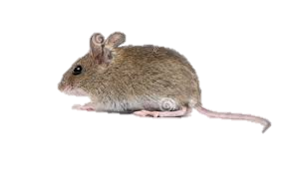
One day the lion sleeping in his den.Alittle mouse was playing near by and he by chance ran into the lion house.

Slide 10
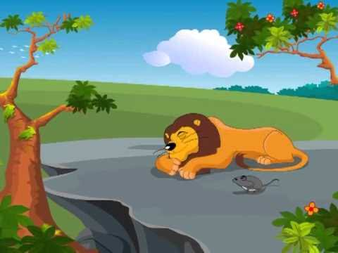
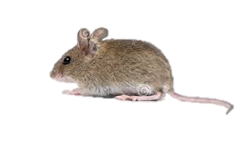

Slide 11
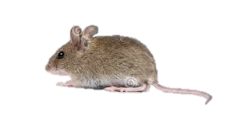
The angry lion said,”I’ll now kill you?

Slide 13
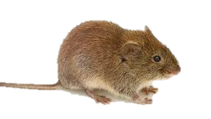
The poor mouse begged for his life to the lion and was set free.

Slide 14
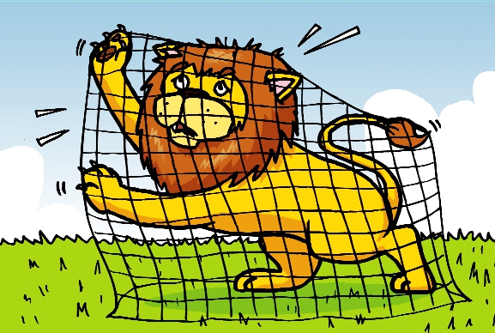
A farmer set a trap,and the lion was caught in the trap.

Slide 15
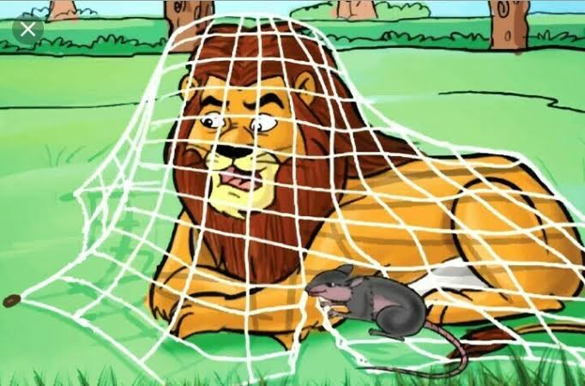
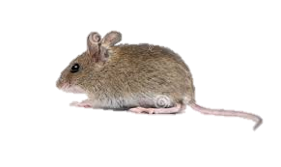
He than began to roar.
The mouse came there and cut the net into pieces.

Slide 16
The lion was free and said,Thank you,little mouse,for saving my life.

Slide 17
Group work
Discusses your partner about the story.

Slide 18
Evaluation
Answer the following questions
1.What is the story about?
2.Who caught the trap?
3.How did the lion saved her life?

Slide 19
Home work
Write a story
The lion and the mouse

Slide 20
Thank you all the best

