Slide 1
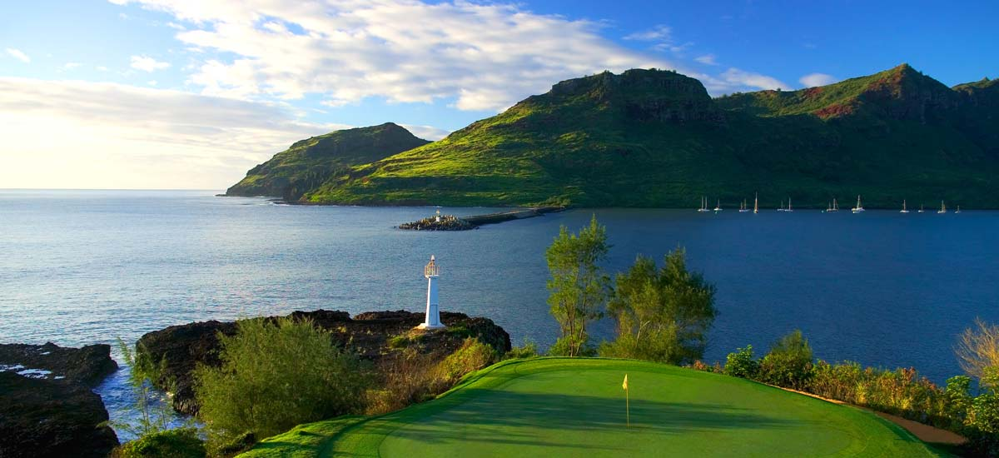
Welcome

Slide 2
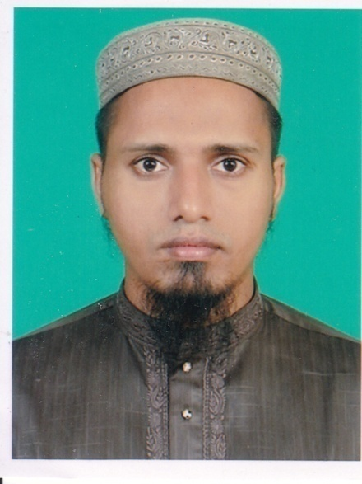
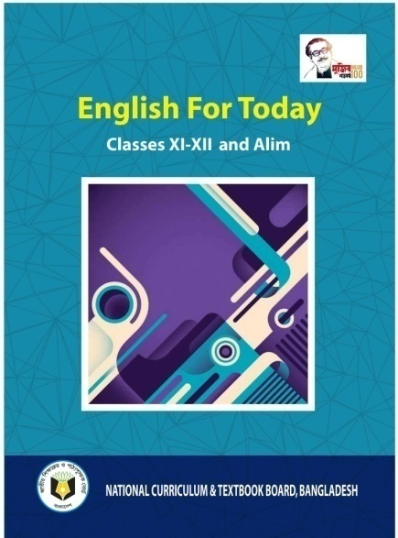
Introduction
Md.Mehedy Hasan
Lecturer in English
Bandar Islamia Fazil Madrasah
Bandar, Narayanganj.
Mob: 01745866460
Email:mehedypakdal@gmail.com
English 1st Paper
Class: Alim

Slide 3
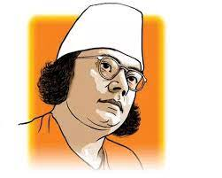
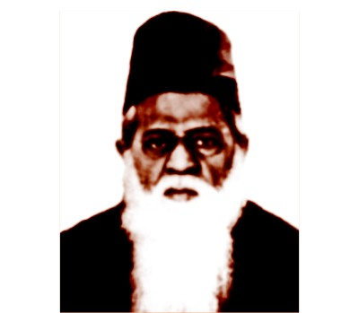
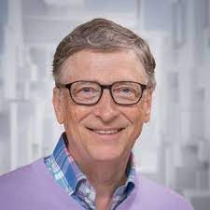
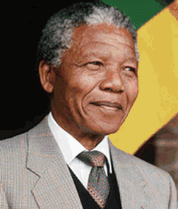
Look at the picture
a) Do you know them?
b) Why are they famous?

Slide 4
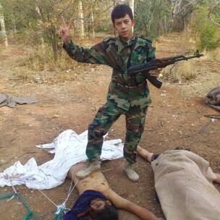
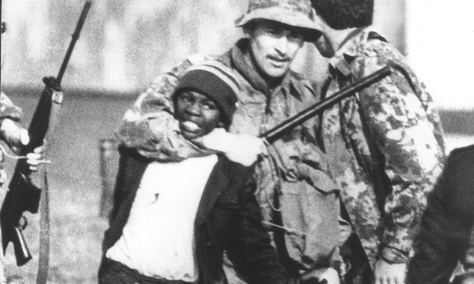
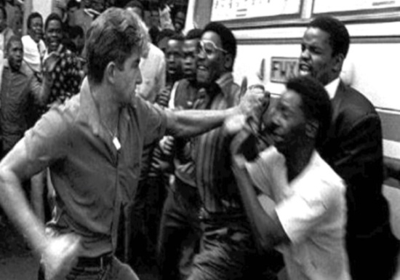
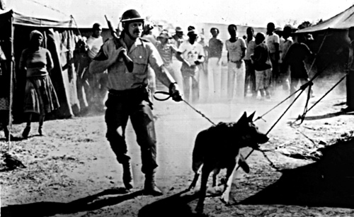
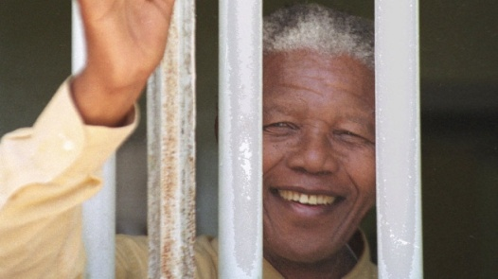
Look at the picture
What do you see in the picture?
These pictures are related to a person and a country.
Can you say what is the name of the country?
Do you know the person?

Slide 5
Our today’s lesson is
Nelson Mendela,from apartheid fighter to President
Unit: 1 Lesson: 1

Slide 6
Learning outcomes
After studied this lesson ,the students will be able to.....
-Choose the best answer.
-fill in the blanks.
-rearrange the jumbled sentences.
-ask and answer questions.
-write a paragraph.

Slide 7
Let’s watch an iconic speech of Mandela

Slide 8
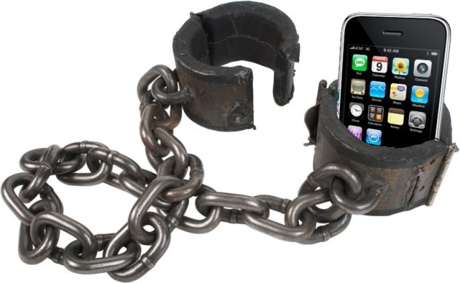
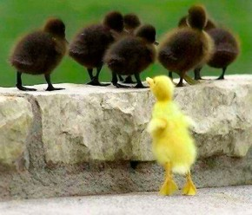
Word meaning
Shackles
Chain,
Apartheid
Discrimination
Icon
Symbol

Slide 9
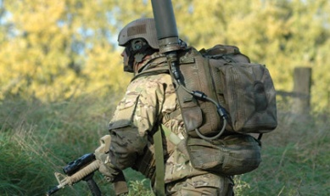
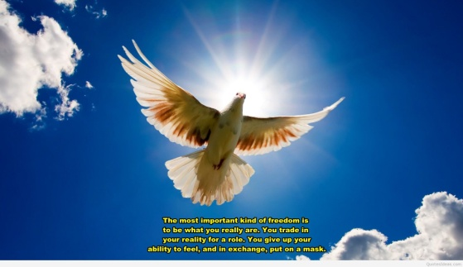
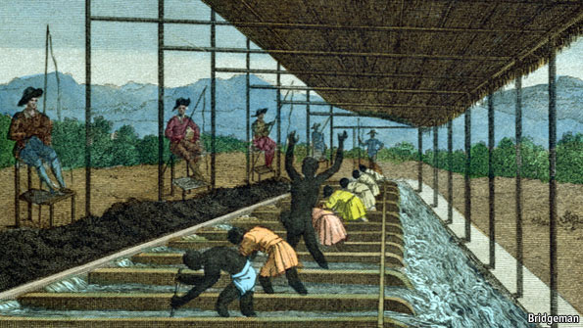
Resolve
Firmness
Emancipation
Liberation
Discrimination
Inequality

Slide 10
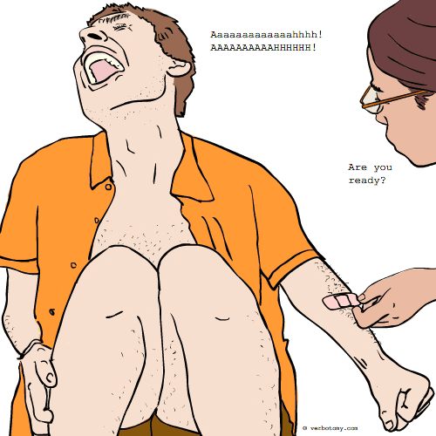
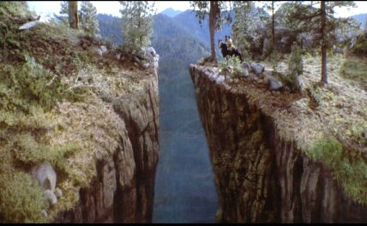
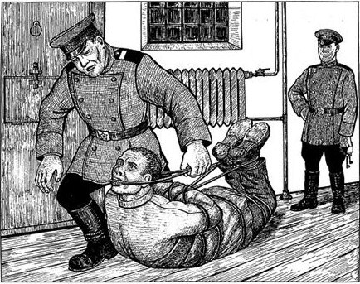
Reconcile
Healing
Gap, Break
Chasms
Repression
Oppression

Slide 11
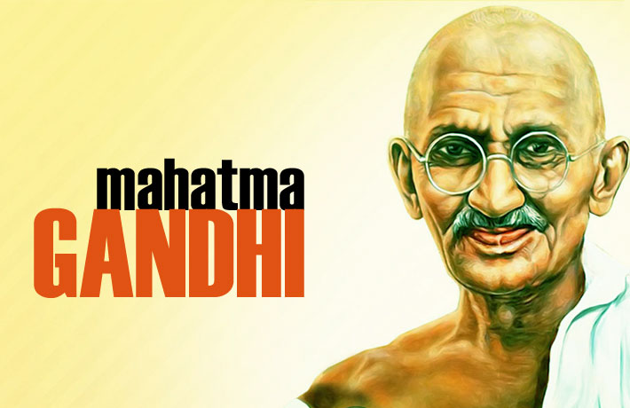
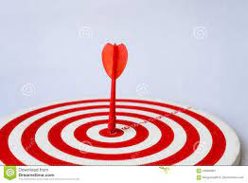
Chasm
Gap
Revered
Respected
Epicenter
Focused point

Slide 12
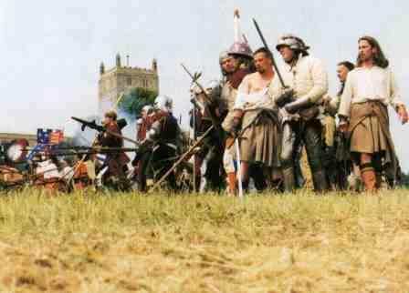
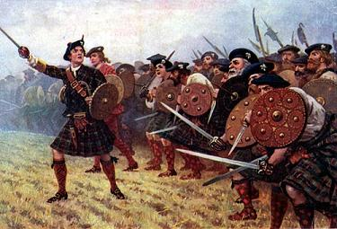
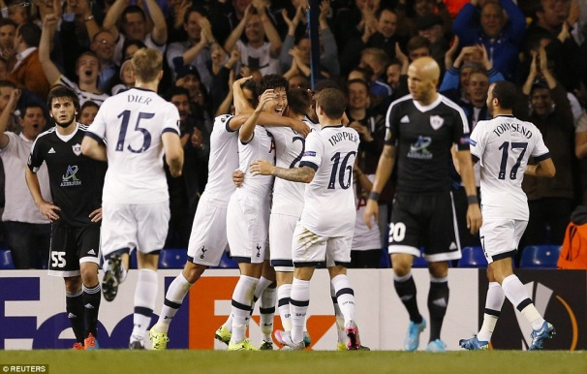
clan
Tribe, Race
Lauded
Praise, Acclaim

Slide 13
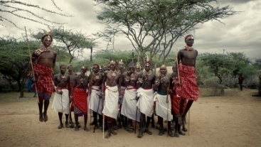
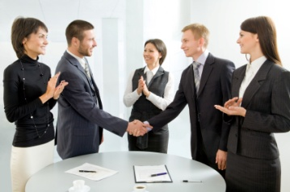
Reconciliation
Reunion
Minority
Small group
Negotiate
Collaborate

Slide 14
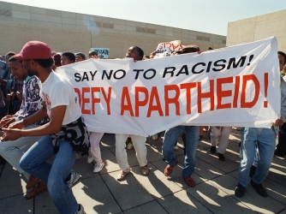
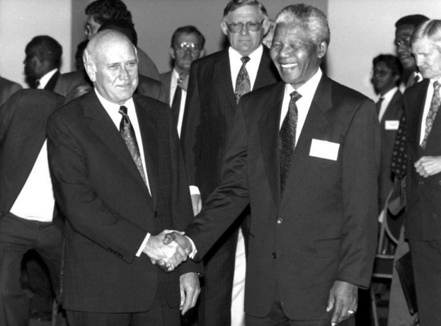
Mandela tried to remove apartheid .
He tried to bring peace and reconciliation .

Slide 15
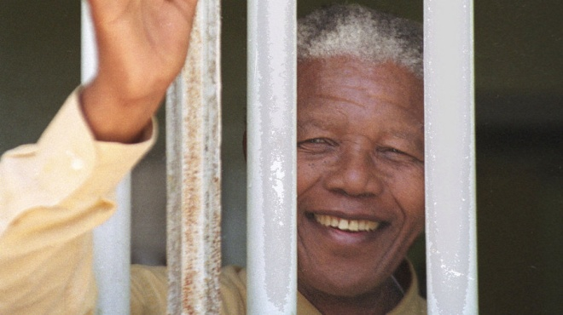
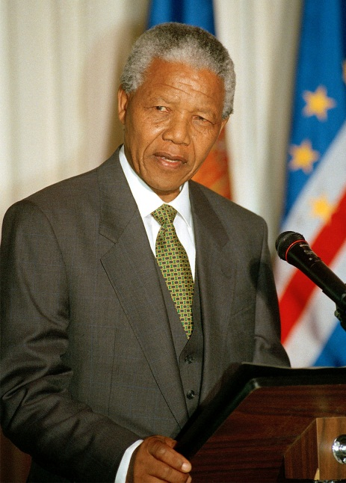
He was imprisoned in 1963 .
He was freed in 1990.

Slide 16
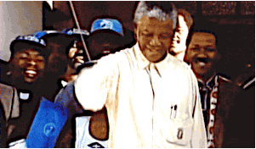
He was awarded the Nobel Peace Prize in 1993 shared with F.W.De. Klark.
He became the first South African black president in 1994.

Slide 17
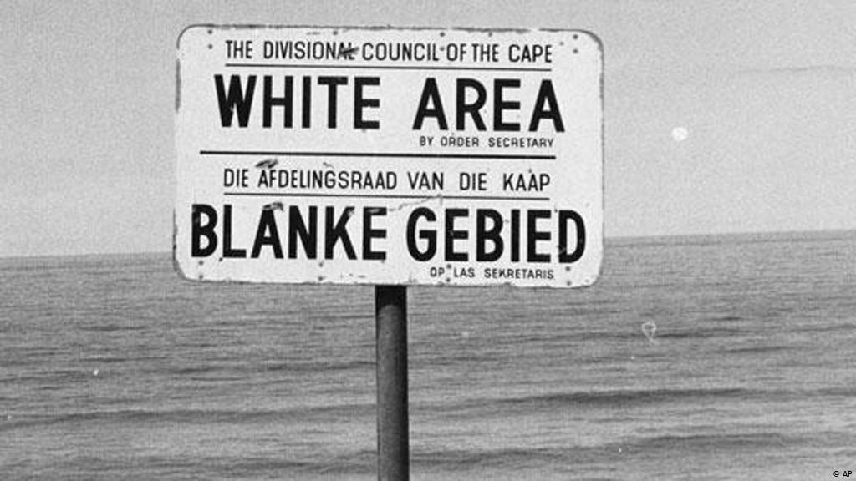
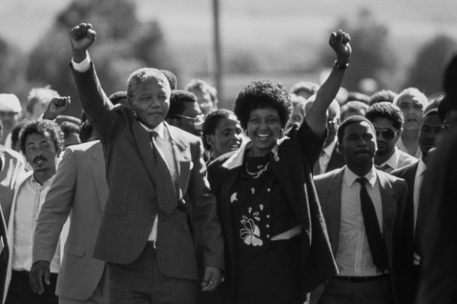
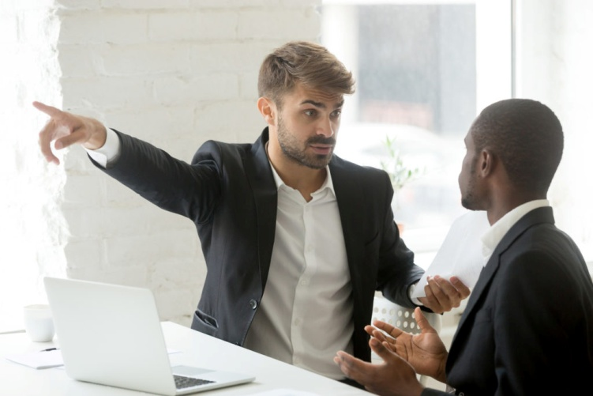
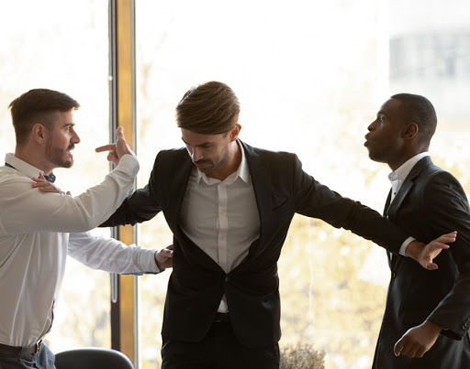
He fought against the white minority rule
He hated race discrimination

Slide 18
He played an important role to remove AIDS.
He tried to achieve political emancipation.

Slide 19
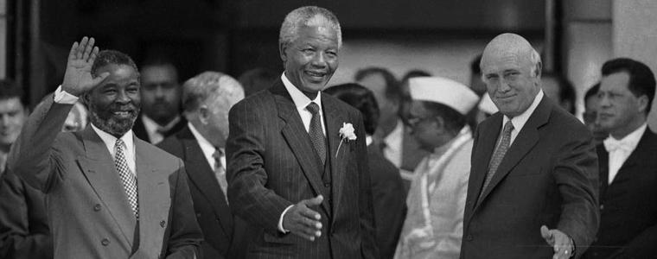
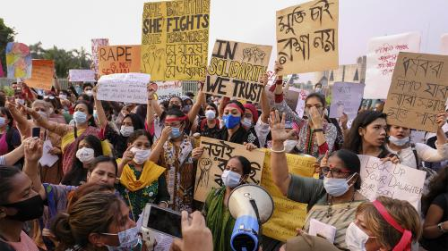
He was a leader of mythic stature .
He cherished a democratic and free society.

Slide 20
Individual work
Read the text and choose the best answer
c
d
a
b
e
a)The word ‘Chasm’ means -
1)Top 2)border 3)hatred 4)cleft
b)The term ‘apartheid ‘means-
1)Anxiety 2)partition 3) fear 4)discrimination
c)What does ‘reconciliation’ refers to-
1)Recognition 2)recitation 3)settlement
d)The word ‘manifestation’ means-
1)Change 2)sign 3)right 4)presentation
e) Mandela won Nobel Peace Prize-
1) 1991 2) 1990 3) 1993 4) 1995

Slide 21
Pair work
fought
apartheid
Spend
At last
1993
Read the text and fill in the gaps.
Nelson Mandela was one of the greatest leaders of the world. Throughout his life, he a)………………….. against b)…………………..this great leader had to c)…………….....near three decades in prison d………….......he awarded the Nobel Peace Prize in…………………………

Slide 22
Group Work
Read the jumbled text and rearrange it .
a) He got nobel prize in 1993 shared with F.W De klerk.
b) He was prisoned nearly three decades.
c) He became the first South African black President in 1994.
d) Mandela was a great leader.
e) He was an icon of peace and reconciliation.
Answer: (d+e+b+a+c)

Slide 23
Evaluation
a) When was he freed ?
b) When did he get the Nobel Peace Prize?
c) When did he become the president?
d) When was he imprisoned?
e) What did he hate?

Slide 24
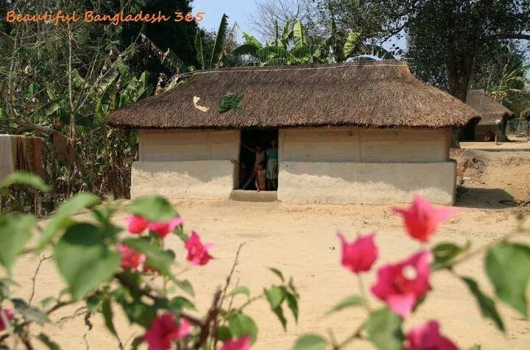
Home work
Write a paragraph on “Mandela: an icon of peace and reconcilation.”

Slide 25
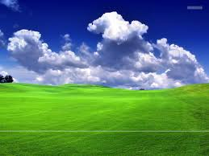
Thanks

