Slide 2
welcome

Slide 3
Introdroction
Class : Two
Subject : English
Unit : 8
Lesson : 1

Slide 4
Learning outcomes
Student’s will be able to:
1.1.1 become similar with English sounds by listeningto common English words.
1.1.2 say simple words and phrases with proper sounds and stress.
2.1.1 recognize and read cardinal numbers up to 30.

Slide 5
Let’s listen and say.

Slide 6
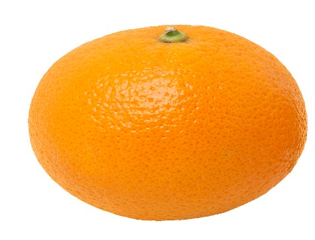
How many ………….. are there
1
one
3
three

Slide 7
7
seven
9
nine

Slide 8
In this way the teacher will practice the calculation and ask them to come to the board one by one to write number’s in figure’s.

Slide 9
Today we will learn to count number’s and say in figures.
Number’s: (11,12,13)

Slide 10
10
ten
11

Slide 11
Let’s see some picture and say.
11
12

Slide 12
12
13

Slide 13
Now open your English book at page 16.
How many mangoes are there
11
How many apples are there
How many oranges are there
12
13

Slide 14
Listen and point the number’s.

Slide 15
Pair work
Teacher will provide number and picture card among the students.

Slide 16
Student will count the pictures with proper sound with the help of one by another, also take help of the teacher if needed. They will change their roll in pair work.
Teacher will monitor and assist if needed.

Slide 17
Evaluation
Read the following numbers.
9
11
5
12
10
13

Slide 18
Home work
Write down the following numbers in your note book and copy the numbers at home
8
9
10

Slide 19
Thank’s all.

