Slide 1
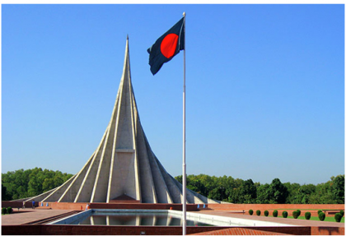

Slide 2
Nahidal Arjin
Class:Five
Subject:English
Unit:19
Title: The Liberation War Museum
Lesson: 1
Time:45 minutes
Date:27/06/2021
Assistant Teacher
Boddipur Govt. Primary School
Satkhira Sadar, Satkhira

Slide 3
Good morning students.
How are you today?
Let’s sing the good morning song.

Slide 4
Let’s See a Video
Click the video below:
https://youtu.be/sM5W4tYm1Ks
What do you see in the video?

Slide 5
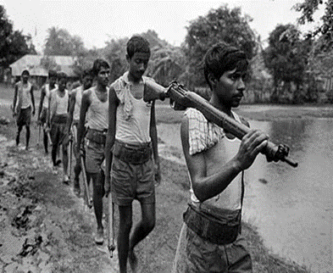
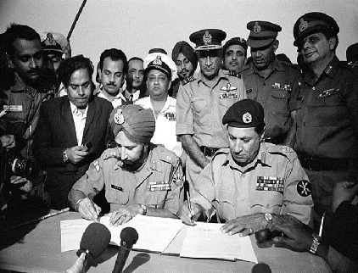
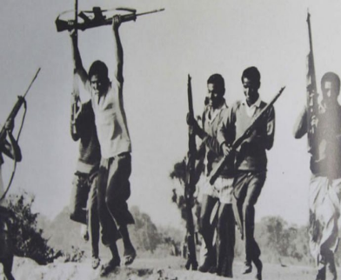
Look at the pictures.
What is Liberation war Museum Mean?
Can you tell what the Liberation War Museum is called in Bangla?
A war fought to gain independence for a country.
মুক্তিযুদ্ধ যাদুঘর

Slide 6
The Liberation War Museum

Slide 7
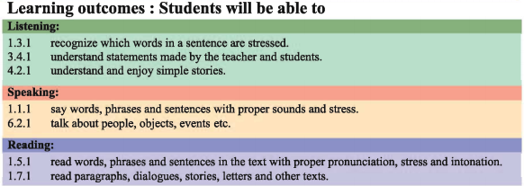
Learning Outcomes
1.5.1
1.7.1
4.2.1

Slide 8
Do you know this?
It’s a Magazine
A large thin book with a paper cover that we can buy every week or month containing, article, photographs etc often on a particular topic is called a ‘Magazine’.

Slide 9
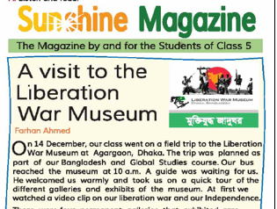
open your book at pg-74
This passage was taken from Sunshine
Magazine which is by and for the
students of class-5.
This news story was written by Raju Roll-1.

Slide 10
Teacher’s Model Reading
Dear students, open your English book at page 74. I am reading the text loudly, please put your fingers on the text.

Slide 11
Listen to the audio carefully.
Listen to the audio again.

Slide 12
Individual work
When did the class go to the Liberation War Museum?
Why did the class go to the Liberation War Museum?
How many galleries are there in the Liberation War Museum?

Slide 13
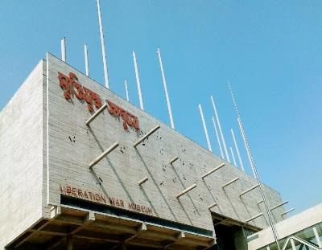
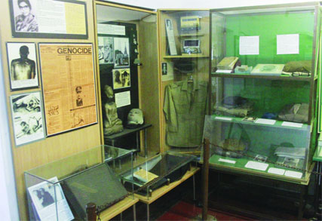
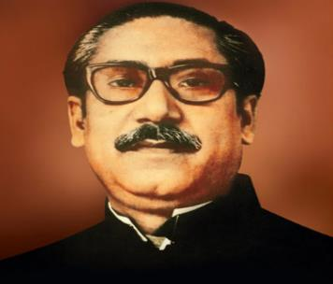
Look at the picture and read the text
On 14 December, our class went on a field trip to the liberation war museum at SegunBagicha, Dhaka. The trip was planned as part of our Bangladesh and Global Studies course.

Slide 14
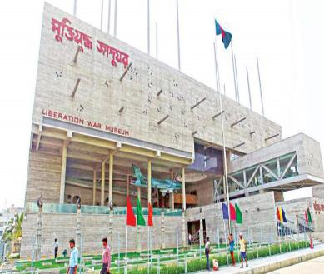
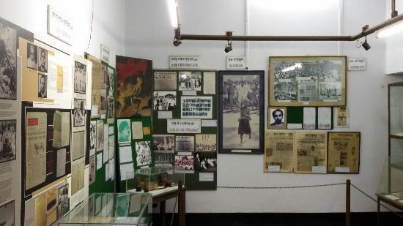
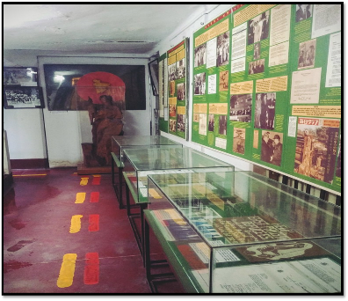
Look at the picture and read the text
Our bus reached the museum at 10 am. A guide was waiting for us. He welcomed us warmly and took us on a quick tour of the different galleries and exhibits of the museum.

Slide 15
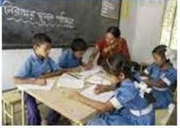
Group Reading
The students will read the text in group.

Slide 16
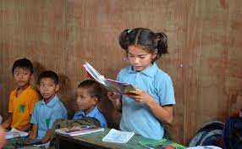
Student’s reading
One student reads the text and others listen.

Slide 17
Pair
work
Match the words with their meaning:
Welcome
Trip
Exhibit
Different
Quick
Display
Well-receive
Not same
Fast
Tour

Slide 18
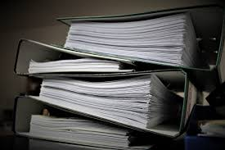
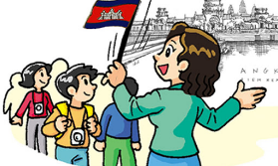
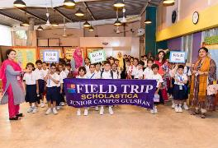
New words
A paper that is used as proof of something
Documents
A person who shows the way to others.
Guide
A visit made by students to gain knowledge
trip

Slide 19
Group work
Write true/ false.
The students visited the Museum on the 16th Dec.
The liberation War Museum is at Agrabad.
A guide welcomed the students warmly.
There were four permanent galleries in Liberation War museum.
The students at first watched a video clip on a sea documentary.
False
False
True
True
False

Slide 20
Evaluation
Answer following questions:
How did the guide assist them?
When did their bus reach the Museum?
Where is the Liberation War Museum?
Who was waiting for them?

Slide 21
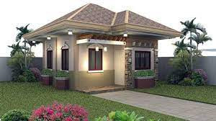
Home Task
Make five sentences about “Our Liberation War” in your own words.

Slide 22
Thank you very much. See you next class.

