Slide 1
IDENTITY
Class- Alim 1st year
Md.Shafiqul Islam
Lecturer (English)
Sreechail Mohammadpur Islamia Alim
Madrasha, Daudkandi, Cumilla

Slide 2
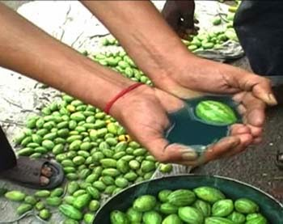
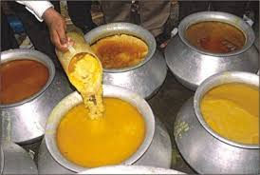
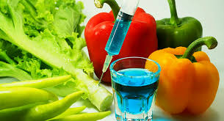
Let’s watch some picture
What do you see in the picture

Slide 3
So, what will we read today?

Slide 4
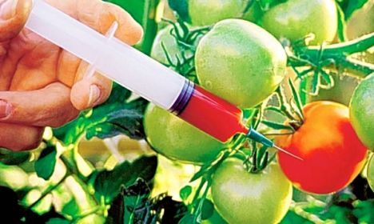
Today’s Lesson?
Food Adulteration Reaches New Height
Unit: Three
Lesson: One
Page No: 28

Slide 5
Learning Outcomes
By the end of the lesson, students will be able to
define food adulteration;
tell the name of some pesticides;
tell the meaning of some new words.

Slide 6
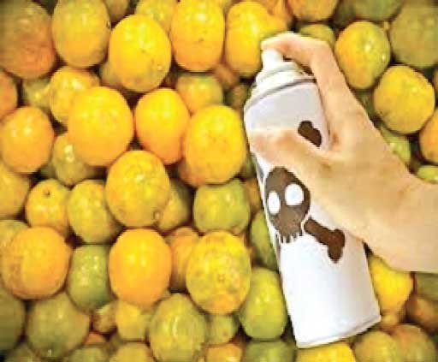
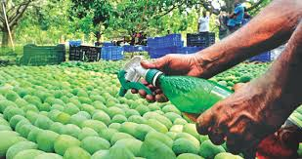
What are they doing?
They are using pesticides in fruits.

Slide 7
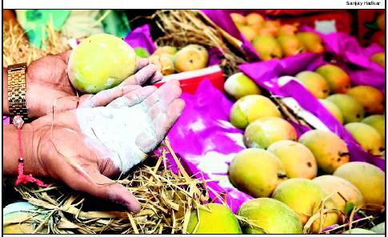
What is happening here?
They are using pesticides in fruits.

Slide 8
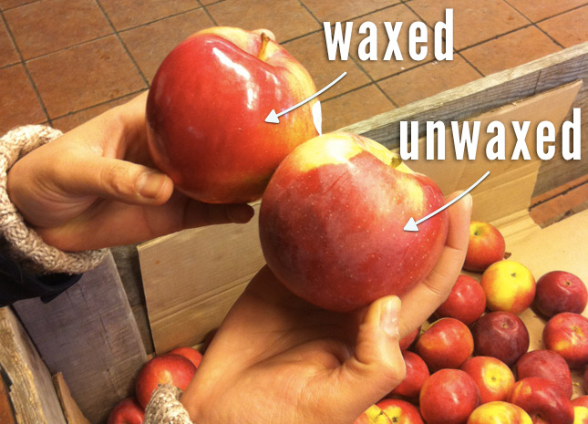
Which one will you take?
This one.

Slide 9
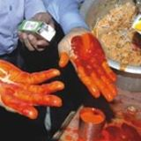
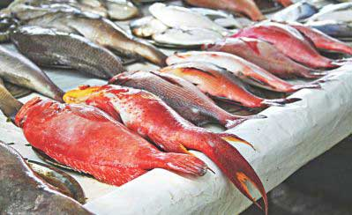
Will you look for more color?

Slide 10
Unsafe level of pesticide are present in around of 50% of vegetables and 35% fruits.
The amount of pesticide in these fruits are 3 to 20 times greater than the limits set by the European Union.

Slide 11
Milk and milk products are contaminated 42% out of 82 samples
Milk and milk products are contaminated with DDT, Aldrin, Chlordane and Heptachlor.

Slide 12
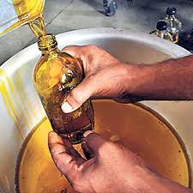
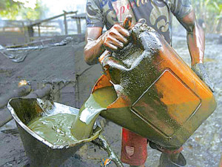
What is happening here?
Chemical is being used in oil.

Slide 13
What is food adulteration?
Food adulteration is the process in which the quality of food is lowered either by the addition of inferior quality material or by extraction of valuable ingredients.

Slide 14
Single Work
1. What is food adulteration?

Slide 15
Causes of Food Adulteration
Food
Food Handlers
Packaging
Insects
Air dust
Animals
Garbage
Ingredients

Slide 16
5 ms
Pair Work
Make a flow chart of five information of causes of food adulteration. First one has been done.
1. Food handlers.
2
3
4
5
6

Slide 17
Effects of Food Adulteration
Effect
Cancer
Kidney failure
Heart Problem
Skin Diseases

Slide 18
Group Work
Do you think that cancer is a fatal disease? Give your reasons.

Slide 19
Evaluation
1. What is the percentage of fruits in which unsafe level of pesticide is found?
2. By which milk and milk products are contaminated?
3. Write down the name of two fatal diseases.

Slide 20
Home work
Write a paragraph on “Food Adulteration.”

Slide 21
THANK YOU ALL

