Slide 1
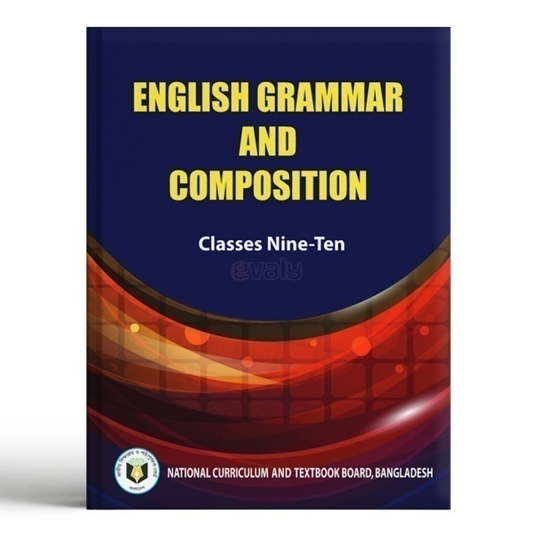
Welcome
Mst. Arifa Khatun
Assistant Teacher( English)
Chand Sultana Secondary
Girls’ School, Kushtia Sadar, Kushtia
Mobl: 01936601076
Email: arifakch87@gmail.com
Class: 9-10
English Grammar and Composition
Topic: The Sentence

Slide 2
Look at the example first, and then discuss it with your partner…..
Person he nice is
Here to come me please
Is good boy a
Are these sentences?
Other example…..
Bill Gates is the founder of Micro- soft.
He is a noble man.
He is the pioneer of modern Information Technology .

Slide 3
Our today’s topic is…………
The Sentence

Slide 4
Learning Outcomes………..
At the end of this lesson, the students will have learnt-
What is sentence?
How many types of sentences?
Ask and answer the questions?

Slide 5
Definition
A word or a group of words, which makes a complete sense, is called a Sentence.

Slide 6
Pair works
How many conditions of a sentence?

Slide 7
Types
There are five types of sentences . Such----
Assertive Sentence
Interrogative Sentence
Imperative Sentence
Optative Sentence
Exclamatory Sentence

Slide 8
Individual Work
How many types of sentences?

Slide 9
Definition of all types of sentences----
They are very beautiful.
Assertive Sentence
A sentence that makes a statement is called an Assertive sentence.

Slide 10
What are they doing?
Interrogative Sentence
A sentence that ask a question is called an Interrogative sentence.

Slide 11
Stop.
Imperative Sentence
A sentence that expresses a command is called an Imperative sentence.

Slide 12
May you be happy.
Optative Sentence
A sentence that expresses a prayer and keen wish is called an Optative sentence.

Slide 13
What a beautiful bird it is!
Exclamatory Sentence
A sentence that expresses strong feeling is called an Exclamatory sentence.

Slide 14
Evaluation
What is sentence?
How many kinds of sentences?
What is Assertive sentence?

Slide 15
Home Work
Write down five sentences about your house.

