Slide 2
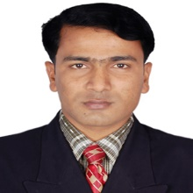
Identity
Muhammad Rehan Uddin
Assistant Teacher
Pakshail Ideal High School
Barlekha, Moulvibazar
Mobile: 01742823363
Emil: mdrehanuddin17@gmail.com
English 1st Paper
Class: Nine & Ten
Unite:06, Lesson:01
Time: 50 Munites

Slide 3
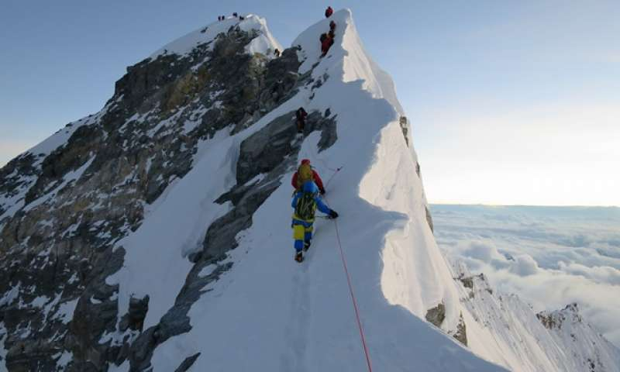
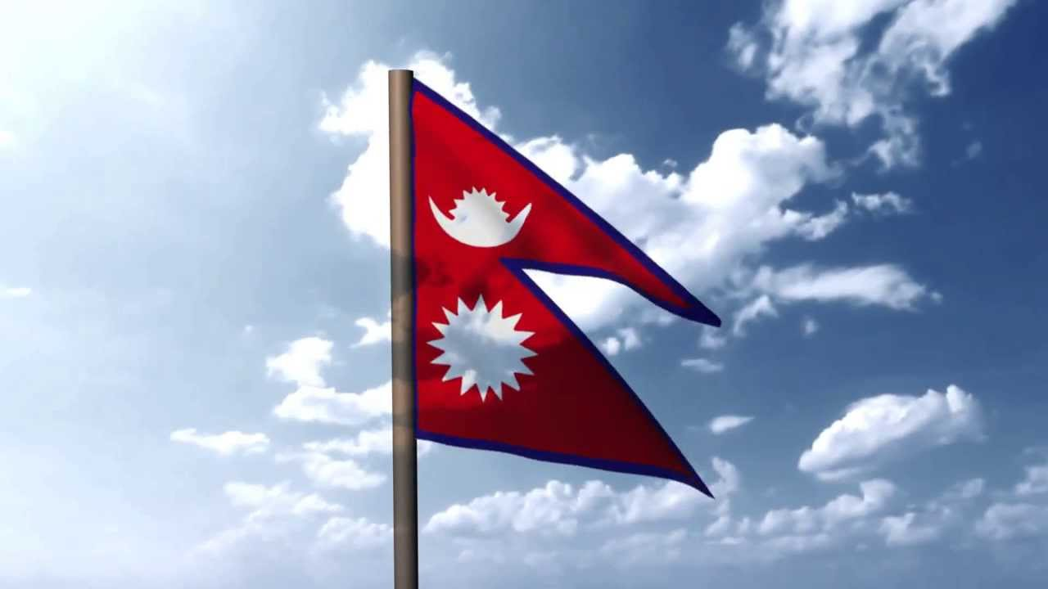
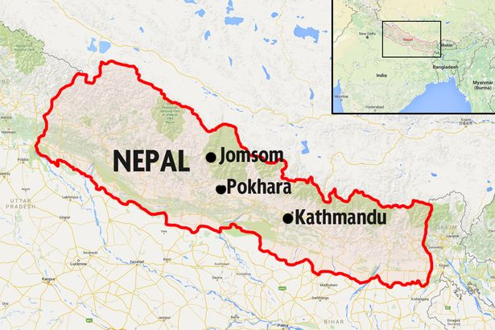
Look at the picture
What’s the name of the peak?
Mount Everest
Do you know which country is the land of Everest?
Nepal

Slide 4
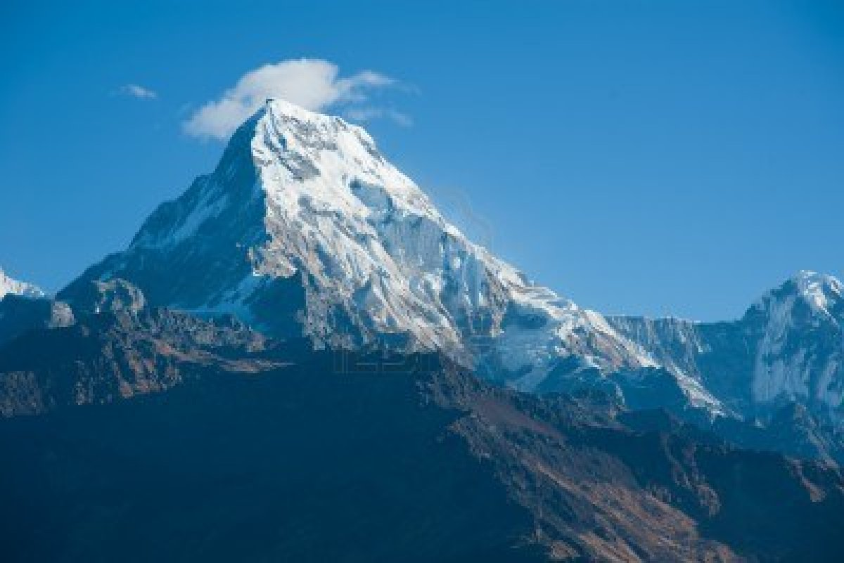
So, Today’s Our lesson Is………
Nepal, the land of Everest

Slide 5
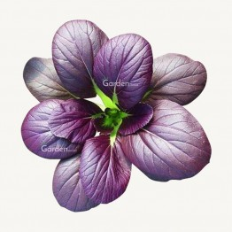
Learning Outcomes
After we have studied this lesson,
we will able to……..
Know some new words.
Gather knowledge about Nepal.
Solved the given items.
Write a letter about the important
places of Nepal.

Slide 6
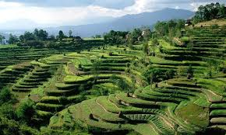
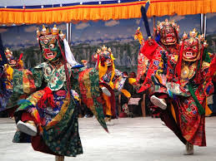
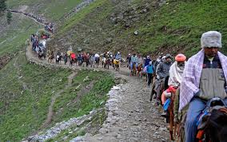
Vocabulary
Slope
Height
Vivid
Vibrant
Holy
Journey
Pilgrimage

Slide 7
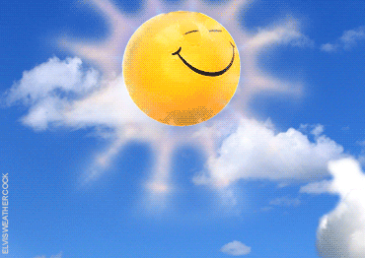
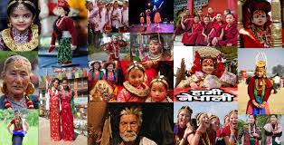
Charming
Attractive
Monsoon
Rainy Season
Demographic
Numeric

Slide 8
Loud reading
Silent Reading

Slide 9
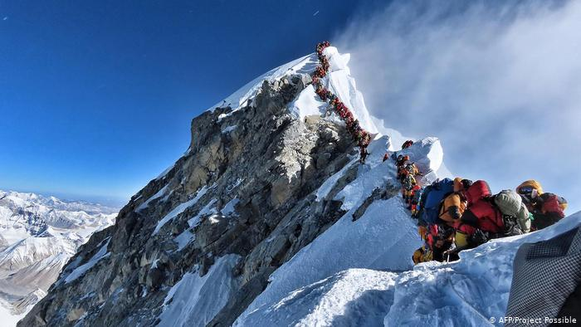
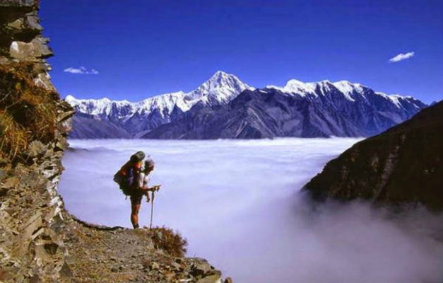
Sublime beauty
Nepal is the land of Everest of Hindu Kingdom with sublime beauly

Slide 10
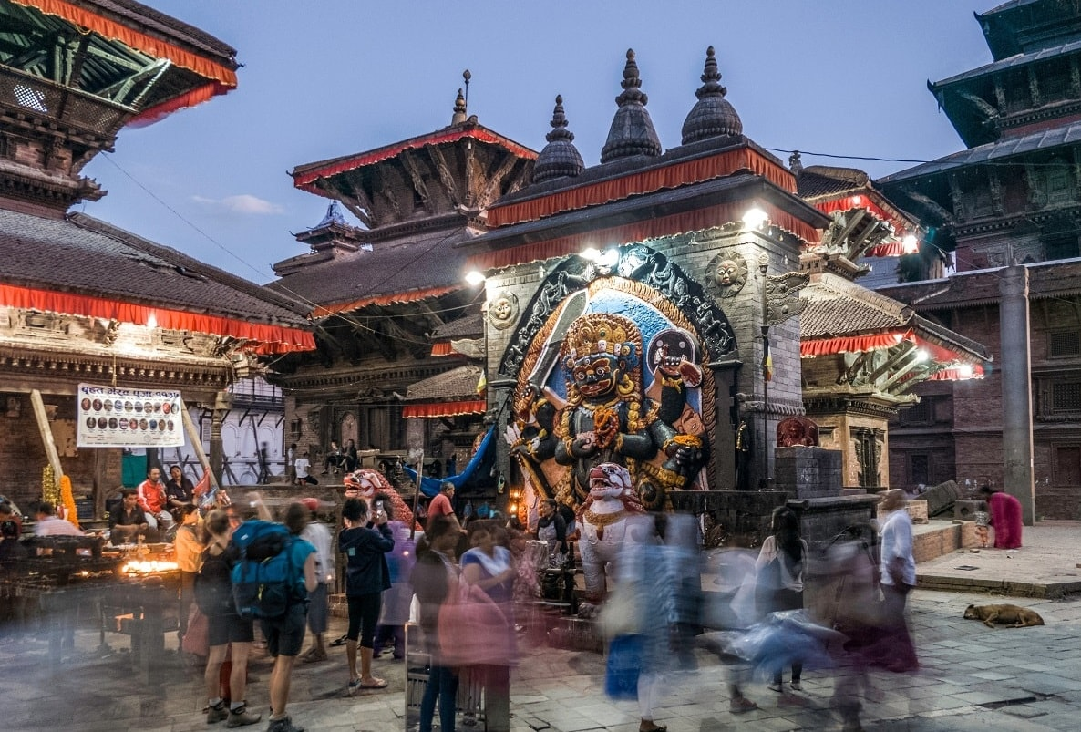
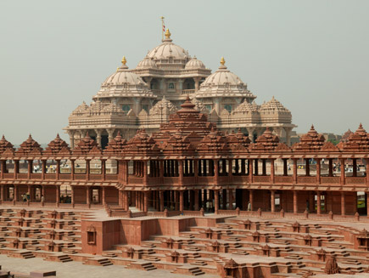
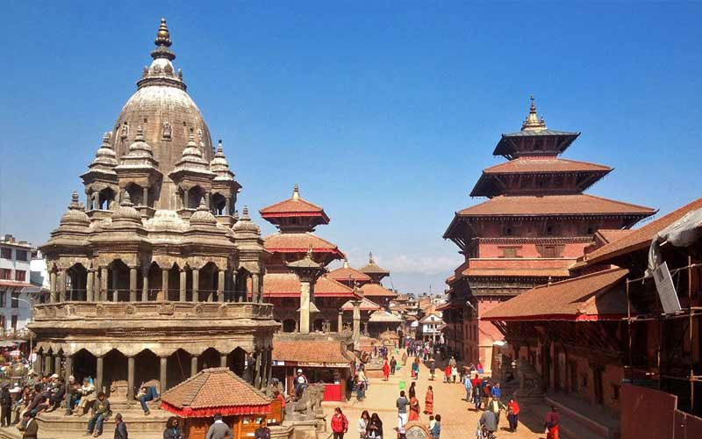
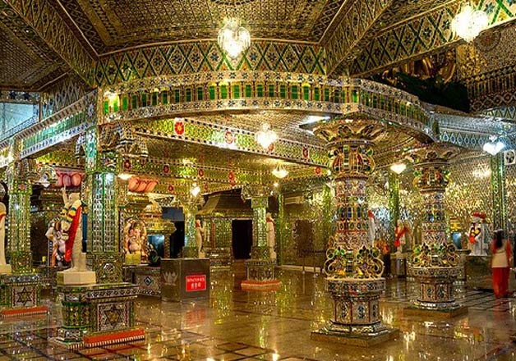
Nepal has some of the world’s best & important Temples.

Slide 11
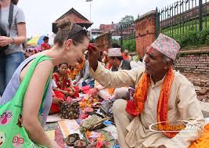
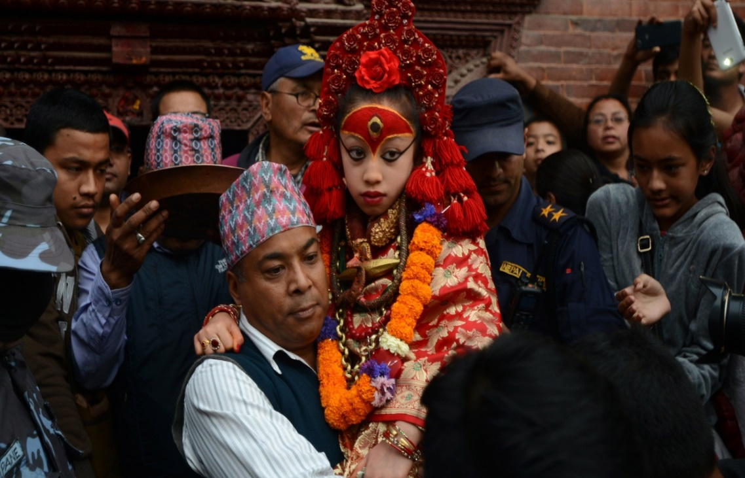
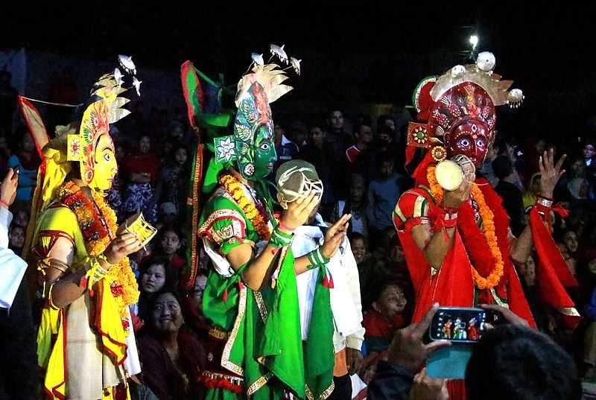
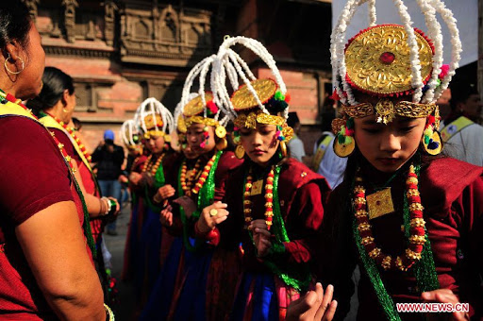
It is rich in cultural heritage

Slide 12
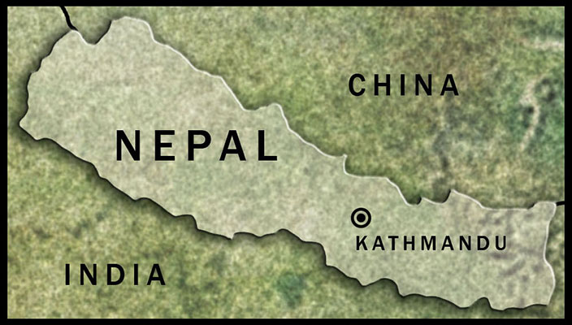
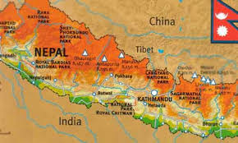
It lies between India & Tibetan part of China

Slide 13
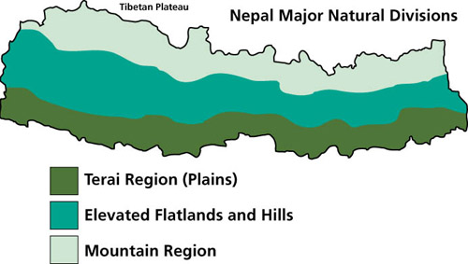
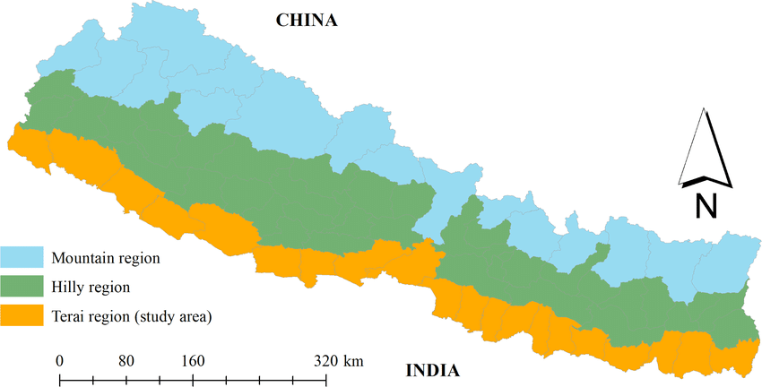
This country has an area of 147,181 square km

Slide 14
Say true/false. If false, write the correct answer.
1.Nepal is the only Hindu kingdom in the world. .
Ans: True.
2. It has some of world’s best mosques.
Ans: False. Corr. Ans: Temples.
3.Napal has an area of 147,181square kilomiter.
Ans: True.
4. It lies between India & Bangladesh.
Ans: False. Corr. Ans: Between India & China.
5. Nepal has hot summers & warm winters.
Ans True.

Slide 15
Some of the highest peaks of Nepal in the world
Peak | Country | Height(in Mtr)
Mt. Everest | Nepal | 8848
Makalu | Nepal | 8481
Dhaulagiri | Nepal | 8172
Annapurna | Nepal | 8078
Gurla Mandhata | Nepal | 7728

Slide 16
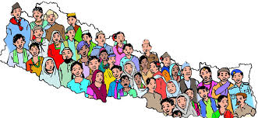
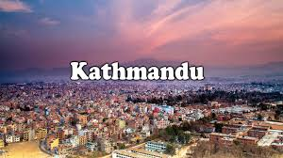
It has nearly29,000,000 people
Capital city of Nepal is
Kathmandu has less than one million people

Slide 17
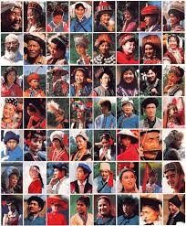
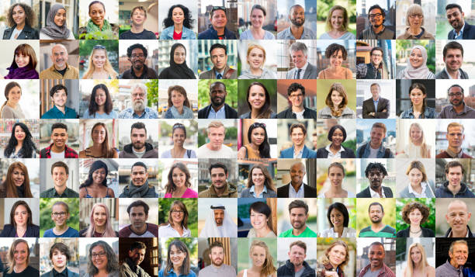
It has dozens of ethnic groups & 103 castes of people

Slide 18
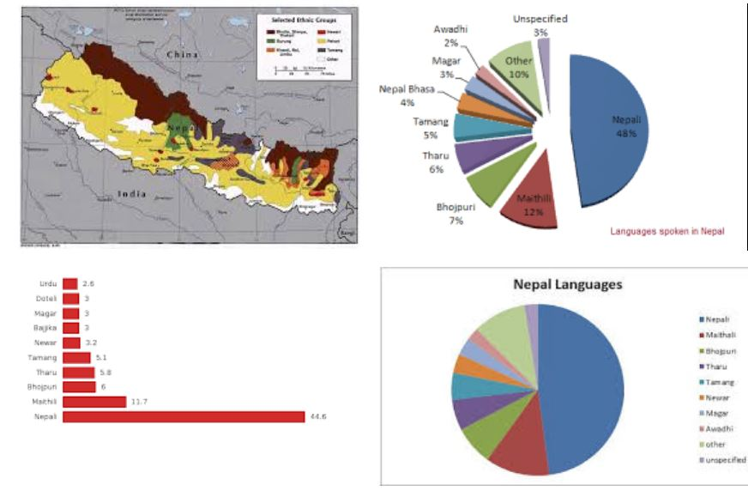
About 48 percent people of Nepal speak Nepali

Slide 19
Name of the ethnic groups & languages of Nepal
Ethnic group | Ethnic group | languages
Chetri | Newar | Nepali
Bahun | Muslim | Maithali
Magar | Gurung | Bhojpuri
Tharu | damai | Tharu
Tamang |  | Tamang

Slide 20
Answer the following questions (in pair)
1. Q . What is the population of Nepal ?
1. Ans: Nearly 29,000.000
2. Q. What’s the capital of Nepal ?
2. Ans: Kathmandu.
3. Q. How many ethnic group are there in Nepal ?
3. Ans:103.
4. Q. 48% people of Nepal in which language ?
4. Ans : Nepali.
5. Q. Mention the languages of Nepal.
5. Ans: Maithali, Bhojpuri, Tharu & Tamang .

Slide 21
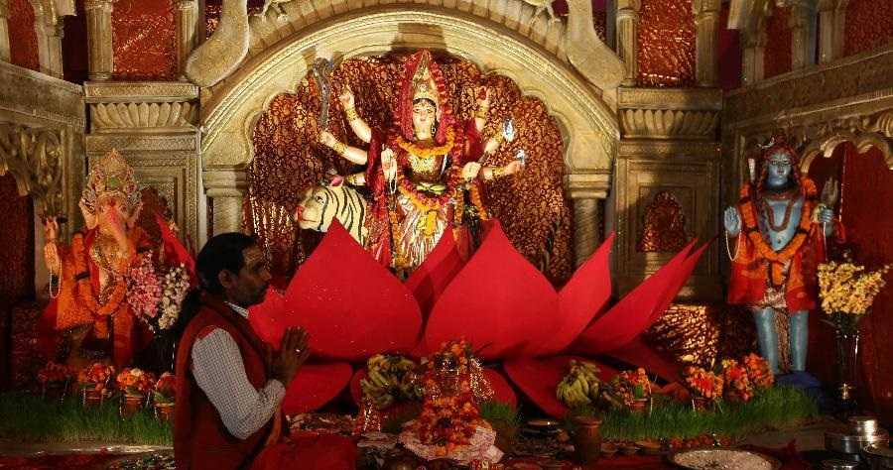
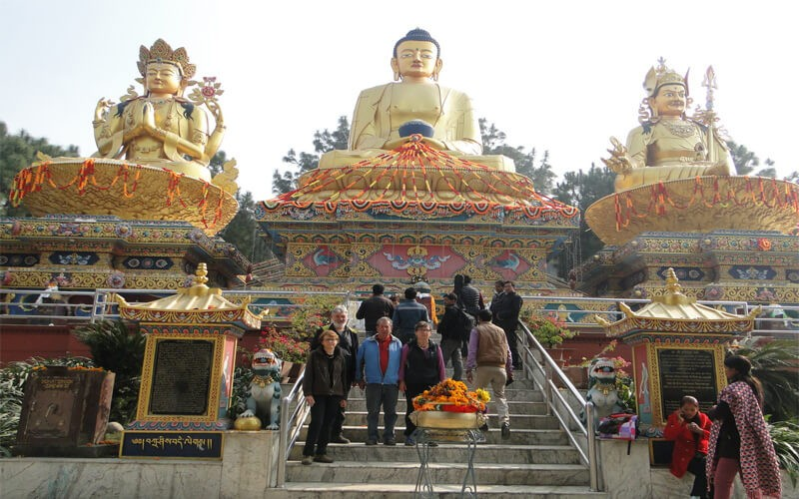
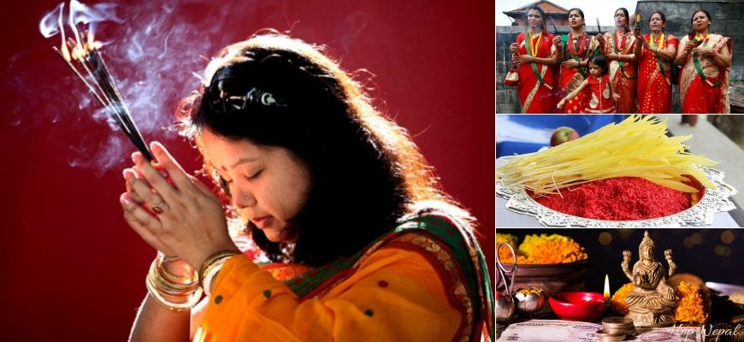
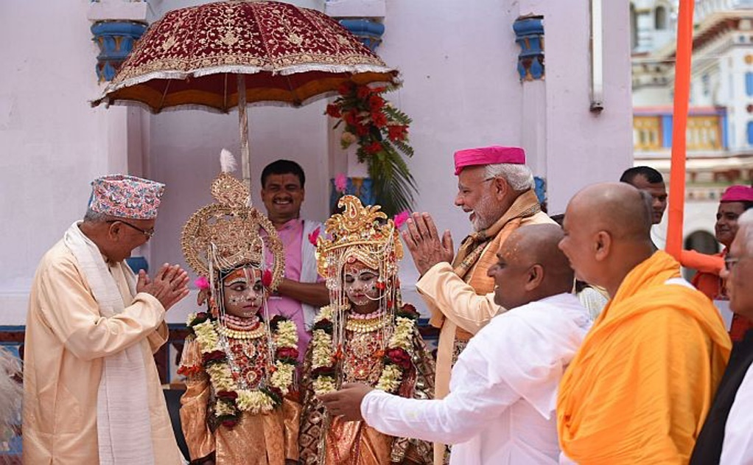
Nepal is the holy land whrre Hindus & Buddhists
live together in harmony for century

Slide 22
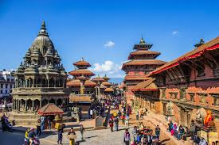
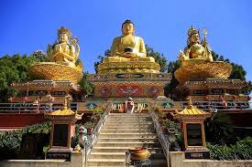
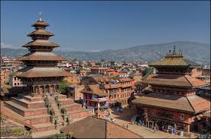
Patan
Kathmandu
Bhaktapur
Nepal has three ancient cities represent urban design, elegant architecture.

Slide 23
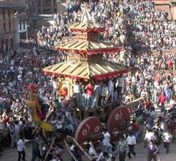
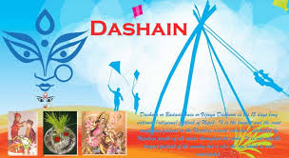
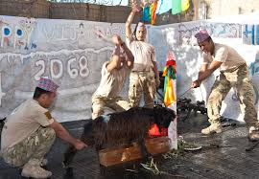
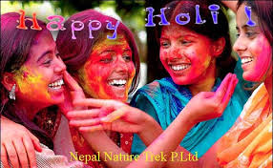
Many festivals & vibrant culture are
celebrated through the year

Slide 24
Name of festival | When | Who
Dasain/Dusherra | October | Nepalese
Tihar | November | Nepalese
Holi | March | Nepalese
Chaitra Daisan | March | Nepalese
Haribodhini Ekadashi |  | Hindu
Maha Sivaratri | February | Hindu
Krishna Jayanti | August | Hindu
Mani Rimd | Tibetan New Year | Buddhist
Buddha Jayanty | Tibetan New Year | Buddhist
Losar | Tibetan New Year | Buddhist

Slide 25
Fill in the gaps with suitable words in group
Nepal is known as the (a)------------------ of Gautam Buddha.
It is a place of (b)pilgrimage for both the Hindus & Buddhists.
Thus there sustains a (c)------------------ tranquility.
Nepal is enriched with cultural (d)-------------------.
The Kathmandu Valley comprises (e)------------------- World
Heritage Sites within the valley.
birthplace
religious
heritage
seven

Slide 26
Evaluation
1. Losar is a --------- festival. (a) Hindu (b) Nepalese (c) Chinese (d) Buddhist
2. The word “sublime” means
(a) elevated (b) great (c) exalt (d) noble
3. What is the richest cultural heritage of Nepal? (a) Hill-lands (b) Tharu & Tamarg (c) Kathmandu valley (d) the capital city
4. The word “peak” means (a) sharp projection (b) the top of a hill (c) summit (d) the highest point
5. The people of Nepal are called (a) Nepalians (b) Nepolese (c) Nepalese (d) Nepali

Slide 27
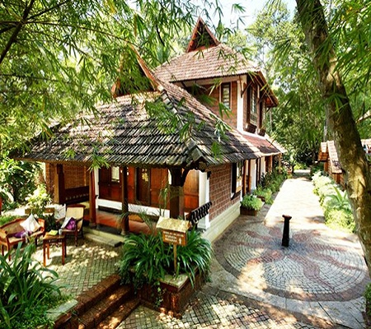
Home work
Write a letter to your friend highlighting the main attraction of Nepal.

Slide 28
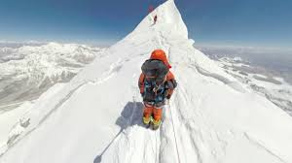
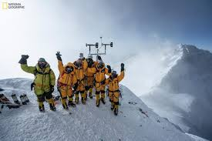
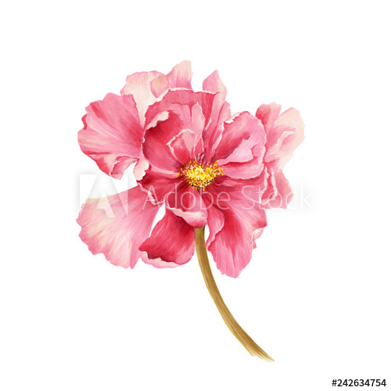
No more today
See you tomorrow

