Slide 1
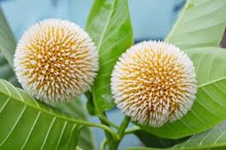

Slide 3
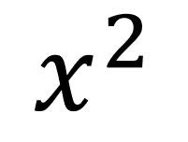

Slide 7
$$a^{2}$$
×
=
$$a$$
$$a$$
1 cm
$${1cm}^{2}$$
1 cm
1 cm
×
$${1cm}^{2}$$
=
1 cm

Slide 8
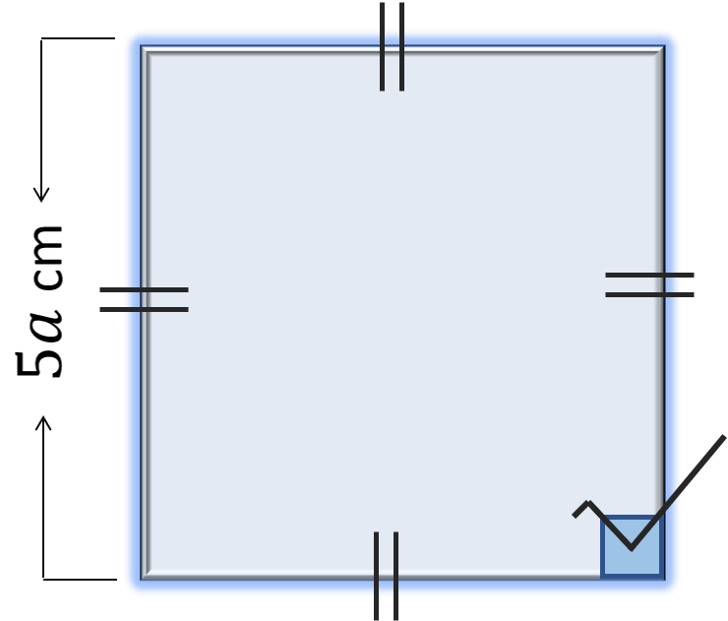

Slide 9
=${\left(5a\right)}^{2}cm$
=${25a}^{2}cm$
(Ans)

Slide 10
a
b
$a$ × $b$ = $a$b
a
$a$ × $a$ =$a^{2}$
a
b
b×b
=$b^{2}$
$a$ × $b$ = $a$b
b
a
b

Slide 11
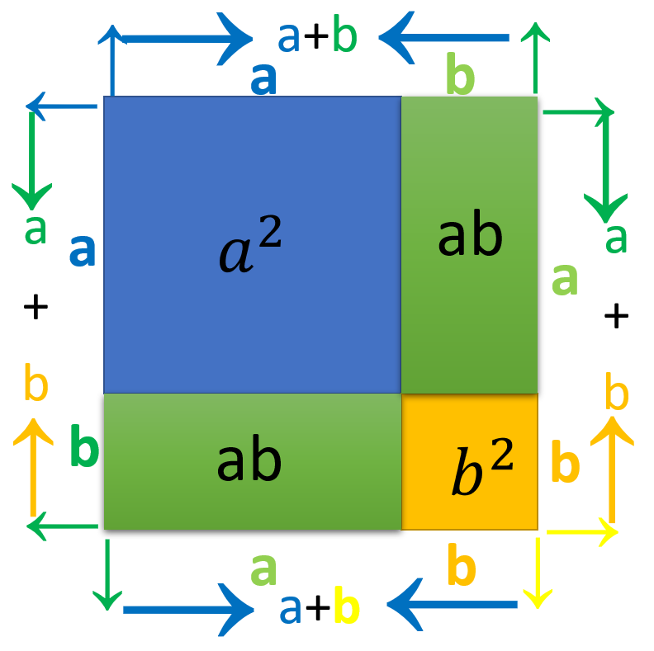

Slide 12
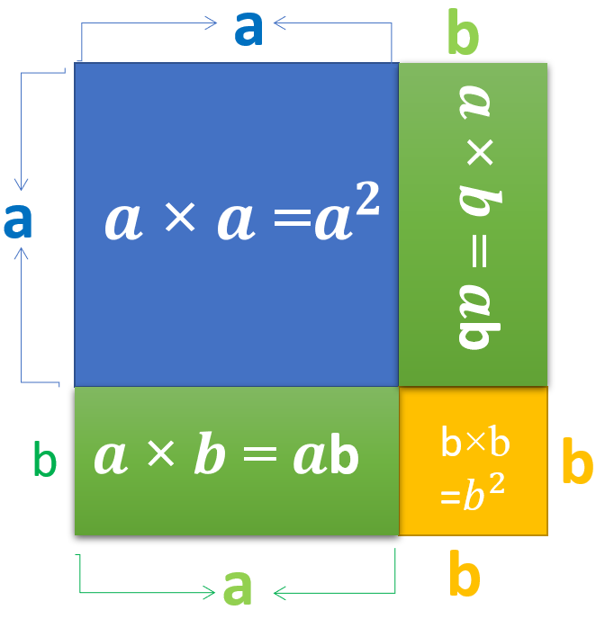
₌
₊
₊
₊
$$a^{2}$$
$$ab$$
$$ab$$
$$b^{2}$$
a
b
$a$ × $b$ = $a$b
a
$a$ × $a$ =$a^{2}$
a
b
$a$ × $b$ = $a$b
b×b
=$b^{2}$
b
a
b

Slide 14
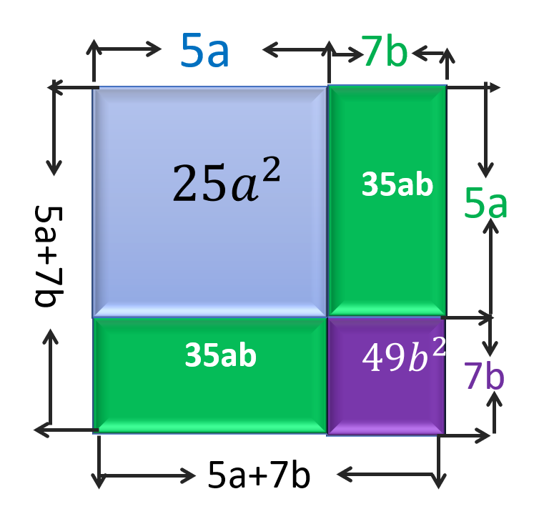

Slide 15
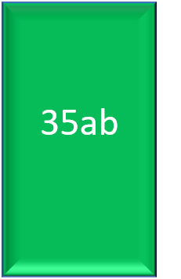
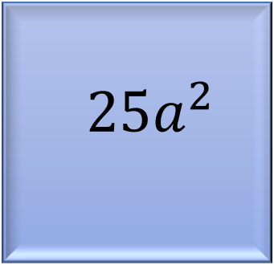
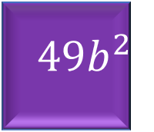

Slide 16
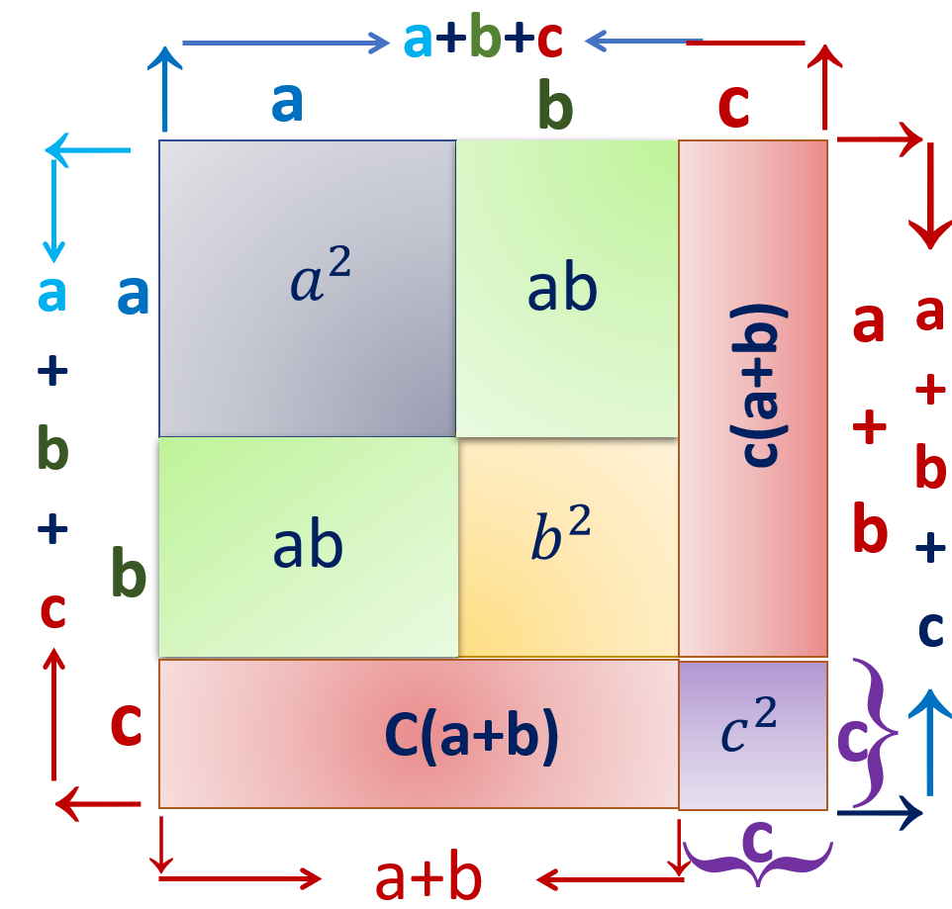
অতএব

Slide 17
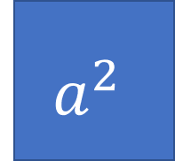
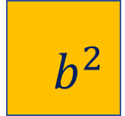
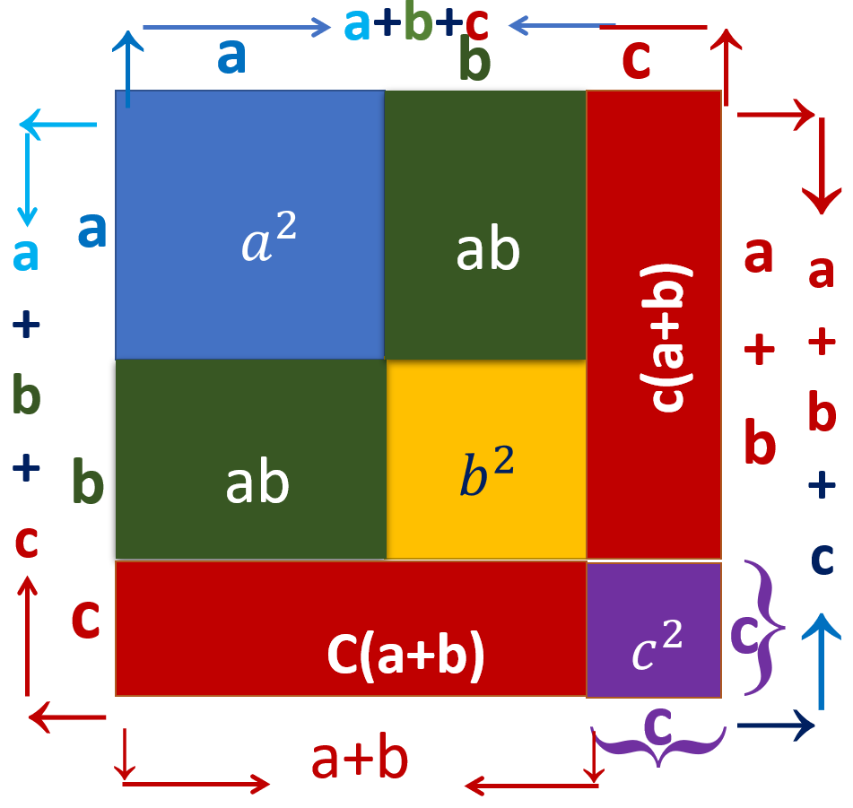
$$b^{2}$$

Slide 18
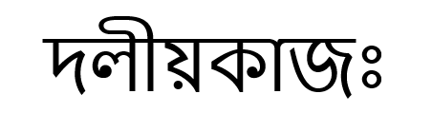

Slide 19
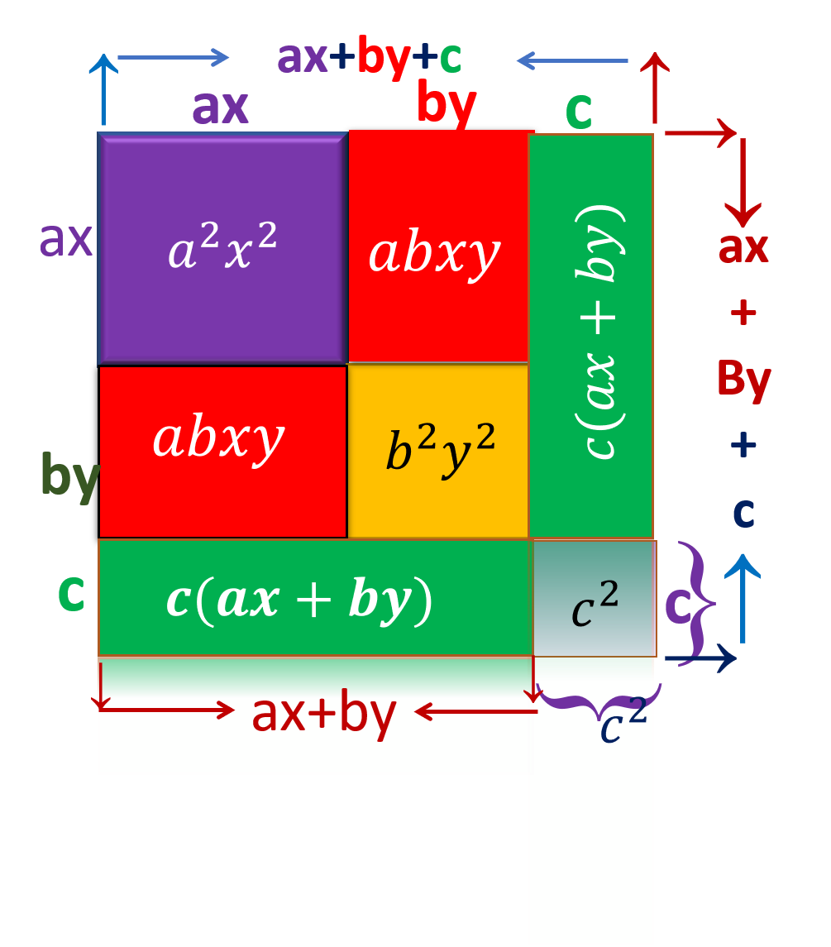

Slide 20
$$c(ax+by)$$
$$c(ax+by)$$
$$a^{2}x^{2}$$
$$b^{2}y^{2}$$
$$c^{2}$$
$$abxy$$
$$abxy$$

Slide 21
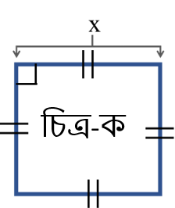
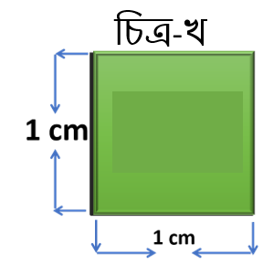
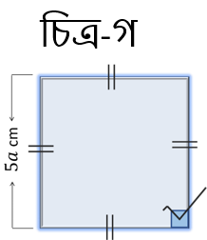

Slide 22
