Slide 3
Lesson INFORMATION
Subject : English
Class : Five
Lesson :1-2
Unit:4
Activity : A(Hi…..
internet)
Time : 40 min
A
e
r
G

Slide 4
Learning Outcomes
Student’s will be able to-
Listening:1.3.1-recognize which words in a sentence are stressed.
Speaking:1.1.1-say words and phrases and sentences with proper sounds and stress.
Reading:1.5.1-read words , phrases and sentences with proper pronunciation , stress and intonation.
Writing:5.1.3-read silently with understanding dialogue.

Slide 5
We can see here 4 persons are talking.
What can you see in the picture ?

Slide 6
Lesson declaration
Our todays lesson is “ Leisure time”

Slide 7
New word
leisure
magazine
pleasure
internet
reporter

Slide 8
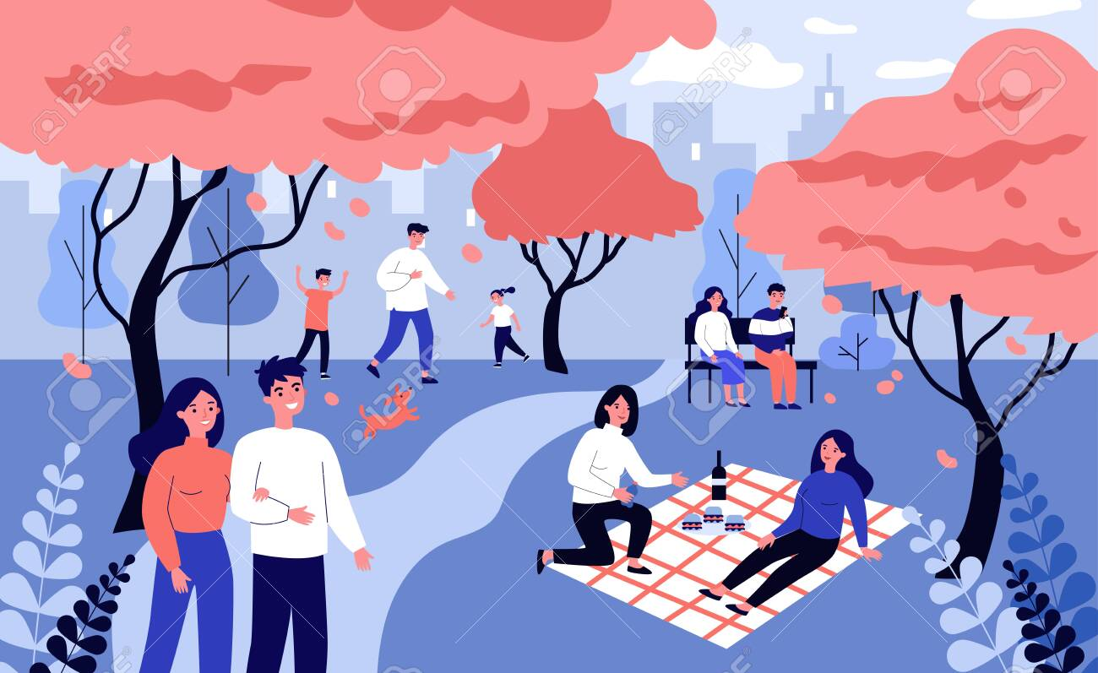
leisure
Free time
How do you spend your leisure time?.

Slide 9
magazine
journal
He is reading a magazine.

Slide 10
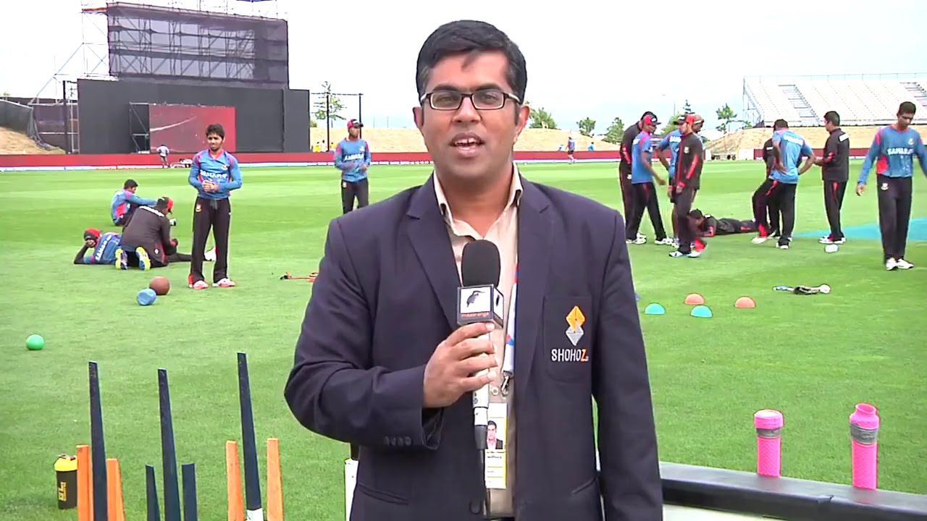
Reporter
Informer
He is a reporter.

Slide 11
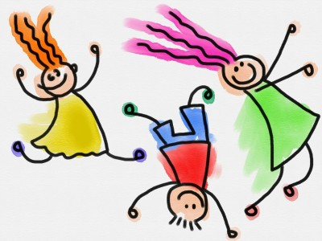
pleasure
joy
It’s my pleasure.

Slide 12
spend
pass
How do you spend your leisure time?.

Slide 13
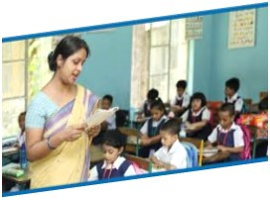
Teacher’s Reading

Slide 15
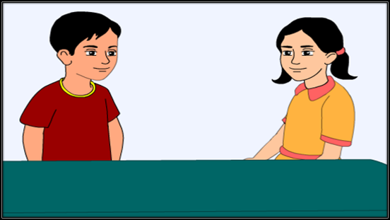
Tamal: Hi, my friend! Nasreen and I are reporters for the English Club Magazine. Would you mind answering some questions ?
Sima: Sure. No problem. It’s my pleasure.

Slide 16
Tamal: Could you tell me your name
and which class you are in ?
Sima:I’m Sima. I’m in class 5..

Slide 17
Tamal: How do you spend your leisure time?
Sima: Well, I like to walk in the park. I also like to sing .My cousin lives in the Uk. Sometimes I talk to her and her friends on the internet.

Slide 18
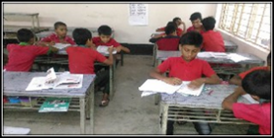
Group reading

Slide 19
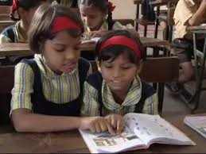
Read in pair

Slide 20
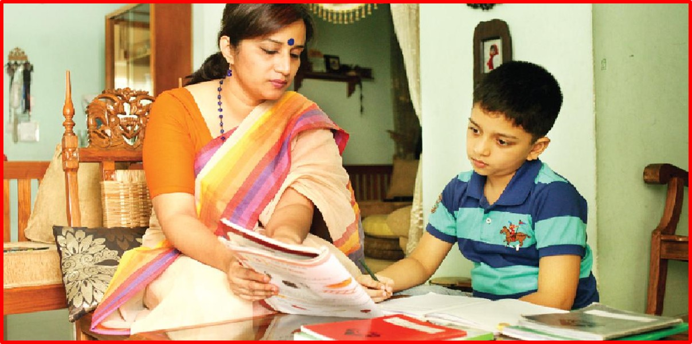
INDIVIDUAL WORK
Student’s reading

Slide 21
Practise the conversation with your partner.

Slide 22
Questions:
1In which class does Sima read in?
2.In which class does Biju read in?
3.What is Nasreen?
4.What is Tamal?
GROUP WORK

Slide 23
Answers:
1.Sima reads in class 5.
2.Biju reads in class 5.
3.Nasreen is a reporter.
4.Tamal is a reporter.

Slide 24
Bingo game
leisure
thanks
magazine
reporter
cousin
internet
problem
pleasure
question
sometime

Slide 25
One day one word
leisure-অবসর

Slide 26
Goodbye

