Slide 1
WELCOME ON OUR TODAY’S CLASS

Slide 2
PRESENTED BY
Teacher Intrduction:
Md. Faizul Alam Biswas
Head Teacher
Nobinagar Government Primary School
Godagari, Rajshahi.
Class Intrduction:
Subject: English
Class: Five
Lesson Title: Eat Healthy Live Healthy
Lesson Unit: 7
Page No : 26

Slide 3
LEARNING OUTCOMES
Students will be able to-
1.To Listen attentively.
2. To read the text with correct pronunciation.
3.To ask short questions answer.
4. To write some short questions answer.

Slide 4
LET’S SEE A VIDEO:
LET’S WE CLICK THE LINK BELOW

Slide 5
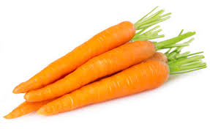
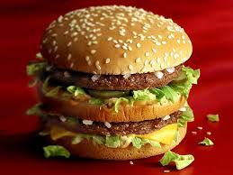
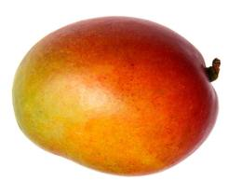
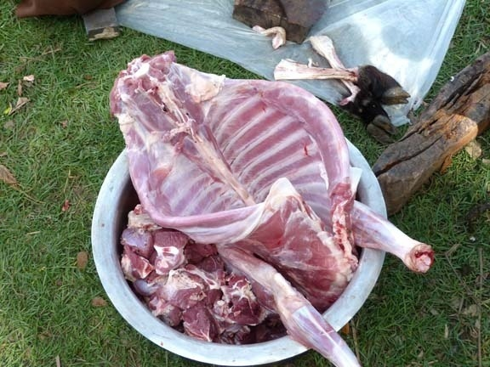
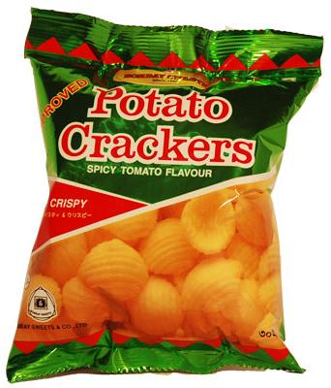
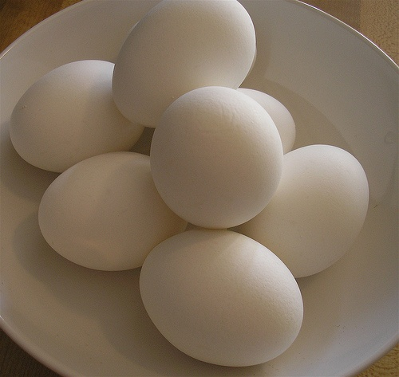
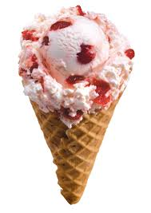
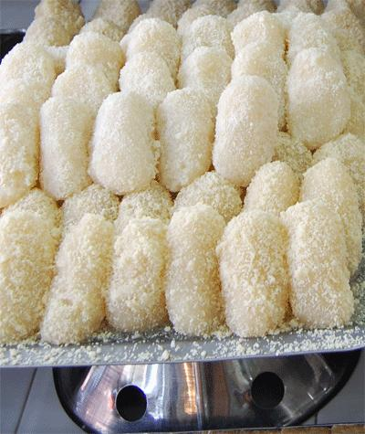
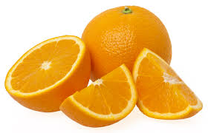

Slide 6
DECLARATION THE LESSON
Eat Healthy Live Healthy

Slide 7
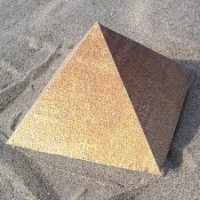
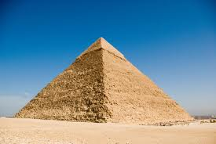
The pyramid of Egypt

Slide 8
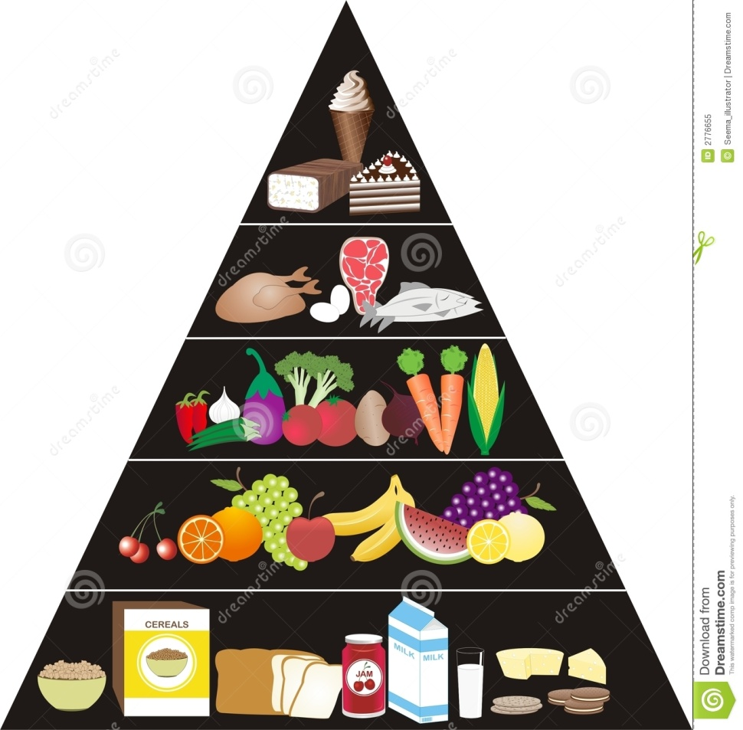
TOP LAYER
THIRD LAYER
SECOND LAYER
BOTTOM LAYER
FOOD PYRAMID

Slide 9
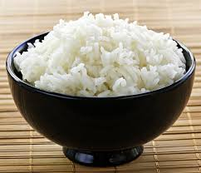
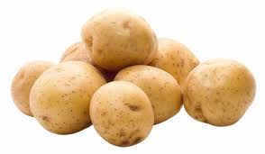
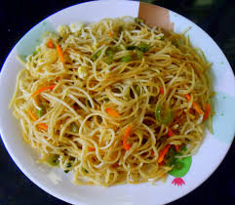
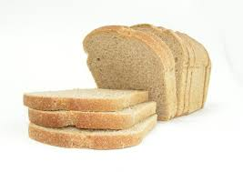
We should eat plenty of these foods

Slide 10
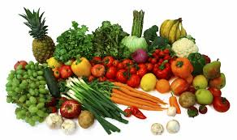
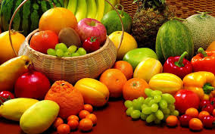
We must eat them regularly

Slide 11
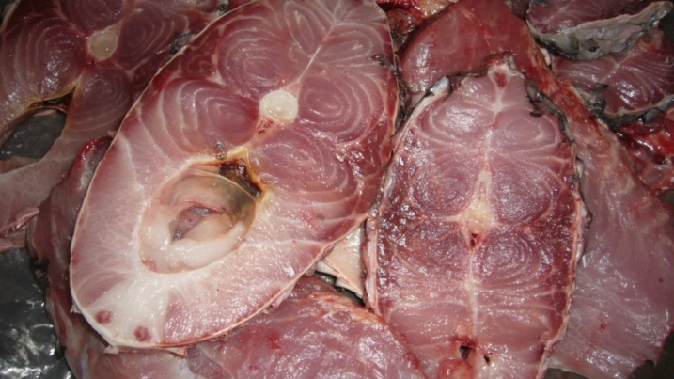
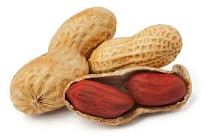
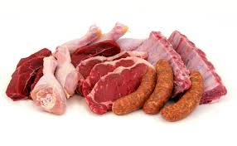
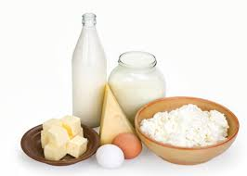
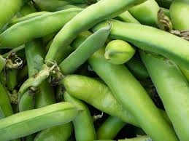
we should eat these foods moderately (not too much)

Slide 12
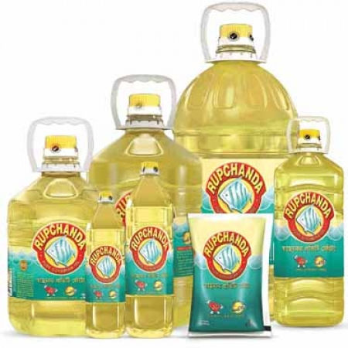
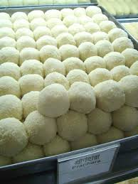
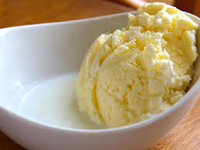
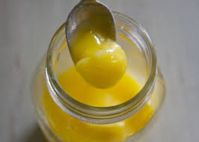
We should eat very little of these foods

Slide 13
OPEN YOUR BOOK AT PAGE - 28

Slide 14
NEW WORDS
PYRAMID
HEALTHY
YOGHURT
STONE

Slide 15
Advance Group:
Each of the student of this group will answer the question.
1.Make a list which foods we should eat more to keep healthy?
Level Group:
Make the sentence of the words
Healthy
Pyramid
plenty
Ans:
Healthy-We must eat healthy food.
Pyramid-Pyramid is a huge pile of stones.
Plenty-You can eat plenty of rice.
Slow Group:
Each of the student of this group rearrange the words-
alhetyh
tyenlp\
ramidyp.
Ans:
Healthy
plenty
pyramid.

Slide 16
QUESTIONS
1.What does our body need?
2.How much bread should you eat?
3.How much fish should you eat?
4.How many sweet should you eat?
ANSWERS
1. Our body needs a good mix of foods.
2.Plenty
3.Moderately
4.Very little

Slide 17
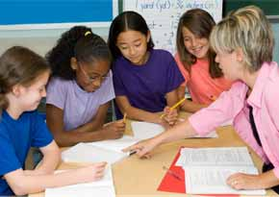
GROUP WORK

Slide 18
GROUP-A
List of those foods which we should eat plenty?
GROUP-B
List of those foods which we should eat regularly?
GROUP-C
List of those foods which we should eat moderately?
GROUP-D
List of those foods which we should eat very little?

Slide 19
TASK
1.What is food pyramid?
2.Write the name of the food at the bottom of the pyramid?

Slide 20
HOME WORK
Write five sentences about your favorite food.

Slide 21
Thank’s

