Slide 1
Adamdighi Balika Government Primary School Adamdighi, Bogura.
Welcome to my online class.
Stay home
Stay safe

Slide 2
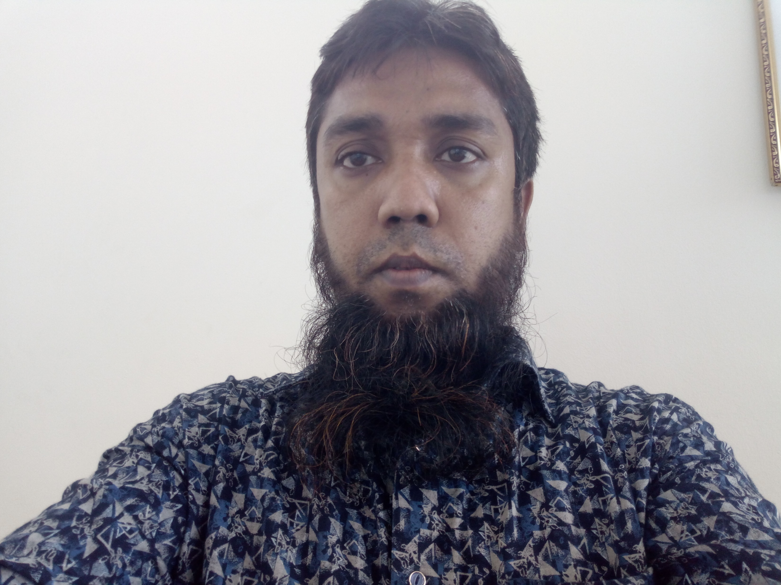
Teacher’s introduce:
M MOSTAB SIRA RUJDI
Assistant teacher
Adamdighi Balika Government Primary School
Adamdighi, Bogura

Slide 3
Lesson introduce:
Subject: English
Tropic:D-E
Unit:3
Class: 5

Slide 4
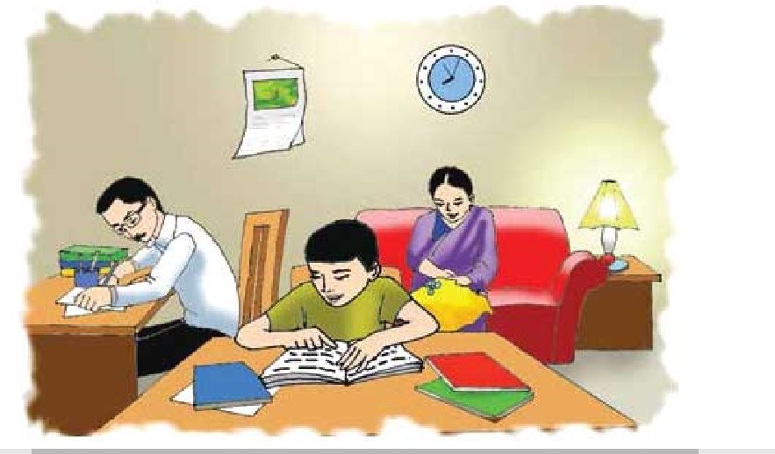

Slide 5
Learning Outcomes:
At the end of the lesson students will be able to----------
Speaking::
3.1.1-ask and answer WH questions.
Reading:
1.6.1-recognize and read statements commands greetings ,
questions and answers.
Writing:
8.1.1-make sentences using words and phrases given in the text book.

Slide 6
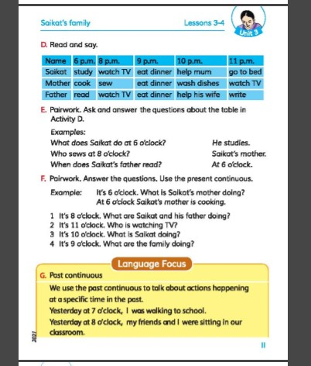

Slide 9
End of the leson:

Slide 10
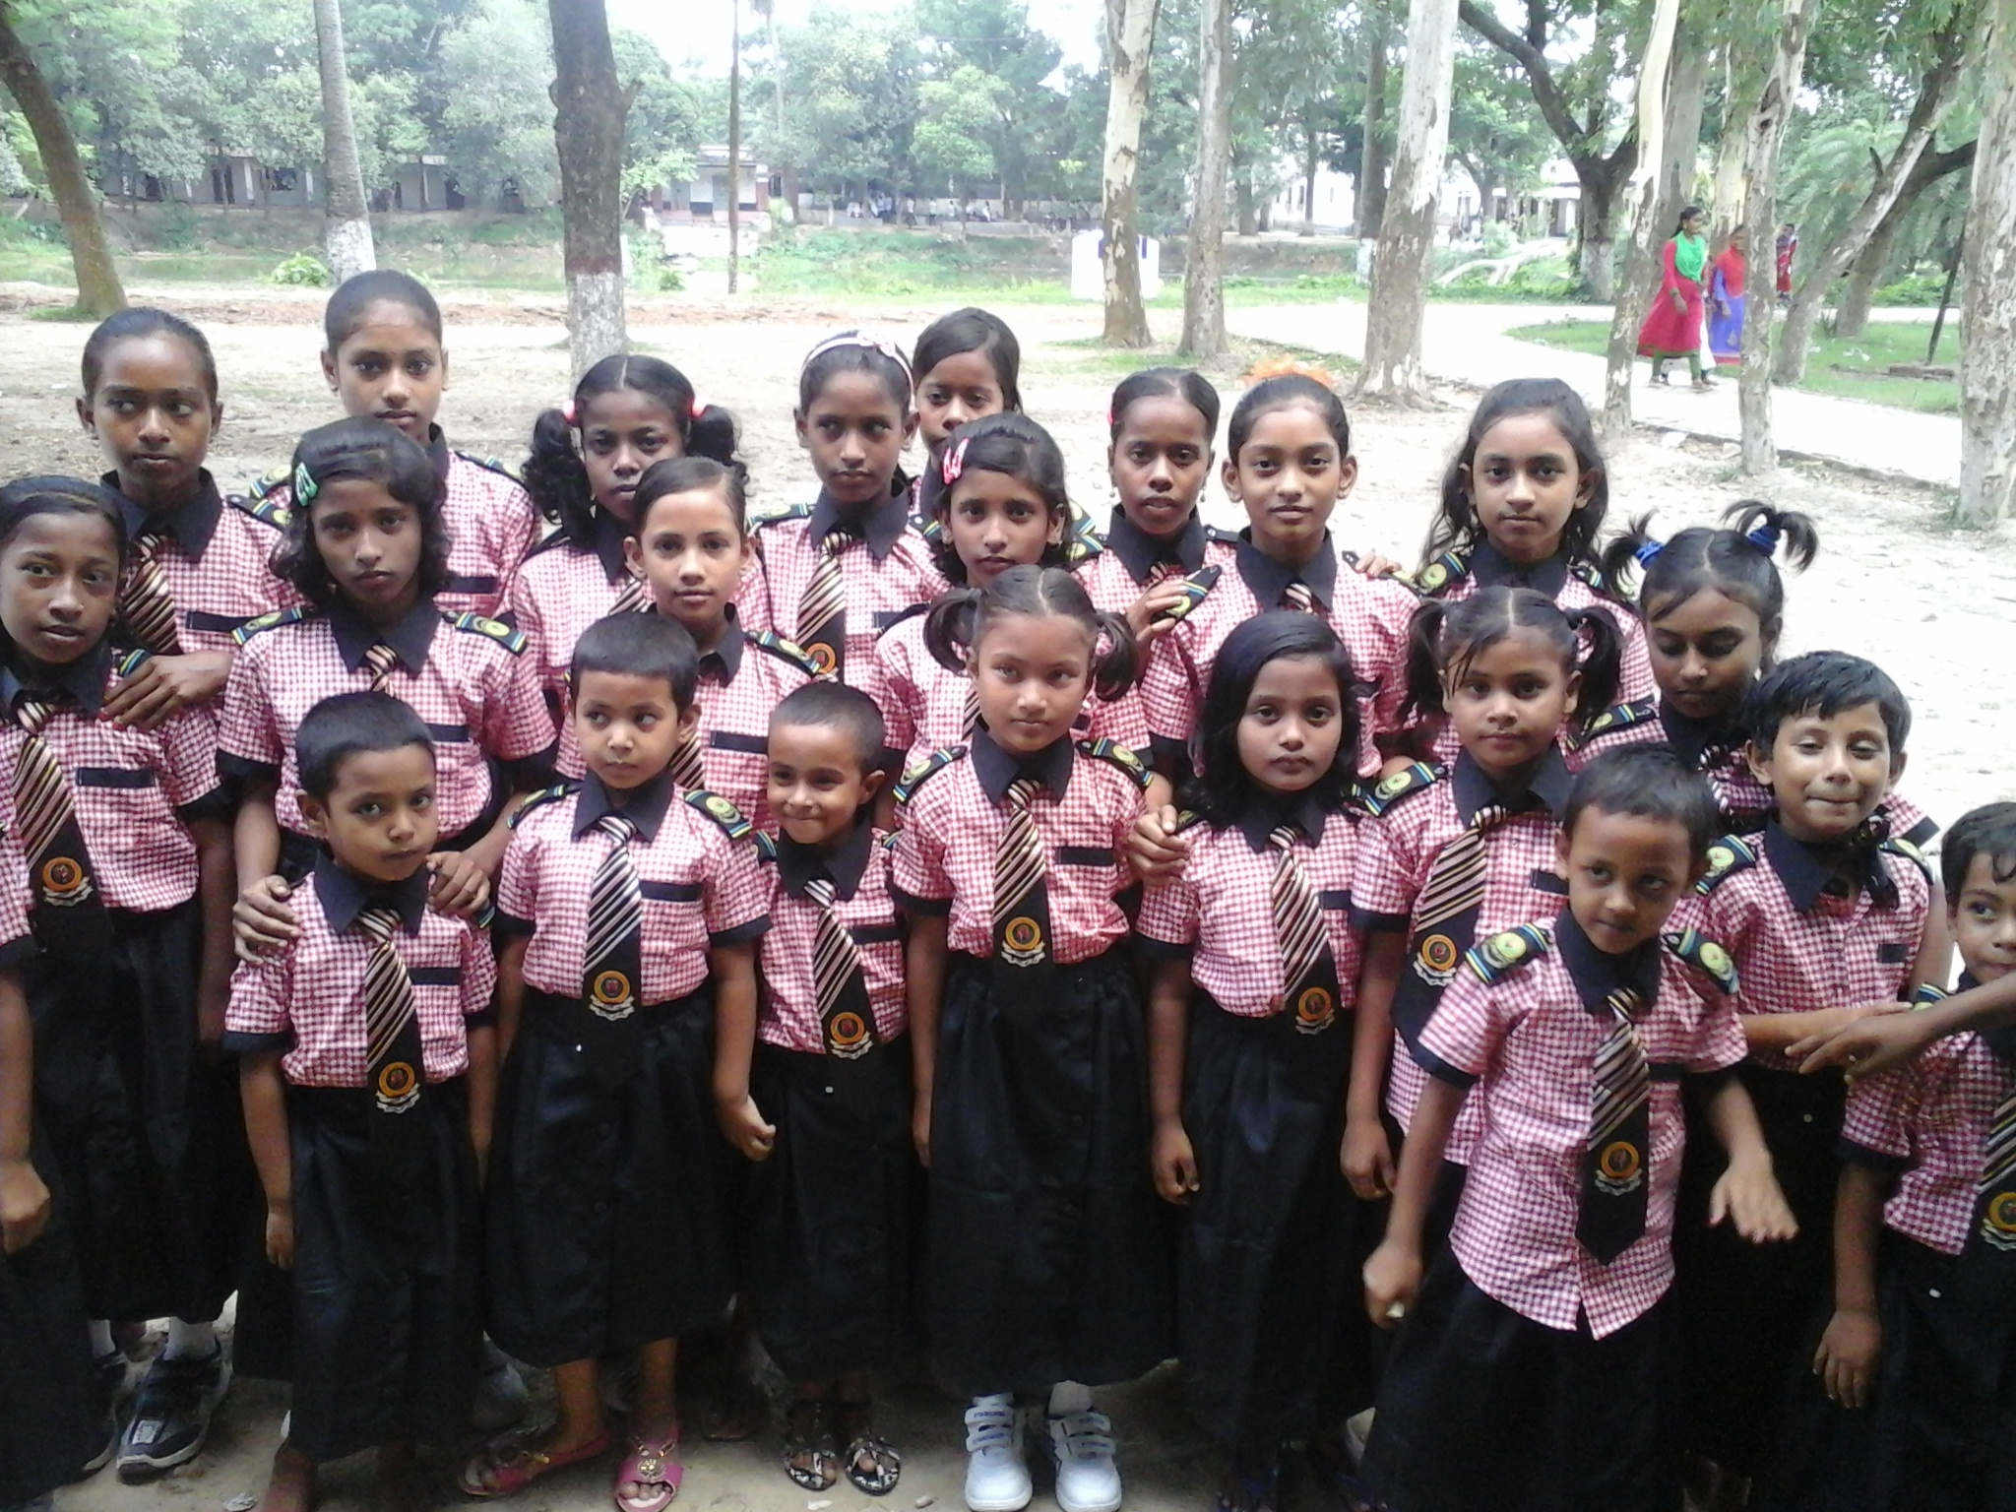
Good bye students!
Take my salam.
See you bye my next class !
_______ Presented by
M Mostab Sira Rujdi
Assistant Teacher at
Adamdighi Balika GPS
,Adamdighi ,Bogura.

