Slide 1
BOGURA ONLINE PRIMARY SCHOOL
Stay home
Stay safe

Slide 2
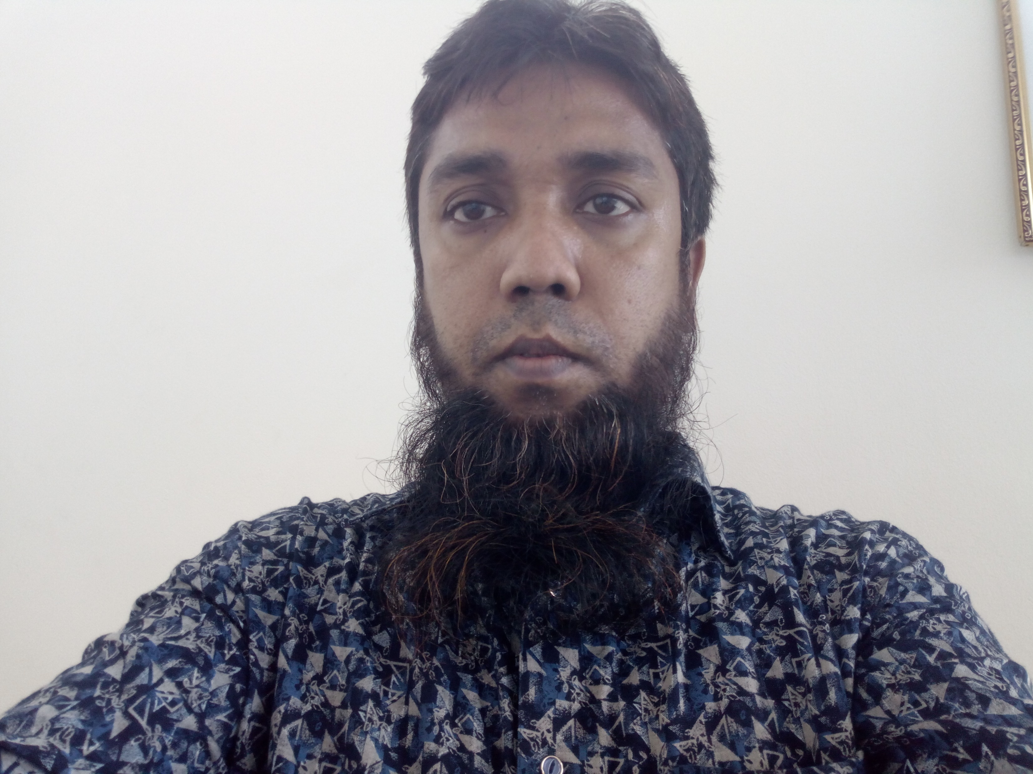
Teacher’s introduce:
M MOSTAB SIRA RUJDI
Assistant teacher
Adamdighi Balika Government Primary School, ADAMDIGHI, BOGURA.

Slide 3
Lesson introduce:
Subject: English
Tropic: WH Question
Class: 5

Slide 4
Learning Outcomes:
At the end of the lesson students will be able to----------
Speaking::
3.1.1-ask and answer WH questions.
Reading:
1.6.1-recognize and read statements commands greetings ,
questions and answers.
Writing:
8.1.1-make sentences using words and phrases given in the text book.

Slide 5
Good morning, students.
How are you?
Notes:
Creating safety environment :By exchange greetings.

Slide 6
WH Question: What,Who,When,Why,Where,Which,Whose,How
Structure :
1. WH +verb +subject
2. WH +Helping verb +subject + main verb +objec
Example:1.The pen is red.
ans:How is the pen?
2.He grows crops.
ans.What does he grow ?

Slide 7
Helping Verb:
There are two kinds of helping verb.
1.Do,Did, Does
2.Am, is, are, was, were,shall, will, have, has, had,
can, could, should, would

Slide 8
9. Make WH questions with underline words.
Tamim goes to Dhaka to play cricket on Monday.
1. Ans:Who goes to Dhaka to play cricket?
2.Where does Tamim go to play cricket?
3.Why does Tamim go to Dhaka?
4.When does Tamim go to Dhaka?

Slide 9
TEST 9.Make five WH question with underline words.
a. Maria gets up early.
b. She feels happy .
c. She can smell the flowers.
D .She is ready for school.
e. Maria is visually impaired.

Slide 10
Answer to the questions No.9:
a. When does Maria get up?
b. How does she feel?
c. What can she ?
d. Why is she ready?
e. Who is visually impaired?

Slide 11
Home Work:
9.Make five WH question with underline words.
A .Sima is ill.
b. Tamim plays cricket.
c. She works in bank.
d. They are going to school at 9.00 am.
e. He is 9 years old.
f. The day was awful.
g. Saikat reads English books.

Slide 12
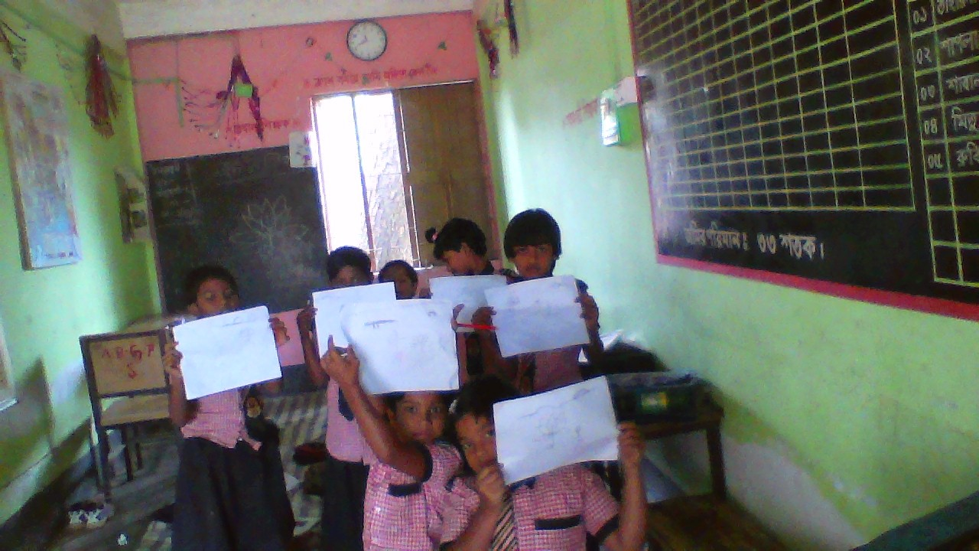
End of the leson:
Good bye students!
Take my salam.
See you bye my next class !
_______ Presented by
M Mostab Sira Rujdi
Assistant Teacher at
Adamdighi Balika GPS,Adamdighi ,Bogura.

