Slide 1
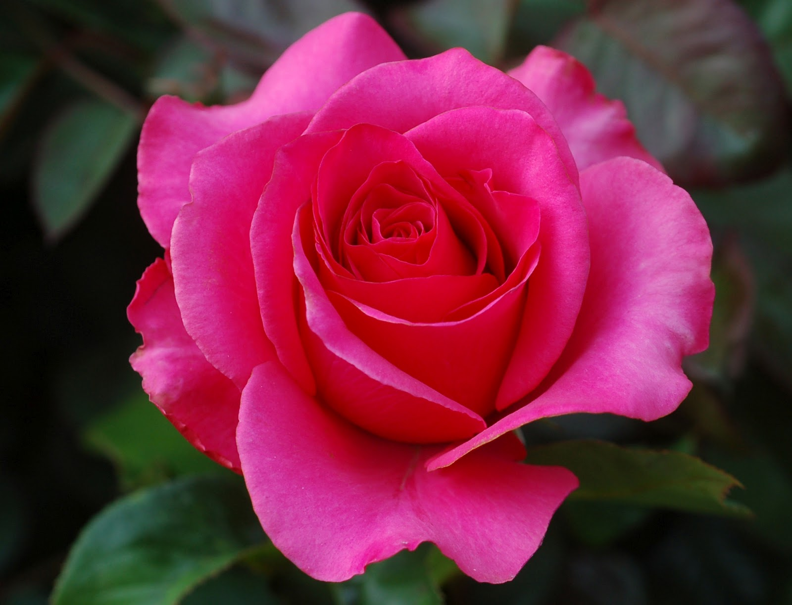
WELCOME

Slide 2
Class: VI-VII
Sub: English Grammar
IBRAHIM KHALIL
B.Com.(Hons), M. Com.(Accounting), M.Ed.
SENIOR TEACHER,
ICHHAPURA GOVT. MODEL HIGH SCHOOL

Slide 6
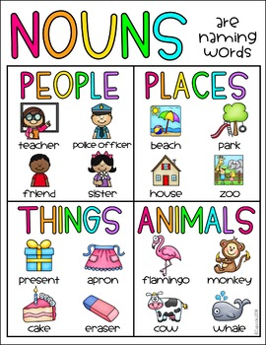
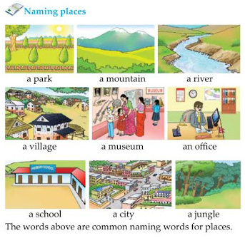
https://www.youtube.com/watch?v=qcXy6_Mqe54

Slide 8
Learning outcomes
After learning this lesson. Ss will be able to--
* Have a clear idea about ‘Noun’
* Define noun.
* Identify naming words in a sentense.
* Ask and answer questions about nouns.

Slide 9
যে word দ্বারা কোন কিছুর নাম প্রকাশ করা হয় তাকেই noun বলে । আমাদের চোখের সামনে যা দেখি সেগুলোর নামকেই noun বলে। Noun দ্বারা কোন ব্যক্তি, বস্তু, প্রাণী ,স্থান ,ঘটনা ইত্যাদির নাম বোঝায়।
Example:
Karim does not like to go to school.
এই বাক্যে Karim একজন ব্যক্তির নাম।
Kuwait is a Muslim country.
এখানে কুয়েত একটি দেশের নাম।
Diamond is very valuable.
ডায়মন্ড একটি বস্তুর নাম।

Slide 10
Noun Definition | Meaning
A noun is a naming word. It can be the name of a thing, place, person, animal or feeling.
Naming People: It could be a name of any person, for example: John, Fatima, Michael, etc.
Naming Places: It could be a name of any place, for example: China, Church, Tajmahal, etc.
Naming Things: Naming things are like Car, Hat, Bottle, Table, Chair, Ball etc.
Naming Animals: Dog, Rabbit, Elephant, Chicken, Horse.
Naming Feeling/Qualities/Ideas: Joy, Fear, Beauty, Strength, Anger.

Slide 11
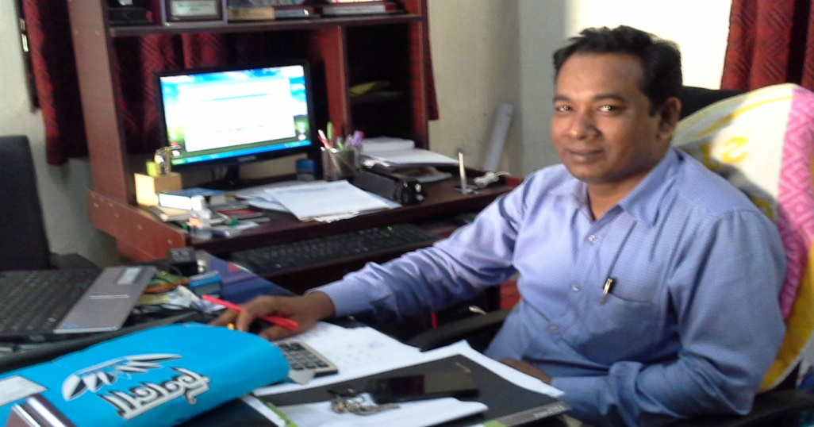
Name of a person:
Mr. NASIR
Mr. JAMAL

Slide 12
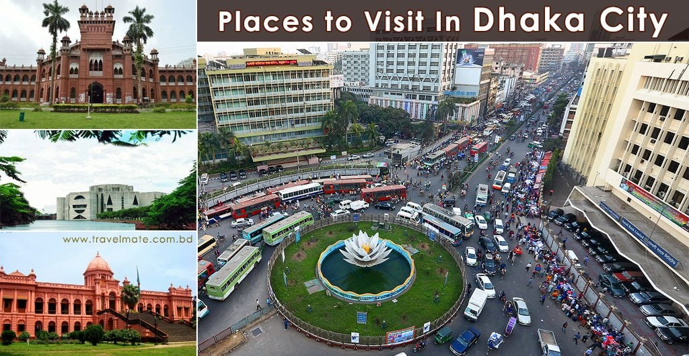
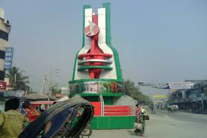
Name of a place :
DHAKA
munshiganj

Slide 13
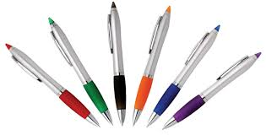
Name of a thing :
BOOK
PEN
CHAIR-TABLE

Slide 14
Identify words that are a person, place, thing, or idea:
• She walked home.
In the sentence “She” is the noun because she is a person.
• Cox’s Bazar is a cool city.
In the sentence “Cox’s Bazar ” is the noun because it is a place.
• The windows need to be open.
In the sentence “windows” is the noun because it is a thing.

Slide 15
• I live in Australia.
• Jenny is my sister.
• I love to play with my dog.
• The name of this monkey is Boo.
• Pacific Ocean is very vast.
• The boy and girl were holding hands as they crossed the bridge on the way to town.
• I love watching my cat play with the pink yarn.
• They have a cow which gives them milk.
• We like to go to school regularly.

Slide 16
Identify words that are a person, place, thing, or idea.
Nouns are words that depict specific objects, ideas, or people, that the sentence is built around. Look out for words in a sentence that are not actionable or descriptive, and instead only state exactly what something is.
• In the sentence “She walked home,” “She” is the noun because she is a person.
• In “Portland is a cool city,” “Portland” is the noun because it is a place.
• In “The windows need to be open,” “windows” is the noun because it is a thing.
• In “Your courage is inspiring,” “courage” is the noun because it is an idea.

Slide 17
Method 1: Finding Nouns in a Sentence
Locate the main verb in the sentence to identify the connected noun:
A verb is an action word that usually describes the act of doing. Grabbing, singing, and playing are all verbs. More often than not, the verb in the sentence is directly linked to the subject of the sentence. Identify who or what is completing the action in the sentence.
In the sentence “She lifts weights,” “lifts” is the verb, and “she” is the noun.

Slide 18
See if the word follows “a,” “and,” or “the.” These words are called articles:
If a word follows an article, it is almost certainly a noun. Try to identify any articles in your sentence and see if there is a noun that follows directly after it.
In the sentence “The dance was held on Saturday,” “dance” is the noun since it follows “the.”

Slide 19
See if the word follows “some,” “a lot,” or a specific number:
Words that describe quantities almost always precede a noun. If the sentence has a quantity word in it, look at the word that is directly after it to see if it could be a noun.
In “Some computers in here are broken,” “computers” is the noun since it follows “some.”

Slide 20
Find words that are capitalized as a clue that they might be nouns:
Words that are capitalized in a sentence are almost always proper nouns, since they are usually the names of people, places, or things. Look for any words in the middle of a sentence that are capitalized and see if they could be a noun.
In the sentence “Do you think the Red Sox will win?” “Red Sox” is the noun, since it is the name of a team.

Slide 21
Determine if the word has a descriptor in front of it:
Descriptive words, or adjectives, almost always are describing a noun. If you are questioning whether a word is a noun or not, see if there is an adjective in front of it. If there is, chances are the word is a noun.
For example, in the sentence “The stinky socks were gross,” “stinky” is the adjective, and “socks” is the noun.

Slide 22
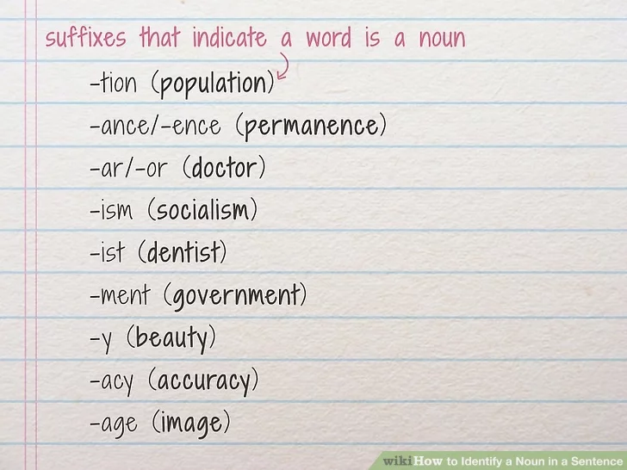
Recognize common endings that indicate a word is a noun.
Sometimes, the ending of a word, or the suffix, can clue you in as to what function it serves in a sentence. Often, nouns end in -ity, -ness, and -hood. Some other common examples of noun suffixes are:
-tion (population), -ance/-ence (permanence), -ar/-or (doctor), -ism (socialism), -ist (dentist), -ment (government), -y (beauty), -acy (accuracy), -age (image)

Slide 23
Test to see if the word can be pluralized.
If you can add a plural modifier onto the back of a word, it is most likely a noun. Choose the word that you believe to be a noun and add a letter or letters on the end of it to make it plural. Most often, the plural version of a word has an “s” on the end of it.
If a noun is plural in a sentence, it is a plural noun.

Slide 24
Spot possessive nouns by looking for an apostrophe and an “s.”
Possessive nouns add ownership to a person, place, thing, or idea by adding an apostrophe and an “s” after the word. Theses nouns usually stand right in front of the thing that they are possessing. If a person, place, thing, or idea owns something, that word is a noun.
In “The book’s cover is gold,” “book’s” is the possessive noun.

Slide 25
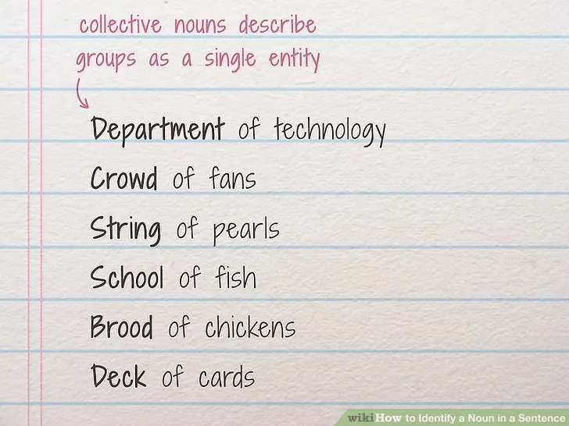
Look for nouns that describe groups as a single entity:
Collective nouns, or nouns that give a name to a large group of people, things, objects, or ideas, can be hard to spot, since they may not seem like nouns at first glance. Watch out for words like “array,” “choir,” and “class” to find collective nouns in a sentence.

Slide 26
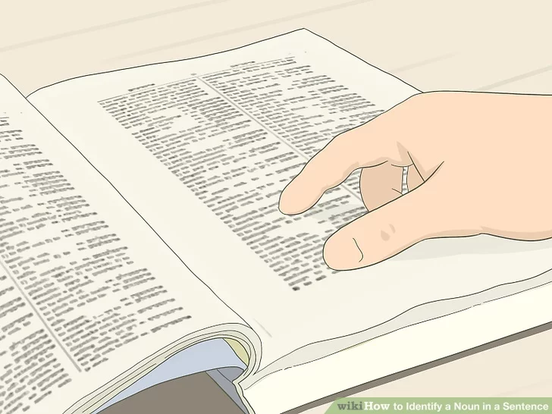
Look up the word in the dictionary to see if it is a noun:
If all else fails, take a peek inside of a dictionary to find out what part of a sentence that word usually is. Dictionaries have symbols next to each definition of a word. A lowercase “n” signifies that a word is a noun.

Slide 27
Classification of nouns:
Proper noun
Common noun
Collective noun
Material noun
Abstract noun

