Slide 2
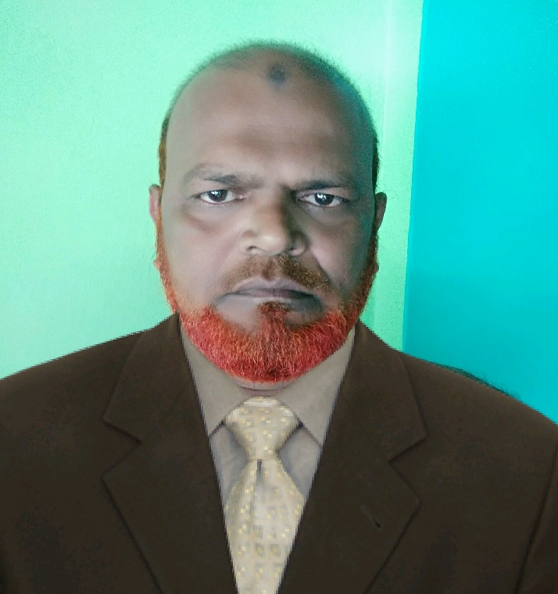
Presented By
md. KHALILUR RAHMAN
ASSISTANT TEACHER
ATGHARIA HIGH SCHOOL,
Email: khalilur521970@gmail.com

Slide 3
Class seven
English 2nd
Transformation
Exclamatory to assertive
Time:45minutes

Slide 4
How nice the rose is!
What kind of sentence it is?
Ans: exclamatory

Slide 5
Our todays topics is Transformation
Exclamatory to Assertive

Slide 6
Exclamatory sentence
How/what + adjective + Subject Verb!
Assertive sentence
Sub +verb +very/great +adjective

Slide 7
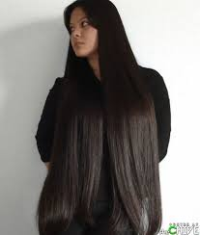
Exclamatory sentence এ How / what থাকলে very/ great বসে
How fast my hair grows!
My hair grows very fast

Slide 8
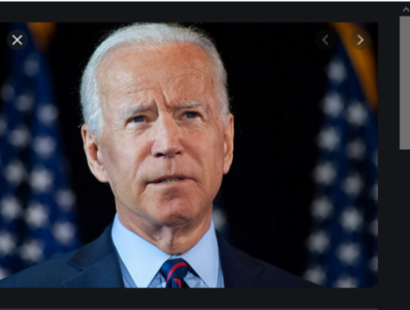
What a f00l I am!
I am a great fool.
Fool থাকলে great বসে

Slide 9
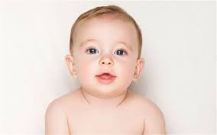
If I were a child again!
I wish I were a child again.
Had I the wings of a dove!
I wish I had the wings of a dove
If/Had থাকলে assertive এ wish বসে

Slide 10
Hurrah! We have won the match.
It is a mater of joy that we have won the match.
Hurrah থাকলে matter of joy বসে।

Slide 11
Evaluation
1.How exciting the game is! (Assertive)
2. If I were a president! (Assertive)
3. How lucky he is! (Assertive)
1.The game is very exciting.
2.I wish I were a president.
3.He is very lucky.

Slide 12
Home work
দশটি exclamatory sentence বাড়ী থেকে লিখে আনবে।

