Slide 1
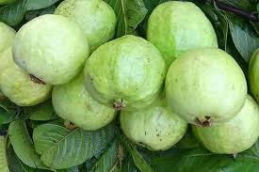
welcome

Slide 2
Teacher`s Identify
Md Abu bkar siddik
Super
Kornoshuti dakhil madrasha
Kamarkhond,sirajgonj.

Slide 3
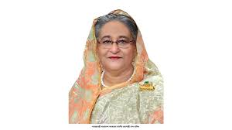
Who is this woman?
What is her name?
Her name is shekh Hasin
She is prime minister of bangladesh.
Where does she live?
She lives in bangladesh.

Slide 4
Our today`s topic is
Bangladesh
Learning out come
1.Students come to know1.The name of prime minister of bangladesh.2. About their mother land.3 where does she (p.m)live.

Slide 5
We live in Bangladesh . Shekh hasina is primeminister of. bangladesh.Bangladesh is a small and beautiful country

Slide 6
What kind country is bangladesh?
Who is shekh hasina?
Thannks all

