Slide 2
Intoduction of Teacher
Hosne Ara Basry
(lecturer in English)
Bakhtiar Para Charpir Aulia Alim Madrasah, Anowara,Ctg.
Cell No: ********
E-mail Add: ******@gmail .com
Introduction of Lesson
English First Paper
English for Today
Alim 1st Year
Time: 40m

Slide 3
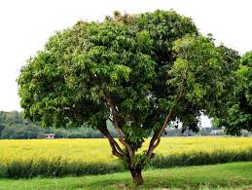
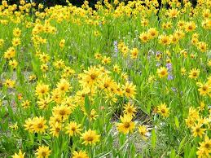

Slide 4
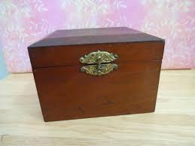
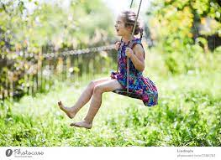

Slide 5
Unit : 4
Lesson : 3
Photograph

Slide 6
Learning Outcomes
Students will be able to learn about-
the meaning/synonym of the hard words
The story
summary / theme

Slide 7
Growth-increase
Count-calculation
Trouble-sorrow
Wallop-bang
Exception-departure
Bow-rainbow
Wrinkle-curling
Knitting-texture
Fade-turn pale
Silence-shut up
String-rope
Warmth-temparature
Common-general
Word Meaning

Slide 8
Story & Summary Discussion

Slide 9
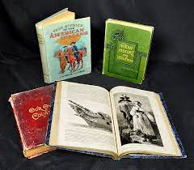
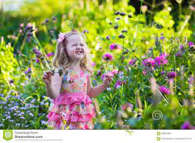
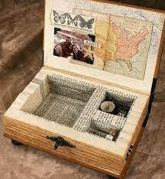

Slide 10
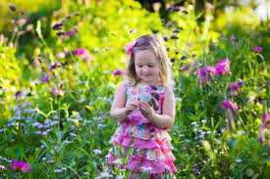
Class Work
Write the name of the flowers which were at the girl’s feet.
Describe about the grandmother and the boy in your own words.

Slide 11
Evaluation
When was the cool breeze blowing?
What flowers were at girl’s feet?
How was the girl in the photograph?
Who has been referred to by cold lady?

Slide 12
Home Work
Write synonyms of the following words:
String, warm, fade, granny, shout, wind.
Write a theme of the story.

