Slide 1


Welcome

Slide 2


Teacher’s Information
Md. Shamsul Alam
BA(Hons.)MA in English.
Assistant Teacher( English)
Nabodoy Girl’s High School
Shailkupa, Jenaidah.
Phone:01917-452052,01722-922691
Email:shamsul101085@gmail.com

Slide 3
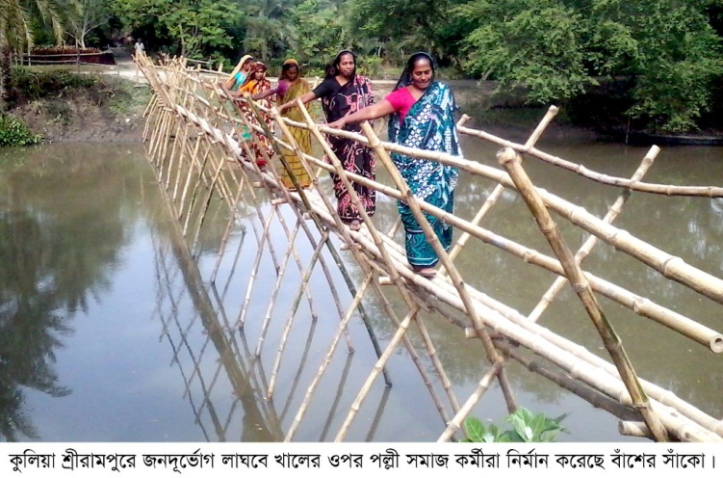
If there is a bridge on the canal, people can
easily connect with the people of other side.

Slide 4
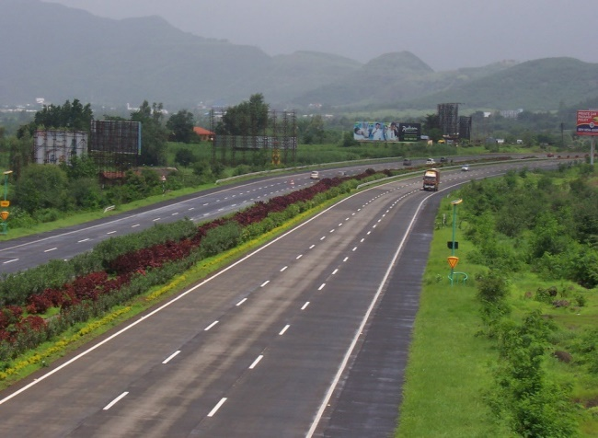
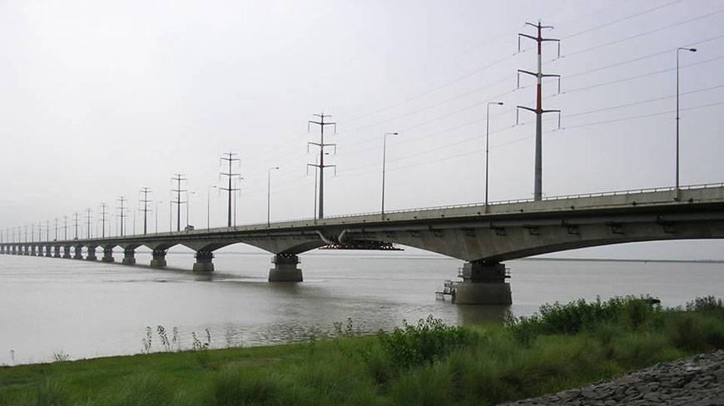

What do you see in the pictures?
,
If you want to cross a river
you need to use a bridge.
Notes:
The learners will be asked to say something on the pictures. After learners’ speech the teacher will announce the day’s topic.

Slide 5
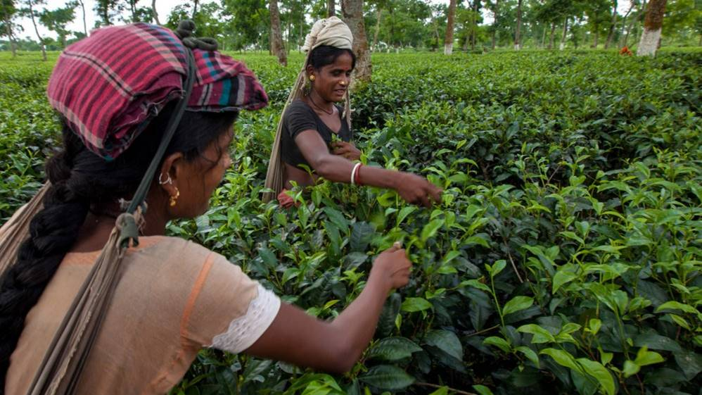
TODAY’S TOPIC
SENTENCE CONNECTORS
(LINKERS)

Slide 6
Learning outcomes
By the end of the lesson the learners will be able to-
*make sentences using sentence connectors (linkers)
*use sentence connectors in a passage listening to a text.
* develop a paragraph using sentence connectors.

Slide 7
What is connector/linker?
A connector/linker is a word that works as a conjunction to join two or more words, phrases and clauses together.

Slide 8

Why do we need them?
We need them because…
They join ideas and show how those ideas are related to one another.
They help us organize our ideas.
It’s easier for the reader to follow.

Slide 9
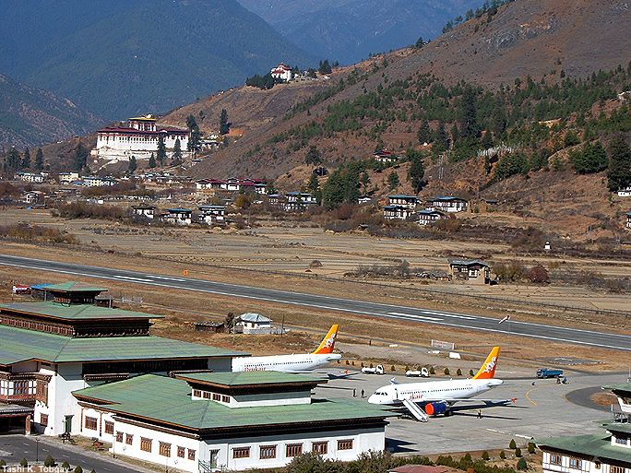
How can we link these sentences?
Life in the hill.
Life in the hill is challenging. Life in the hill can be really exciting.
Despite the life in the hill is challenging, it can be really exciting.
Even though life in the hill is challenging, it can be really exciting.
Life in the hill is challenging; however, it can be very exciting.
Despite, Even though, however are connectors.

Slide 10
Wait! There’s a different way.
Life in the hill is challenging; therefore, it can be very exciting.

Slide 11
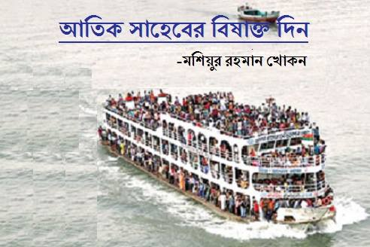
The launch was over crowded .
As a result, it may sink.
Notes:
The learners will be asked for making more sentences using the given linker.

Slide 12
Always use a comma after “however” and “therefore”.
I don’t like when it rains, however we desperately need water in our tent.
Use a comma after however.
I don’t like when it rains. However, we desperately need water in our tent.
OR
I don’t like when it rains; however, we desperately need water in our tent.

Slide 13
Connectors of cause and effect
Therefore - অতএব
Consequently -ফলস্বরূপ/পরিনামে
As a result -ফলে
Thus -এভাবে
For this reason -এ কারনে
Because -কারণ
Because of -কারনে/জন্যে
In order to -কারনে/জন্যে
So that -যাতে

Slide 14
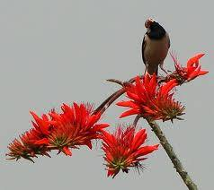
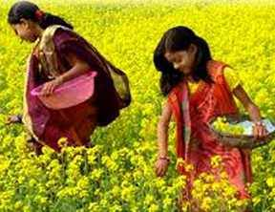
When it is spring , colourful flowers bloom.
Notes:
The learners are asked to maake more sentences with when.

Slide 15
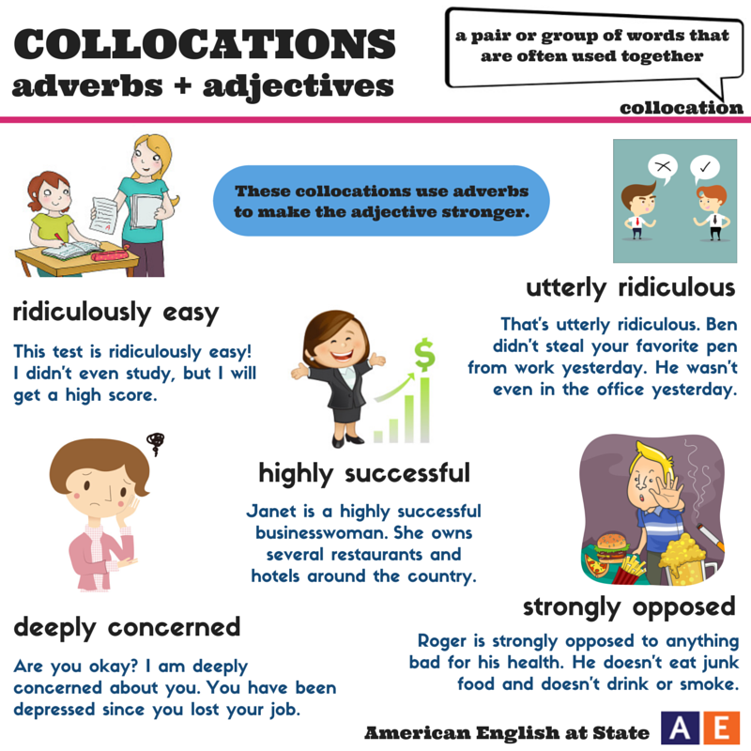

. In addition to , you have lost the former one.
Are you okay ? I am deeply concerned about you. You have been depressed since you missed the new job interview.
Notes:
The learners will make more sentences with in addition to.

Slide 16
Connectors of sequence
First / Firstly -প্রথমত
Second / secondly -দ্বিতীয়ত
Third/Thirdly etc. -তৃতীয়ত ইত্যাদি।
Next -তারপর
Afterwards / After that -পরবর্তীতে/তারপর
Eventually -অবশেষে
Finally -অবশেষে
Before that / before hand -নির্দিষ্ট সময়ের পূর্বেই

Slide 17

At first The bees collect honey from flowers.
After that they store them in the beehive.
Notes:
The learners will be asked for developing a sequence using the given connectors.

Slide 18
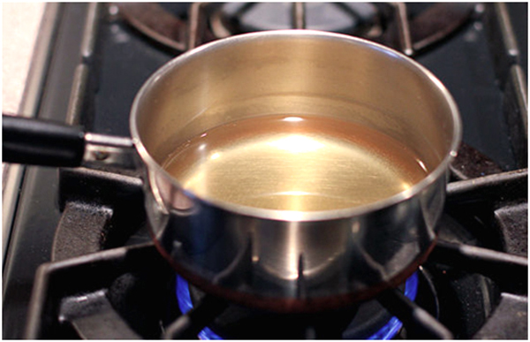
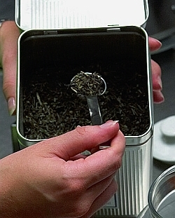
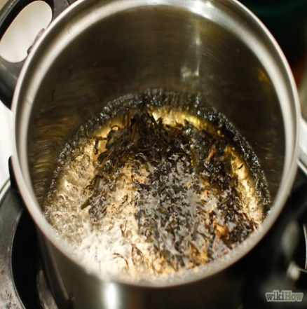
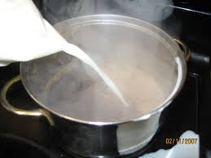
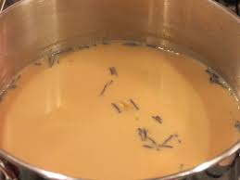
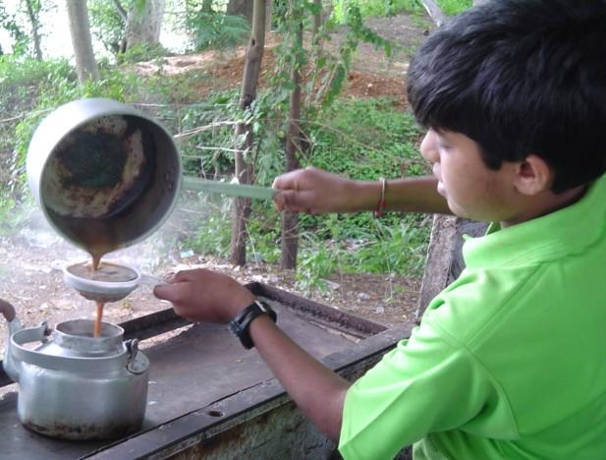
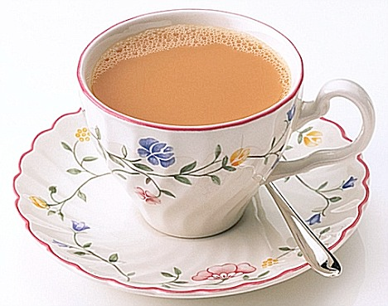
Discuss the pictures in pairs . Then develop a paragraph using the given clues.
Clues: At first, Then, After that,
Next, Afterward, later ,Finally

Slide 19
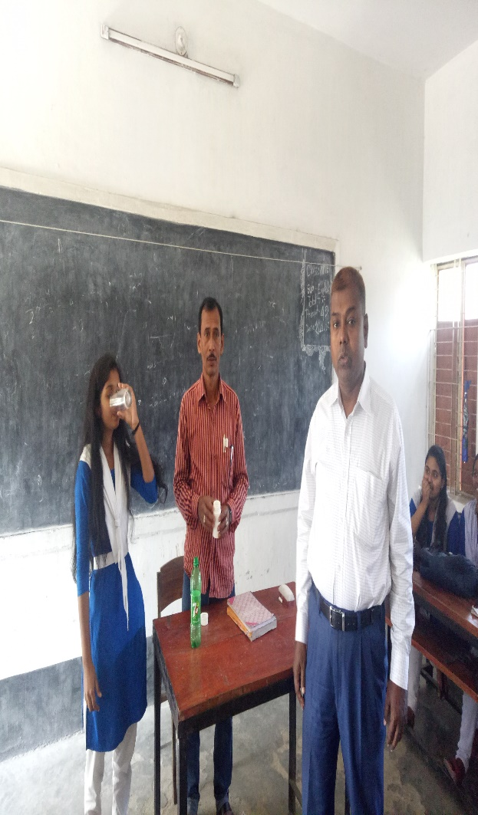
I couldn’t get my head around the Passive Voice. Anyway, I don’t think it’s important to use it all the time.
Notes:
The learners will be asked for making sentence or passage using more dismissal sentence connectors- any way, any how,at any rate

Slide 20
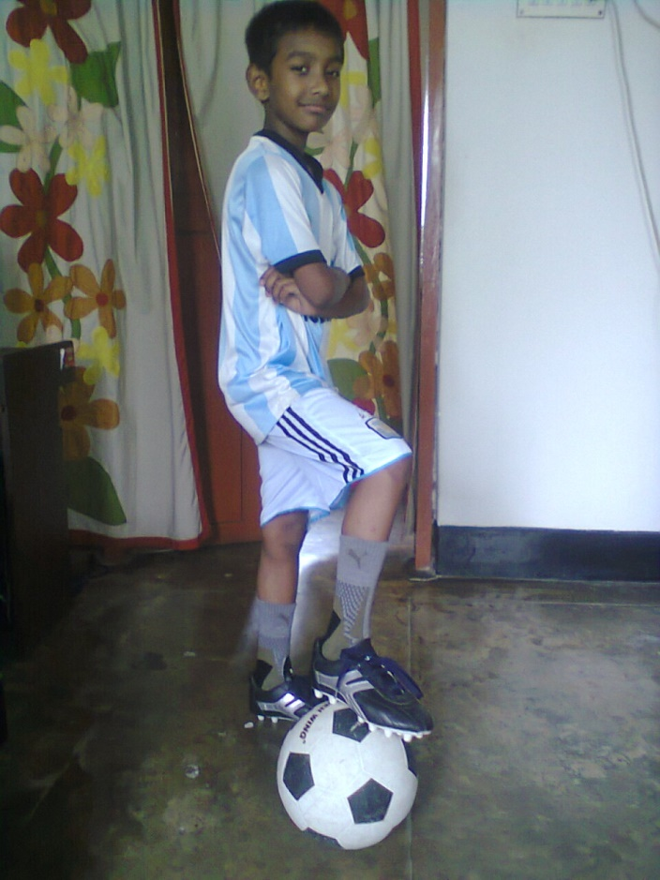
Riad was in so much pain . He didn’t want to get up in the morning to go to school. Nevertheless, now he is ready to go to football practice as usual.

Slide 21
Connectors of contrast (To mean different)
However -যাইহোক
Nevertheless -তবুও/তথাপিও
Although / though / even though-যদিও
In spite of / despite -সত্ত্বেও
In contrast to -অন্যদিকে
On the other hand -অন্যদিকে
Whereas / while -যেখানে
On the contrary -পক্ষান্তরে

Slide 22
Yesterday I appeared at a sudden class test. The test was ridiculously easy ! I didn’t even study ,
but I will get a high score.

Slide 23
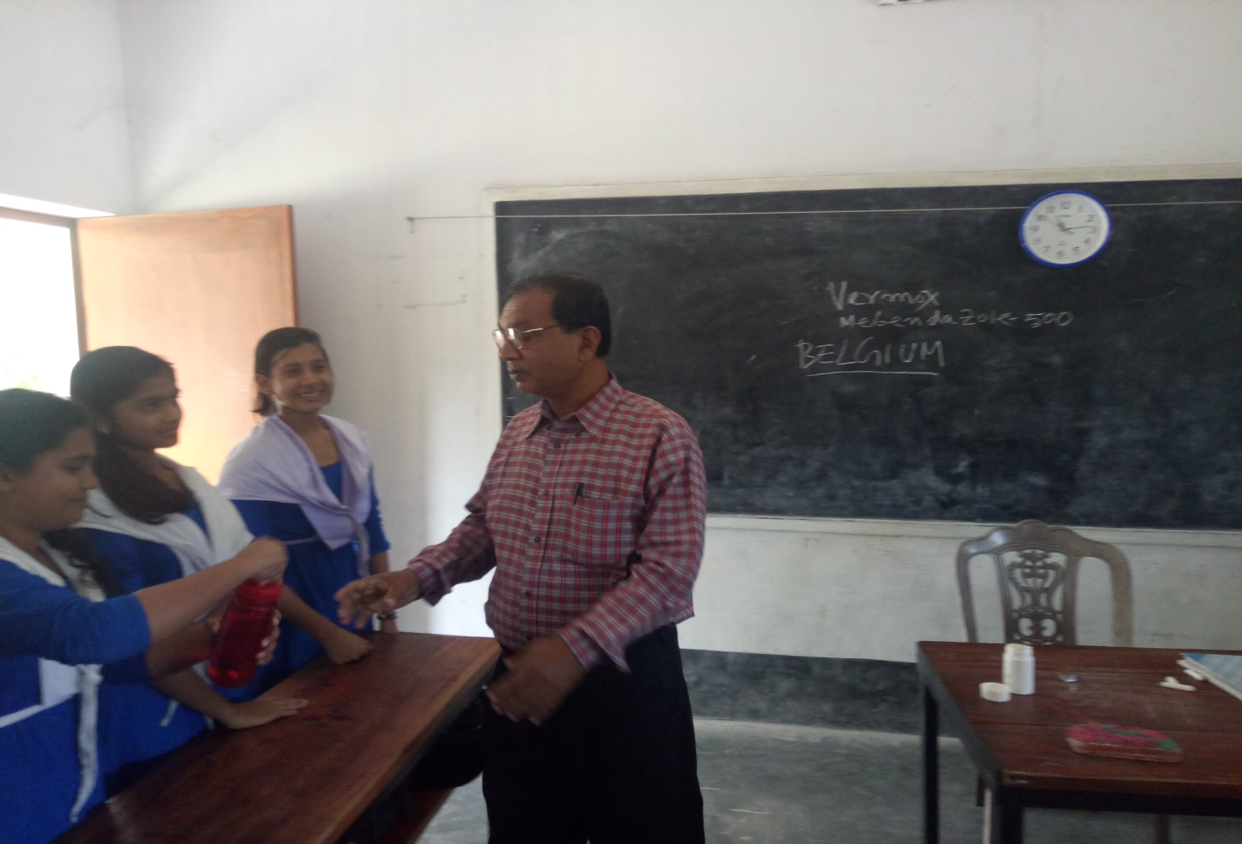
Mr. Nikhil didn’t want to take a side in the argument. Instead, he put his headphones on and listened to some smooth Rabindra Sangeets.
Notes:
The learners will be asked for making sentences with the given connectors and with in any case, on the contrary and all the same.

Slide 24
At a glance Sentence Connectors:
‘Connectors’ are used to link large groups of words: phrases and sentences. You can also use them to connect paragraphs to give them coherence.
Sentence connectors are usually placed at the beginning of a sentence and may be categorized as follows:
Contrast, Similarity, Result, Sequence, Dismissal and order of Importance

Slide 25

Audio
The government has taken steps to make our country Digital. a)…. every other sectors , education sector is going forward using ICT. In the institutions we are taking classes in the multimedia classrooms . b)…we, the teachers have to make digital contents for this purpose. c)…. most of the teachers have given training on making digital contents, all of them can not develop contents due to various types of barriers. d)…..considering all sides and facilities to fulfill this increasing demand of getting ready made contents, a group of model content developers has been selected by A2i . e)….. A2i is doing this job very successfully.
Notes:
The learners will be asked for listening to the text attentively. After that a gap filling task will be given. Like , So , Although, Therefore , and – the answers serially. If needed, the teacher may tell them the answers.

Slide 26
HOME WORK
Write a paragraph on
“How to open a Bank Account.”

Slide 27
Thank You
So Much

