Slide 2
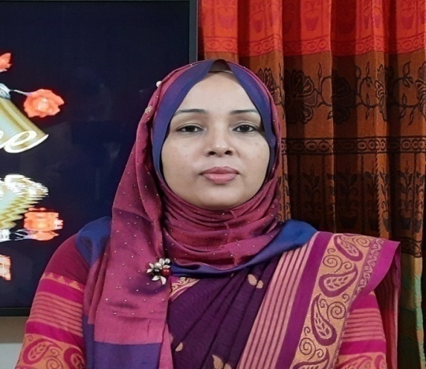
Identity
Achia Begum
Head Teacher
Uttarsur k.c Govt’ Primary School
Sreemangal,Moulvibazar.
English For Today
Class:5

Slide 3
Learning outcomes:
Students will be able to
Understand questions about family and friends of students .
1
2
Ask and answer Wh questions.
3
Read paragraphs , dialogues stories , letters and other texts .

Slide 4
Good morning. Let’s sing a song.

Slide 5
They are in the Town Hall Language Club.
He is reading a book about Bangladesh.
Who are they?.
Where are Sima and Tamal?
They are Sima and Tamal.
What is he reading?
Andy Smith is the new person there.
Who is the new person there?
Look at the picture
Can you say, what do they do?

Slide 6
Our today’s topic is -
Unit-One
Lesson:4-5
Lesson Title: Hello!
Page no:4

Slide 7
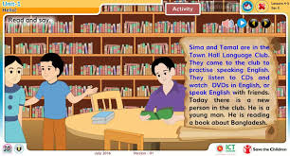
Vocabulary
Town Hall Language Club
Meaning : A club where anyone can learn and practise English language properly .

Slide 8
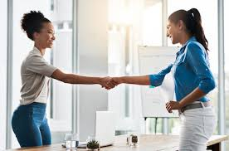
Vocabulary
New person
Meaning : someone new

Slide 9
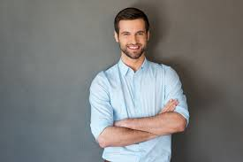
Vocabulary
Young man
Meaning : A teenager or a adult male.

Slide 10
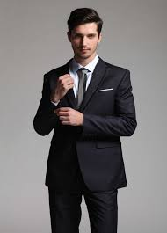
Vocabulary
Gentleman
Meaning : male or young man.

Slide 11
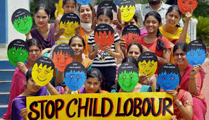
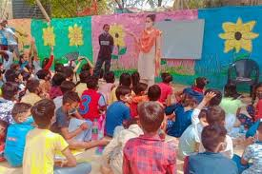
Vocabulary
NGO
Meaning : non-governmental organization.

Slide 12
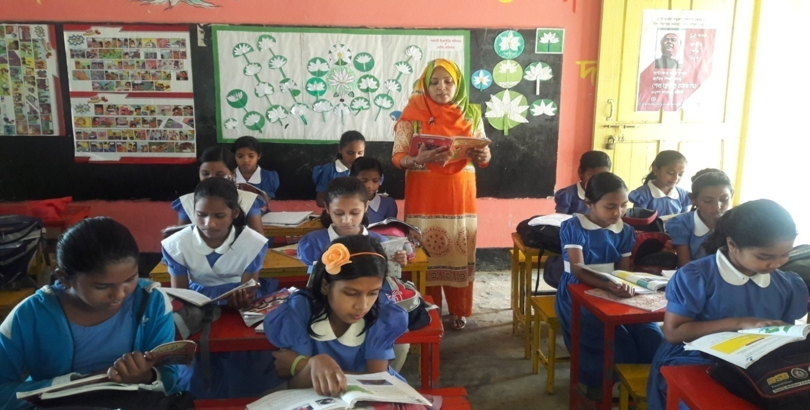
Teacher’s loud reading
Students repeat after teacher. And they will put their finger under the line.

Slide 13
Listen to the audio carefully.
Open your book and put your finger under the line.

Slide 14
I will tell the students to read the text silently. I will check if the students are reading correctly.

Slide 15
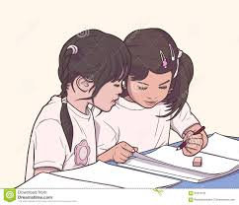
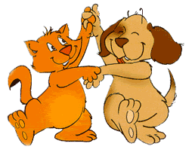
Pair work
Teacher will ask two students in front and tell them to read aloud. And all the students to sit in their seats and read aloud together.

Slide 16
Individual work
Language club is a place where anyone can learn and practise language properly.
1
What is a language club?
2
In a Language Club We practise speaking any language.
What can we do in a Language Club?

Slide 17
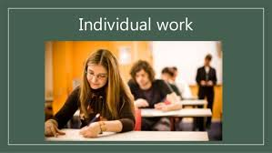
3
Any of you belong to a language club?
4
If any student is a member of language club then what do you do there?

Slide 18
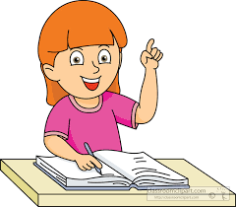
Individual work
What have you learned from today’s lesson?
We’ve learnt about a Language Club today.

Slide 19
Homework
Read the text E at home.

