Slide 1
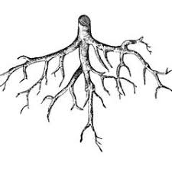
e
e
W
l
m
o
c
To my English Class

Slide 2
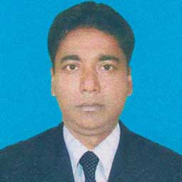
Identity
Azimnagor Computer Technical School & Commercial College.
Subject: English First Paper
Class - Nine
Time -45 mins

Slide 3
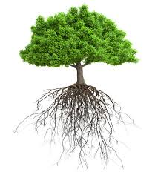
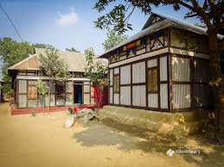
What do you see ?
Root of tree
Birth place / paternal address
Root of human

Slide 4
Our Today’s Lesson is --
My Roots
Unit No -12, Lesson No -1

Slide 5
Learning outcomes
After studied the lesson students will able to --
ask and answer questions; narrate incidents and events in a logical sequence; Exchange personal information; read and understand the text through silent reading.

Slide 6
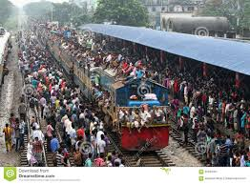
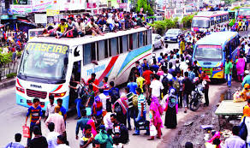
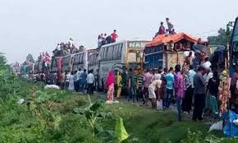
A Look at the pictures . How do you feel to see this photo ? Why do people take such risks to go home ?

Slide 7
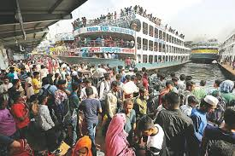
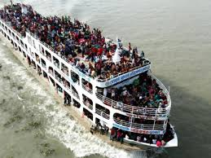
Going to village home at any cost.
But why they take risk to go home ?

Slide 8
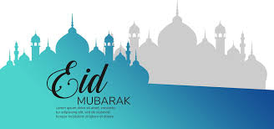
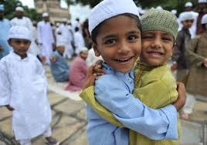
People take such risks to go home to celebrate Eid .
What is Eid ?
Eid is the main religious festival of the Muslims in Bangladesh. Eid means happiness

Slide 9
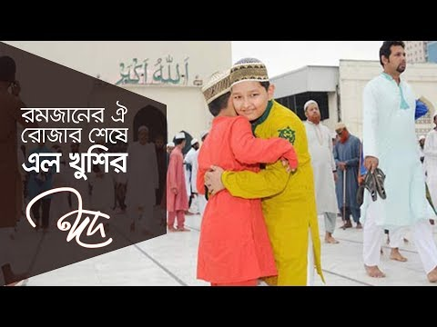
Let’s enjoy a video about Eid.

Slide 10
Now my dear students, we will share our ideas about some difficult vocabulary of this lesson.

Slide 11
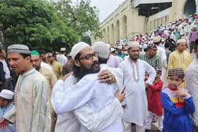
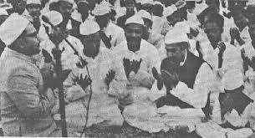
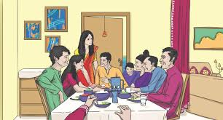
Happiness
Means
loving yourself and being less concerned with the approval of others.
Everyone wants to share happiness with their near and dear ones during Eid.

Slide 12
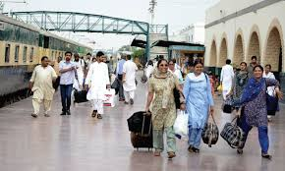
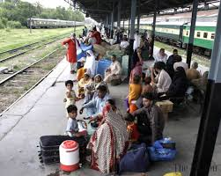
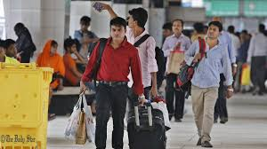
Desire
Means
A strong feeling of wanting to have something. wish
Most of the people , who are living outside their homes for different reasons have a strong desire to get back home during the Eid vacations.

Slide 13
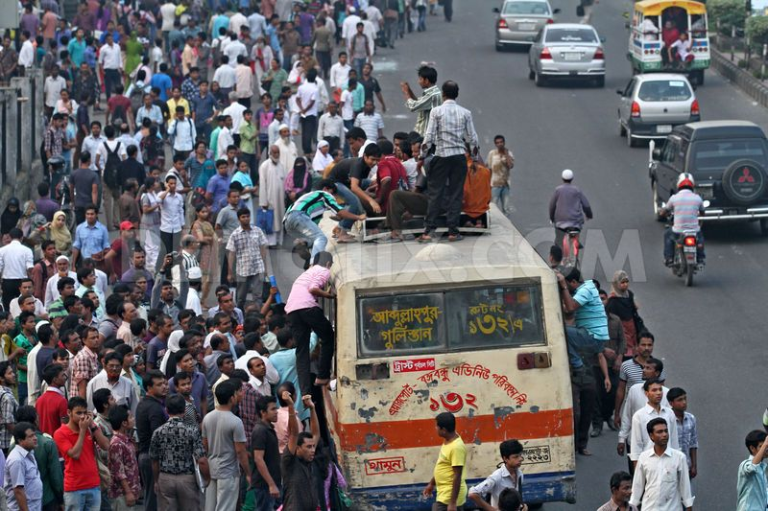
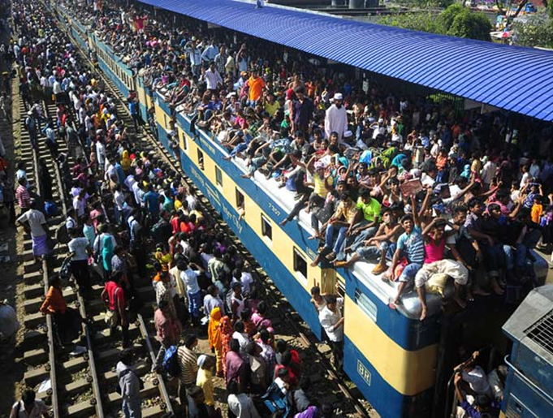
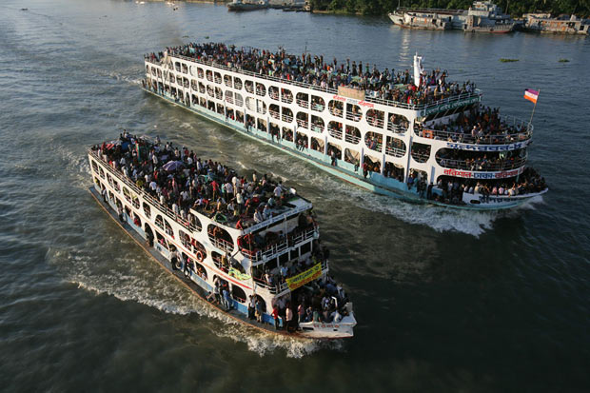
Rush
Means
A sudden quick movement towards somethings, typically by a number of people.
As a result there is a mad rush to board buses, trains, or launches for going home.

Slide 14
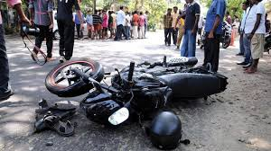
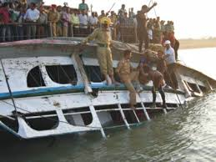
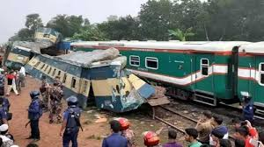
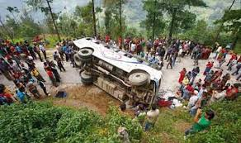
Transport
Means
A system or means of conveying people or goods from place to place.
Train
Bus
Motor cycle
Launch
This often causes transport accidents that takes away many lives.

Slide 15
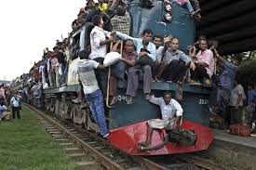
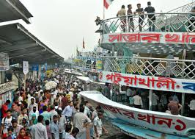
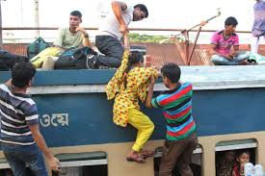
Hazards
Means
A danger or risk
What makes people rush for their homes in spite of serious hazard ?

Slide 16
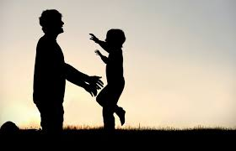
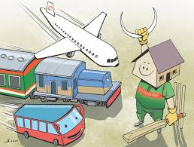
This is nothing but people’s desire to return to the roots.
Roots

Slide 17
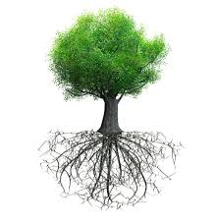
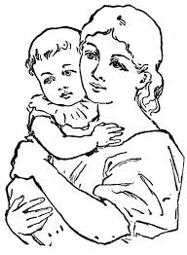
Do human beings have roots like the trees.
but unlike the roots of the trees they are invisible, they lie in our minds.
Yes
The answer is

Slide 18
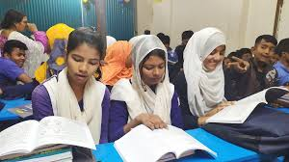
Dear learners,
Read the text silently to know the rest about roots.
Unit 12. lesson -1

Slide 19
Read the text in the speech bubbles. Make questions for them and then compare in pairs.
Pair work
Eid is the main religious festival of the Muslims in Bangladesh
Eid means happiness
What does Eid means ?
What is the main religious festival of the Muslims?
It’s our roots that develop our identity making us what we are.
In that sense our families, our land of birth, relatives, our culture, traditions, or surroundings are our roots.
What do our rootsdo to us?
What are our roots?

Slide 20
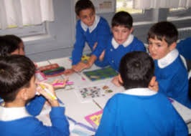
Groupwork
Make a classroom survey present in a chart the types of roots your classmates have .

Slide 21
Evaluation
1. Family bondage | 1. No entity
2. Love of friends | 2. Devoid of values
3. Love to in-laws | 3. Devoid to humanity
4. Love to neighbours | 4. Devoid of social responsibility
5. Vacinity with the land where we were born and grew up | 5. Feeling of emptiness
That makes our roots | The problems of a rootless person

Slide 22
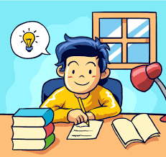
Homework
Write a paragraph about “religious Festival of Muslims”

Slide 23
Thank you very much.

