Slide 1
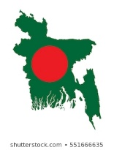

Slide 2
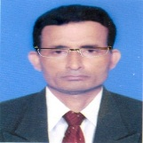
Identity
Manik Chandra Majumder
Senior Teacher
Gazirhat High School
Senbag, Noakhali
Mobile No: 01717155169
Email-manikmajumder01@gmail.com
Class : Nine-Ten
Subject : English 1st paper
Time : 50 Minutes
Date : 01/03/2021

Slide 3
Look at the picture.
Who is speaking ?
Where is he speaking?
What do you know about the UN?
What do you know about Bangabandhu’s speech at the UN?

Slide 4
Let’s watch a video clip

Slide 5
That was the beginning of Bangabandhu’s speech at the UN.

Slide 6
Our today’s lesson is……...
Bangabandhu at the UN
Unit-1, Lesson-3

Slide 7
Let’s watch a video clip

Slide 8
Learning outcomes
After we have studied this lesson ,we will be able to …
a. read and understand text.
b. narrate incidents and events in a logical sequence.
c. participate in conversation, discussion and debates.
d. tell stories.

Slide 9
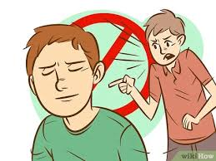
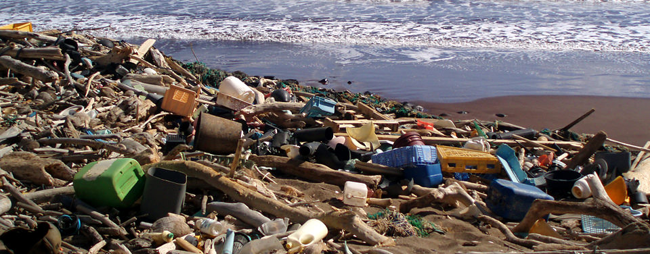
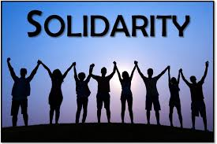
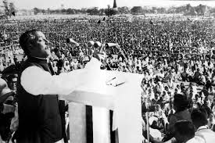
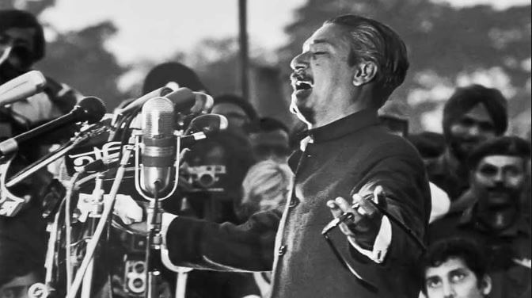
Word meaning and sentence making
Meaning : Unity, Unanimity, Agreement
Meaning :Wreckage (the remains of something after badly damaged or destroyed)
Meaning : Mesmerizing, Captivating
Meaning : Denounce, Judge as bad
Meaning : Oration, Address, Lecture
Click word
Speech
Debris
Criticize
Solidarity
Charismatic
Sentence: Bangabondhu expressed his solidarity for all oppressed people around the world.
Sentence: Bangabandhu had a charismatic quality of leadership.
Sentence: After liberation there were debris of war.
everywhere in the country .
Sentence: Bangabondhu delivered a great speech on 7 March 1971 and declared our Liberation War.
Sentence: To criticize other is a bad habit.

Slide 10
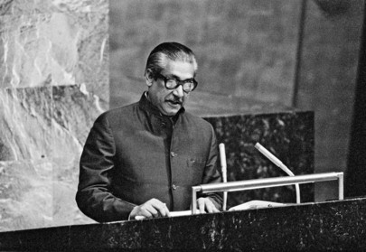
A. Work in pairs and discuss the following questions.
Ans-2 :Bangabandhu’s speech in the UN is a matter of pride for us. He delivered the speech on 25th September 1974, just after getting the membership of the UN. He was the first person in the history of the UN to deliver a speech in Bangla to pay tribute to the lanaguage martyrs. Through this speech Bangabandhu revealed Bangladesh's stand on national and, international issues before global community.
Ans-1: The UN is an international organization founded by 51 countries after the Second World War in 1945. It was established with the aim of preventing war, establishing international peace and security and creating friendly relationship among the nations.
2. What do you know about Bangabandhu’s speech at the UN?
What do you know about the UN?

Slide 11
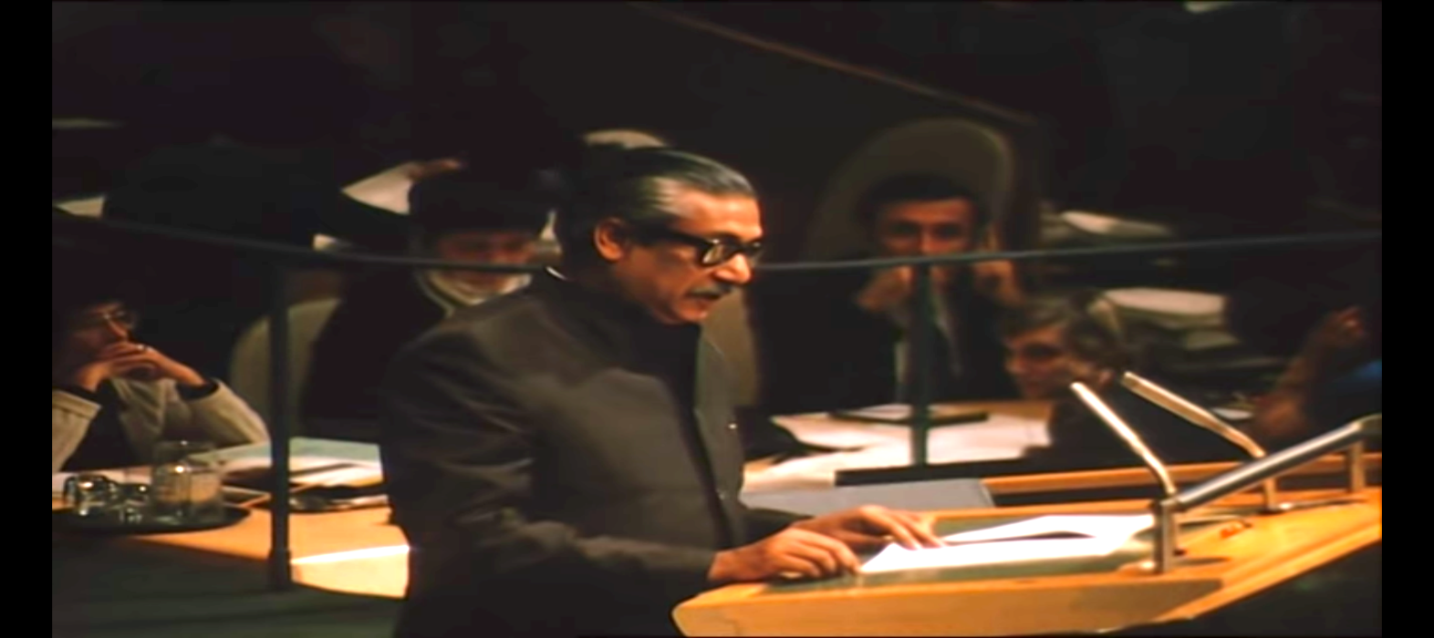
B. Read the text and answer the questions that follow.
Bangabandhu’s speech at the United Nation’s General Assembly is a matter of great pride for us. He delivered the speech on 25th September 1974, just after a week Bangladesh became a member of the UN. To be a member of the UN was not an easy go as some influential countries were opposing the membership for Bangladesh. So it was another war that Bangabandhu had to wage.

Slide 12
But finally, Bangabandhu won. He won not only the UN membership, but also everyone who listened to his ever first speech at the UN. It was a veni vidi vici experience for him – he came, he saw and he conquered everyone. Bangabandhu was the first person in the history of the UN to deliver a speech in Bangla, the language of the seven and a half crore (seventy-five million) Bangalees, the language of the language martyrs. The poet of oration, the icon of charismatic leadership touched another milestone and so did the Bangalees through him. It was a speech that revealed Bangladesh’s stand on national and international issues before the global community.

Slide 13
Identifying the UN as the parliament for the humankind, Bangabandhu recognized the moment of delivering his speech historical. He mentioned that the very moment justified the century-long struggle and sacrifice of the Bangalees for self-rule, independence, dignity and co-existence along with other nations. He assured that Bangladesh would follow the ideology of mutual respect, national sovereignty, regional integrity and non-interference into internal issues of other countries. Bangabandhu explained Bangladesh’s absolute pledge to the UN charters and reminded how the people of his country made the highest sacrifice to achieve the same. The Father of the Nation added that Bangladesh would look forward to such a world where peace and justice would take their rightful place. It was essential to justify the sacrifice of the countless martyrs.

Slide 14
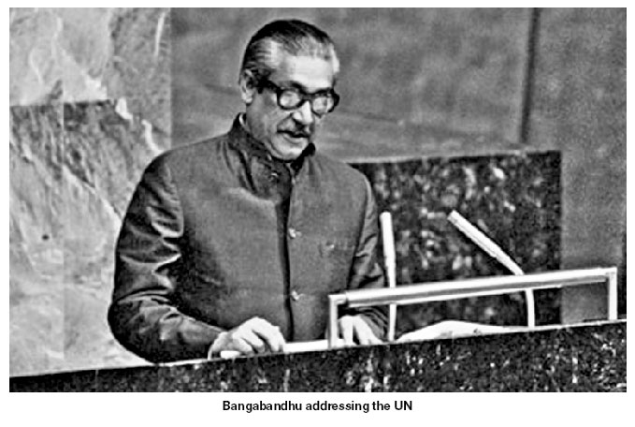
In his speech, Bangabandhu expressed his utmost gratitude to the UN and the international community for standing beside Bangladesh with their aids and support in the reconstruction of the war-ravaged country, relocation of 10 million war-refugees who took shelter in India during the Liberation War. The leader of the country reminded the world how Bangladesh stood on the ruins and debris of a war where people were just struggling for survival. However, the repeated natural calamities were making their life harder and people even didn’t have a minimum intake of food for a day.

Slide 15
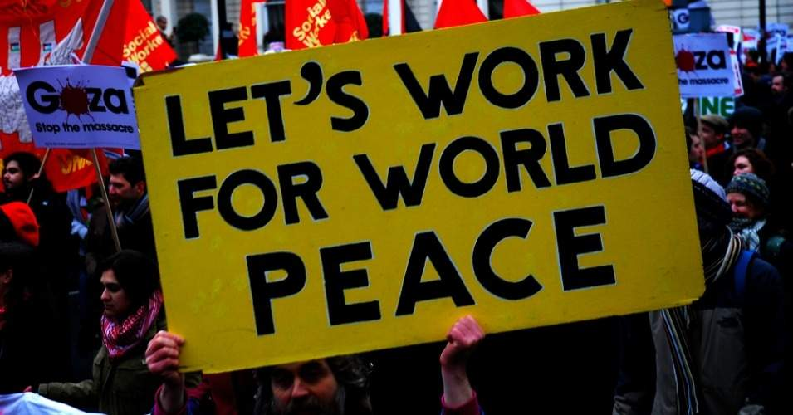
Going beyond Bangladesh, he expressed solidarity for all the oppressed people around the world and denounced racism, discrimination, imperialism and the use of force to stop people’s justified movements for their rights. Referring to the struggle of the people in Africa, Asia, Latin America, Namibia, Palestine and Zimbabwe, he expressed his worry about people’s plight to achieve their own rights. The leader of the oppressed noted- when millions of people destitute with unending miseries, only a handful of people were enjoying the highest luxuries. He emphasized quick measures for global financial management based on justice. Bangabandhu warned that an absence of such a system would lead the world to experience and unprecedented misery of the history.

Slide 16
The leader of the third world countries expressed his deep concerns over a global recession and inflation, unemployment, unequal distribution of wealth and opportunities and the gap between the rich and the poor countries. He described how those had hit the development plans in many poor countries of the planet. To Bangabandhu, it was a global responsibility to fight these problems and take concerted efforts to put an end to these.

Slide 17
Before he concluded his speech, Bangabandhu declared that Bangladesh would follow the paths of togetherness, brotherhood and mutual respect and cooperation. He expected the UN would take substantial roles in solving the prevailing human crises in the subcontinent as well as in other countries.
Bangladesh has been following the paths of Bangabandhu, the dreamer and the people’s leader, even after his death nearly five decades ago.

Slide 18
D. Here are some sentences that sum up the text in Section B. Match the title with each of the paragraphs except the last two. The first two paragraphs will have the same title.
1. Bangabandhu’s policy to friends and neighbours
3rd para
2. Call for unity
6th para
3. The background information
1st & 2nd para
4. Voice against tyranny
5th para
5. Thanks giving
4th para

Slide 19
E. Read the text in Section B again. Work with a partner and ask and answer the following questions.
1. How did Bangabandhu pay tribute to the language martyrs?
Answer: Bangabandhu paid tribute to the language martyrs by giving his maiden speech in Bangla at the UN.
2. Why did Bangabandhu seek for togetherness and global relationship?
Answer: Because Bangabandhu wanted to see the world free from racism, discrimination and oppression. So he sought for togetherness and global friendship

Slide 20
3. What foreign policy did Bangabandhu formulate in his speech?
Answer: In his speech Bangabandhu formulated that the foreign policy of Bangladesh will make friendship with all and malice to none.
4. Do you think Bangabandhu could speak about the national, regional and international problems? Justify your argument.
Answer: Yes, I agree with this argument. His words were clear in his speech. He just wanted to see an oppression free world, where no people will sleep with hunger

Slide 21
5. Why did the text term Bangabandhu as a leader of the oppressed and leader of the third world?
Answer: In the text Bangabandhu was called leader of the oppressed and leader of the third world because in his speech made it clear to everyone that he was beside the people who were fighting for their rights and those are oppressed. He also reminded that if the distribution of wealth will not be equal to all it will become a problem for the whole humankind. He emphasized on togetherness, brotherhood and mutual respect and understanding. According to him it is the global responsibility to pull up the under developed country.

Slide 22
C. Here are some words/phrases from the text the meaning of which are given below with alternatives. Choose the best answer as per the context.
Evaluation
1. So it was another war that Bangabandhu had to wage. Here the meaning of the underlined word is –
b. carry on
c. currency
d. pay
Cor.Ans:
a. salary
b. carry on
Cor.Ans:
2. It was a veni vidi vici experience for him. The meaning of the underlined phrase is –
a. He came, he spoke, he won
b. He spoke, he ran, he saw
Cor.Ans:
Cor.Ans:
c. He ran, he came, he won
d. He came, he saw, he conquered
d. He came, he saw, he conquered

Slide 23
3. Bangabandhu clarified Bangladesh’s absolute pledge to the missions of the UN charters. The meaning of the underlined word is –
Cor.Ans:
d. situation
Cor.Ans:
a. determination
a. determination
b. position
c. narration
4. It was essential to justify the sacrifice of the countless martyrs. The meaning of the underlined phrase is -
a. number of people who sacrificed their lives.
b. number of people who sacrificed their lives but not counted.
b. number of people who sacrificed their lives but not counted.
Cor.Ans:
Cor.Ans:
c. number of people who sacrificed their lives and has been counted.
d. number of people who sacrificed their lives and it is impossible to count them.

Slide 24
5. Bangabandhu expressed his utmost gratitude to the UN … for standing beside … the war-ravaged country. The meaning of the underlined phrase is
a. attracted by the war
b. disturbed by the war
Cor.Ans:
Cor.Ans:
c. developed by the war
d. damaged by the war
d. damaged by the war
6. He expressed his worry about people’s plight to earn their own rights. The meaning of the underlined word is-
a. suffering
c. crying
Cor.Ans:
a. suffering
b. flying
d. fighting
Cor.Ans:

Slide 25
HOME WORK
Search the net to listen the speech and then write an email to one of your friends giving him/her the information that you have gathered about Bangabandhu’s speech at the UN”.

Slide 26
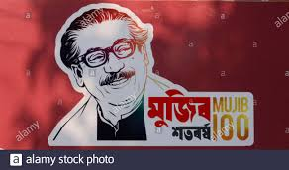
Thank you all

