Slide 1
Welcome
To
English Class

Slide 2
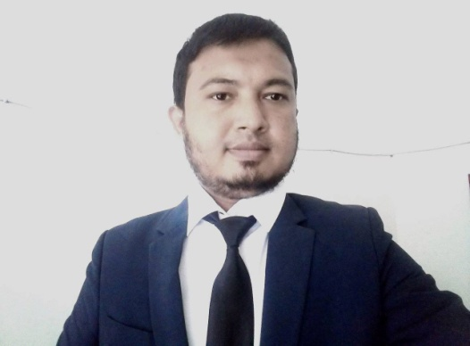
পরিচিতি
Class: Five
Sub: English For Today
Unit: 01
Lesson: 01
Md. Nasir Uddin Khan
Assistant Teacher
Gridakalindia GPS
Faridgonj, Chandpur
01687422109
nu01687@gmail.com

Slide 3
Dear Students, Good morning. I am your new English Teacher. Lets signg a good morning song together.

Slide 4
Dear Students, look at the picture, now tel l me,What is this?
Yes, this is our ‘English For Today’ textbook.

Slide 5
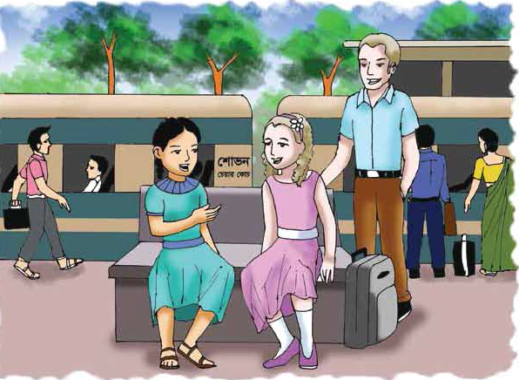
What do you see in the picture below? Think and say
Someone is introducing with others.

Slide 6
What do you see in the picture below? Think and say
Someone is introducing with others.

Slide 7
What could be our lesson today?
Our Today’s lesson,
Hello!
Unit: 01
Lesson: 01

Slide 8
Learning outcomes:-
Listening-
1.4.2: recognize and use intonation patterns
for greetings and statements.
Speaking-
2.1.1. : exchange greetings and farewells.
2.1.2 : make introductions.
Reading-
1.5.1: Read words, phrases and sentences in the text with
proper pronunciation stress and intonation.

Slide 9
So, Let's learn the meaning of the following words before the class starts
Introduce
Really
Holiday
Meeting

Slide 10
Now, Open your book. Page no 2, Section A
Tell me about the picture

Slide 11
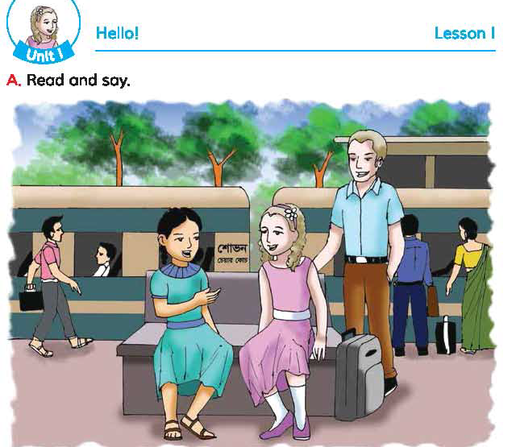
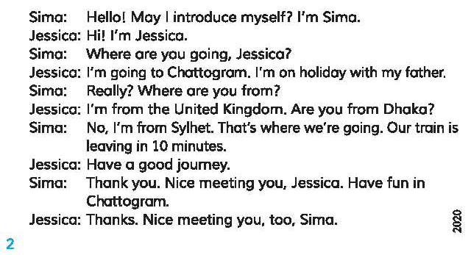
Now read the passage with me from your textbook

Slide 12
Now answer the following question
Where is Jesica going?
Where is Sima from?

Slide 13
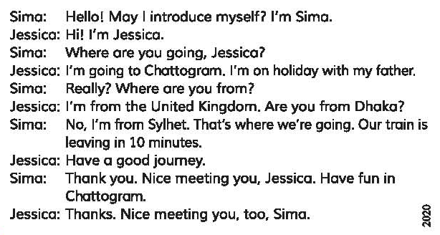
Now read the passage loudly in pairs
Sima
Jesica

Slide 14
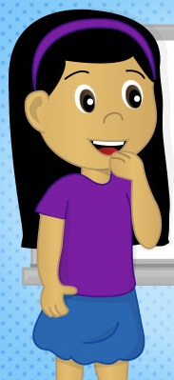
Now introduce someone like Sima or Jesica
Hi..
I am Sujana
I am in class 5
I am from Faridgonj, Chandpur.

Slide 15
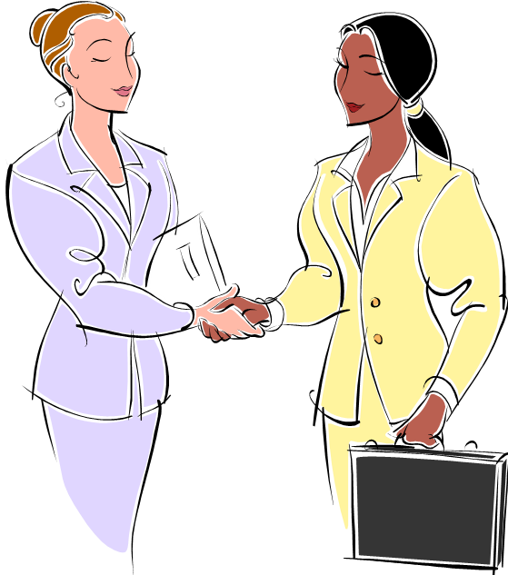
Bye! nice to meeting you
Bye! nice to meeting you, too
কারো কাছ থেকে বিদায় নিতে আমরা এ কথাগুলো ব্যবহার করে থাকি।

Slide 16
So, students, what we have learnt from today’s class?
Yes, we have leant how to introduce myself, greet people and take leave of someone.

Slide 17
Now answer the following question
How we greet people?
How we introduce myself into someone?
How we take leave of someone?

Slide 18
Thank you

