Slide 1
CLASS 9
welcome

Slide 2
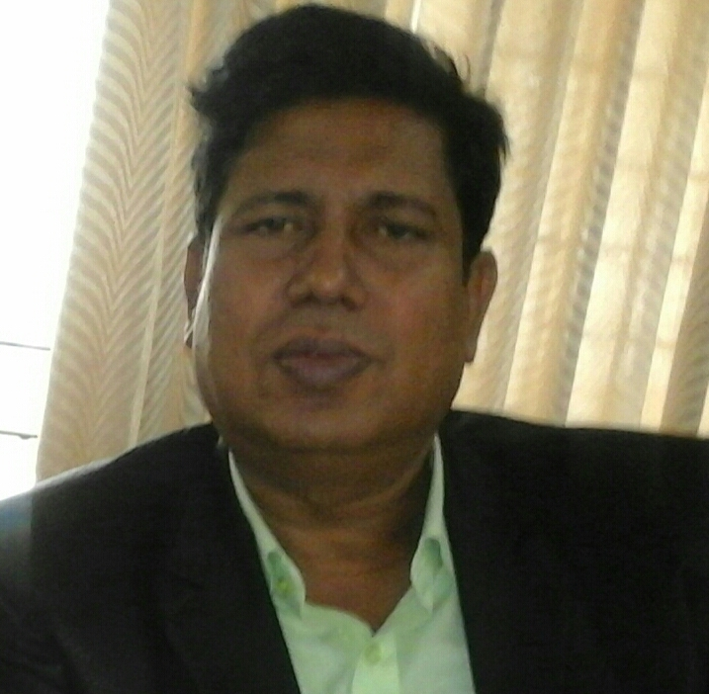
IDENTITY
Md. Jahangir Alam
Senior Teacher
Parzowar Kalindi High School
Keranigonj, Dhaka

Slide 3
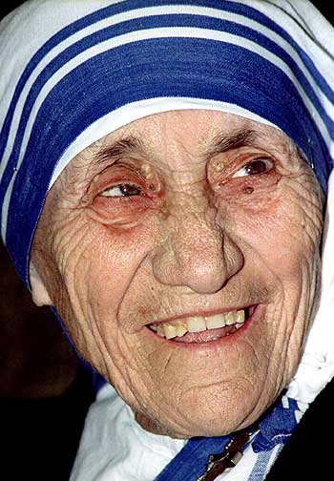
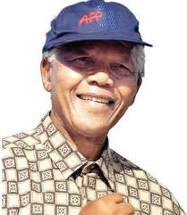
Whom do you see in the pictures ?
Notes:
The learners will be invited in front of the audience ( the teacher and the students of the class) to describe the persons saying about their works and lives what they know. After that he/she announce the day’s topic.

Slide 4
LOVE FOR HUMANITY
Learning outcomes
* By the end of the lesson the learners
* will be able to able to describe people
say about mother Teresa’s missions for humanity.
*Ask and answer questions ?

Slide 5
Text reading
Read more about Mother Teresa.
Notes:
The learners will read the text to fulfill the learning outcomes. While they will be reading the passage the will monitor them, help them to overcome shyness of pronouncing hard word correctly with interaction then explain the necessary vocabs.If necessary, the teacher may read out the text to make clear the correct pronunciation of the learners

Slide 6
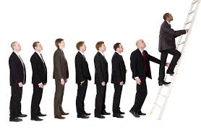
Promotion
Support or encouragement of doing something

Slide 7
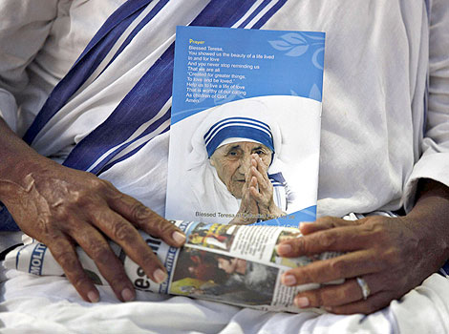
salute
to pay homage to someone

Slide 8
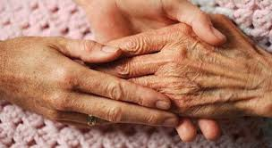
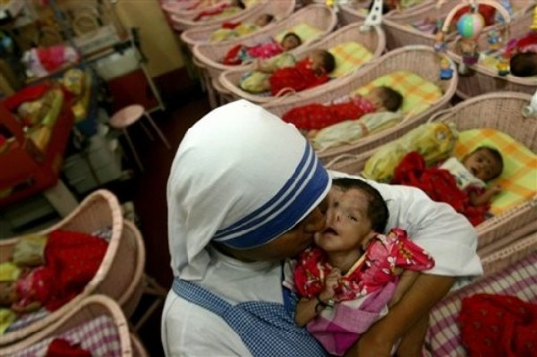
Compassion
pity for the sufferings of others

Slide 9
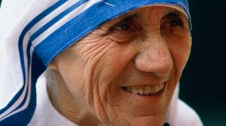
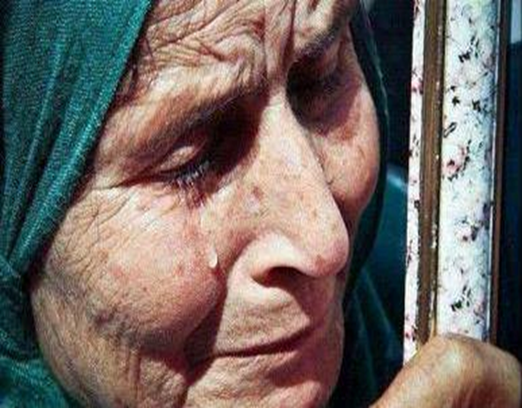
Wrinkled
having or showing a small fold or line in the skin due to age

Slide 10
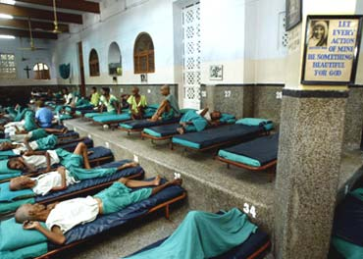
Dying
on the point of death.

Slide 11
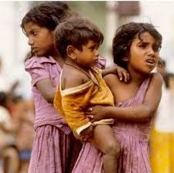
Destitute
Without money, food and other things necessary for life

Slide 12
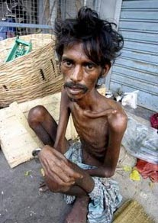
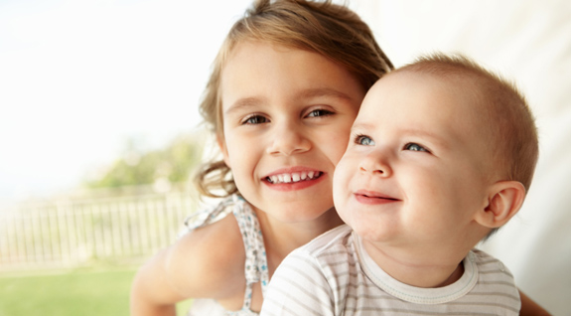
Survive
To continue to live or exist

Slide 13
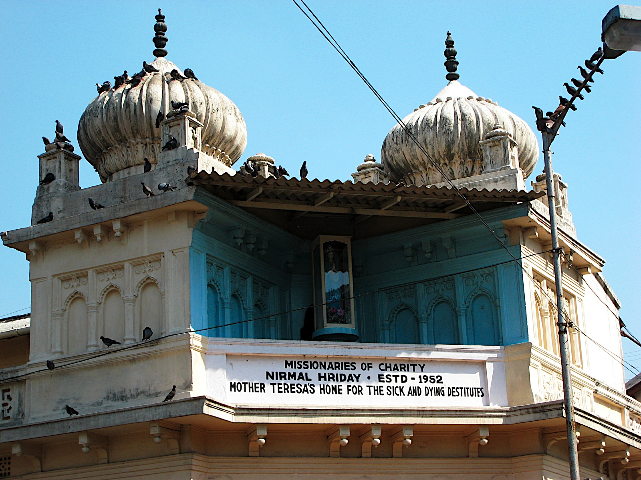
Nirmol Hriday
Pure heart-a home for the dying destitute

Slide 14
Answer the following questions
What do you think about Mother Teresa’s achievement of many awards?
What does Nirmol Hridoy stand for?
What is your thinking about the name?
Why did Mother Teresa want the dying people to feel that they deserve care and love too?
What are the things that you have learnt from Mother Teresa’s life?

Slide 15
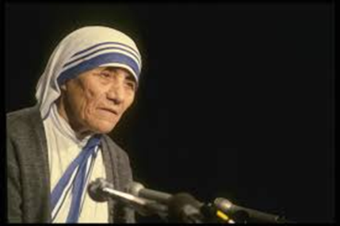
Group Work
How do you feel about the services of Mother Teresa? And How do you want to serve the people following her path? Discuss in groups.
Notes:
The teacher will elicit the answers from the learners.

Slide 16
HOME WORK
Write paragraph on Haji Muhammad Mohsin

Slide 17
Thank You So Much

