Slide 1
Welcome to all

Slide 2
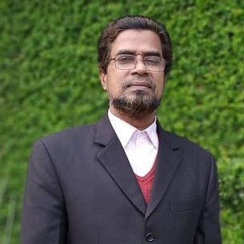
Teacher`s Identity
MD.GOLAM NABI HEAD TEACHER
UMEDPUR GPS
SHAILKUPA, Jhenaidah.

Slide 3
Lesson Introduce
ClASS: ONE
SUB : English UNIT : SIX
Title : EAT HEALTHY FOODS
LESSON: ONE
Time:40 minutes
Md Golam Nabi

Slide 4
Unit : 6 (Eat healthy)
Lesson- 1
Md Golam Nabi

Slide 5
Learning outcomes:
1.1.1. Recognize sound difference in the context of word.
1.1.1. Say word, phrases and sentences with proper sounds and
stress(word say).
Md Golam Nabi

Slide 6
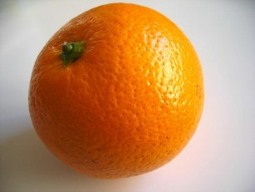
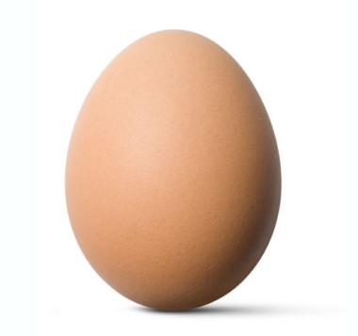
Orange
Egg
Healthy foods

Slide 7
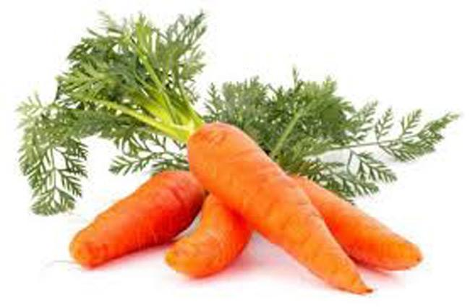
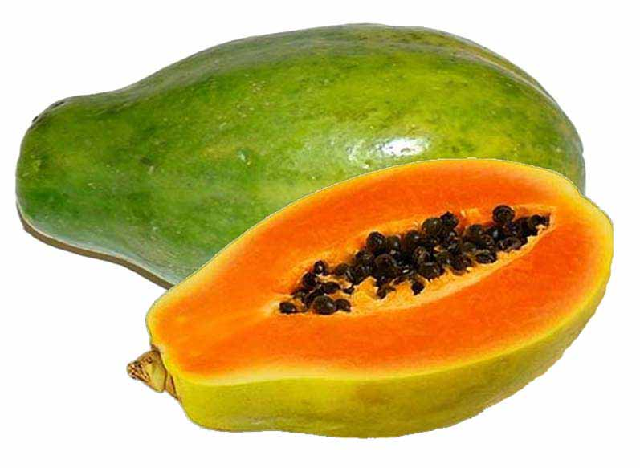
Carrots
Papaya
Healthy foods

Slide 8
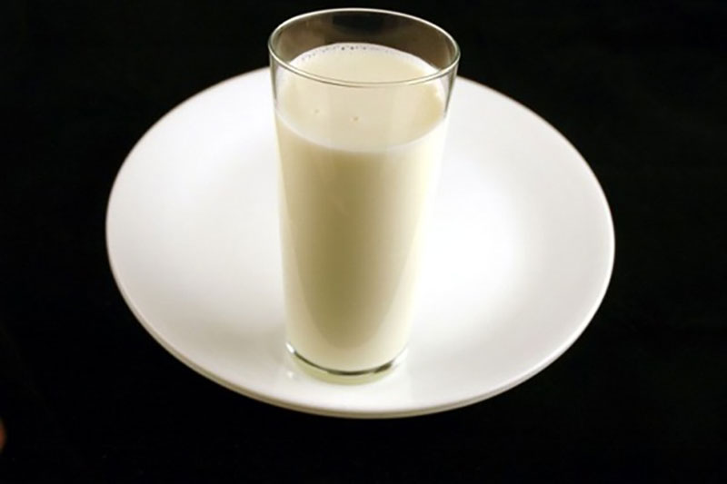
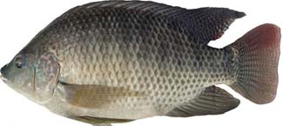
Milk
Fish
Healthy foods

Slide 9
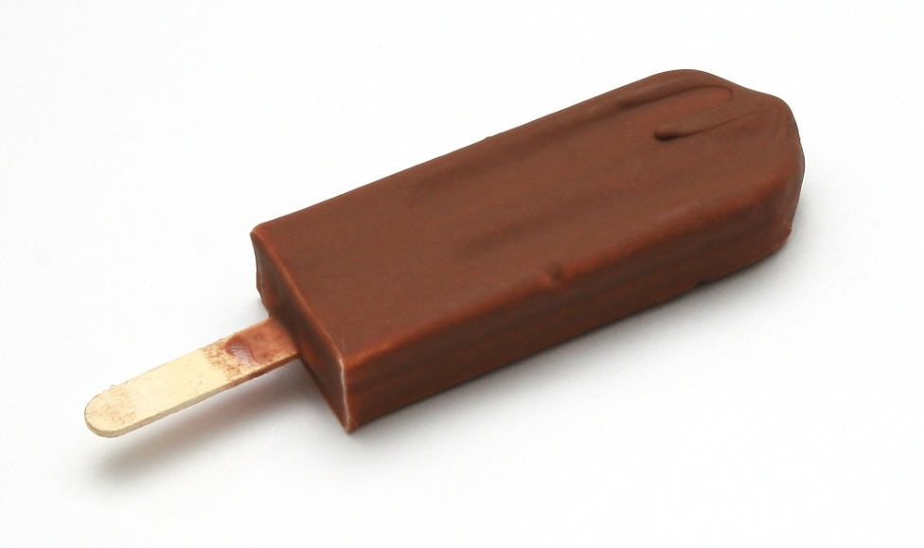
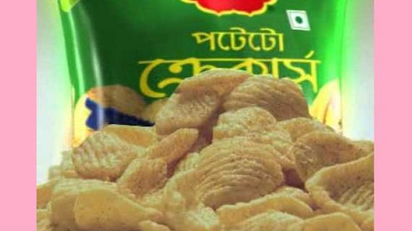
Ice-cream
Chips
Unhealthy foods

Slide 10
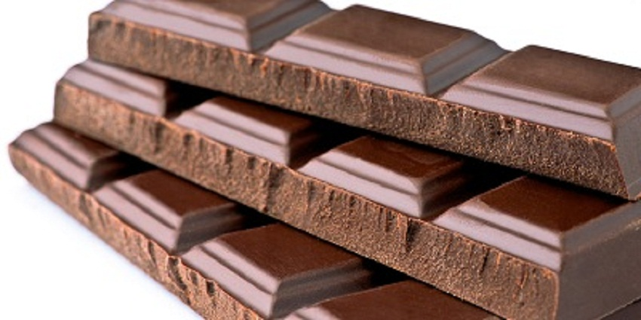
Fries
Chocolate
Unhealthy foods

Slide 11
Loudly Say

Slide 12
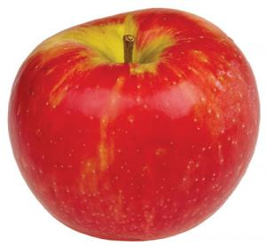
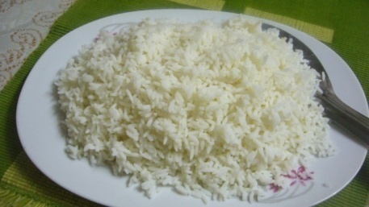
Say some healthy foods on showing pictures

Slide 13
Group Work
Wrigte down healthy foods and unhealthy foods
A-Group | B-Group
Healthy foods | Unhealthy foods
Apple
Ice-cream
Carrots
Chocolate
Papaya
Chips
Milk
Fries

Slide 14
Say 5 healthy foods

Slide 15
Thanks to all

Slide 16
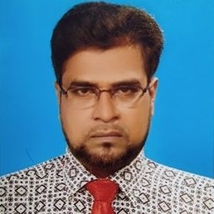
MD.GOLAM NABI
01921775174
THANK YOU
FACE BOOK ID MD.GOLAM NABI

