Slide 1
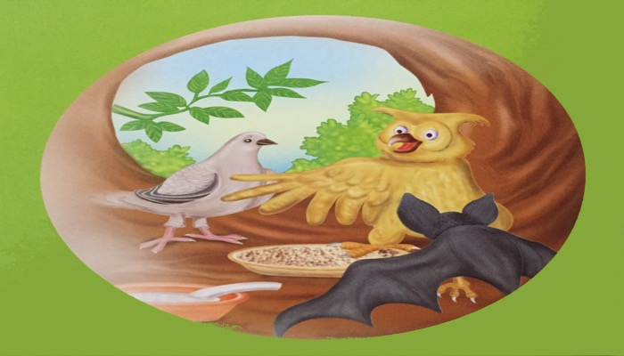
Talk about the picture

Slide 2
The truthful dove unit-6 lesson -2

Slide 3
After we have studied this unit ,we will be able to
Read and understand texts through silent reading
Listen for information
Ask and answer questions
Write answers to questions

Slide 4
New-word
Shelter
Grumpy
Unwillingly
Generous
flattery

Slide 5
Read the passage and answer the following questions
Who were the two good friends ?
What did they decide to do ?
Why were they tired ?
Why did they look for a shelter?
Whose nest was there on the tree?

Slide 6
Home-work
Which word would you use to describe an eagle or a crow?

