Slide 1
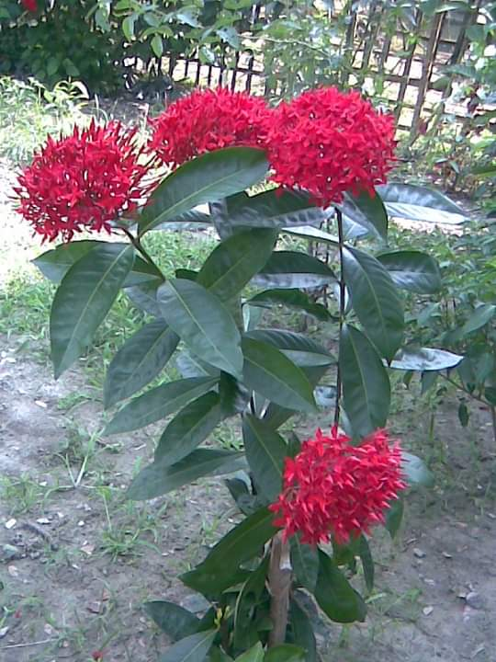
G
G
Welcome
G
G

Slide 2
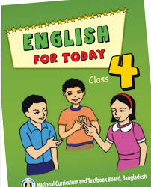
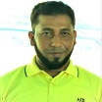
I D
E
N
T
I
T
Y
Mohammad Abdul Gafur Mojumder,
Assistant teacher
Gaiar Bhanga G.P.S
Lalmai, Cumilla.
Class: Four
Sub: English
Unit: 40 (A garment worker’s day)
Lesson: 1 (Reshma is a …..sells them)
Time: 35 minutes

Slide 3
Let’s watch a video and think what is the video about.
Let’s watch a video
What do you see in the video?

Slide 4
Today we will read about
‘A garment worker’s day”

Slide 5
Learning outcomes
Students will be able to:
Listening:recognize sound differences in the context of words.
Speaking:ask and answer Wh questions.
Reading: read words, phrases and sentences in the text.
Writing: write a short composition about oneself, friends, family and other familiar topics.

Slide 6
Who works in a garment factory.
Garment worker
A natural disaster caused by breaking of river bank.
River erosion
An unexpected incident.
Accident

Slide 7
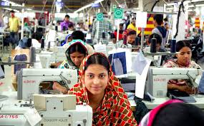
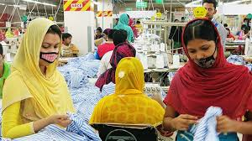
Reshma is a garment worker in Dhaka. She is 18 years old.

Slide 8
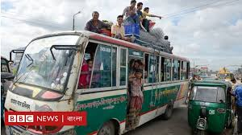
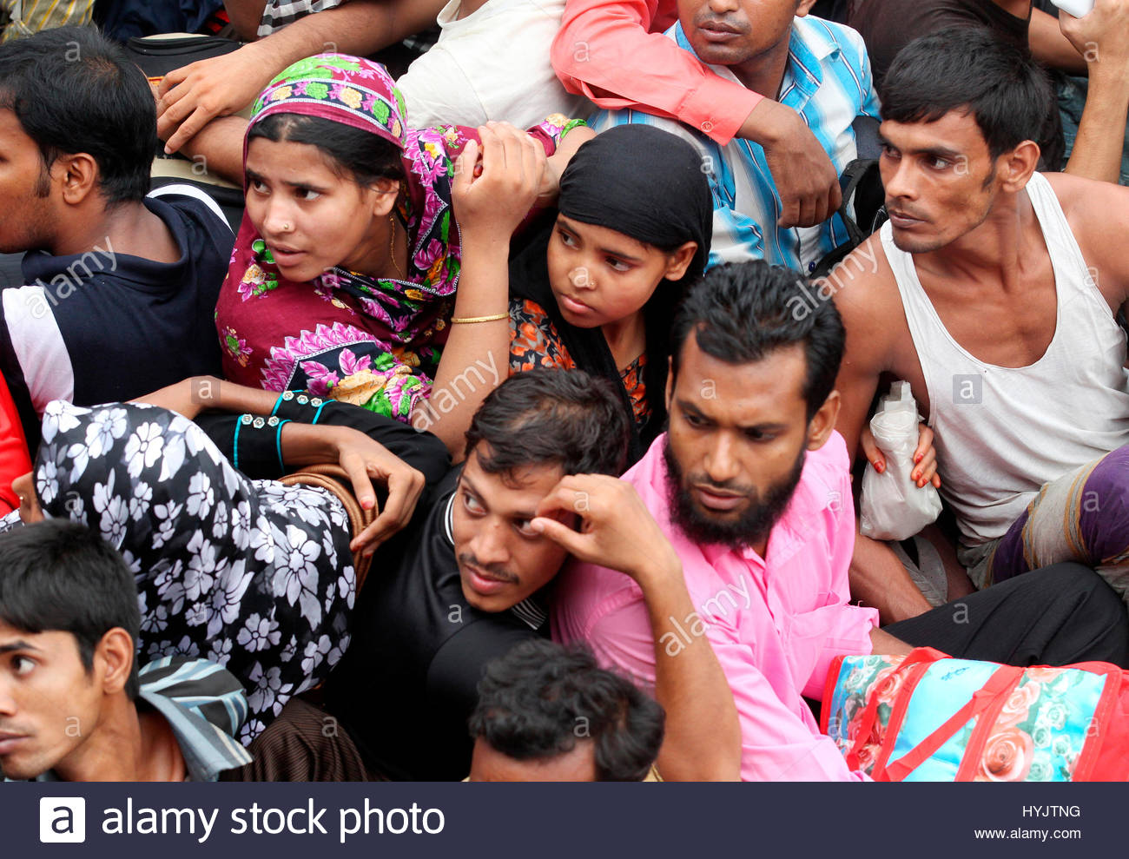
Her family came to Dhaka from a village eight years ago.

Slide 9
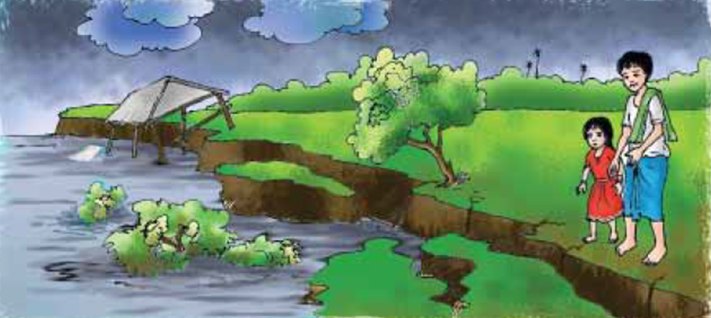
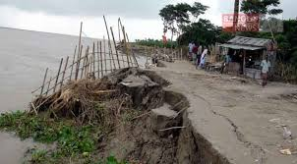
There was river erosion in their village. They lost their home. So the family came to Dhaka.

Slide 10
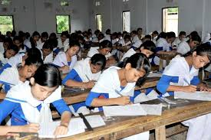
Individual Work
What is Reshma?

Slide 11
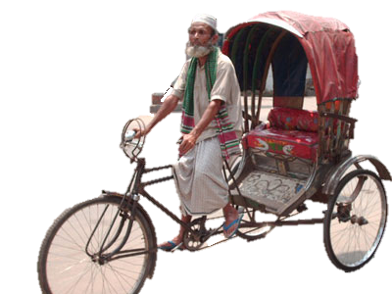
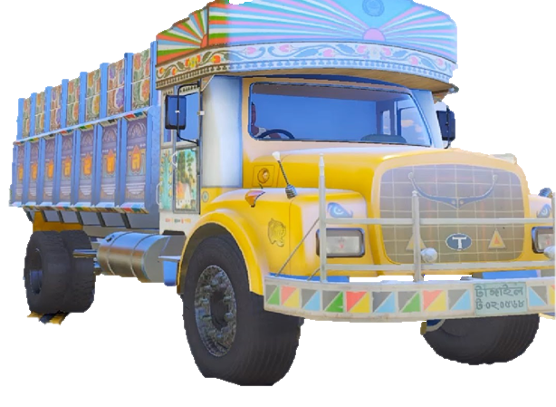
Reshma’s father worked as a rickshaw driver,
but he died in an accident.

Slide 12
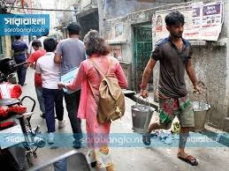
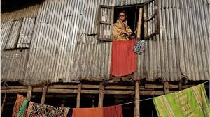
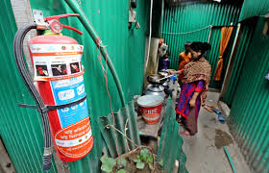
Reshma’s uncle Ratan helped the family. He found a small house for them at Kalyanpur.

Slide 13
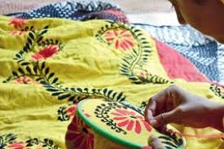
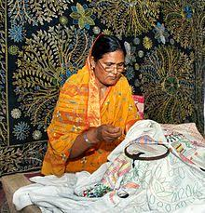
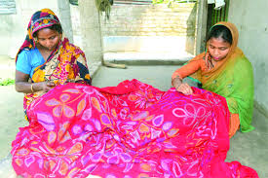
Her mother stitches “Nakshi kathas” at home and sells them.

Slide 14
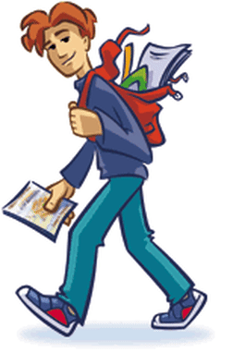
Her younger brother Babul goes to school. He’s in class 5.
Her younger brother Babul goes to school. He’s in class 5.
Her younger brother Babul goes to school. He’s in class 5.

Slide 15
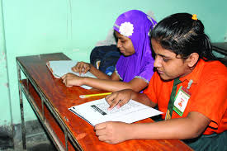
Pair work
a) Who is Babul?
b)How does Reshma’s mother help the family?

Slide 16
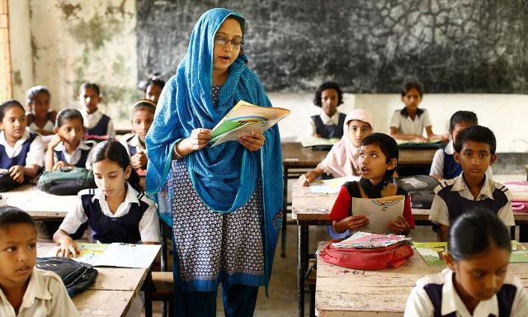
Now open your English book at page number 80. Listen to me carefully and put your finger under the line.

Slide 17
Group work
Wh Questions:
I’ll divide the students in 5 groups. Give them a sentence card with 3 sentences. Ask them to make 3 WH questions:
1. Reshma is 18 years old.
2. Ratan helped the family.
3. Her mother stitches “Nakshi Kathas” at home.
I’ll monitor their group work and help them if needed.
Then I’ll cross check their answers.

Slide 18
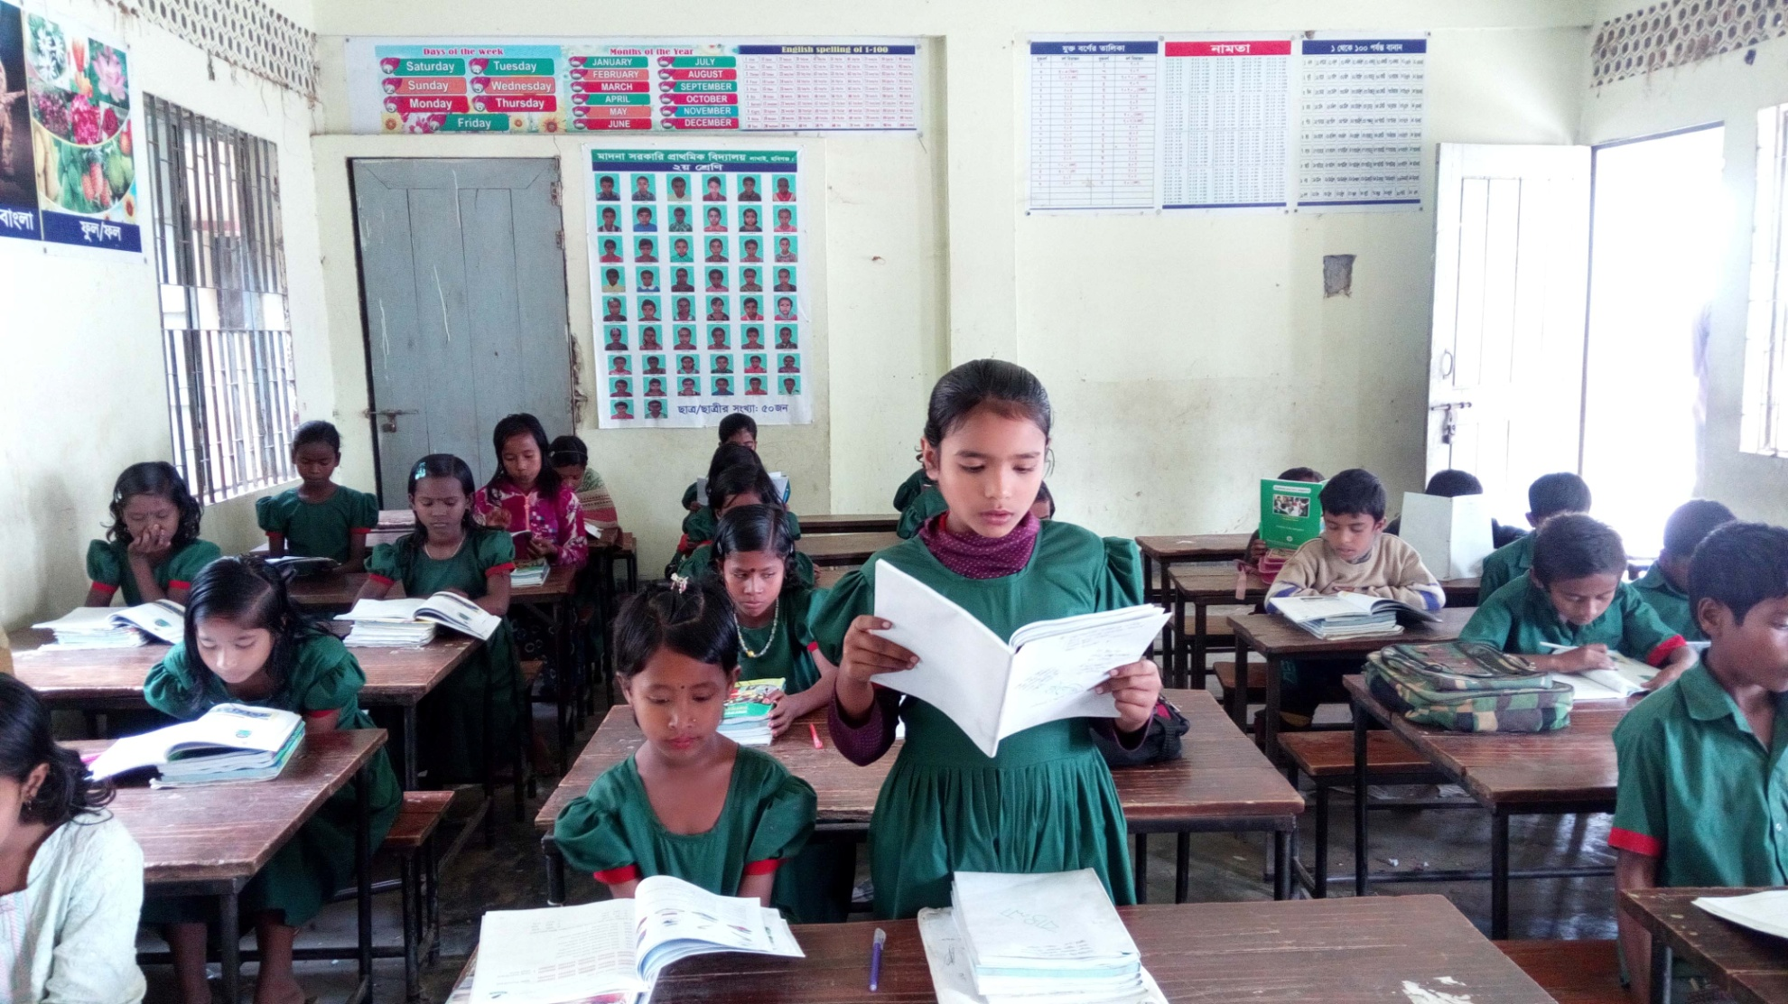
Now open your English book at page number 80 and read the text silently.

Slide 19
Evaluation
Answer the following questions:
Students will write the answer of the following questions on their own khata individually.
Why did Reshma’s family come to Dhaka?
Who helped the family?
Where does Reshma work now?
What class is Babul in?
What does Reshma’s mother do?

Slide 20
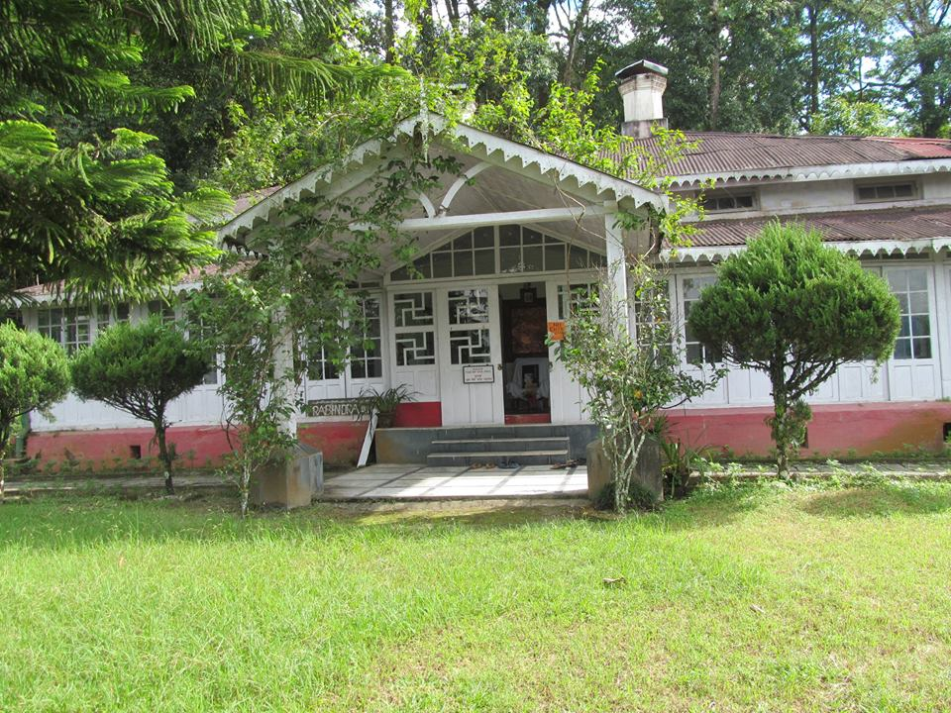
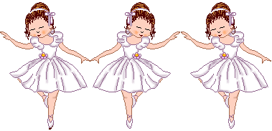
Home work
Write five sentences about a garment worker.

Slide 21
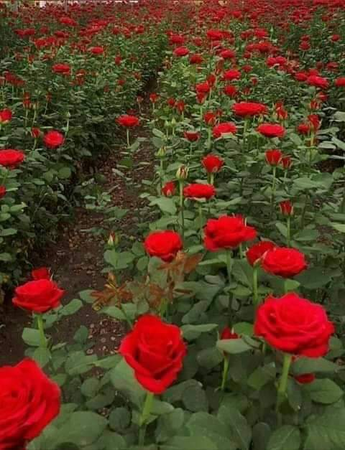
G
G
Thank you very much.
G
G

