Slide 2
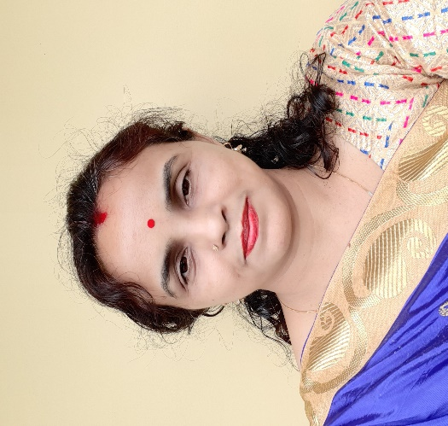
Presented By
SHAMPA RANI DAS
ASSISTANT TEACHER
SATKORAKANDI GOVT.PRIMARY SCHOOL
BARLEKHA ,MOULVIBAZAR.

Slide 3
Lesson Identity
Class:v
Subject:English
Lesson:Cyclone Aila
Unit:24(Babul and his….years ago)
Time:40 minutes

Slide 4
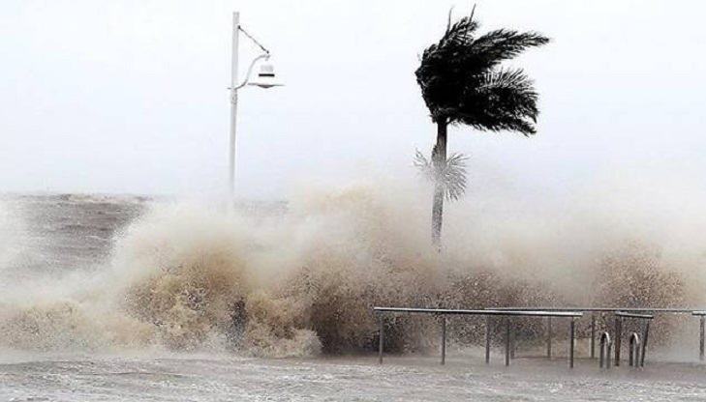
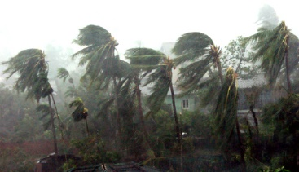
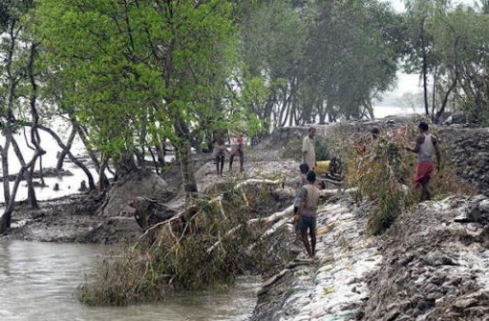
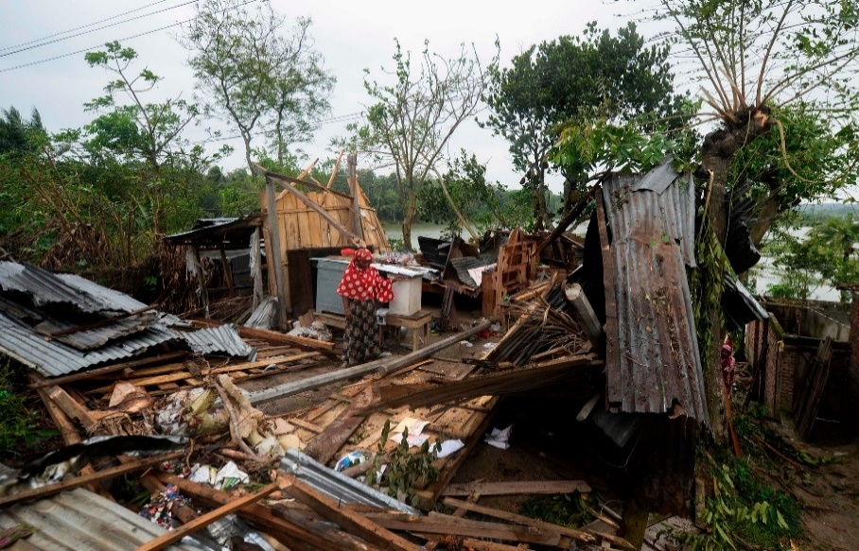
Lets see some picture

Slide 5
Let’s see a video

Slide 6
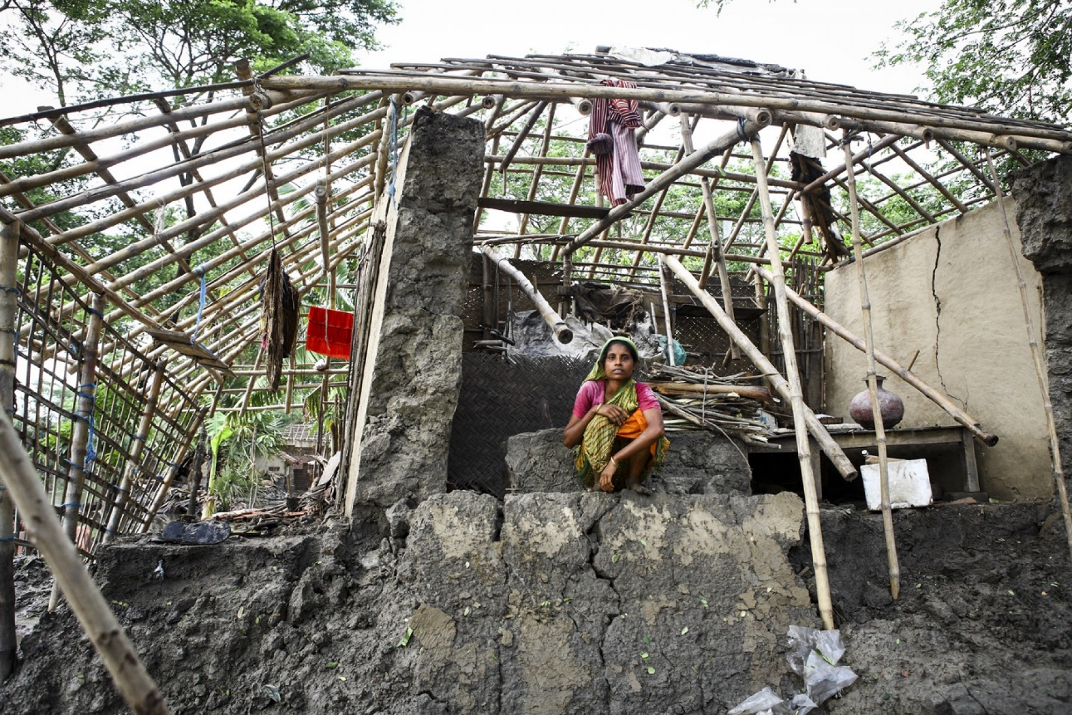
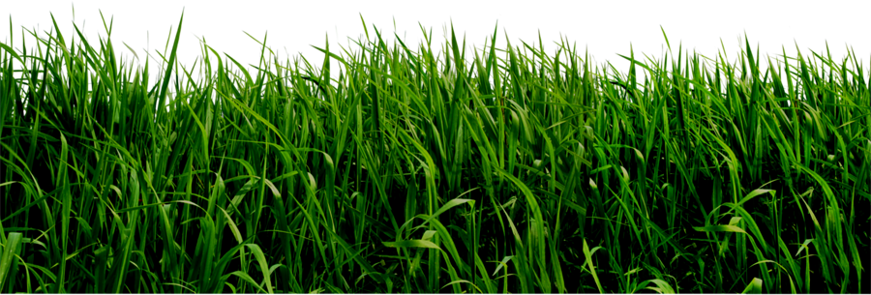
Todays lesson is------
Cyclone Aila

Slide 7
Learning outcomes
Students will be able to-------
4.2.1 Understand and enjoy simple stories.
1.1.1 Say words,phrases and sentences with proper sounds and stress.
1.5.1 Read words,phrases and sentences in the text with proper pronunciation,stress and intonation.

Slide 8
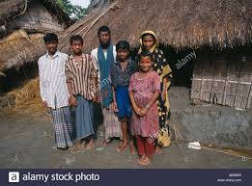
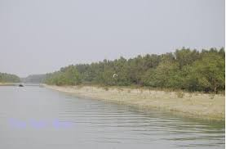
Babul and his family live on the island of dublar char.

Slide 9
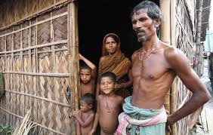
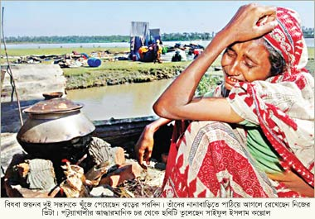
Life is good for the family now, but that wasn’t true after Cyclone Aila.

Slide 10
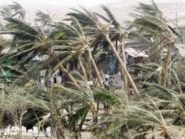
Babul doesn’t remember Cyclone Aila,but his parents often talk about that terrible night in 2009.

Slide 11
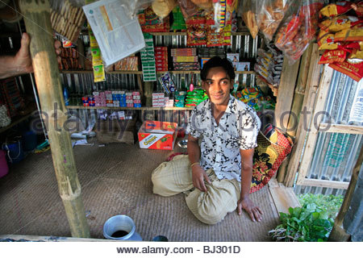
Babul’s father had a grocery shop.

Slide 12
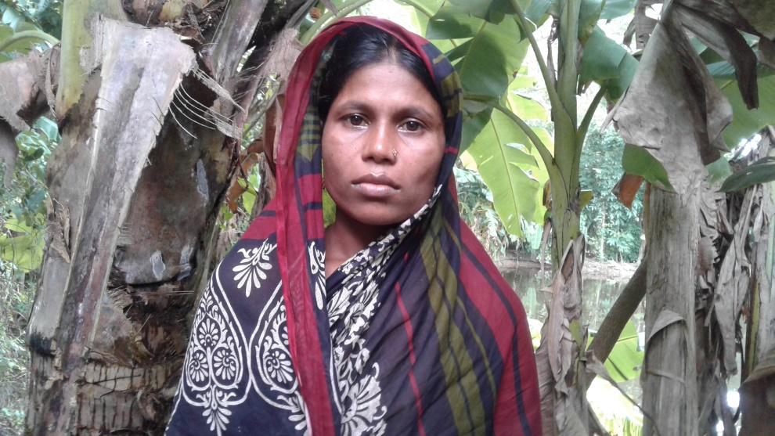
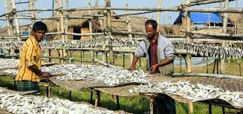
His mother worked in a fish farm.

Slide 13
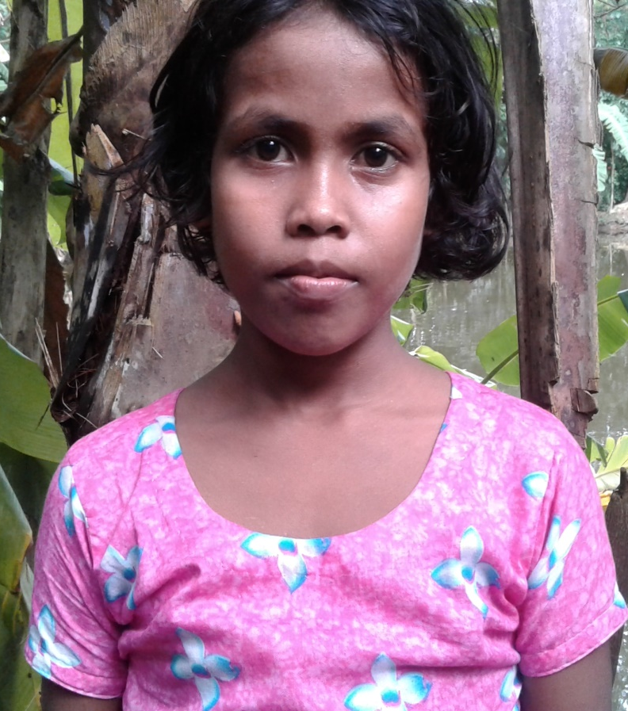
Babul was just a baby, but his sister Nipa was six years old.

Slide 14
They had a small house that they shared with Babul’s grandparents.

Slide 15
Read the text please then write answer the questions(gw)
Time:7 minutes
Rhidyota lives at Hatiya Island.Cyclone “Mora” has attacked their island on the last 30 May.They have got worried on that day. She along with her family members has taken shelter at a cyclone centre.Many trees and houses have been broken down.The island has been flooded with tidal bores.
Where has Rhidyota taken shelter?
Why has Rhidyota got worried?
What loses have been left by “Mora”?

Slide 16
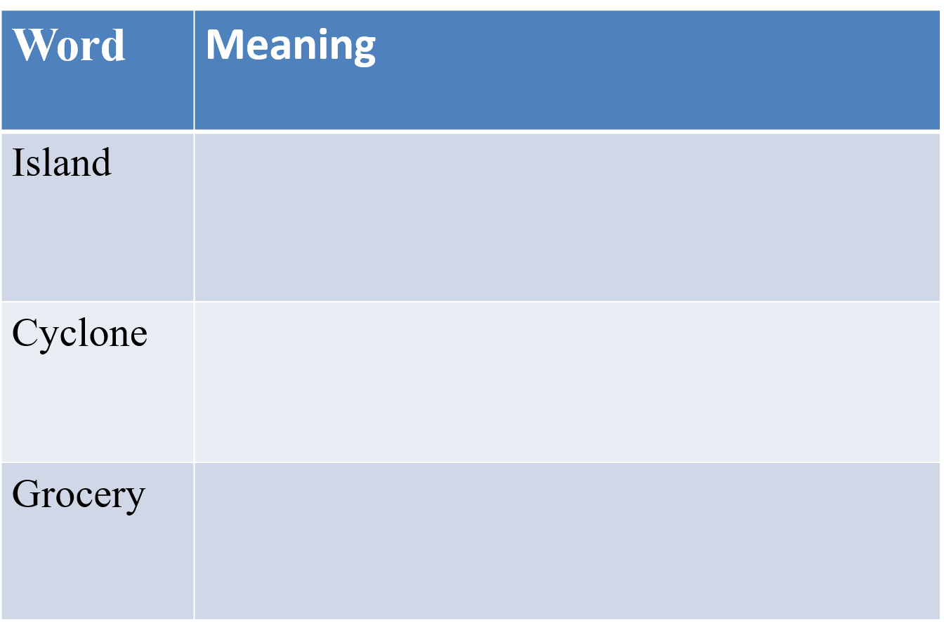
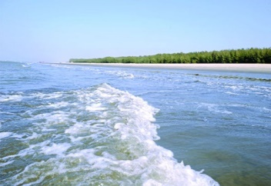
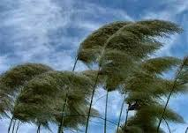
New words with sentences(by using picture)
Isolated land
Hatiya is an island.
One kind of storm.
Cyclone attacked their island.
The goods that are to be sold
He had a grocery shop.

Slide 17
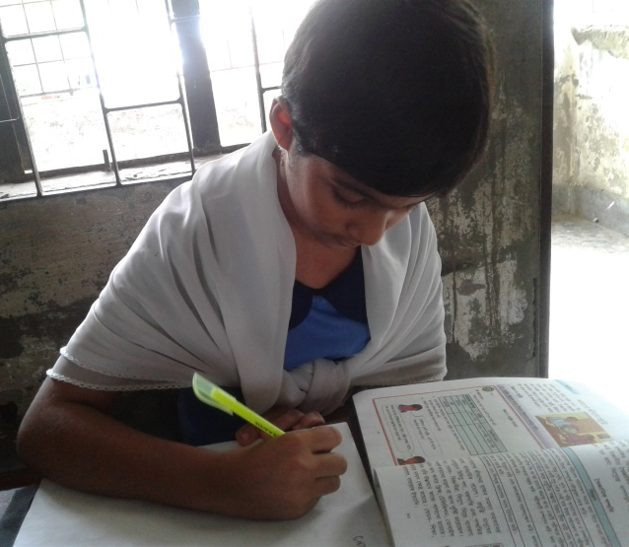
Let’s play a game(iw)
Bingo Game

Slide 18
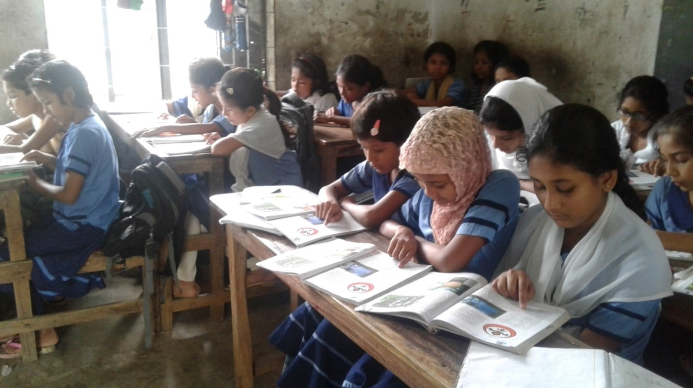
Silent Reading

Slide 19
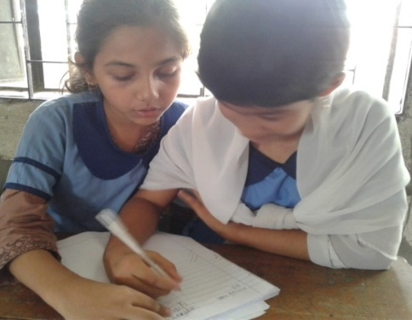
Match the words with their similar meaning(pw)
Time:5 minutes
Island One kind of storm
Terrible Isolated land
Cyclone Father and mother
Parents The goods that are to be sold
Grocery Extremely bad or serious

Slide 20
Evaluation
Answer the following questions
1.How is life now in Dhublar Char?
Where did babul’s parents work?
Say two lines about life style of people of an island.

Slide 21
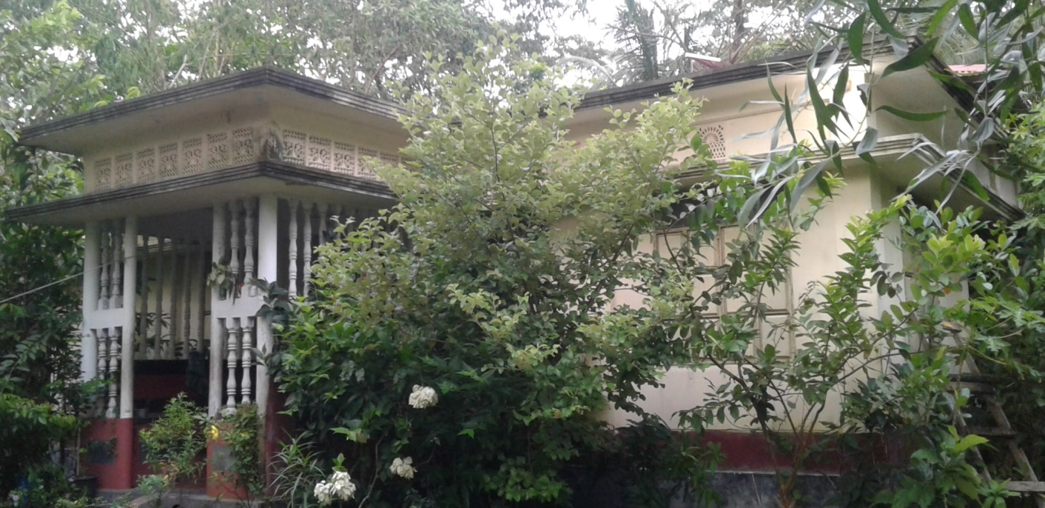
Homework
Write five sentences about “A Memorable Event in Your Life”

Slide 22
Thank You

