Slide 2
Identity
Sanjida Akter
Lecturer In English
Alua Islamia Alim Madrasha
B-para,Cumilla.
Class-X
Subject: English Ist Paper

Slide 3
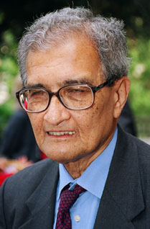
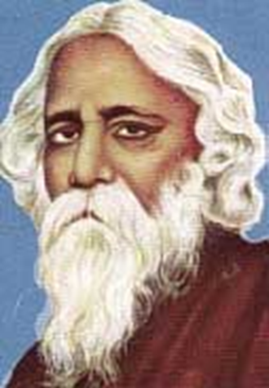
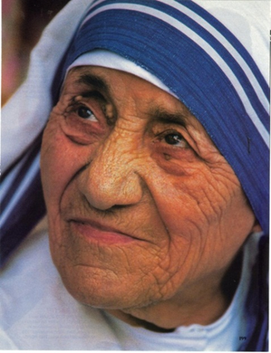
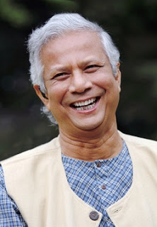
Mother Teresa
Amartya Sen
Rabindranath Tagore
Dr. Md. Yunus

Slide 4
Love for Humanity

Slide 5
Learning Outcomes
By the end of the lesson students will be able to
read a text and find out information
speak about a renowned person.
Ask and answer the questions.
write a paragraph about a renowned person.

Slide 6
Talk to your partner about the picture.
Who are there with mother Teresa?
How is their relation with mother Teresa?
What did she do for the children?

Slide 7
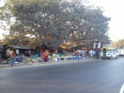
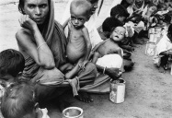
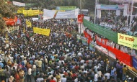
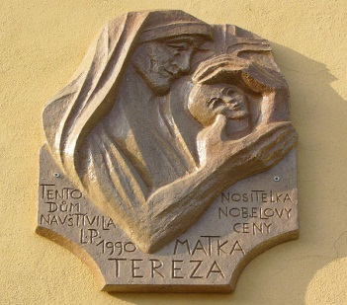
Word Meaning-
Street
Destitute
Gather
Award
Way
Deprived
Crowd
prize

Slide 8
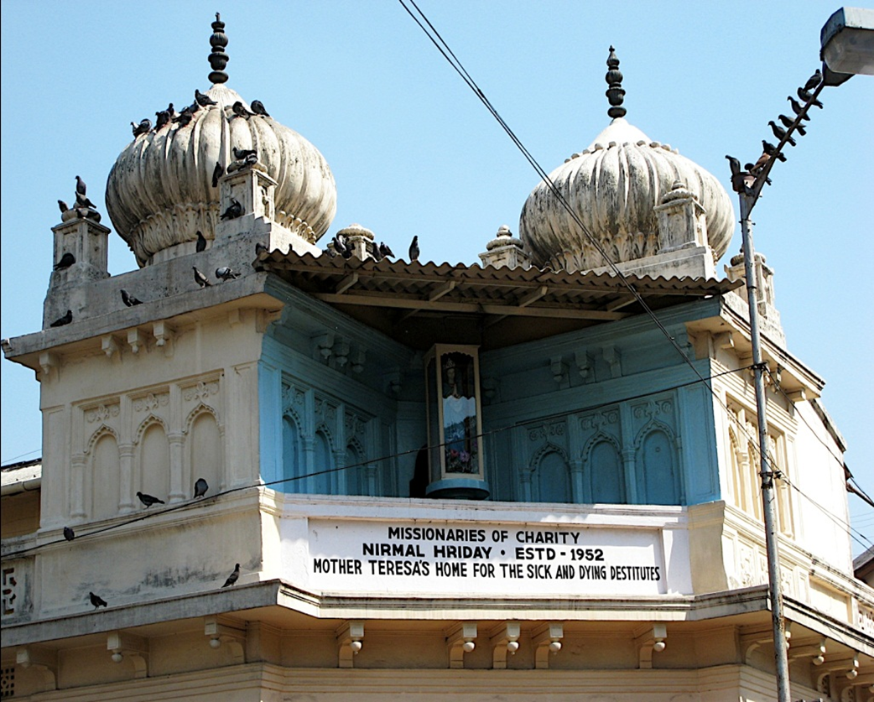

Slide 9
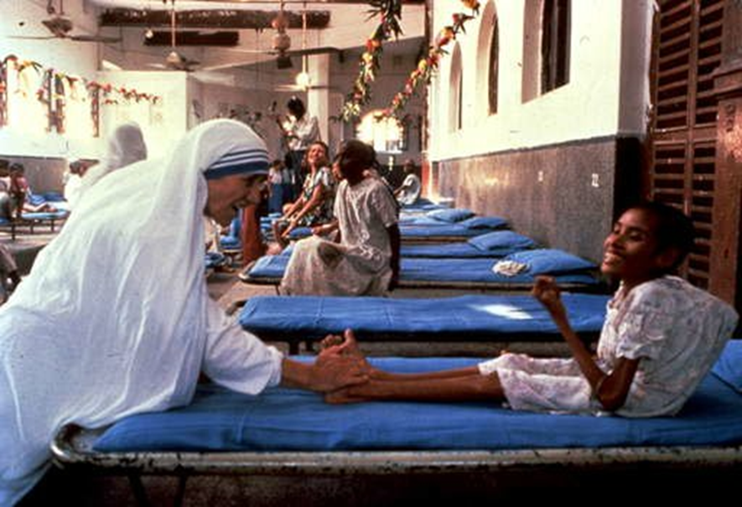

Slide 10
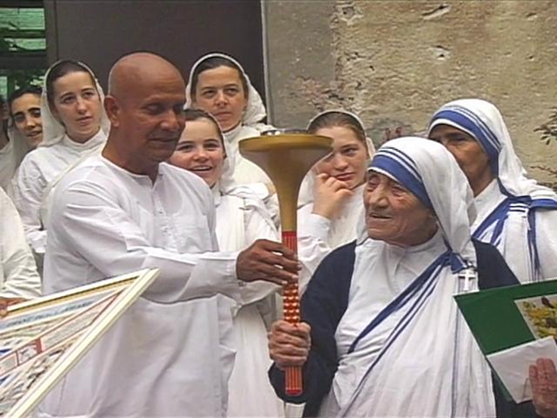

Slide 11
At first read the statements below . Then read the text in your book about Mother Teresa and find out whether the statements are true or false.
1.Mother Teresa was moved to see the diseases that spread in the streets of Kolkata
2.She didn’t open a home for the orphans.
3.She and her group brought in the dying people from the streets of kolkata.
4.“Nirmol Hridoy” was not founded for the poor and dying people.
5.Mother Teresa said that humanity passes through charitable organization.
1.True 2.False 3.True 4.False 5.True.

Slide 12
At first read the following questions. Then read the text in your book about Mother Teresa and find out answers to the questions.
Why do you think Mother Teresa won so many awards?
What does “Nirmol Hridoy” stand for?
Why do you think the home is named “Nirmol Hridoy”?
Why did Mother Teresa want the dying people to feel that they deserve care and love too ?

Slide 13
Why do you think Mother Teresa won so many awards?
Ans: Mother Teresa’ humanitarian work has been recognized throughout the world. That’s why I think she got so many awards
What does “Nirmol Hridoy” stand for?
Ans: Nirmal Hridoy stands for “Pure Heart”.

Slide 14
Why do you think the home is named “Nirmol Hridoy”?
Ans: A “Nirmal Hridoy” is that heart which can accept everyone. That’s why it is named so.
Why did Mother Teresa want the dying people to feel that they deserve care and love too ?
Ans: She wanted it because they are also the children of God. So they can not live on the street without love and care.

Slide 15
Home Work
Write a paragraph on another renowned person who performed welfare activities.

